Slide 1
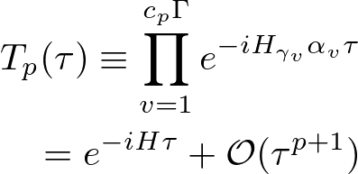
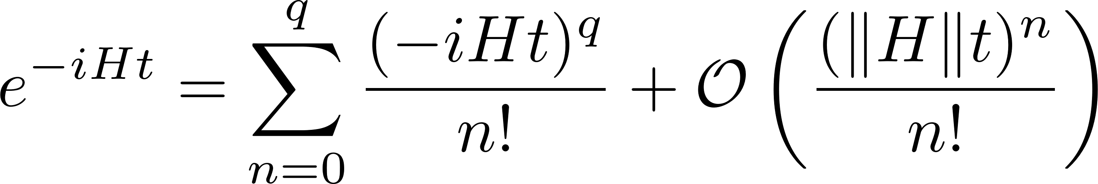

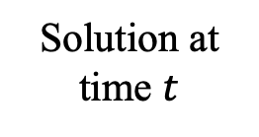

1. Intro: Hamiltonian simulation
■ Hamiltonian simulation
Solve Schrodinger equation with quantum computers
$N$-qubit state
Solution at time $t$
Small error
- Potential exp. speedup
- Application to physics & chemistry
Goal: What is the fastest quantum algorithm
achieving the best scaling in size $N$, time $t$, and error $ε$ ?
■ Various quantum algorithms
[Product formula (PF)]
or Trotterization
[Linear combination of unitaries (LCU)]
/ [Quantum singular value transform (QSVT)]
e.g.
D. W. Berry, et al.,
PRL 114, 090502 (2015).
S. Lloyd, Science 273, 1073 (1996)
A. Gilyén, et al., STOC 2019

