Slide 1
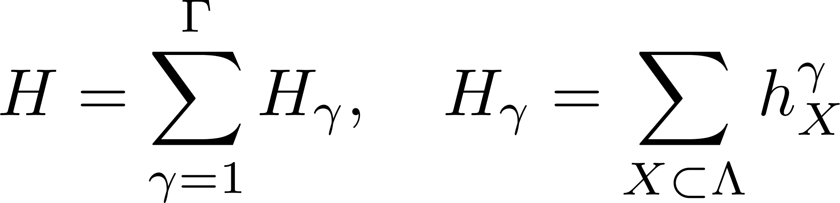
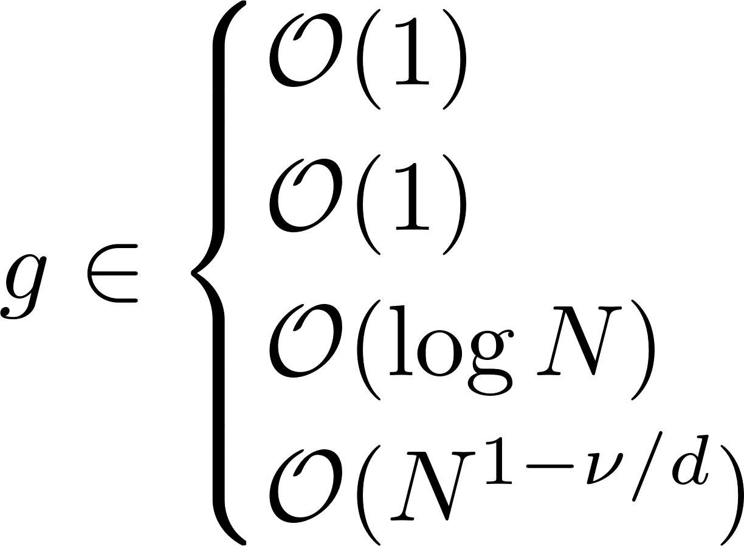
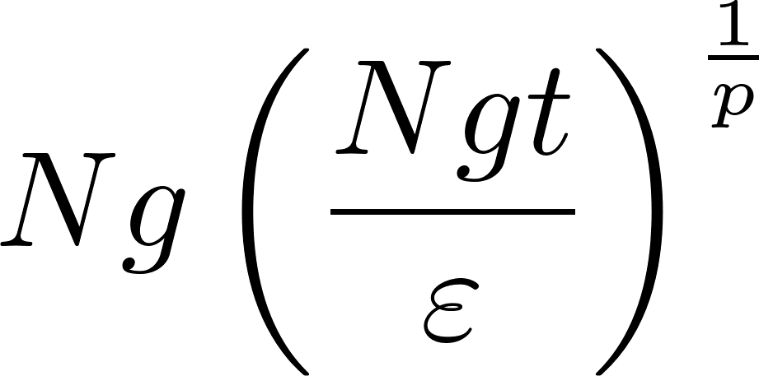
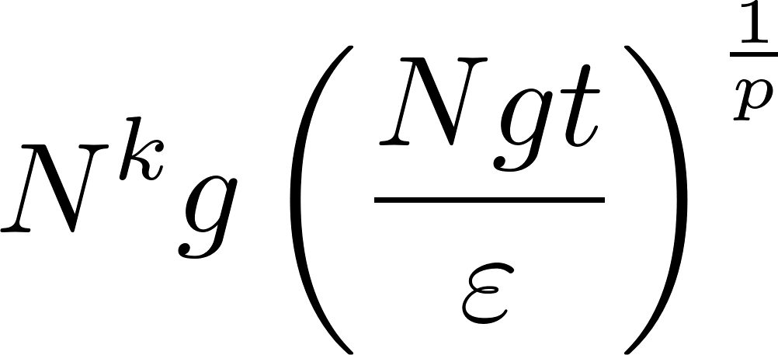
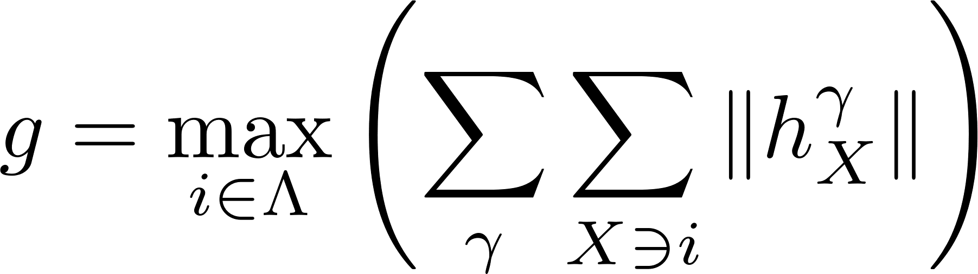

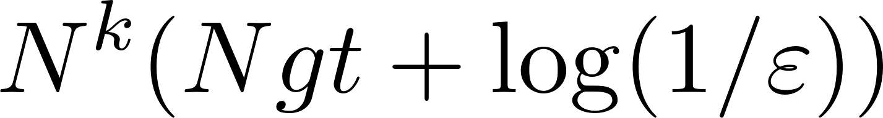
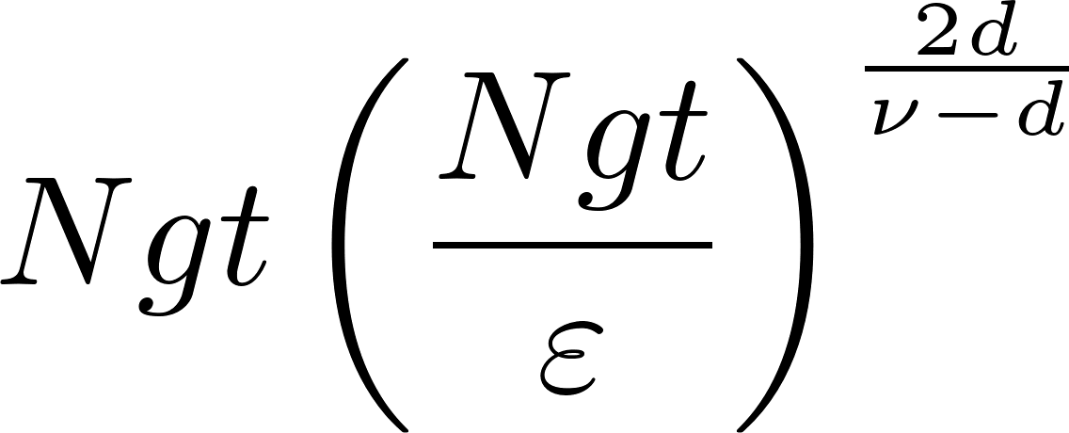

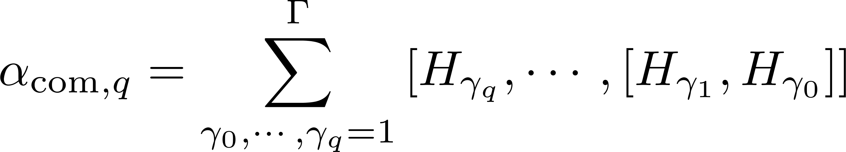
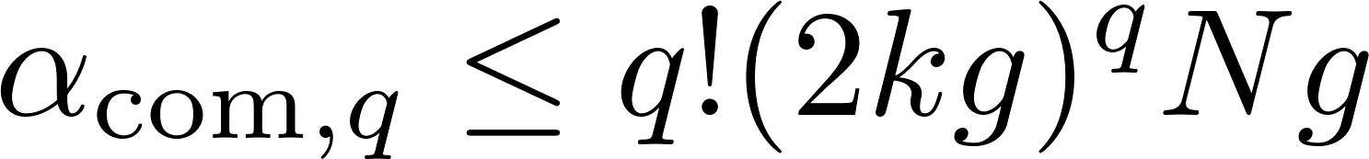
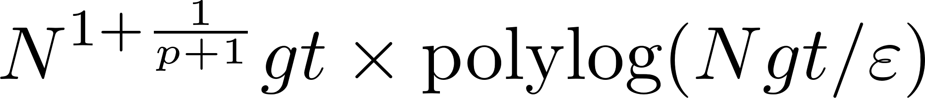
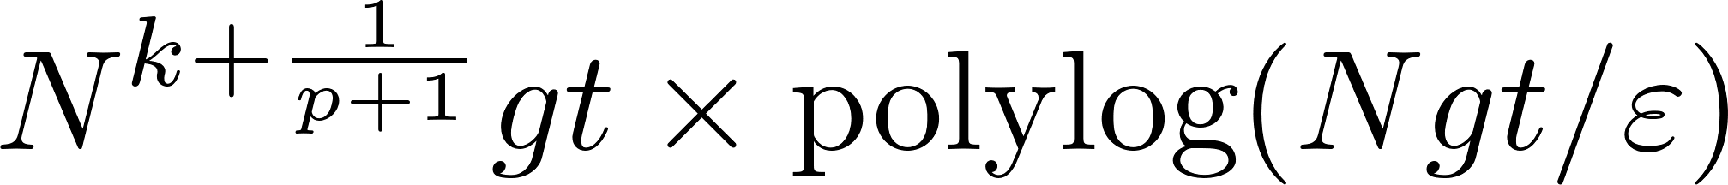





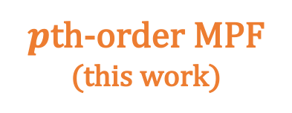

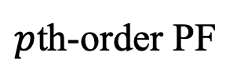

3. Results: Simultaneous efficiency of MPF in size, time, accuracy
Number of $𝒪(1)$-qubit gates
■ Setup
Generic $k$-local Hamiltonian
■ Cost
Ancilla qubits
for finite-range int.
for long-range int.
(finite-range interaction)
$p$th-order PF
(long-range int., $ν>d$)
A. Childs, et al. (2021)
Extensiveness:
(long-range int., $ν=d$)
$$U\left(r\right)\sim r^{−ν}$$
(long-range int., $ν<d$)
LCU/QSVT
■ Nested commutators
A. Gilyén, et al. (2019)
Locality of Hamiltonian
HHKL
J. Haah, et al. (2021)
Only for $ν>2d$
← Needs Lieb-Robinson bound
$p$th-order MPF
(this work)
c.f. PF error with commutator scaling:
Good $N$-scaling like PF & Good $t$-, $ε$-scaling like LCU/QSVT & Versatility to generic local Hamiltonians !

