Slide 1
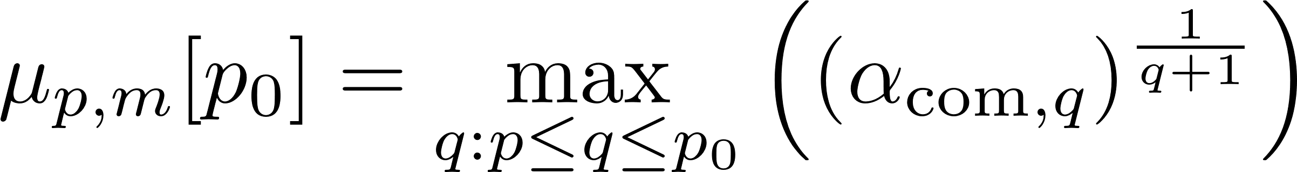
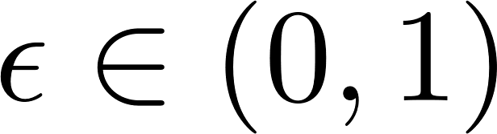
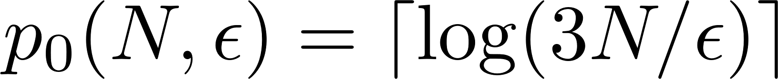
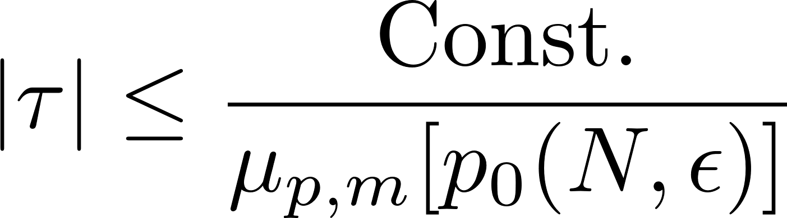
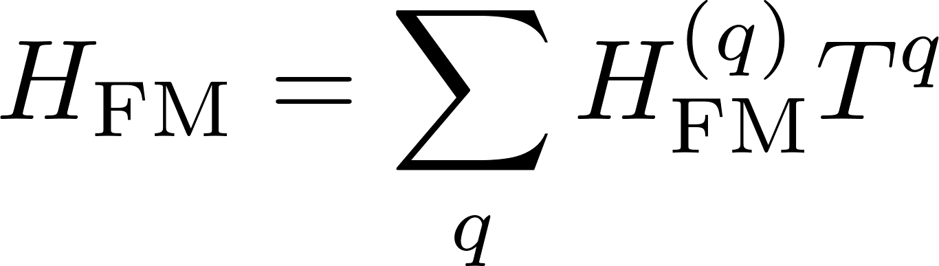

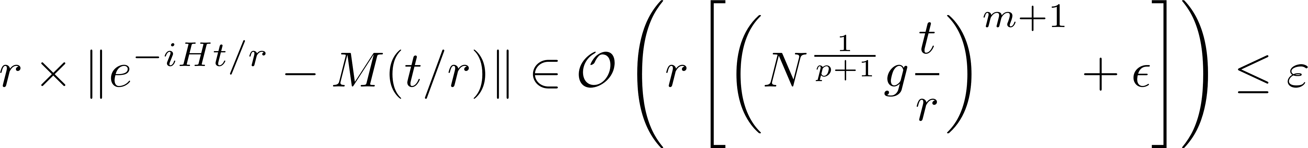
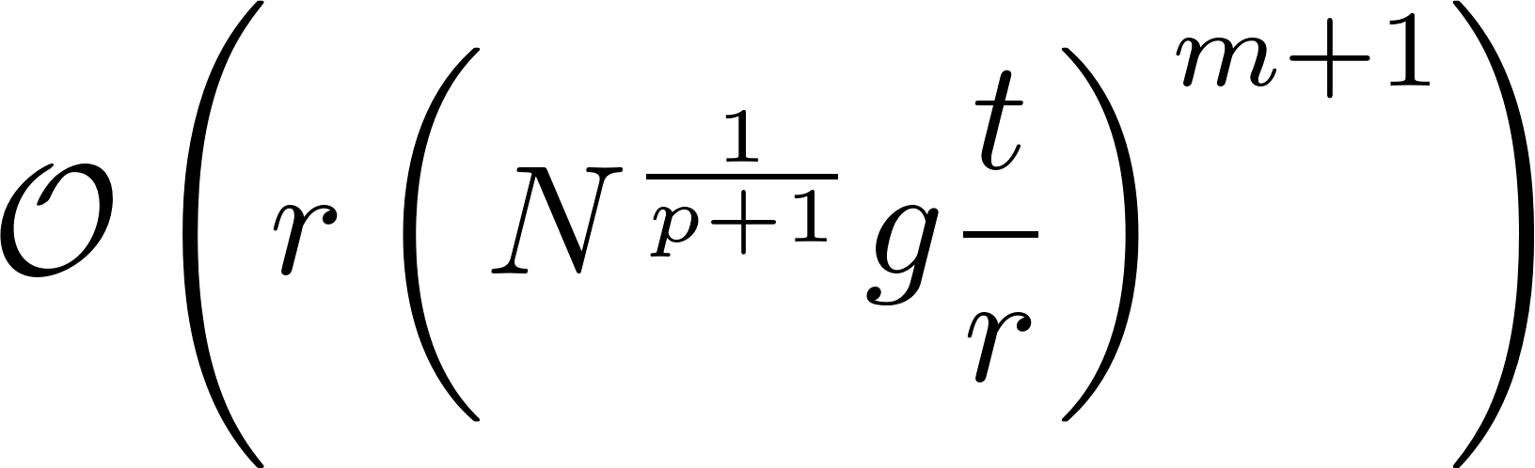

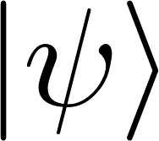
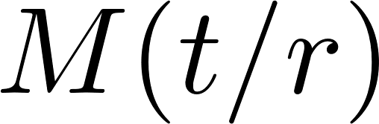

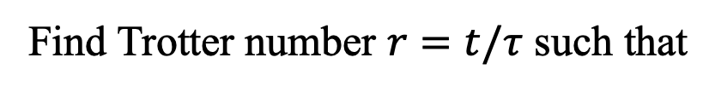





4. Results & Derivation
■ MPF error with commutator scaling
Commutator factor for MPF:
Theorem 1
: arbitrary fixed value,
: truncation order
When the time $τ$ is small enough to satisfy
, the MPF error is bounded by
Theorem 2
■ Derivation of the error bound
Theorem 1
Inspired by Floquet prethermalization
T. Kuwahara, T. Mori, K. Saito, Ann. Phys. 367, 96 (2016)
$$H\left(t+T\right)=H(t)$$
$q$-fold commutator
$q_{i}$-fold commutator
[$q→∞$] Divergent [Consider $q≤\log{(N/ε}$)] Convergence within error $ε$
Theorem 2
Use the bound on the nested commutator $α_{com,q}$ with the locality
■ Derivation of the computational cost
$r$ times
Find Trotter number $r=t/τ$ such that
with setting
[Gate counts]
LCU + amplitude amplification

