Slide 1

SLIDING WINDOW LOG ALGORITHM
Under the Esteemed Guidance
Submitted By
Mr. Kumar Nayak, M.Tech
Assistant Professor, CSE
Mr. K. K. N. Harshavardhan
(24KT1A5426)
Mr. D. Jai Teja
(25KT5A5405)
Ms. A. Neha Sri
(24KT1A5401)
Ms. G. Pavithra
(24KT1A5417)
Department of Artificial Intelligence & Data Science

Slide 2
Why Rate Limiting?
The Problem
Objectives
Services have limited capacity; one client can slow down everyone else
Fixed-window counters allow bursts at window boundaries
Sliding Window Log stores each timestamp for exact control
Static diagrams make this hard to grasp
Show how rate limiting protects APIs
Demo timestamp storage and expiry
Show HTTP 200 OK vs 429 live
Adjustable limit (1–12) and window (3–30 s)
Visualize with timeline, metrics and event log

Slide 3
How It Works
1
2
3
4
Purge
Count
Decide
Accept
Drop timestamps older than the window
Count entries still inside the window
Count ≥ limit → reject with 429
Otherwise store time, reply 200 OK
Defaults: 5 requests per 10 seconds; adjustable 1–12 requests, 3–30 s
A 100 ms timer keeps the log fresh and drives the live timeline
More accurate than fixed-window counters at window boundaries
A retry countdown shows when capacity returns

Slide 4
System Design
Architecture
Main Modules
Single-page, client-side React app; no backend or database
App component holds logic and UI; CSS handles styling
Flow: request → purge → count → 200 or 429
Blue accent, green = accepted, red = throttled
Request Handling – decides the status
Sliding Window Log – stores and expires timestamps
Throttling – blocks at limit, retry countdown
Visualization – SVG timeline and markers
Metrics & Status – capacity, event registry
Control – sliders, pause/resume, reset

Slide 5
Build & Testing
Technologies
const now = Date.now();
logs = logs.filter(t => now - t < WIN);
if (logs.length >= LIMIT)
return { status: 429 };
logs.push(now);
return { status: 200 };
React 19 – UI and state hooks
Vite 8 – dev and build
JavaScript/JSX, HTML5, CSS3
Inline SVG – live timeline
Testing
8 test cases: defaults, accept (200), limit reached, reject (429), expiry recovery
Also covers slider changes, pause/resume and reset

Slide 6
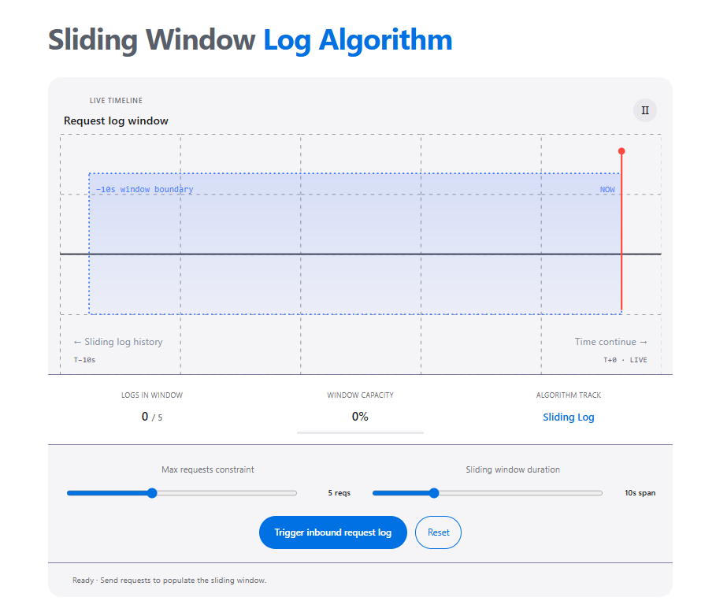
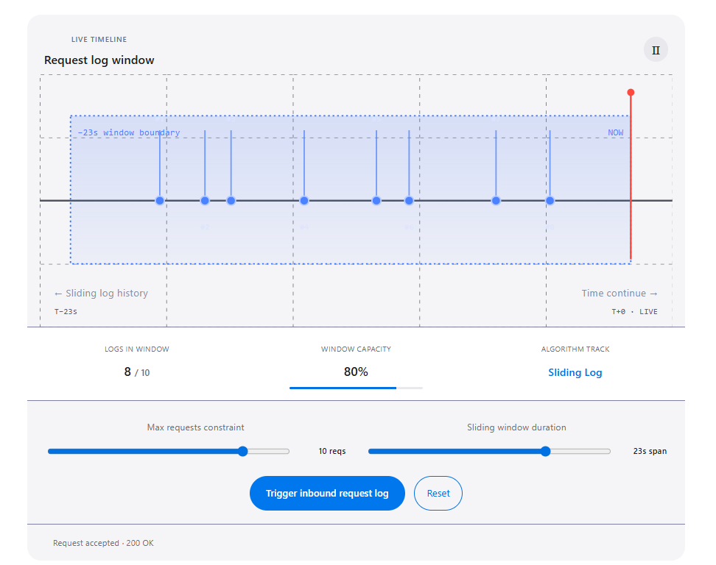
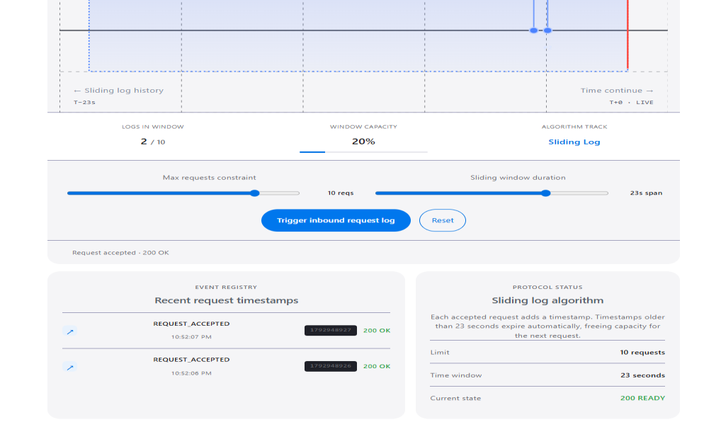
Output: User Interface
Ready state: 0 / 5 logs, 0% capacity
Active window: 8 / 10 logs, 80% capacity, 200 OK
Event registry and protocol status panel

Slide 7
Outlook & Conclusion
Advantages
Limitations
Future Scope
Clear interactive demo
Instant 200 / 429 feedback
Adjustable limit and window
Runs in browser, no backend
Simulator; protects no real service
Logs lost on reload or reset
No shared storage across servers
For learning, not production
Connect to a backend API
Redis for shared limits
Algorithm comparison mode
Step-by-step mode, automated tests
Conclusion: a lightweight React + Vite simulator that makes timestamp-based rate limiting easy to see and understand.

