Slide 1
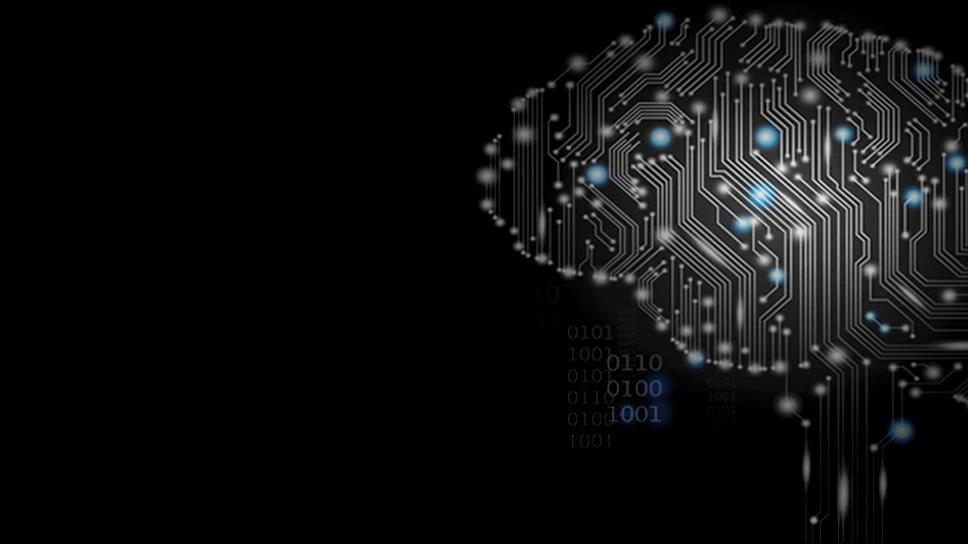


Neural Networks Project
Image Classifier
Presented by : Khalid OUHMAID
Supervised by: Hamd AIT ABDELALI
2019-2020

Slide 2
Plan :
What are Neural networks?
What they do?
Why use Neural networks?
Presentation of the Neural Network Project

Slide 3

What are Neural networks?

Slide 4
What
they do?

Slide 5
Why use Neural networks?

Slide 6
Presentation of the Neural Network
Image Classifier

Slide 7


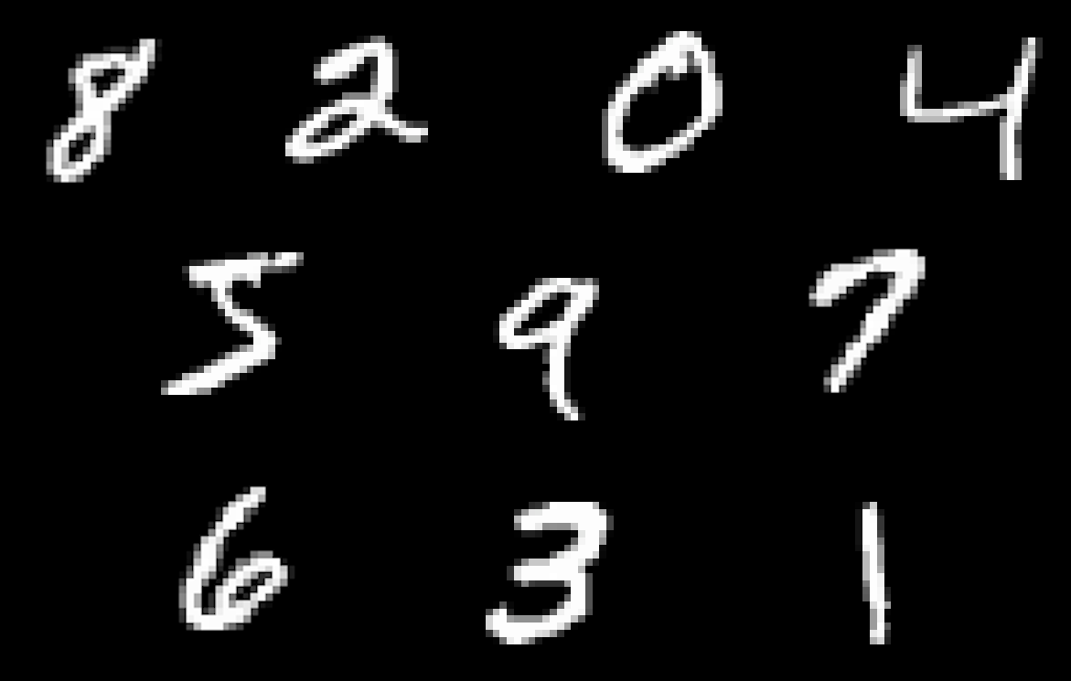

Slide 8
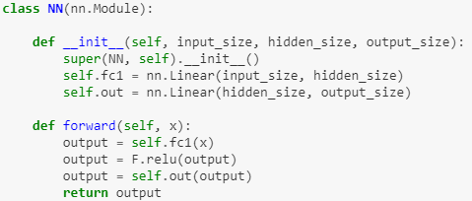
Standard feedforward neural network

Slide 9
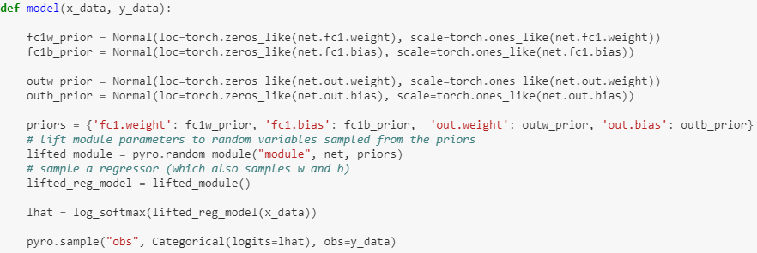
how the output data is generated ?

Slide 10
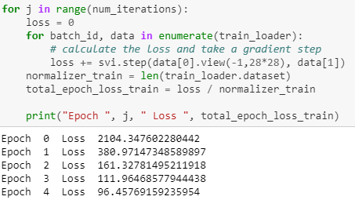

Slide 11
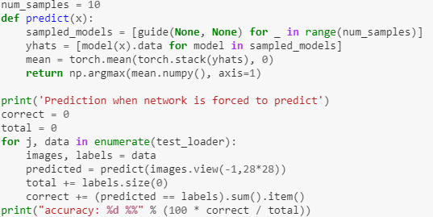

Slide 12
Results on the MNIST dataset
Percentage of images which the network refused to classify: 12.5% (1250 out of 10,000)
Accuracy on the remaining 8750 “accepted” images: 96%

Slide 13
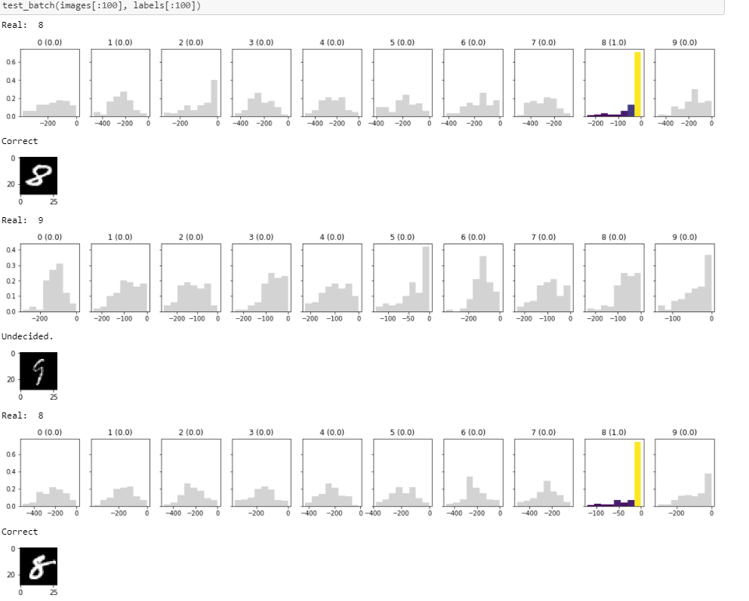
MNIST test batch

Slide 14
Thanks For your ATTENTION

