Slide 1
EMPLOYEE DATA ANALYSIS USING EXCEL
STUDENT NAME: Pooja K
REGISTER NO: 122204185
DEPARTMENT: Corporate Secretaryship
COLLEGE: St Anne’s Arts and Science College

Slide 2
PROJECT
Employee Performance Analysis using Excel

Slide 3

AGENDA
Problem Statement
Project Overview
End Users
Our Solution and Proposition
Dataset Description
Modelling Approach
Results and Discussion
Conclusion
3/21/2024 Annual Review

Slide 4
PROBLEM STATEMENT
Ensuring that staff and volunteers are being used to their best effect, including the direct supervision, appraisal and development of the Play Leader; taking an overview of the development of the staff team as a whole.
To analyse the employee attendance and performance.
Ensuring that the committee functions well, meetings are effective, decisions are made.

Slide 5
PROJECT OVERVIEW
.The overview of the project to ensure the employees have clear goals and priorities, an understanding of where their performance falls, and frequent feedback.
Making employees be more productive, a by-product of high engagement is the actual motivation for employees to strive for better performance.
Five component processes (i.e., planning, monitoring, developing, rating, rewarding) work together and support each other, resulting in natural, effective performance management.

Slide 6

WHO ARE THE END USERS?
When employees work well, companies can benefit from a number of factors, including:
INCREASED PRODUCTIVITY
Studies show that happy employees are more productive and are more likely to stay with the company long-term.
IMPROVED COMPANY PROFITS
Health insurance can help boost company profits when employees are less burdened by financial stress.

Slide 7
OUR SOLUTION AND ITS VALUE PROPOSITION
Conditional formatting
Filter – remove
Formula – Performance
Pivot Summary
Graph data visualization

Slide 8
Dataset Description
This dataset includes important attributes of the below mentioned topics:
EmpID
FirstName
LastName
StartDate
ExitDate
Title Supervisor
ADEmail BusinessUnit
EmployeeStatus
EmployeeType
PayZone
EmployeeClassificationType

Slide 9
Dataset Description
TerminationType
TerminationDescription
DepartmentType
Division
DOB
State
JobFunction
Description
GenderCode
LocationCode

Slide 10
Dataset Description
MaritalDesc
RaceDesc
Performance Score
Current Employee Rating

Slide 11
THE "WOW" IN OUR SOLUTION
Calculated Performance level using this category:
Performance level =IFS (Z8>=5,”VERY HIGH”,Z8>=4,”HIGH,Z8>=3”,”MED”,TRUE,”LOW”)
3/21/2024 Annual Review
11

Slide 12
MODELLING:
DATA COLLECTION:
Collected data using Kaggle
And represented in bar graph
FEATURE COLLECTION:
By using documents and records in Kaggle, I collected the feature of the employee to make more efficient and better analysis.
DATA CLEANING:
By using data cleansing removed incorrect, corrupted, incorrectly formatted, duplicate, or incomplete data within a dataset.
PERFORMANCE LEVEL:
Used three categories like Fully meet, Exceed and need improvement as a result of performance level of the employees.
12

Slide 13
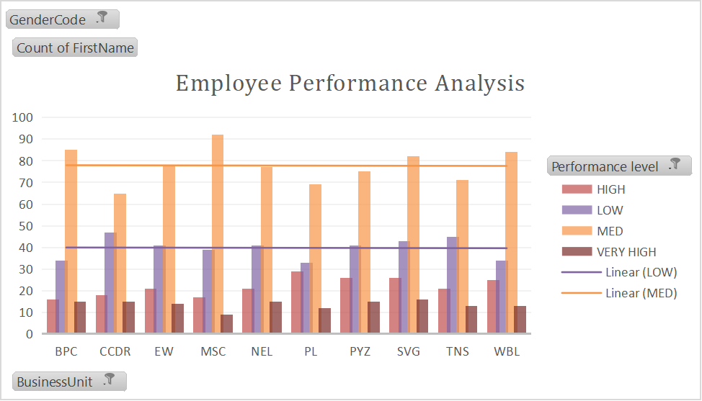
RESULTS
EMPLOYEE PERFORMANCE ANALYSIS
13

Slide 14
conclusion
Performance reviews provide a regular, structured opportunity to give employees feedback so they know where they stand on their goals and how to improve.
This process helps team members grow professionally—which also benefits your organization. In addition, constructive feedback leads the way for personal improvement, which levels up your entire team.

