Slide 1
AWS KUBO Deploying Guide
Abhilash S
㈜크로센트
2018. 06

Slide 2
Agenda
AWS Infrastructure Setting
Deploying Bosh Director on AWS
Deploying KUBO on AWS
KUBO Deployment Architecture on AWS
Note: This deployment Guide is targeted only Ubuntu 16.04 users.

Slide 3
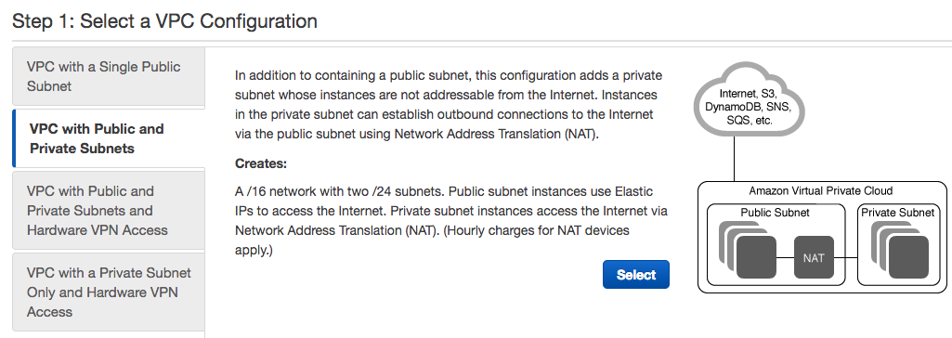
1. AWS Infrastructure Setting (1/12) - Creating VPC (1/2)
Note: Install and Configure below Steps on your AWS Console.
Create Elastic IPS in your Preferred Zone.
* AWS Services → EC2 → Elastic IPs → Allocate new address → Allocate
Create VPC Wizard in your Preferred Zone.
1
2
* Select VPC with Public and Private Subnets

Slide 4
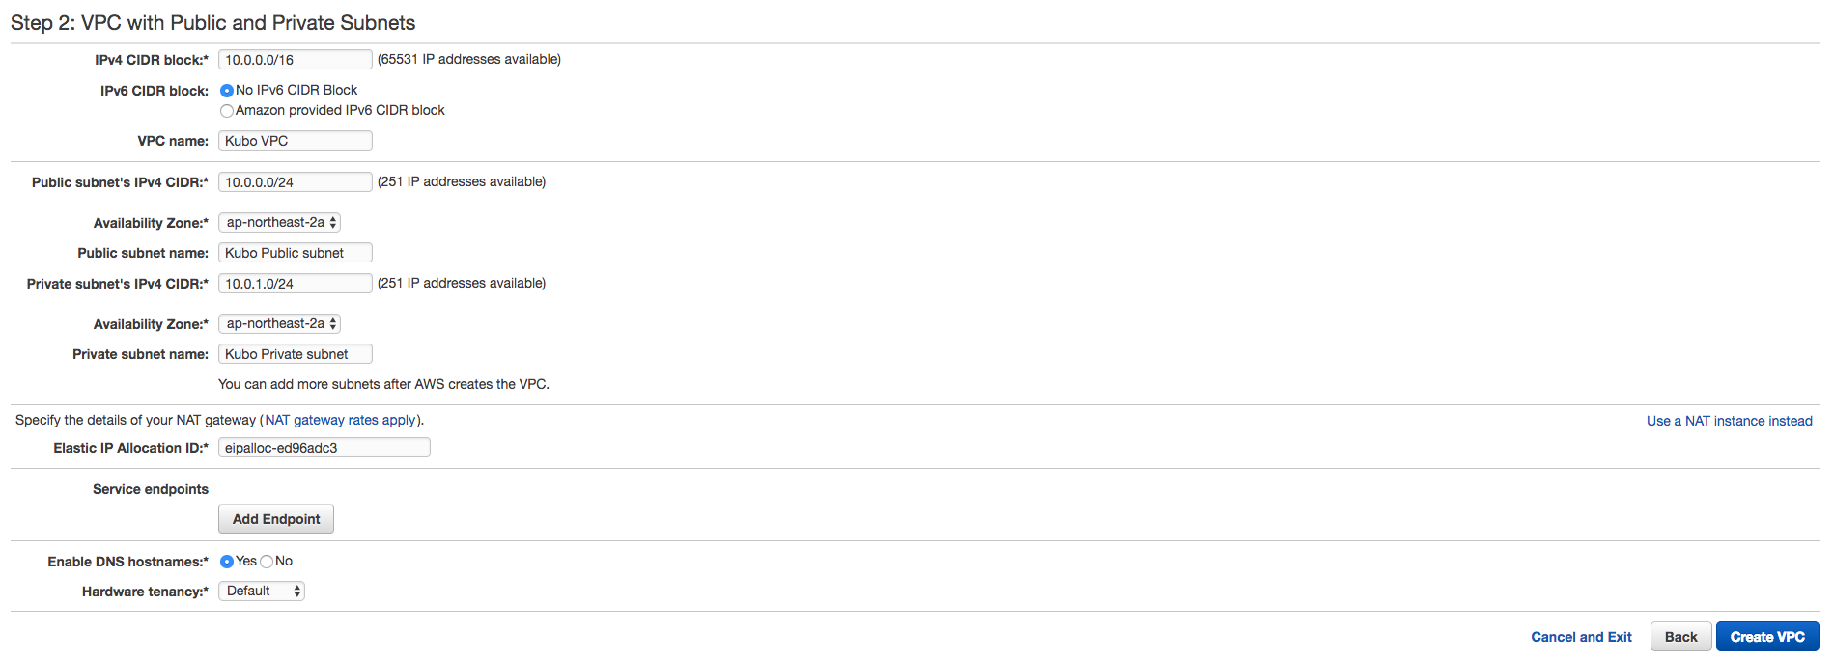
1. AWS Infrastructure Setting (2/12) - Creating VPC (2/2)
1
* CIDR range should be /16 netmask
2
Public Subent CIDR range should be /24 netmask
Select Your Availability Zone
Name your Pubic Subnet
3
Private Subent CIDR range should be /24 netmask
Select Your Availability Zone
Name your Private Subnet
4
* Select Elastic IP, that created in previous steps
5
* Make Sure to enable DNS hostnames
6
Note: It will take 2 ~ 3 Minutes to create VPC Wizard.
Check your VPC is created.
* AWS Services → VPC → Your VPCs

Slide 5
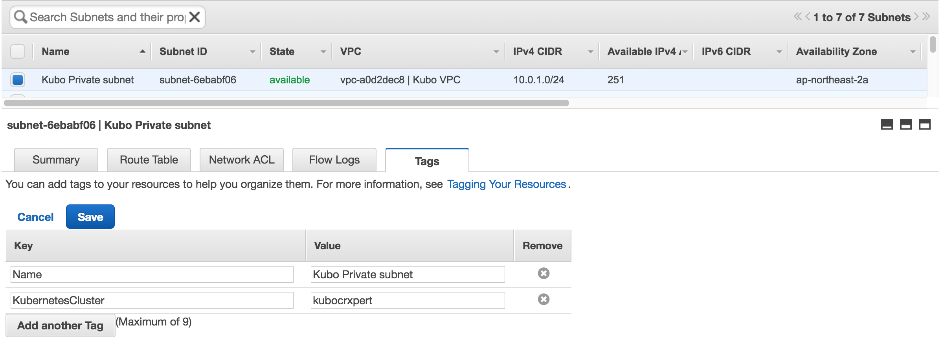
1. AWS Infrastructure Setting (3/12) - Configure Tags for Subnets (1/2)
Move to Subnets TAB.
* AWS Services → VPC → Subnets
Create Tags for Your Private Subnets.
* AWS Services → VPC → Subnets → Kubo Private subnet → Tags → Edit
1
2
3
This Tag is used in Kubo Deployment
Make Sure to have same Tag Key and Value for Private and Public Subnets

Slide 6
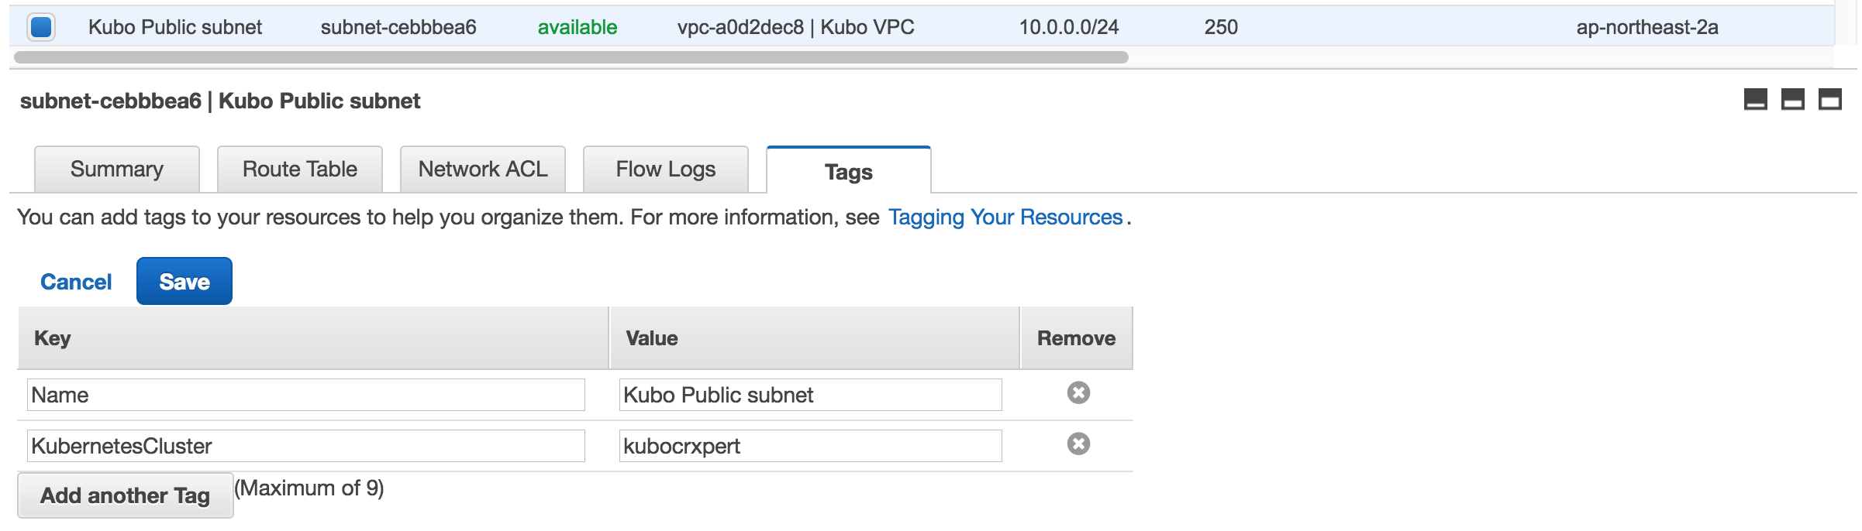
1. AWS Infrastructure Setting (4/12) - Configure Tags for Subnets (2/2)
Move to Subnets TAB.
* AWS Services → VPC → Subnets
Create Tags for Your Private Subnets.
* AWS Services → VPC → Subnets → Kubo Public subnet → Tags → Edit
1
2
3
This Tag is used in Kubo Deployment
Make Sure to have same Tag Key and Value for Public and Private Subnets

Slide 7
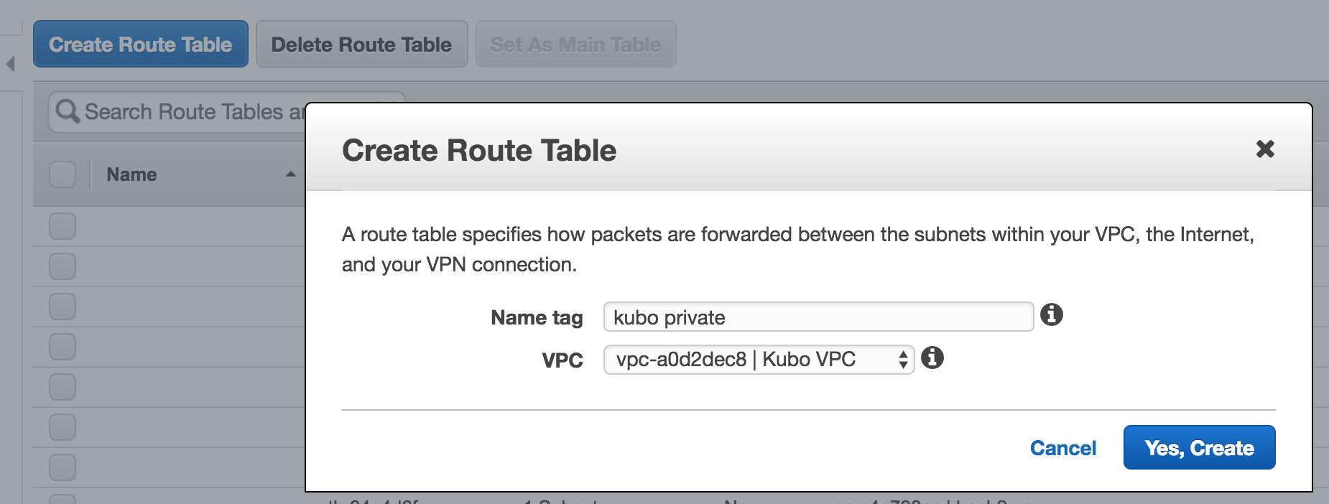
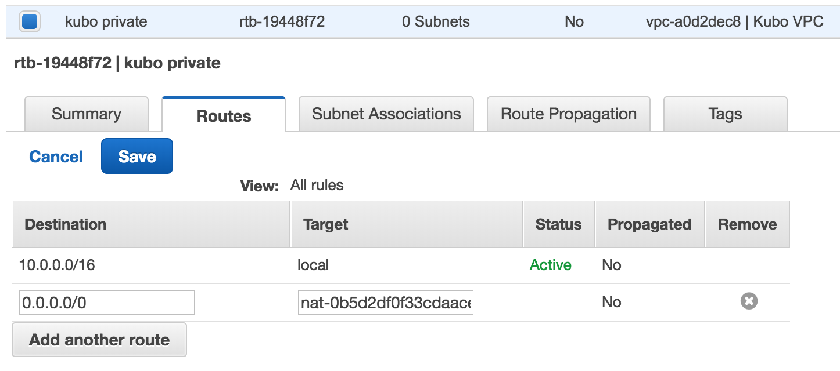
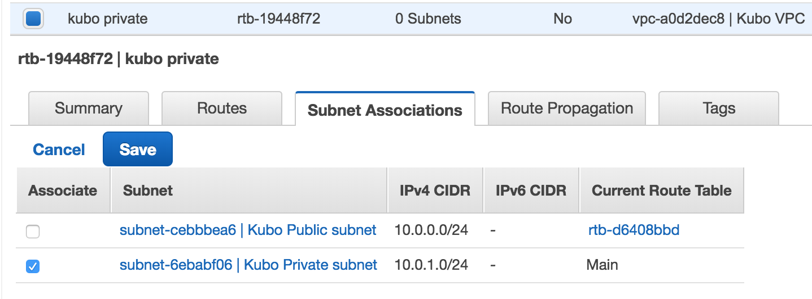
1. AWS Infrastructure Setting (5/12) - Configure Route Tables
Move to Route Tables TAB.
* AWS Services → VPC → Route Tables
Create Route Table for Your Private Subnet.
* AWS Services → VPC → Route Tables
Create Routes in your Created Route Table.
* AWS Services → VPC → Route Tables → Kubo Private
1
4
5
2
7
3
6
Name Your Route Table
Select your VPC created in previous steps
Make Sure to select Nat Gateway where our deployment access
to internet through Nat Gateway.
Edit Subnet Associations in your Route Table.
* AWS Services → VPC → Route Tables → Kubo Private
8
9
11
Select Your Private Subnet where we deploy Micro-Bosh, and Kubo.
10

Slide 8
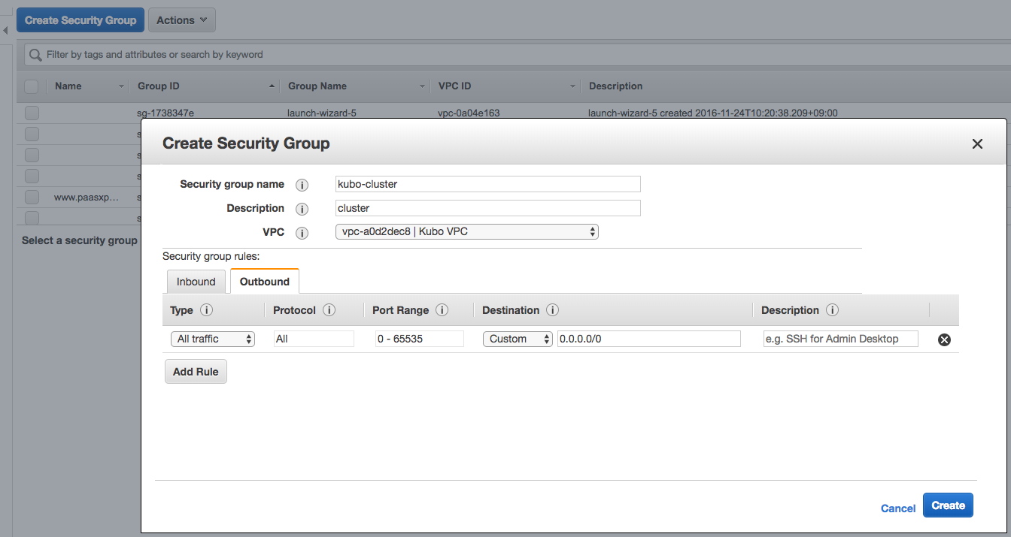
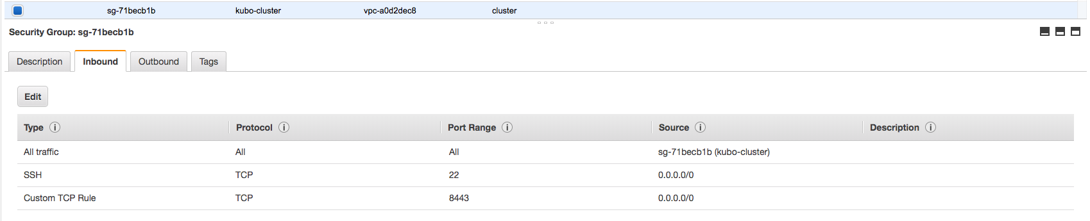
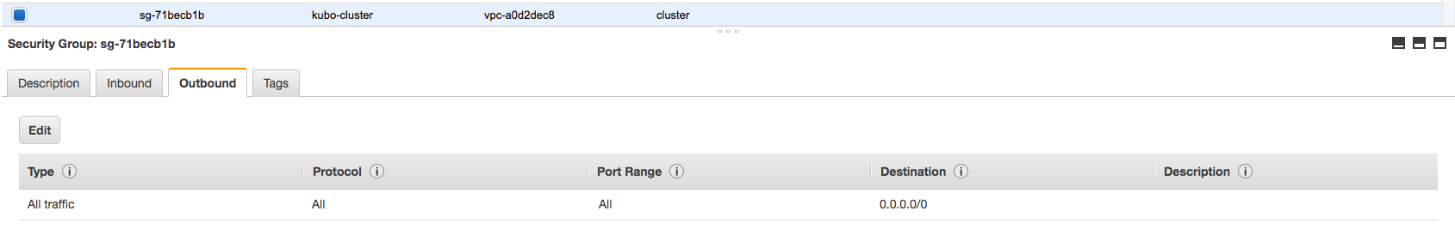
1. AWS Infrastructure Setting (6/12) - Create Security Groups (1/2)
Move to Security Group TAB.
* AWS Services → EC2 → Security Groups
1
This Security Group is Used only for Inception,
Micro-Bosh, Kubo VM’s.
2
3
4
Make sure to have Same Inbound and
Outbound Values.

Slide 9
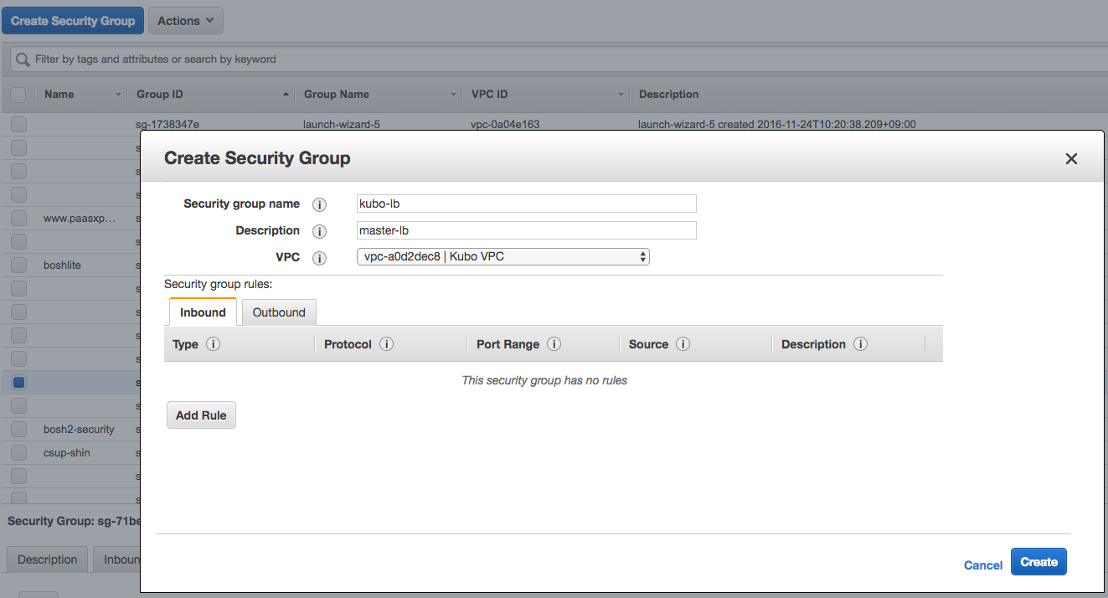
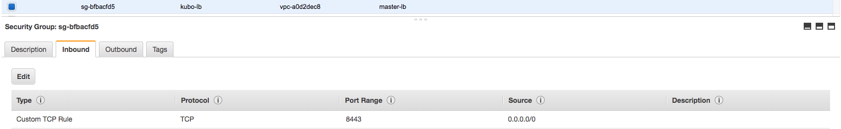
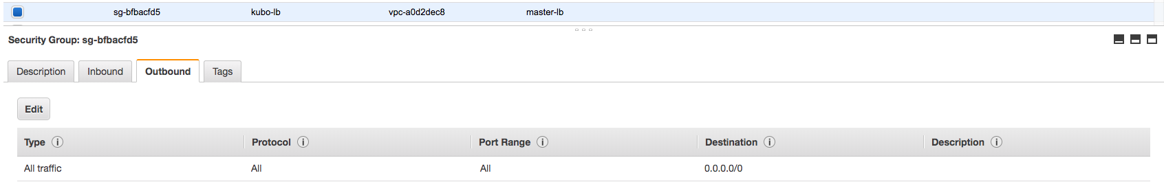
1. AWS Infrastructure Setting (7/12) - Create Security Groups (2/2)
Move to Security Group TAB.
* AWS Services → EC2 → Security Groups
1
This Security Group is Used only for Kubernetes
Master Load Balancer.
2
3
4
Make sure to have Same Inbound and
Outbound Values.

Slide 10
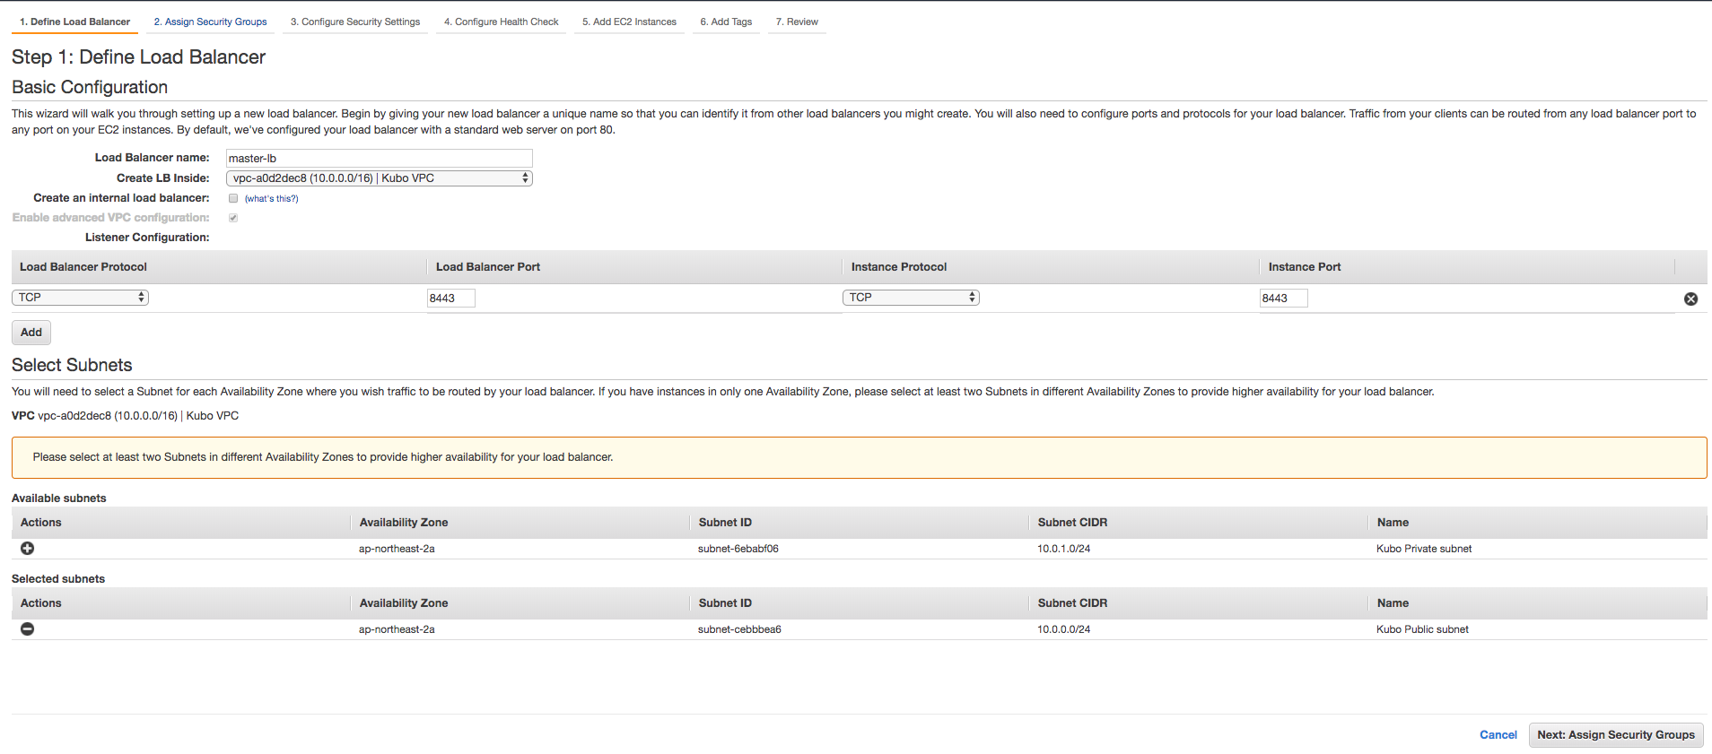
1. AWS Infrastructure Setting (8/12) - Create Load Balancer (1/3)
Create Classic Load Balancer.
* AWS Services → EC2 → Load Balancers → Classic Load Balancer
1
Name you LB and Select your VPC where LB want’s to create.
2
Make sure to listen TCP 8443 Port
3
Make Sure to select public subnet
4

Slide 11
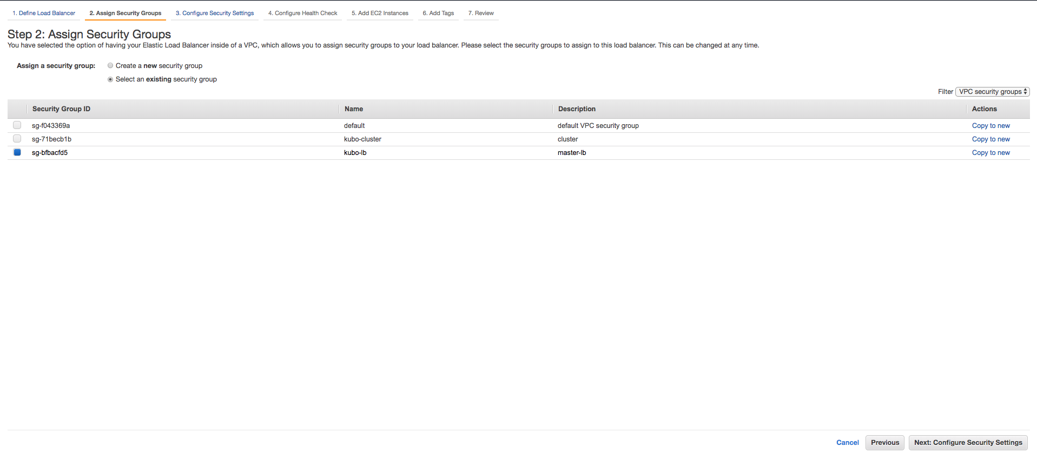
1. AWS Infrastructure Setting (9/12) - Create Load Balancer (2/3)
Create Classic Load Balancer.
* AWS Services → EC2 → Load Balancers → Classic Load Balancer
1
Make sure to select kubo-lb security group for security reasons
2

Slide 12
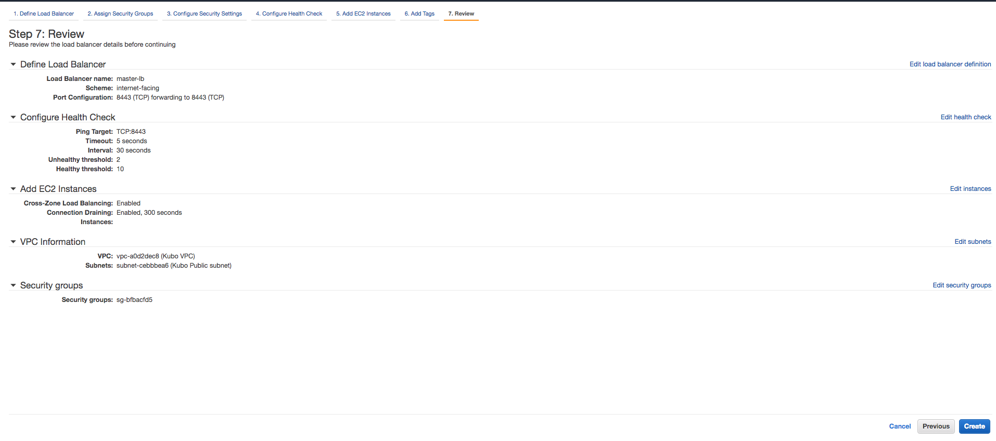
1. AWS Infrastructure Setting (10/12) - Create Load Balancer (3/3)
Create Classic Load Balancer.
* AWS Services → EC2 → Load Balancers → Classic Load Balancer
1
Make sure to check all the above properties match your requirements.
2

Slide 13
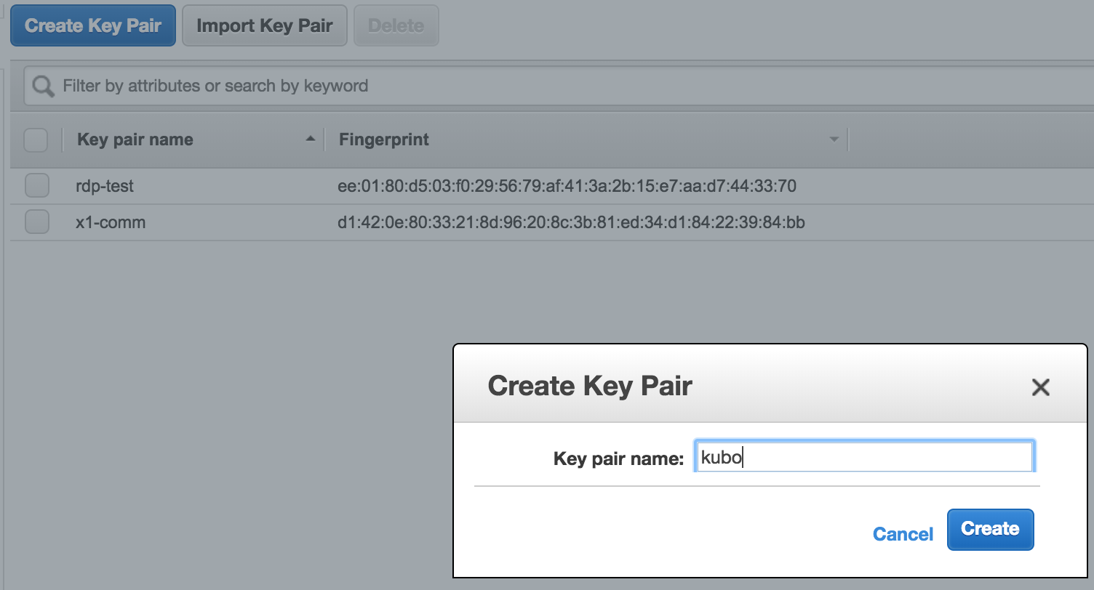
1. AWS Infrastructure Setting (11/12) - Create Keypairs
Create Classic Load Balancer.
* AWS Services → EC2 → Key Pairs → Classic Load Balancer
1
2
Make sure to save key pair in safe place for future proceedings.

Slide 14
1. AWS Infrastructure Setting (12/12) - Create Instance
Create Classic Load Balancer.
* AWS Services → EC2 → Instances
Requirements | Description
OS | Select Ubuntu 14.04 LTS
Instance Size | Select t2.micro
Network | Select your VPC (Kubo VPC)
Subnet | Select Your Public Subnet (Kubo Public subnet)
Auto-assign Public IP | Manually Enable
Storage | Minimum 40 GB
Security Group | Select kubo-cluster Security Group
Key | Select Key Pair you created before

Slide 15
2. Deploying Bosh Director on AWS (1/8) - Installing Pre-Requirements (1/3)
Note: Perform below steps in your AWS Inception.
ssh into inception
$ ssh ubuntu@your-aws-inception-public-domain
Install bosh-cli-2.0
$ wget https://s3.amazonaws.com/bosh-cli-artifacts/bosh-cli-3.0.1-linux-amd64
$ chmod +x bosh-cli-3.0.1-linux-amd64
$ sudo mv bosh-cli-3.0.1-linux-amd64 /usr/local/bin/bosh
Check the bosh version
$ bosh -v
version 3.0.1-712bfd7-2018-03-13T23:26:42Z
Check the bosh version
$ sudo apt-get install -y build-essential zlibc zlib1g-dev ruby ruby-dev openssl libxslt-dev libxml2-dev libssl-dev libreadline6 libreadline6-dev libyaml-dev libsqlite3-dev sqlite3

Slide 16
2. Deploying Bosh Director on AWS (2/8) - Installing Pre-Requirements (2/3)
Install Git
$ sudo apt-get install git
$ git --version
git version 2.14.3
Install Credhub-Cli
$ wget https://github.com/cloudfoundry-incubator/credhub-cli/releases/download/1.7.6/credhub-linux-1.7.6.tgz
$ tar -xvf credhub-linux-1.7.6.tgz
$ chmod +x credhub
$ sudo mv credhub /usr/local/bin/credhub
Check the credhub version
$ credhub --version
CLI Version: 1.6.0

Slide 17
2. Deploying Bosh Director on AWS (3/8) - Installing Pre-Requirements (3/3)
Install Kubectl-Cli
$ curl -LO https://storage.googleapis.com/kubernetes-release/release/v1.10.3/bin/linux/amd64/kubectl
$ chmod +x kubectl
$ sudo mv kubectl /usr/local/bin/kubectl
$ kubectl version

Slide 18
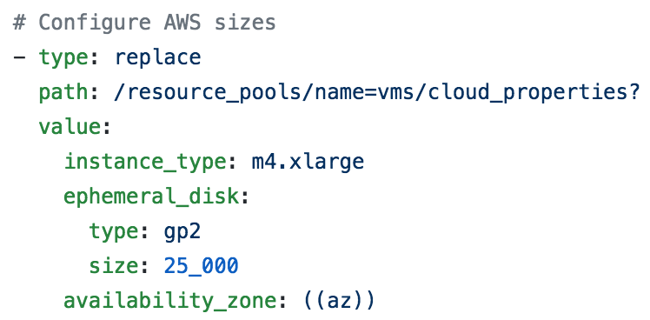
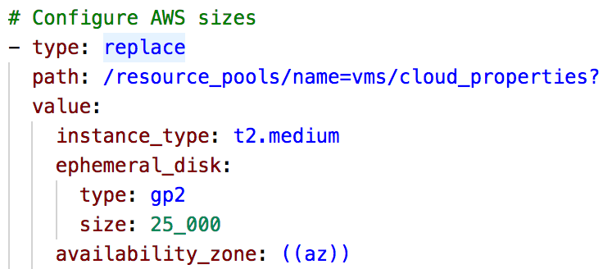
2. Deploying Bosh Director on AWS (4/8) - Deploying Bosh-Director (1/5)
In your Inception
Next clone the bosh-deployment and kubo-deployment repositories
$ mkdir ~/workspace && cd ~/workspace
$ git clone https://github.com/cloudfoundry/bosh-deployment.git
$ git clone https://github.com/cloudfoundry-incubator/kubo-deployment.git -b v0.17.0
Edit AWS cpi.yml file to configure Nat VM.
$ vi ~/workspace/bosh-deployment/aws/cpi.yml
Before Editing
After Editing
Change your instance_type according to your usage

Slide 19
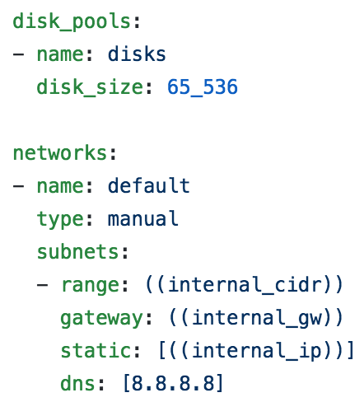
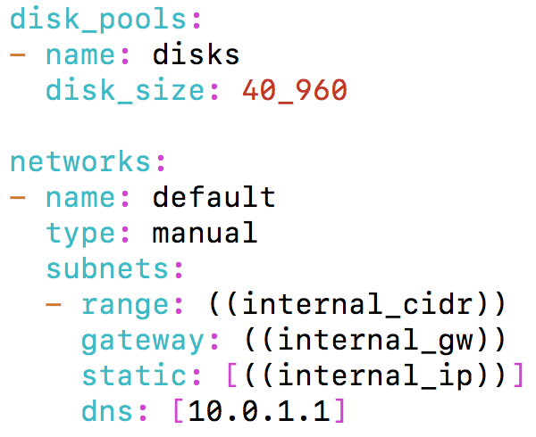
2. Deploying Bosh Director on AWS (5/8) - Deploying Bosh-Director (2/5)
Edit Bosh bosh.yml file to configure Nat VM.
$ vi ~/workspace/bosh-deployment/bosh.yml
Before Editing
After Editing
Your Private Subnet CIDR & Nat Gateway
Create directory to store director deployment state and credentials.
$ cd ~/workspace/bosh-deployment/ && mkdir kubo && cd kubo

Slide 20
2. Deploying Bosh Director on AWS (6/8) - Deploying Bosh-Director (3/5)
Below command create bosh-init vm on virtualbox by means of bosh.yml as base manifest.
Yaml files with –o command set variables director_name, internal_ip, internal_gw, internal_cidr, outbound_network_name using –v command.
It also create state.json to record running state and creds.yml (for certs & credentails) in your ~/deployments/vbox directory
Following Command Creates Director’s vm and install it’s jobs
$ bosh create-env ~/workspace/bosh-deployment/bosh.yml
--state=~/workspace/bosh-deployment/kubo/state.json
-o ~/workspace/bosh-deployment/aws/cpi.yml
-o ~/workspace/bosh-deployment/jumpbox-user.yml
-o ~/workspace/bosh-deployment/uaa.yml
-o ~/workspace/bosh-deployment/credhub.yml
--vars-store=~/workspace/bosh-deployment/kubo/creds.yml
-v director_name=”kubo"
-v internal_ip=10.0.1.6
-v internal_gw=10.0.1.1
-v internal_cidr=10.0.1.0/24
-v access_key_id=Your IAM User Access Key
-v secret_access_key=Your IAM User Secret Access Key
-v region=ap-northeast-2
-v az= ap-northeast-2a
-v default_key_name=Your Key Name Created Before (kubo)
-v default_security_groups= Your Secirity Group Name Created Before (kubo-cluster)
--var-file private_key=~/kubo.pem (Copy your key to your inception home director)
-v subnet_id=subnet-6ebabf06 (Your Private Subnet in Your VPC)

Slide 21
2. Deploying Bosh Director on AWS (7/8) - Deploying Bosh-Director (4/5)
Log into director with your alias name.
$ bosh alias-env kubo -e 10.0.1.6 --ca-cert <(bosh int ~/workspace/bosh-deployment/kubo/creds.yml --path /director_ssl/ca)
$ export BOSH_CLIENT=admin
$ export BOSH_CLIENT_SECRET=`bosh int ~/workspace/bosh-deployment/kubo/creds.yml --path /admin_password`
Create directory to download releases and stemcells
$ mkdir ~/workspace/releases && cd ~/workspace/releases
Download Upload AWS Stemcell
$ wget https://s3.amazonaws.com/bosh-core-stemcells/aws/bosh-stemcell-3586.16-aws-xen-hvm-ubuntu-trusty-go_agent.tgz
$ bosh -e kubo upload-stemcell bosh-stemcell-3586.16-aws-xen-hvm-ubuntu-trusty-go_agent.tgz

Slide 22
2. Deploying Bosh Director on AWS (8/8) - Deploying Bosh-Director (5/5)
Target & Log into director credhub
$ export CREDHUB_CLIENT=credhub-admin
$ export CREDHUB_SECRET=$(bosh int --path /credhub_admin_client_secret ~/workspace/bosh-deployment/kubo/creds.yml)
$ export CREDHUB_CA_CERT=$(bosh int --path /credhub_tls/ca ~/workspace/bosh-deployment/kubo/creds.yml)
$ credhub login -s https://10.0.1.252:8844 --skip-tls-validation
List out Certificates and Passwords in credhub
$ credhub find
To Delete Certificates and Passwords in credhub
$ credhub delete -n /director_name/deployment-name/certificate-name

Slide 23
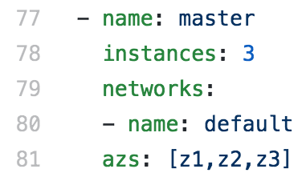
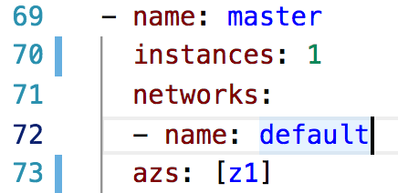
3. Deploying KUBO on AWS (1/8) - Deploying Kubo (1/5)
Download kubo-release.
$ cd ~/workspace && mkdir releases && cd ~/workspace/releases
$ wget https://github.com/cloudfoundry-incubator/kubo-release/releases/download/v0.17.0/kubo-release-0.17.0.tgz
Upload kubo-release
$ bosh -e kubo upload-release ~/workspace/releases/kubo-release-0.17.0.tgz
Edit kubo-deployment cfcr.yml file for deploying kubernetes master bosh-lite
$ cd ~/workspace/kubo-deployment
$ vi ~/workspace/kubo-deployment/manifests/cfcr.yml
Before Editing
After Editing

Slide 24
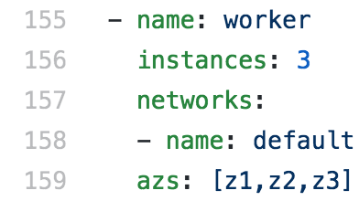
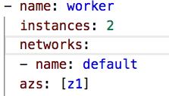
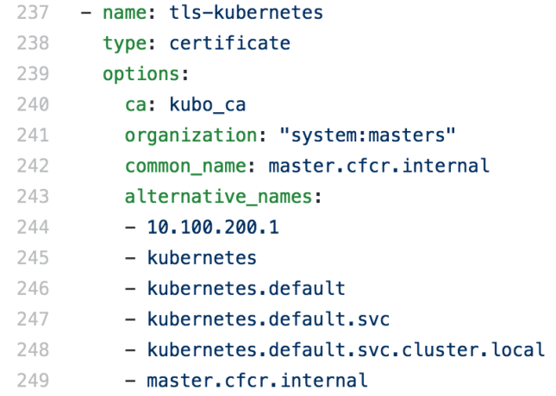
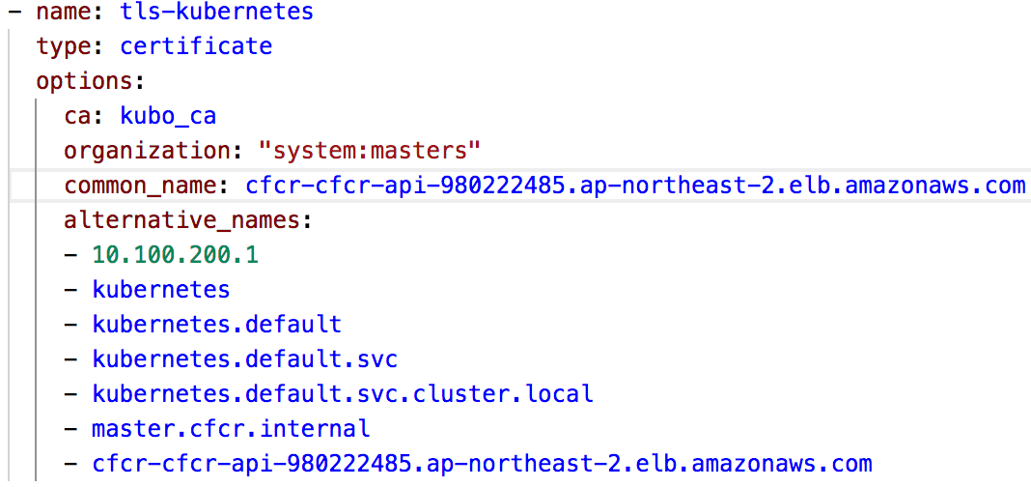
3. Deploying KUBO on AWS (2/8) - Deploying Kubo (2/5)
Edit kubo-deployment cfcr.yml file for deploying Kubernetes worker-nodes AWS
$ vi ~/workspace/kubo-deployment/manifests/cfcr.yml
Before Editing
After Editing
Edit kubo-deployment cfcr.yml file for deploying kubernetes master certificates
$ vi ~/workspace/kubo-deployment/manifests/cfcr.yml
Before Editing
After Editing
Note: Change cfcr-cfcr-api-980222485.ap-northeast-2.elb.amazonaws.com
according to your LB DNS Name Created in Previous Steps.

Slide 25
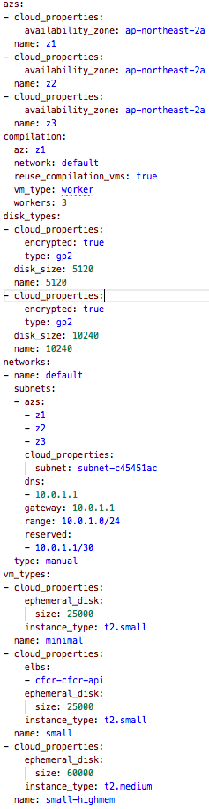
3. Deploying KUBO on AWS (3/8) - Deploying Kubo (3/5)
Create and Save bosh director cloud-config
$ vi ~/workspace/kubo-deployment/manifests/cloud-config.yml

Slide 26
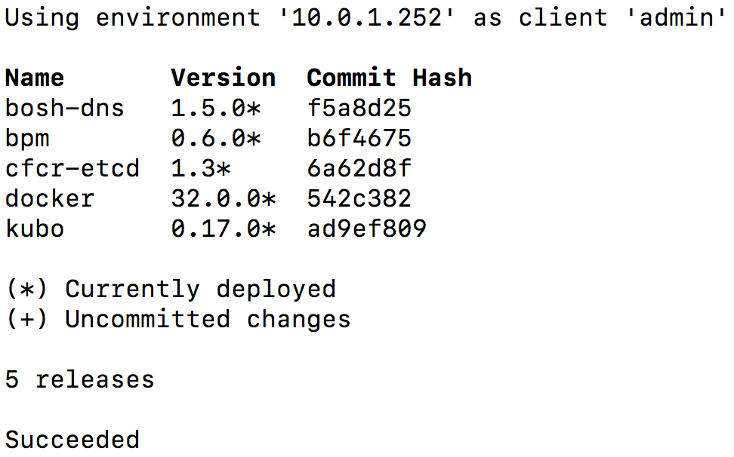
3. Deploying KUBO on AWS (4/8) - Deploying Kubo (4/5)
Update bosh director cloud-config
$ bosh -e kubo update-cloud-config ~/workspace/kubo-deployment/manifests/cloud-config.yml
Check the desired releases and stemcell to deploy kubo on AWS bosh
$ bosh -e kubo releases
Output
$ bosh -e kubo stemcells

Slide 27
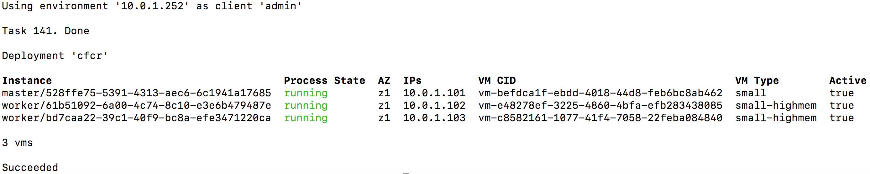
3. Deploying KUBO on AWS (5/8) - Deploying Kubo (5/5)
Deploy Kubo on AWS
$ bosh -e kubo -d cfcr deploy ~/workspace/kubo-deployment/manifests/cfcr.yml -o ~/workspace/kubo-deployment/manifests/ops-files/iaas/aws/cloud-provider.yml -o ~/workspace/kubo-deployment/manifests/ops-files/iaas/aws/add-master-credentials.yml -o ~/workspace/kubo-deployment/manifests/ops-files/iaas/aws/add-worker-credentials.yml -v aws_access_key_id_master=XXXX -v aws_secret_access_key_master=XXXX -v aws_access_key_id_worker=XXXX -v aws_secret_access_key_worker=XXXX -o ~/workspace/kubo-deployment/manifests/ops-files/iaas/aws/lb.yml -v kubernetes_cluster_tag=kubocrxpert
Deploy Kubernetes add-ons
$ bosh -e kubo -d cfcr run-errand apply-specs
Check Kubernetes Deployment
$ bosh -e kubo -d cfcr vms
Output
ssh into master and work vms
$ bosh -e kubo -d cfcr ssh master
$ bosh -e kubo -d cfcr ssh worker/61b51092-6a00-4c74-8c10-e3e6b479487e

Slide 28
3. Deploying KUBO on AWS (6/8) - Accessing Kubernetes (1/3)
Download tls-kubernetes certificate from credhub
$ bosh -e kubo -d cfcr int <(credhub get -n "/kubo/cfcr/tls-kubernetes" --output-json) --path=/value/ca > ~/workspace/kubo-deployment/kubo/kubernetes.crt
Download kubo-admin-password password from credhub
$ bosh -e kubo -d cfcr int <(credhub get -n "/kubo/cfcr/kubo-admin-password" --output-json) --path=/value > ~/workspace/kubo-deployment/kubo/kubernetes_pwd.crt
Configure Kubernetes Cluster by using above Certificate (kubernetes.crt)
$ kubectl config set-cluster "dev" --server https://you-lb-dns:8443 --embed-certs=true --certificate-authority=~/workspace/kubo-deployment/kubo/kubernetes.crt
Configure Kubernetes User and Context (Note: Use Kubernets User Password from above kubernetes_pwd.crt)
$ kubectl config set-credentials "dev" --token=your-kubernetes_pwd.crt-password
$ kubectl config set-context "dev" --cluster="dev" --user="dev
$ kubectl config use-context "dev"

Slide 29
3. Deploying KUBO on AWS (7/8) - Accessing Kubernetes (2/3)
Obtain kubernetes node Information
$ kubectl get node -o wide
Output
Obtain kubernetes Cluster Information
$ kubectl cluster-info
Get all information regarding your Namespace
$ kubectl get pods --namespace=kube-system
$ kubectl get all -n kube-system
Check 8001 port is active on your notebook, if active kill the process
$ sudo lsof -PiTCP -sTCP:LISTEN
$ sudo kill -9 your-pid-number
Accessing to Kubernetes Dashboard
$ kubectl proxy
Starting to serve on 127.0.0.1:8001
$ http://localhost:8001/api/v1/namespaces/kube-system/services/https:kubernetes-dashboard:/proxy/#!/login

Slide 30
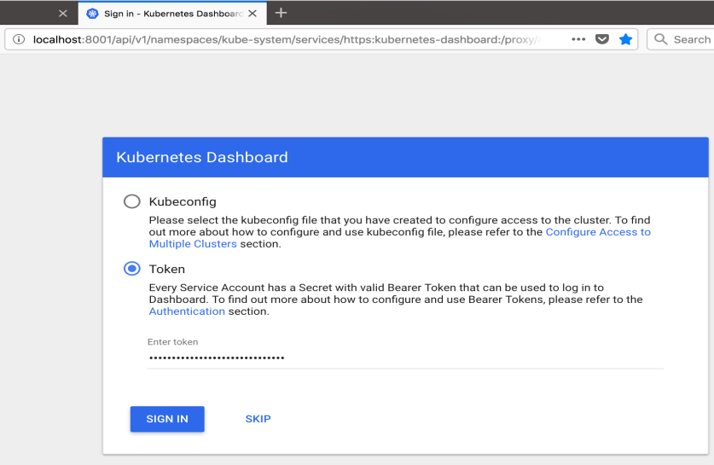
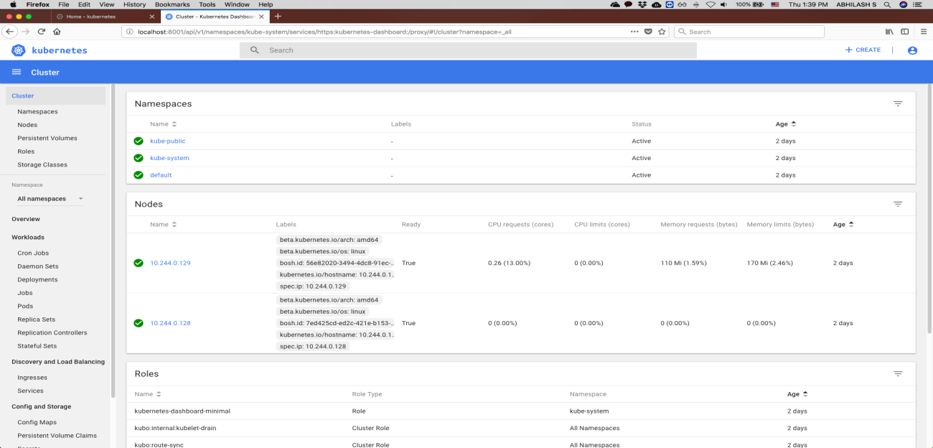
3. Deploying KUBO on AWS (8/8) - Accessing Kubernetes (3/3)
Accessing Kubernetes Dashboard in your Browser
Select token option and paste above kubernetes_pwd.crt password to login into your kubernets cluster
Output
Kubernetes Home Dashboard
Output

Slide 31
4. KUBO Deployment Architecture on AWS - Deployment Architecture
1
AWS Console Services,
Manual Setting
2
Inception
8
5
Create IAM User
Policy
3
4
Micro
Bosh VM
Create VPC with Public and Private Subnets
Configure Tags for Public and Private Subnets
Public Subnet
6
Master Node VM
7
Worker Node VMs
Create & Configure Routes for Private Subnet
Public Internet Access Using
Nat & Internet Gateway
Private Subnet
Create two Security Groups for LB and VMs
Create two Security Groups for LB and VMs
Create LB on Public Subnet
Create Key Pair for Inception and KUBO Deployment
Create Inception

Slide 32
THANK YOU

