Slide 1
Kubo & Kubernetes Deploying Guide
Abhilash S
㈜크로센트
2018. 06

Slide 2
Agenda
Kubo Deployment Guide
. Install Pre-Requirements
. Deploying Bosh-Director
. Deploying Kubo
. Accessing Kubernetes Cluster
Kuberentes Deployment Guide on AWS
. Install Pre-Requirements
. Deploying Kubernetes
. Accessing Kubernetes Cluster
Note: This deployment Guide is targeted only Ubuntu 16.04 users.

Slide 3
1. Kubo Deployment Guide (1/16) - Install Pre-Requirements (1/4)
Download and Install Virtualbox Ubuntu
$ https://www.virtualbox.org/wiki/Linux_Downloads
Install bosh-cli-2.0
$ wget https://s3.amazonaws.com/bosh-cli-artifacts/bosh-cli-3.0.1-linux-amd64
$ chmod +x bosh-cli-3.0.1-linux-amd64
$ sudo mv bosh-cli-3.0.1-linux-amd64 /usr/local/bin/bosh
Check the bosh version
$ bosh -v
version 3.0.1-712bfd7-2018-03-13T23:26:42Z

Slide 4
1. Kubo Deployment Guide (2/16) - Install Pre-Requirements (2/4)
Install bosh dependencies
$ sudo apt-get install build-essential ruby ruby-dev libxml2-dev libsqlite3-dev libxslt1-dev libpq-dev libmysqlclient-dev zlib1g-dev
$ sudo apt-get install -y build-essential zlibc zlib1g-dev ruby ruby-dev openssl libxslt-dev libxml2-dev libssl-dev libreadline6 libreadline6-dev libyaml-dev libsqlite3-dev sqlite3
Install GO
$ sudo add-apt-repository ppa:longsleep/golang-backports && sudo apt-get update && sudo apt-get install golang-go
$ mkdir ~/gocode
$ export GOPATH=~/gocode && echo export GOPATH=$GOPATH >> ~/.bash_profile
$ source ~/.bash_profile
Check the Go version & Environemnt
$ go version
$ go env

Slide 5
1. Kubo Deployment Guide (3/16) - Install Pre-Requirements (3/4)
Check the ruby version
$ ruby -v
ruby 2.3.3p222
Install Uaa-Cli
$ sudo gem install cf-uaac
$ uaac --version
UAA client 4.0.0
Install Kubectl-CLI
$ sudo apt-get update && sudo apt-get install -y apt-transport-https
$ curl -s https://packages.cloud.google.com/apt/doc/apt-key.gpg | apt-key add -
$ cat <<EOF >/etc/apt/sources.list.d/kubernetes.list
deb http://apt.kubernetes.io/ kubernetes-xenial main
EOF
$ sudo apt-get update && sudo apt-get install -y kubectl
$ kubectl version

Slide 6
1. Kubo Deployment Guide (4/16) - Install Pre-Requirements (4/4)
Install Git
$ sudo apt-get install git
$ git --version
git version 2.14.3
Install Credhub-Cli
$ wget https://github.com/cloudfoundry-incubator/credhub-cli/releases/download/1.7.6/credhub-linux-1.7.6.tgz
$ tar -xvf credhub-linux-1.7.6.tgz
$ chmod +x credhub
$ sudo mv credhub /usr/local/bin/credhub
Check the credhub version
$ credhub --version
CLI Version: 1.6.0

Slide 7
1. Kubo Deployment Guide (5/16) - Deploying Bosh-Director (1/4)
First Create a workspace directory.
Next clone the bosh-deployment and kubo-deployment repositories
$ mkdir ~/workspace && cd ~/workspace
$ git clone https://github.com/cloudfoundry/bosh-deployment.git
$ git clone https://github.com/cloudfoundry-incubator/kubo-deployment.git -b v0.17.0
Note: we can increase default memory size of bosh director in ~/workspace/bosh-deployment/virtualbox/cpi.yml for example 4096 to 7168
Note: we can increase default disk size of bosh director in ~/workspace/bosh-deployment/bosh-lite.yml for example 65_536 to 100_536
Create a directory to store deployment state and credentials.
$ mkdir ~/workspace/bosh-deployment/kubo
$ mkdir ~/workspace/kubo-deployment/kubo

Slide 8
1. Kubo Deployment Guide (6/16) - Deploying Bosh-Director (2/4)
Below command create bosh-init vm on virtualbox by means of bosh.yml as base manifest.
Yaml files with –o command set variables director_name, internal_ip, internal_gw, internal_cidr, outbound_network_name using –v command.
It also create state.json to record running state and creds.yml (for certs & credentails) in your ~/deployments/vbox directory
Following Command Creates Director’s vm and install it’s jobs
$ bosh create-env ~/workspace/bosh-deployment/bosh.yml
--state=~/workspace/bosh-deployment/kubo/state.json
-o ~/workspace/bosh-deployment/virtualbox/cpi.yml
-o ~/workspace/bosh-deployment/virtualbox/outbound-network.yml
-o ~/workspace/bosh-deployment/bosh-lite.yml
-o ~/workspace/bosh-deployment/bosh-lite-runc.yml
-o ~/workspace/bosh-deployment/jumpbox-user.yml
-o ~/workspace/bosh-deployment/uaa.yml
-o ~/workspace/bosh-deployment/credhub.yml
-o ~/workspace/bosh-deployment/local-dns.yml
--vars-store=~/workspace/bosh-deployment/kubo/creds.yml
-v director_name=”kubo"
-v internal_ip=192.168.50.6
-v internal_gw=192.168.50.1
-v internal_cidr=192.168.50.0/24
-v outbound_network_name=NatNetwork

Slide 9
1. Kubo Deployment Guide (7/16) - Deploying Bosh-Director (3/4)
Log into director with your alias name.
$ bosh alias-env kubo -e 192.168.50.6 --ca-cert <(bosh int ~/workspace/bosh-deployment/kubo/creds.yml --path /director_ssl/ca)
$ export BOSH_CLIENT=admin
$ export BOSH_CLIENT_SECRET=`bosh int ~/workspace/bosh-deployment/kubo/creds.yml --path /admin_password`
$ bosh -e vbox env
Create directory to download releases and stemcells
$ mkdir ~/workspace/releases && cd ~/workspace/releases
Download Upload BOSH Lite Stemcell
$ wget https://s3.amazonaws.com/bosh-core-stemcells/warden/bosh-stemcell-3586.16-warden-boshlite-ubuntu-trusty-go_agent.tgz
$ bosh -e kubo upload-stemcell bosh-stemcell-3586.16-warden-boshlite-ubuntu-trusty-go_agent.tgz
Update cloud config & set-up local route for bosh ssh
$ sudo route add –net 10.244.0.0/16 gw 192.168.50.6 # Linux

Slide 10
1. Kubo Deployment Guide (8/16) - Deploying Bosh-Director (4/4)
Target & Log into director uaa.
$ export BOSH_CLIENT_SECRET=`bosh int ~/workspace/bosh-deployment/kubo/creds.yml --path /admin_password`
$ uaac target https://192.168.50.6:8443 --skip-ssl-validation && uaac token client get admin -s $BOSH_CLIENT_SECRET
Target & Log into director credhub
$ export CREDHUB_CLIENT=credhub-admin
$ export CREDHUB_SECRET=$(bosh int --path /credhub_admin_client_secret ~/workspace/bosh-deployment/kubo/creds.yml)
$ export CREDHUB_CA_CERT=$(bosh int --path /credhub_tls/ca ~/workspace/bosh-deployment/kubo/creds.yml)
$ credhub login -s https://192.168.50.6:8844 --skip-tls-validation
List out Certificates and Passwords in credhub
$ credhub find
Delete Certificates and Passwords in credhub
$ credhub delete -n /director_name/deployment-name/certificate-name

Slide 11
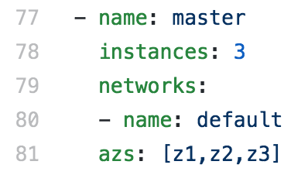
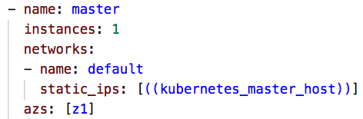
1. Kubo Deployment Guide (9/16) - Deploying Kubo (1/5)
Download kubo-release.
$ cd ~/workspace/releases
$ wget https://github.com/cloudfoundry-incubator/kubo-release/releases/download/v0.17.0/kubo-release-0.17.0.tgz
Upload kubo-release
$ bosh -e kubo upload-release ~/workspace/releases/kubo-release-0.17.0.tgz
Edit kubo-deployment cfcr.yml file for deploying kubernetes master bosh-lite
$ cd ~/workspace/kubo-deployment
$ vi ~/workspace/kubo-deployment/manifests/cfcr.yml
Before Editing
After Editing

Slide 12
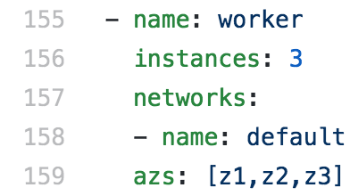
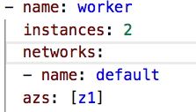
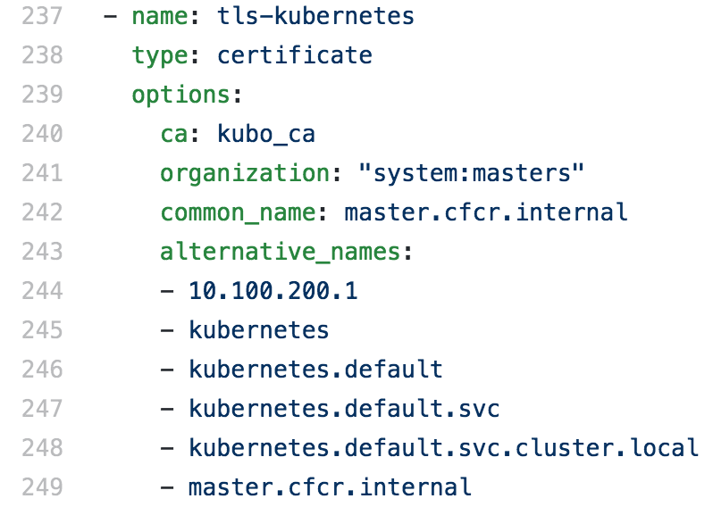
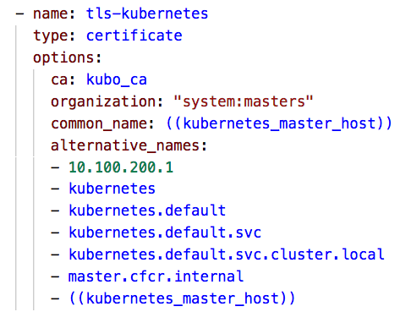
1. Kubo Deployment Guide (10/16) - Deploying Kubo (2/5)
Edit kubo-deployment cfcr.yml file for deploying Kubernetes worker-nodes bosh-lite
$ vi ~/workspace/kubo-deployment/manifests/cfcr.yml
Before Editing
After Editing
Edit kubo-deployment cfcr.yml file for deploying kubernetes master certificates
$ vi ~/workspace/kubo-deployment/manifests/cfcr.yml
Before Editing
After Editing

Slide 13
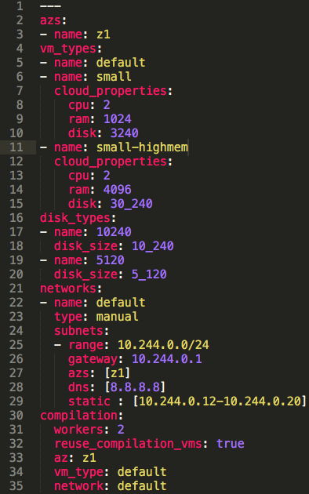
1. Kubo Deployment Guide (11/16) - Deploying Kubo (3/5)
Create and Save bosh director cloud-config
$ vi ~/workspace/kubo-deployment/manifests/cloud-config.yml

Slide 14
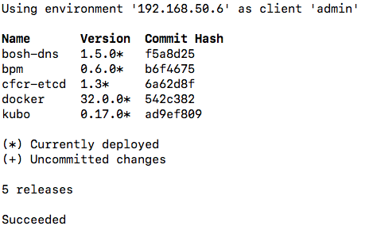
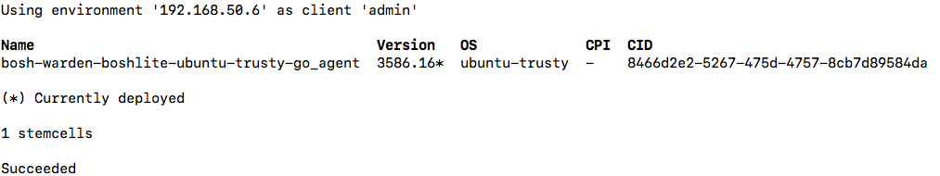
1. Kubo Deployment Guide (12/16) - Deploying Kubo (4/5)
Update bosh director cloud-config
$ bosh -e kubo update-cloud-config ~/workspace/kubo-deployment/manifests/cloud-config.yml
Check the desired releases and stemcell to deploy kubo on bosh lite
$ bosh -e kubo releases
Output
$ bosh -e kubo stemcells
Output

Slide 15
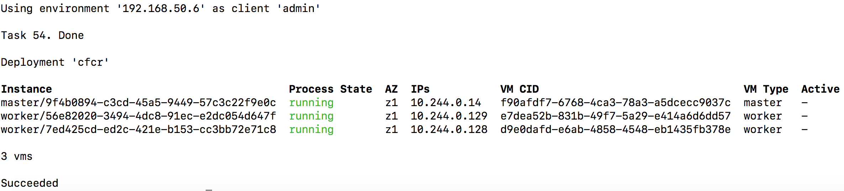
1. Kubo Deployment Guide (13/16) - Deploying Kubo (5/5)
Deploy Kubo on bosh-lite
$ bosh -e kubo -d cfcr deploy ~/workspace/kubo-deployment/manifests/cfcr.yml -v kubernetes_master_host=10.244.0.14
Deploy Kubernetes add-ons
$ bosh -e kubo -d cfcr run-errand apply-specs
Check Kubernetes Deployment
$ bosh -e kubo -d cfcr vms
Output
ssh into master and work vms
$ bosh -e kubo -d cfcr ssh master
$ bosh -e kubo -d cfcr ssh worker/56e82020-3494-4dc8-91ec-e2dc054d647f

Slide 16
1. Kubo Deployment Guide (14/16) - Accessing Kubernetes (1/3)
Download tls-kubernetes certificate from credhub
$ bosh -e kubo -d cfcr int <(credhub get -n "/kubo/cfcr/tls-kubernetes" --output-json) --path=/value/ca > ~/workspace/kubo-deployment/kubo/kubernetes.crt
Download kubo-admin-password password from credhub
$ bosh -e kubo -d cfcr int <(credhub get -n "/kubo/cfcr/kubo-admin-password" --output-json) --path=/value > ~/workspace/kubo-deployment/kubo/kubernetes_pwd.crt
Configure Kubernetes Cluster by using above Certificate (kubernetes.crt)
$ kubectl config set-cluster "dev" --server https://10.244.0.14:8443 --embed-certs=true --certificate-authority=~/workspace/kubo-deployment/kubo/kubernetes.crt
Configure Kubernetes User and Context (Note: Use Kubernets User Password from above kubernetes_pwd.crt)
$ kubectl config set-credentials "dev" --token=your-kubernetes_pwd.crt-password
$ kubectl config set-context "dev" --cluster="dev" --user="dev
$ kubectl config use-context "dev"

Slide 17
1. Kubo Deployment Guide (15/16) - Accessing Kubernetes (2/3)
Obtain kubernetes node Information
$ kubectl get node -o wide
Output
Obtain kubernetes Cluster Information
$ kubectl cluster-info
Output
Get all information regarding your Namespace
$ kubectl get pods --namespace=kube-system
$ kubectl get all -n kube-system
Check 8001 port is active on your notebook, if active kill the process
$ sudo lsof -PiTCP -sTCP:LISTEN
$ sudo kill -9 your-pid-number
Accessing to Kubernetes Dashboard
$ kubectl proxy
Starting to serve on 127.0.0.1:8001
$ http://localhost:8001/api/v1/namespaces/kube-system/services/https:kubernetes-dashboard:/proxy/#!/login

Slide 18
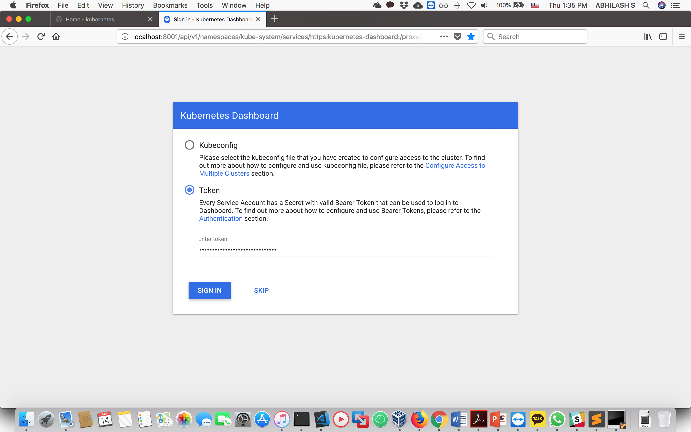
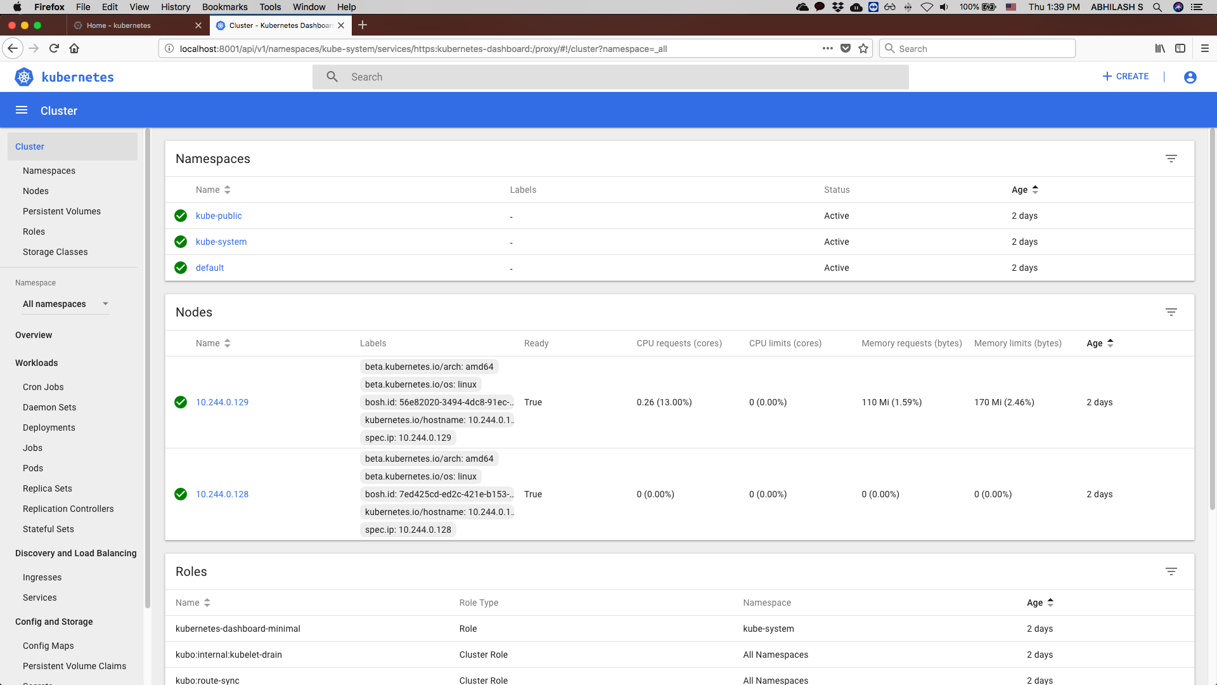
1. Kubo Deployment Guide (16/16) - Accessing Kubernetes (3/3)
Accessing Kubernetes Dashboard in your Browser
Select token option and paste above kubernetes_pwd.crt password to login into your kubernets cluster
Output
Kubernetes Home Dashboard
Output

Slide 19
2. Kubernetes Deployment Guide on AWS (1/8) - Install Pre-Requirements (1/2)
Install kops-cli
$ wget https://github.com/kubernetes/kops/releases/download/1.9.1/kops-linux-amd64
$ chmod +x kops-linux-amd64
$ sudo mv kops-linux-amd64 /usr/local/bin/kops
Check the kops version
$ kops version
Version 1.9.1
Install Kubectl-CLI
$ sudo apt-get update && sudo apt-get install -y apt-transport-https
$ curl -s https://packages.cloud.google.com/apt/doc/apt-key.gpg | apt-key add -
$ cat <<EOF >/etc/apt/sources.list.d/kubernetes.list
deb http://apt.kubernetes.io/ kubernetes-xenial main
EOF
$ sudo apt-get update && sudo apt-get install -y kubectl
$ kubectl version

Slide 20
2. Kubernetes Deployment Guide on AWS (2/8) - Install Pre-Requirements (2/2)
Install aws-cli
$ sudo apt-get update && sudo apt-get upgrade
$ sudo apt install awscli
Check the aws-cli version
$ aws --version

Slide 21

2. Kubernetes Deployment Guide on AWS (3/8) - Deploying kubernetes (1/6)
Configure AWS Access Key and Secret Access Key ID’S
Use your Access & Secret Keys
Use your preferred location (Note: Here I am using Asia Pacific (Seoul) location)
$ aws configure
Output
Create AWS S3 bucket for Kubernetes Deployment.
$ aws s3api create-bucket --bucket your-bucketname --region your-region --create-bucket-configuration LocationConstraint=your-region
Output
Providing S3 bucket URL in the following environment variables:
$ export KOPS_STATE_STORE=s3://paastakubo

Slide 22
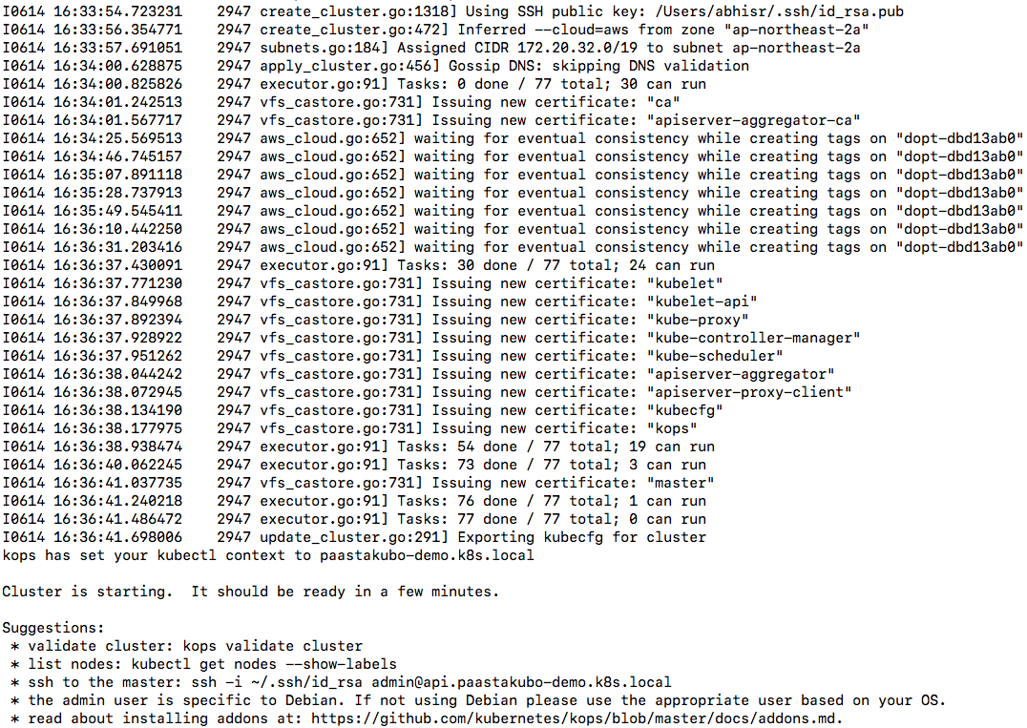
2. Kubernetes Deployment Guide on AWS (4/8) - Deploying kubernetes (2/6)
Configure AWS Access Key and Secret Access Key ID’S
$ kops create cluster cluster-domain --master-count=1 --master-size=t2.medium --node-count=2 --node-size=t2.medium --zones your-zone-in-your-selected-region --yes
For-Example
$ kops create cluster paastakubo-demo.k8s.local --master-count=1 --master-size=t2.medium --node-count=2 --node-size=t2.medium --zones ap-northeast-2a --yes
Output

Slide 23
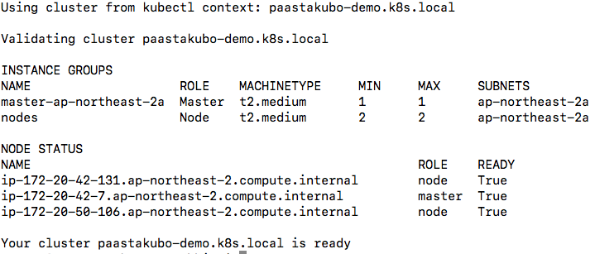
2. Kubernetes Deployment Guide on AWS (5/8) - Deploying kubernetes (3/6)
Check your Kubernetes Cluster
$ kops validate cluster
Output
Deploy Kubernetes Dashboard.
$ kubectl apply -f https://raw.githubusercontent.com/kubernetes/dashboard/master/src/deploy/recommended/kubernetes-dashboard.yaml
Get your Kubernetes Cluster Information
$ kubectl cluster-info
Output

Slide 24

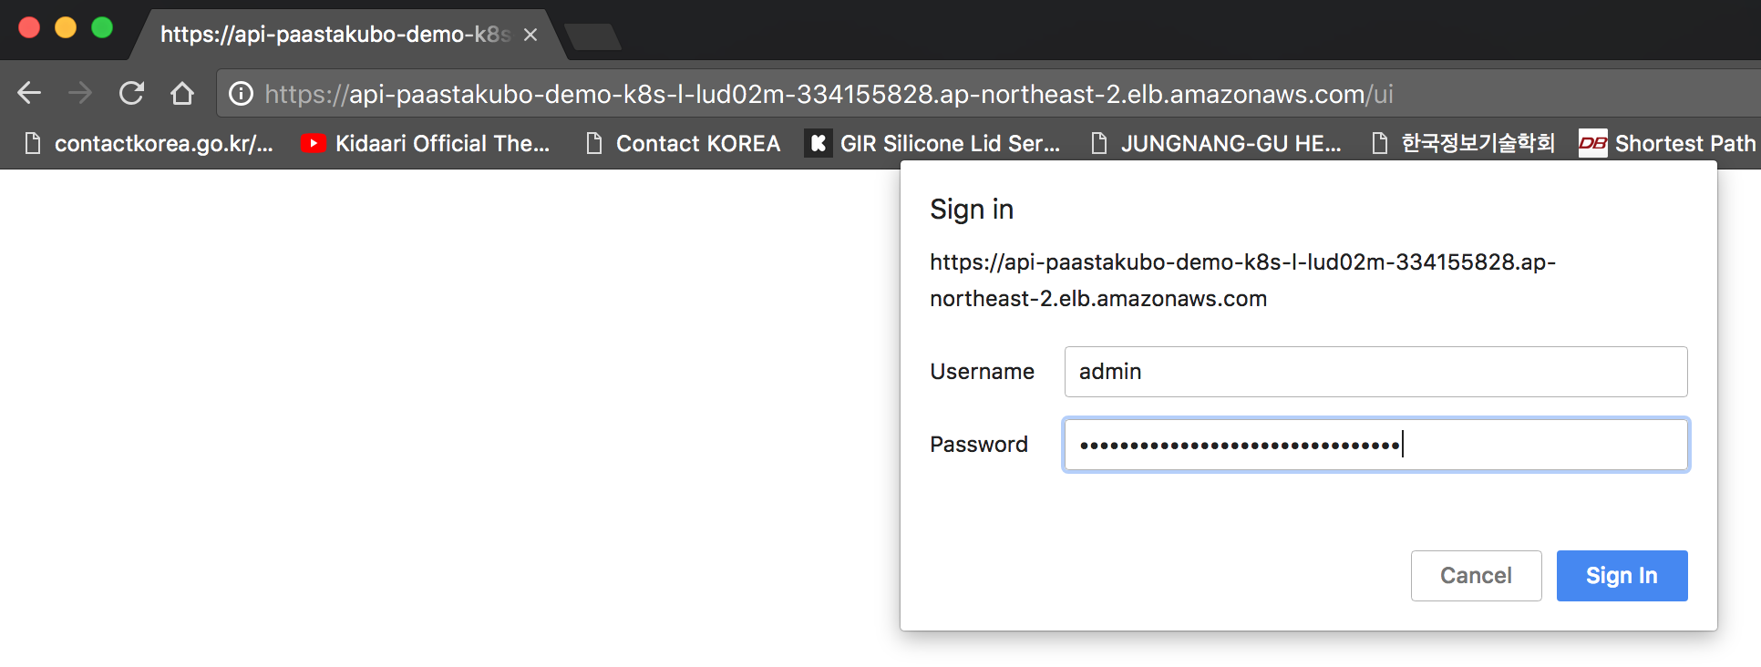
2. Kubernetes Deployment Guide on AWS (6/8) - Deploying kubernetes (4/6)
Execute below command to obtain kops login
$ kops get secrets kube --type secret -oplaintext
Output
Login into kops (Note: Below url is obtained from “kubectl cluster-info” command ) .
$ https://api-paastakubo-demo-k8s-l-lud02m-334155828.ap-northeast-2.elb.amazonaws.com/ui
Username = admin
Password = HcNMaFZrE8s4FdTeNH5os1fkH9Ovx3oR
Output

Slide 25

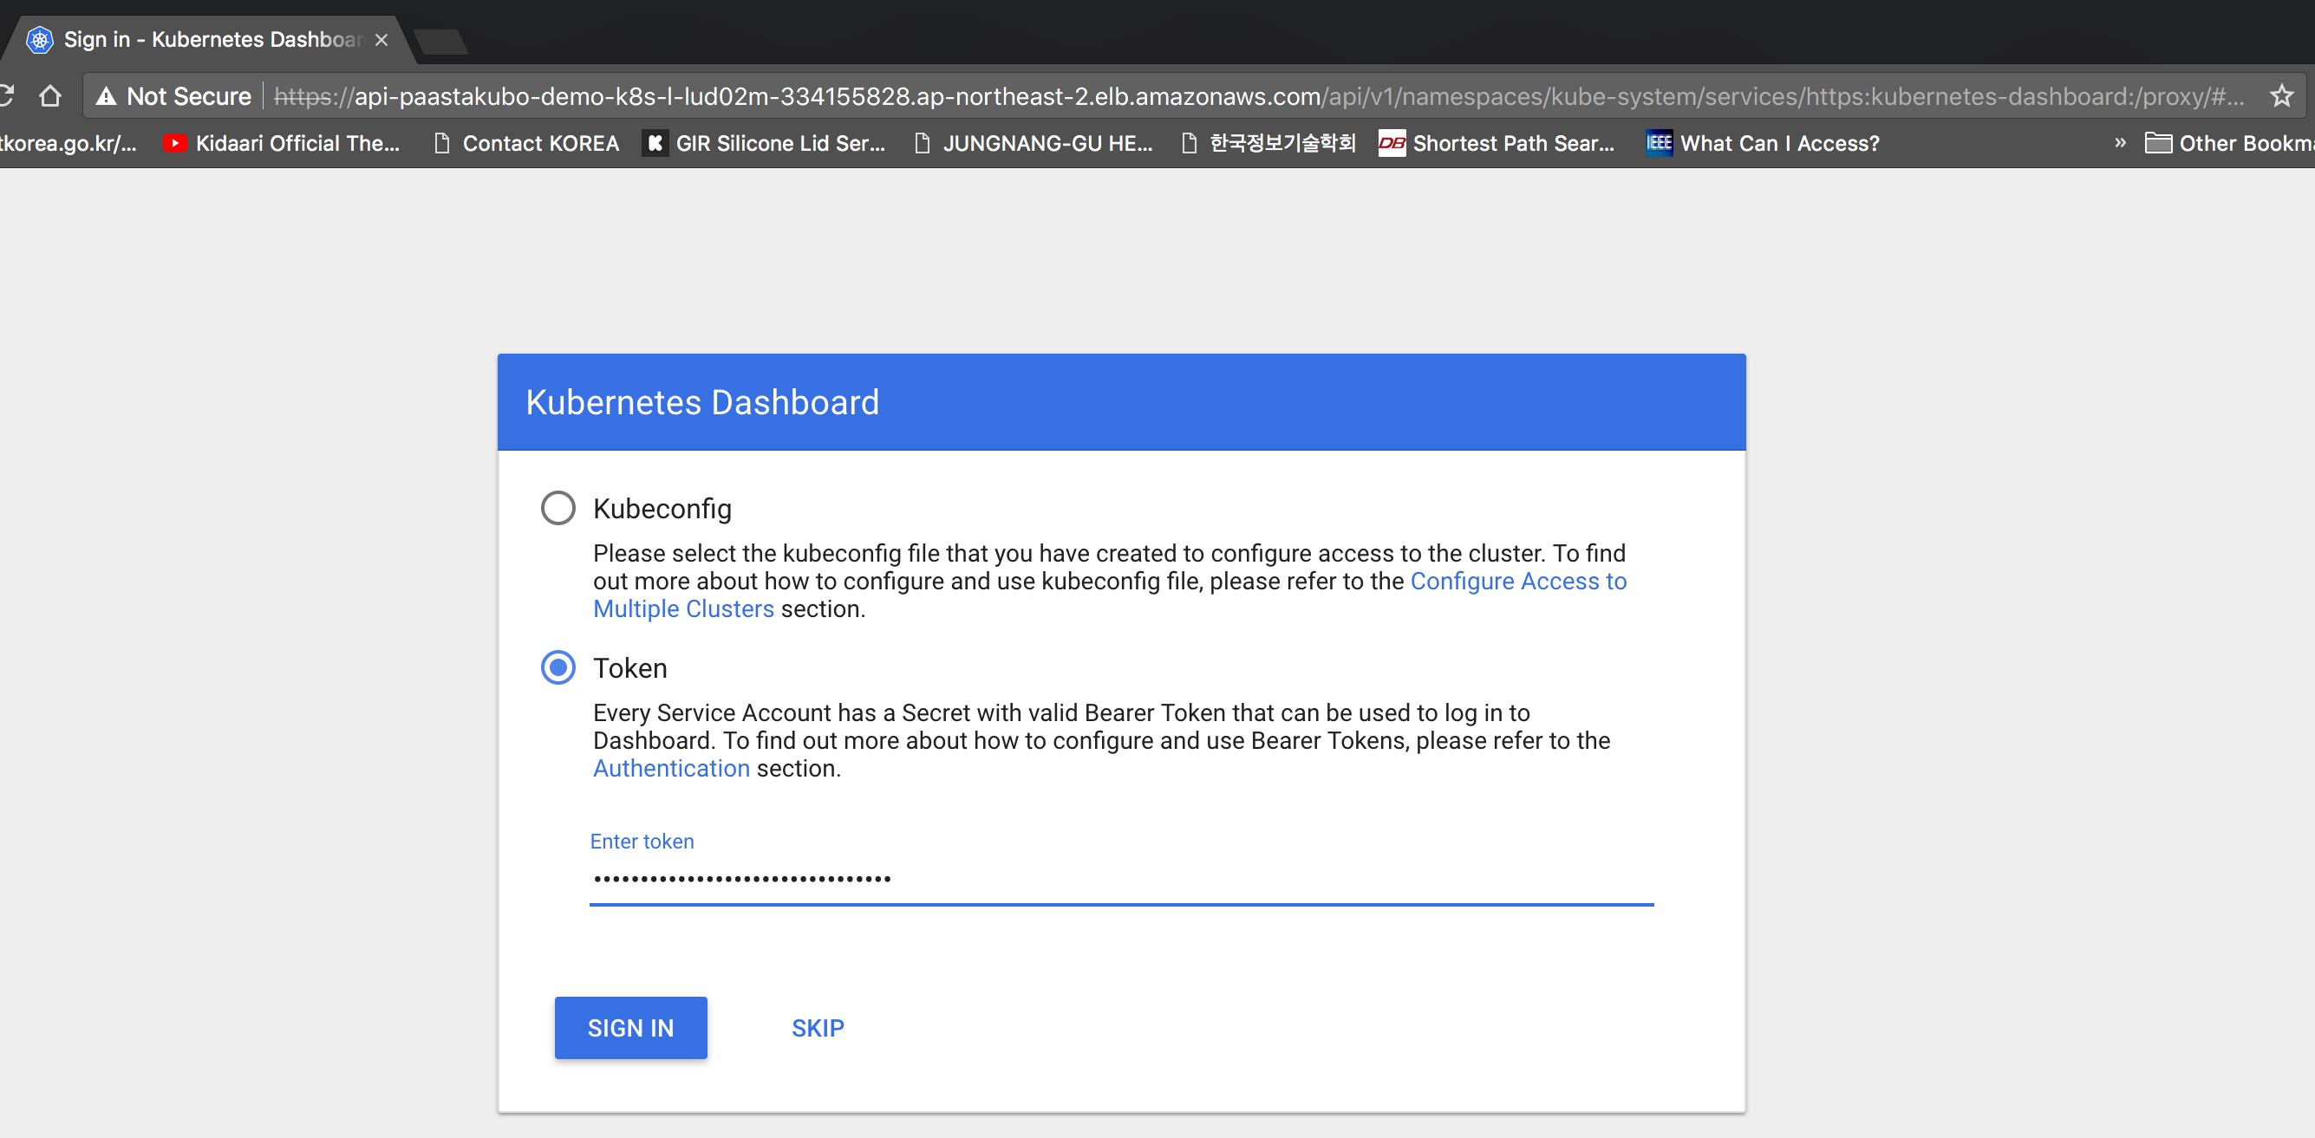
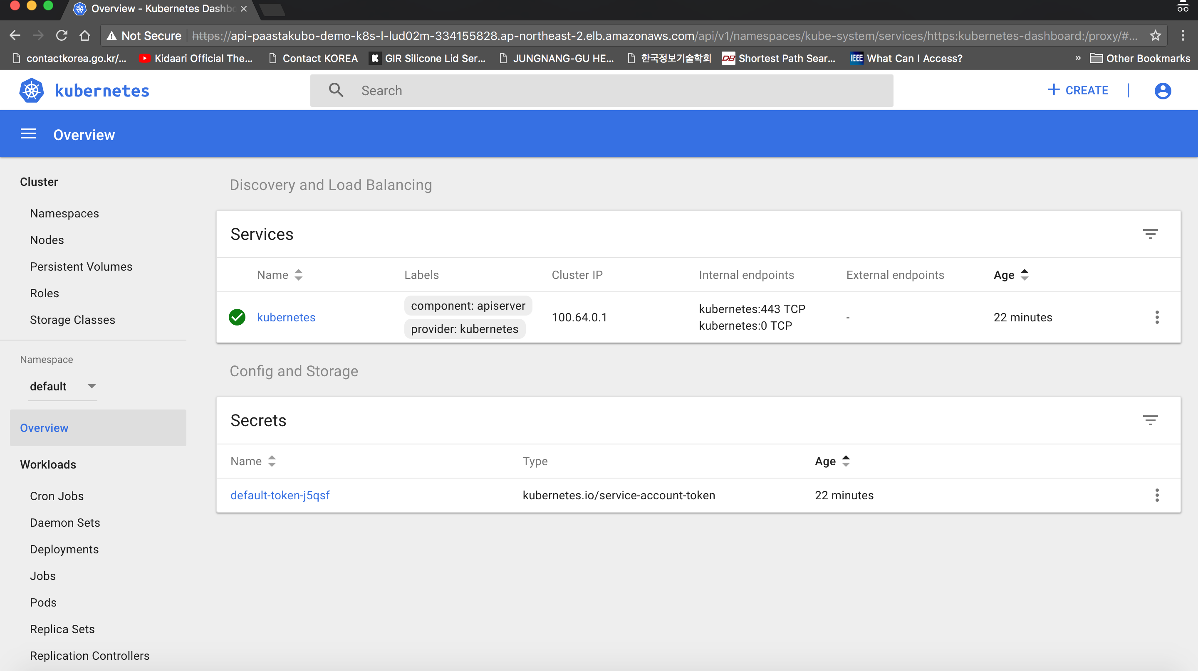
2. Kubernetes Deployment Guide on AWS (7/8) - Deploying kubernetes (5/6)
Execute below command to obtain Kubernetes dashboard login
$ kops get secrets admin --type secret -oplaintext
Output
Login into Kuberntes Dashboard.
Token = QZOynD537wIUwNWvJ6EyFgonhcda6YX3
Output

Slide 26

2. Kubernetes Deployment Guide on AWS (8/8) - Deploying kubernetes (6/6)
Get all information regarding your Namespace
$ kubectl get pods --namespace=kube-system
$ kubectl get all -n kube-system
SSH into Kops Kuberntes Cluster (Master & Worker) on AWS.
$ ssh -i ~/.ssh/id_rsa admin@your-master-public-dns
$ ssh -i ~/.ssh/id_rsa admin@your-worker-public-dns
Delete You Kuberntes Cluster on AWS.
$ export KOPS_STATE_STORE=s3://paastakubo
$ kops delete cluster paastakubo-demo.k8s.local --yes
Output

Slide 27
THANK YOU

