Slide 1
Openstack KUBO Deploying Guide
Abhilash S
㈜크로센트
2018. 07

Slide 2
Agenda
Openstack Infrastructure Setting
Deploying Bosh Director on Openstack
Deploying KUBO on Openstack
KUBO Deployment Architecture on Openstack
Note: This deployment Guide is targeted only Ubuntu 16.04 users.

Slide 3
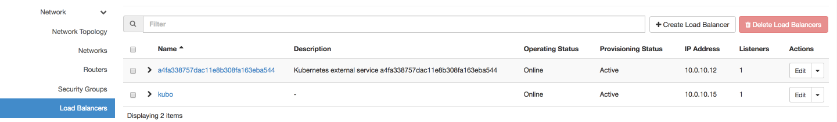
1. Openstack Infrastructure Setting (1/4) - Install Pre-Requirements (1/4)
Note: This installation Guide does not provide Deep Dive into Openstack Infrastructure Setting.
Note: This installation Guide requires Openstack Load Balancer (HaProxy Provider).
Note: This installation Guide is carried on Openstack OCATA version.
Note: This installation Guide assumes your Openstack Tenant has preconfigured Private and Public Networks .
Follow Below link to create Openstack Infrastructure.
https://bosh.io/docs/init-openstack/
Create HaProxy Load Balancer in Openstack.
1
3
2

Slide 4
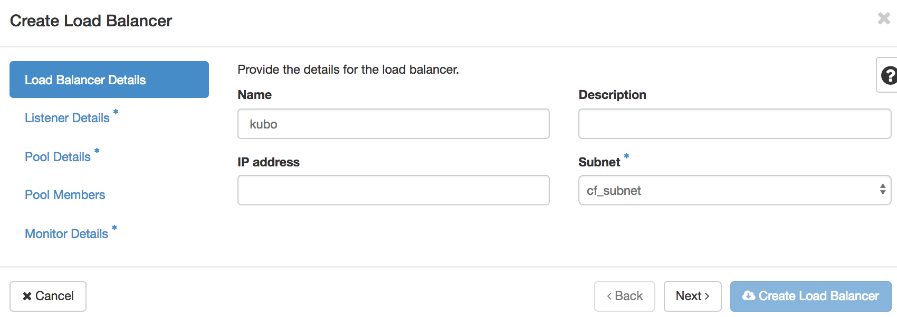
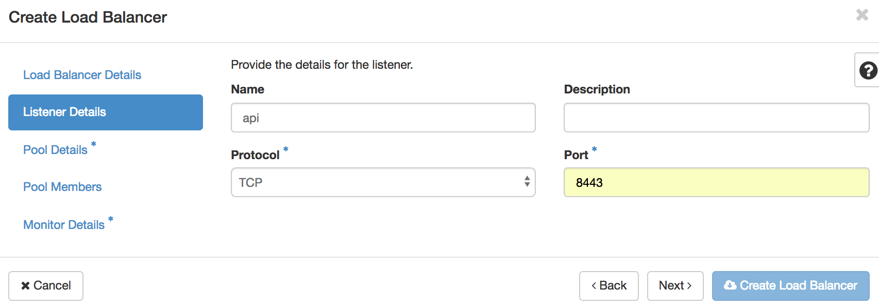
1. Openstack Infrastructure Setting (2/4) - Install Pre-Requirements (2/4)
Create HaProxy Load Balancer in Openstack (Continuing) .
4
5
6
7
9
8
11
10
12

Slide 5
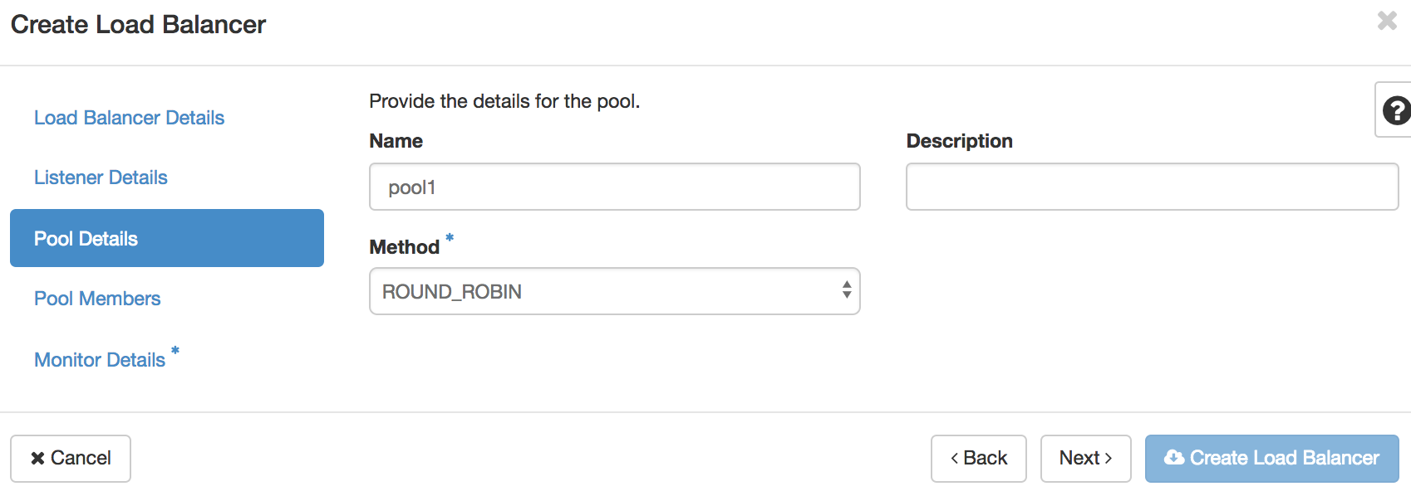
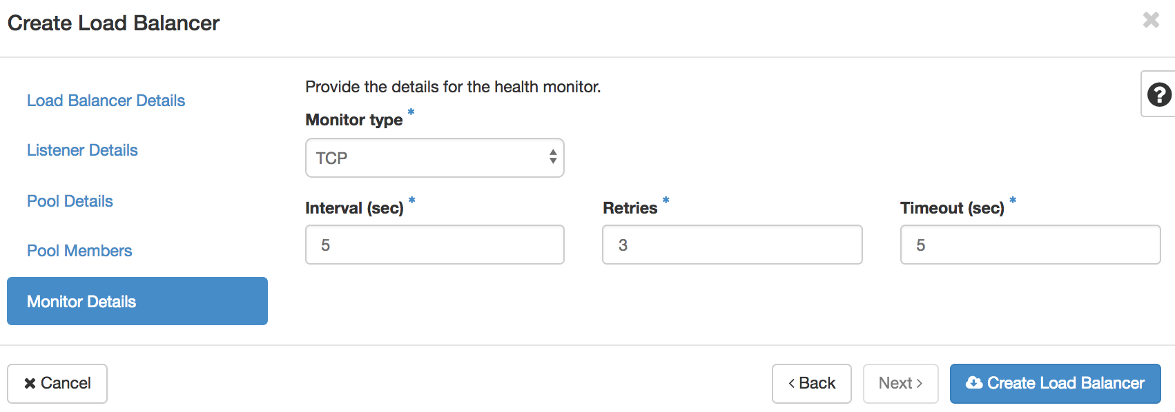
1. Openstack Infrastructure Setting (3/4) - Install Pre-Requirements (3/4)
Create HaProxy Load Balancer in Openstack (Continuing) .
14
13
15
16
18
19
17
20

Slide 6
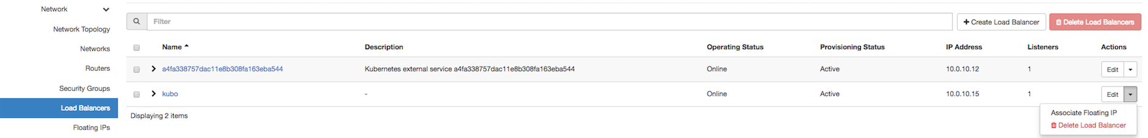
1. Openstack Infrastructure Setting (4/4) - Install Pre-Requirements (4/4)
Assign Floating IP (Public IP) HaProxy Load Balancer in Openstack.
1
2
3
4

Slide 7
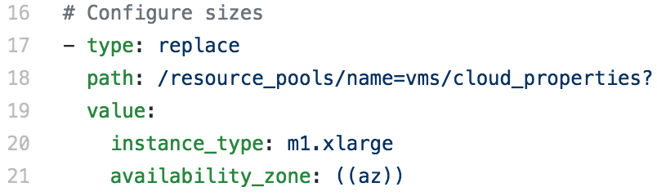
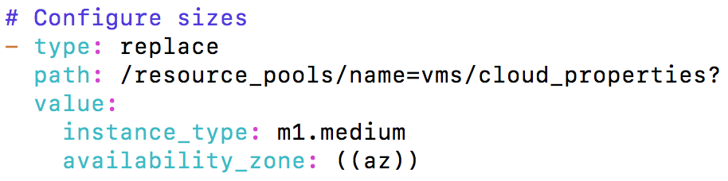
2. Deploying Bosh Director on Openstack (1/6) - Deploying Bosh-Director (1/6)
Note: Perfrom below steps in your Inception.
ssh into inception
Next clone the bosh-deployment and kubo-deployment repositories
$ ssh -i your-key ubuntu@yours-instance-public-ip
$ mkdir ~/workspace && cd ~/workspace
$ git clone https://github.com/cloudfoundry/bosh-deployment
$ git clone https://github.com/cloudfoundry-incubator/kubo-deployment
$ cd bosh-deployment
Edit Openstack cpi.yml file to configure Nat VM.
$ vi ~/workspace/bosh-deployment/openstack/cpi.yml
Before Editing
After Editing

Slide 8
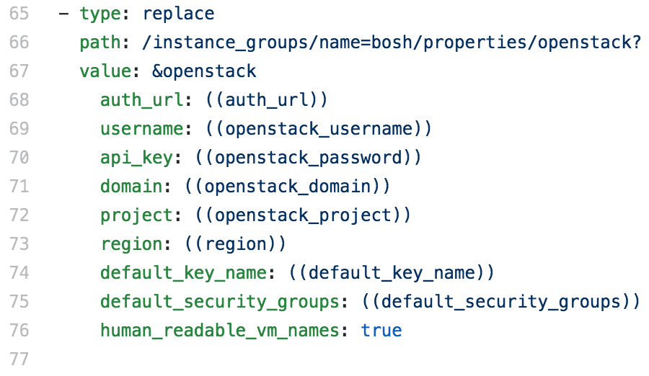
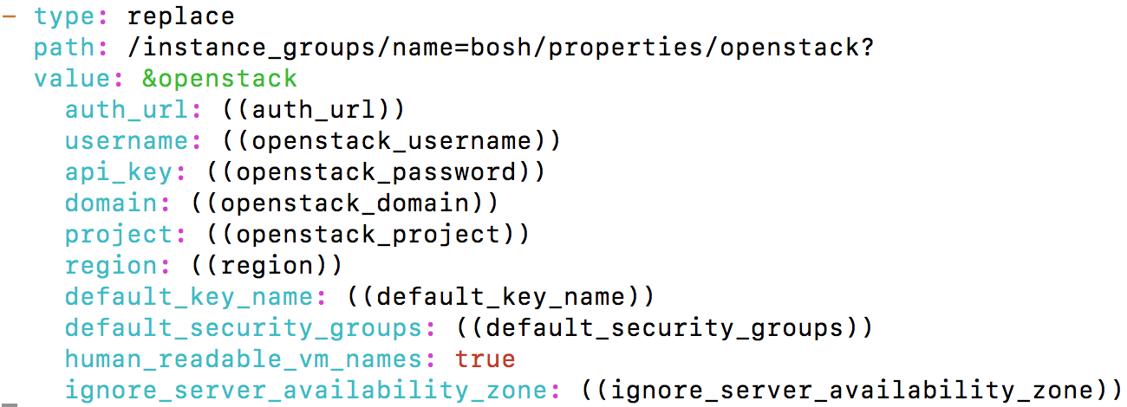
2. Deploying Bosh Director on Openstack (2/6) - Deploying Bosh-Director (2/6)
Edit Openstack cpi.yml file to configure Cinder Availability Zone .
$ vi ~/workspace/bosh-deployment/openstack/cpi.yml
Before Editing
After Editing
Note: enable “ignore_server_availability_zone: true” only when your openstack compute nodes are in multizone. If not set “ignore_server_availability_zone: false”.
Note: Our openstack compute nodes are in singlezone. So we set “ignore_server_availability_zone: false”.

Slide 9
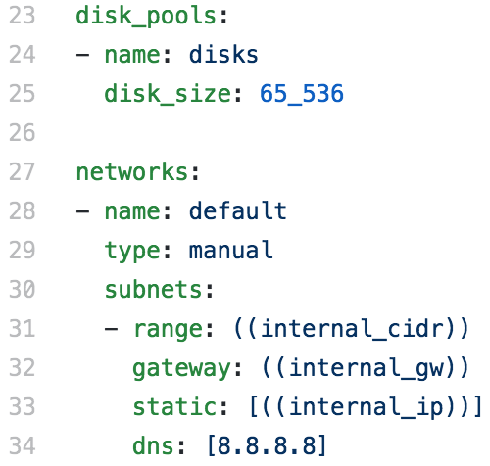
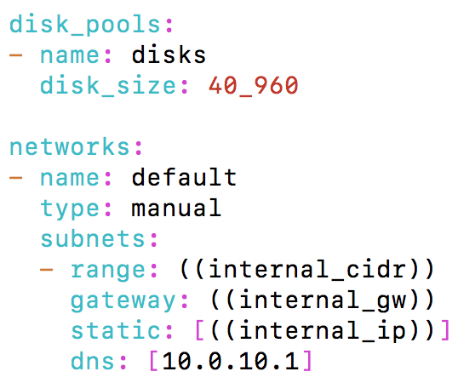
2. Deploying Bosh Director on Openstack (3/6) - Deploying Bosh-Director (3/6)
Edit Bosh bosh.yml file to configure Gateway.
$ vi ~/workspace/bosh-deployment/bosh.yml
Before Editing
After Editing
Your Private Subnet Gateway IP
Create directory to store director deployment state and credentials.
$ cd ~/workspace/bosh-deployment/ && mkdir kubo && cd kubo

Slide 10
2. Deploying Bosh Director on Openstack (4/6) - Deploying Bosh-Director (4/6)
Below command create bosh-init vm on virtualbox by means of bosh.yml as base manifest.
Yaml files with –o command set variables director_name, internal_ip, internal_gw, internal_cidr, outbound_network_name using –v command.
It also create state.json to record running state and creds.yml (for certs & credentails) in your ~/deployments/vbox directory
Following Command Creates Director’s vm and install it’s jobs
$ bosh create-env ~/workspace/bosh-deployment/bosh.yml
--state=~/workspace/bosh-deployment/kubo/state.json
--vars-store=~/workspace/bosh-deployment/kubo/creds.yml
-o ~/workspace/bosh-deployment/openstack/cpi.yml
-o ~/workspace/bosh-deployment/jumpbox-user.yml
-o ~/workspace/bosh-deployment/uaa.yml
-o ~/workspace/bosh-deployment/credhub.yml
-o ~/workspace/bosh-deployment/openstack/disable-readable-vm-names.yml
-o ~/workspace/bosh-deployment/local-dns.yml
-o ~/workspace/kubo-deployment/configurations/generic/dns-addresses.yml
-v director_name=”kubo"
-v internal_ip=10.0.10.252
-v internal_gw=10.0.10.1
-v internal_cidr=10.0.10.0/24
-v auth_url=http://your-openstack-identity-public-ip:5000/v3
-v az=nova
-v default_key_name=paasta
-v default_security_groups=[bosh]
-v net_id=bc8559ef-b82d-4f03-b4f5-650e6d84add8
-v openstack_password=xxxxx # Your Openstack Tenant Username
-v openstack_username=xxxxx # Your Openstack Tenant Password
-v openstack_domain=default
-v openstack_project=crossent
-v private_key=~/workspace/paasta.pem
-v region=RegionOne
-v ignore_server_availability_zone=false # Enable “ignore_server_availability_zone=true” if your openstack compute nodes in multizones

Slide 11
2. Deploying Bosh Director on Openstack (5/6) - Deploying Bosh-Director (5/6)
Log into director with your alias name.
$ bosh alias-env kubo -e 10.0.10.252 --ca-cert <(bosh int ~/workspace/bosh-deployment/kubo/creds.yml --path /director_ssl/ca)
$ export BOSH_CLIENT=admin
$ export BOSH_CLIENT_SECRET=`bosh int ~/workspace/bosh-deployment/kubo/creds.yml --path /admin_password`
Create directory to download releases and stemcells
$ mkdir ~/workspace/releases && cd ~/workspace/releases
Download Upload Openstack Stemcell
$ wget https://s3.amazonaws.com/bosh-core-stemcells/openstack/bosh-stemcell-3586.16-openstack-kvm-ubuntu-trusty-go_agent.tgz
$ bosh -e kubo upload-stemcell bosh-stemcell-3586.16-openstack-kvm-ubuntu-trusty-go_agent.tgz

Slide 12
2. Deploying Bosh Director on Openstack (6/6) - Deploying Bosh-Director (6/6)
Target & Log into director credhub
$ export CREDHUB_CLIENT=credhub-admin
$ export CREDHUB_SECRET=$(bosh int --path /credhub_admin_client_secret ~/workspace/bosh-deployment/kubo/creds.yml)
$ export CREDHUB_CA_CERT=$(bosh int --path /credhub_tls/ca ~/workspace/bosh-deployment/kubo/creds.yml)
$ credhub login -s https://10.0.1.252:8844 --skip-tls-validation
List out Certificates and Passwords in credhub
$ credhub find
To Delete Certificates and Passwords in credhub
$ credhub delete -n /director_name/deployment-name/certificate-name

Slide 13
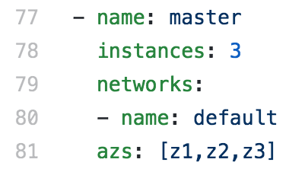
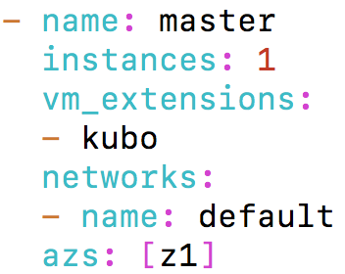
4. Deploying KUBO on Openstack (1/9) - Deploying Kubo (1/6)
Download kubo-release.
$ cd ~/workspace && mkdir releases && cd ~/workspace/releases
$ wget https://github.com/cloudfoundry-incubator/kubo-release/releases/download/v0.21.0/kubo-release-0.21.0.tgz
Upload kubo-release
$ bosh -e kubo upload-release ~/workspace/releases/kubo-release-0.21.0.tgz
Edit kubo-deployment cfcr.yml file for deploying kubernetes master on Openstack
$ cd ~/workspace/kubo-deployment
$ vi ~/workspace/kubo-deployment/manifests/cfcr.yml
Before Editing
After Editing
Your LB Extension Name in
Cloud-config

Slide 14
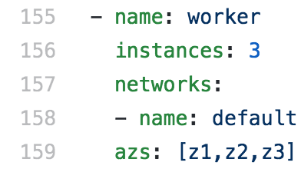
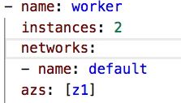
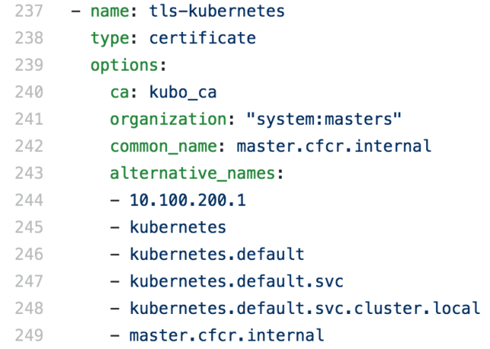
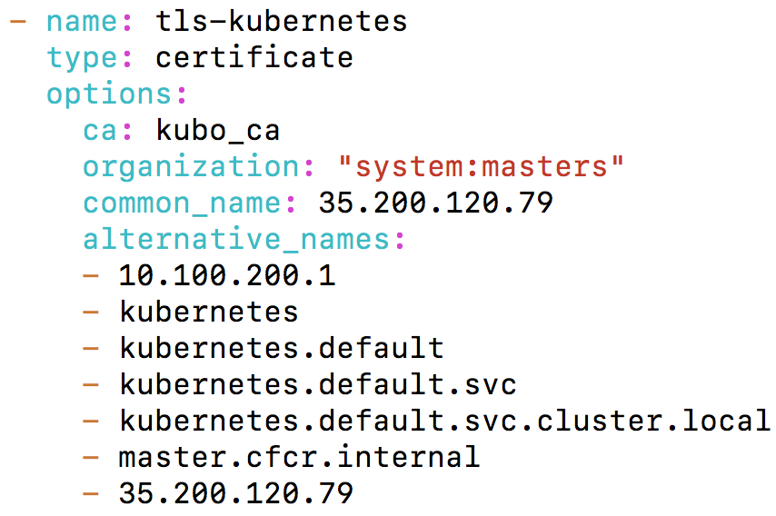
4. Deploying KUBO on Openstack (2/9) - Deploying Kubo (2/6)
Edit kubo-deployment cfcr.yml file for deploying Kubernetes worker-nodes Openstack
$ vi ~/workspace/kubo-deployment/manifests/cfcr.yml
Before Editing
After Editing
Edit kubo-deployment cfcr.yml file for deploying kubernetes master certificates.
$ vi ~/workspace/kubo-deployment/manifests/cfcr.yml
Before Editing
After Editing
Note: Change 35.200.120.79 IP according to your LB Floating IP.

Slide 15
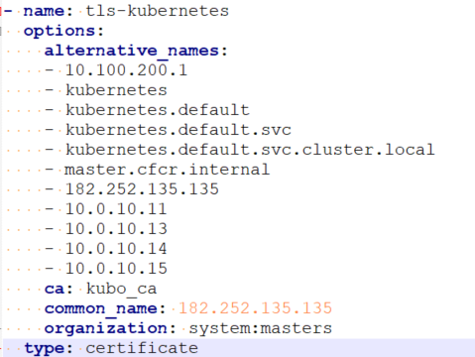
4. Deploying KUBO on Openstack (2/9) - Deploying Kubo (2/6)
If you Use prometheus monitoring like blow
$ vi ~/workspace/kubo-deployment/manifests/cfcr.yml
Before Editing
Master Node Floating IP and
Master/worker Node Internal IP ADD

Slide 16
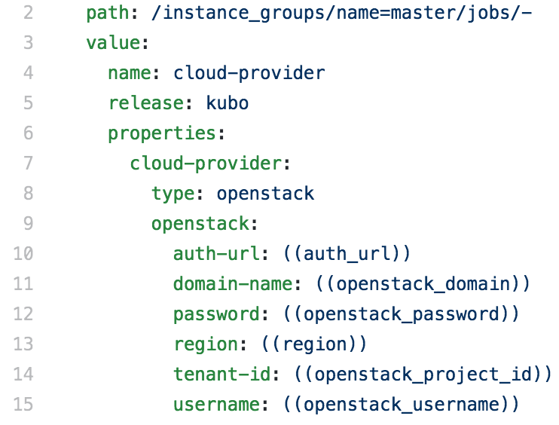
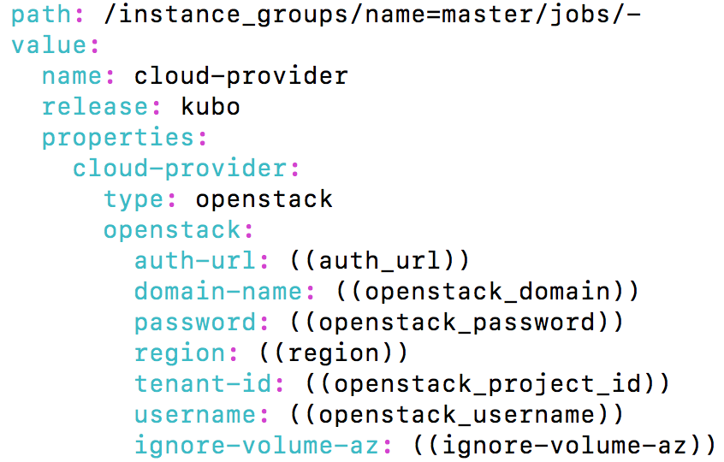
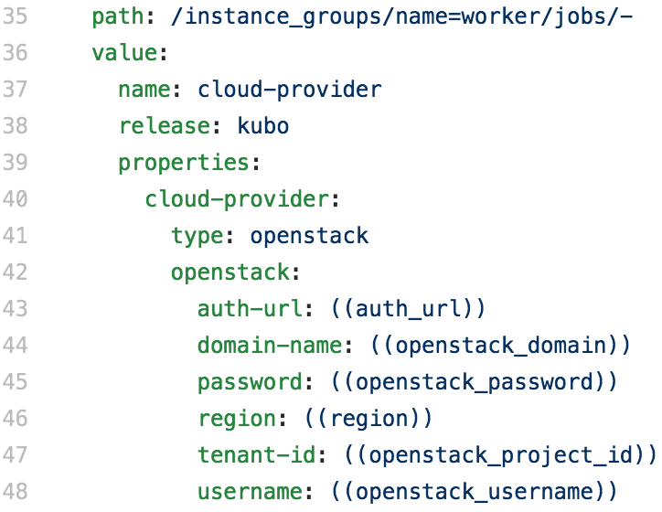
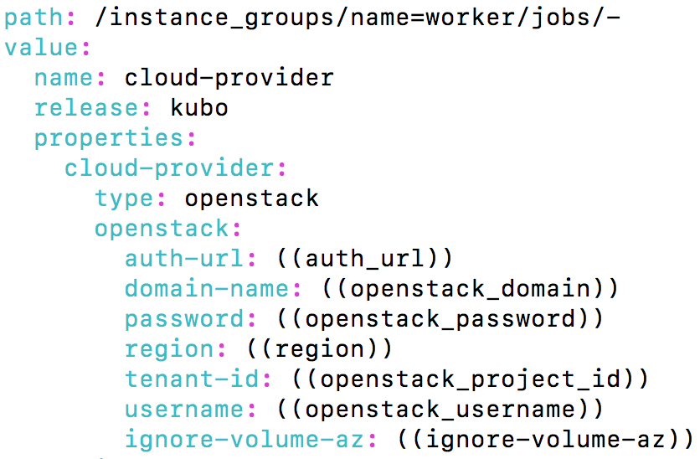
4. Deploying KUBO on Openstack (3/9) - Deploying Kubo (3/6)
Edit kubo-deployment cloud-provider.yml if your openstack compute nodes are in multizone.
$ vi ~/ workspace/kubo-deployment/manifests/ops-files/iaas/openstack/cloud-provider.yml
Before Editing
After Editing
Before Editing
After Editing

Slide 17
3. Deploying KUBO on Openstack (4/9) - Deploying Kubo (4/6)
Create and Save bosh director cloud-config
$ vi ~/workspace/kubo-deployment/manifests/cloud-config.yml
- name: vip
type: vip
vm_types:
- cloud_properties:
instance_type: m1.medium
root_disk_size_gb: 20
name: minimal
- cloud_properties:
instance_type: m1.medium
root_disk_size_gb: 20
name: small
- cloud_properties:
instance_type: m1.large
root_disk_size_gb: 100
name: small-highmem
disk_types:
- name: 5120
disk_size: 5120
- name: 10240
disk_size: 10240
vm_extensions:
- name: kubo
cloud_properties:
security_groups: [bosh]
loadbalancer_pools:
- name: pool1
port: 8443
azs:
- cloud_properties:
availability_zone: nova
name: z1
compilation:
az: z1
network: default
reuse_compilation_vms: true
vm_type: minimal
workers: 4
networks:
- name: default
subnets:
- azs:
- z1
range: 10.0.10.0/24
reserved: [10.0.10.2-10.0.10.10]
static: [10.0.10.11-10.0.10.30]
gateway: 10.0.10.1
cloud_properties:
net_id: bc8559ef-b82d-4f03-b4f5-650e6d84add8
security_groups: [bosh]
dns:
- 10.0.10.1
Openstack LB Setting

Slide 18
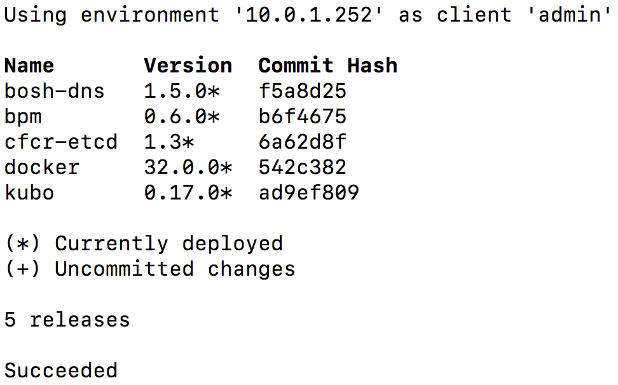
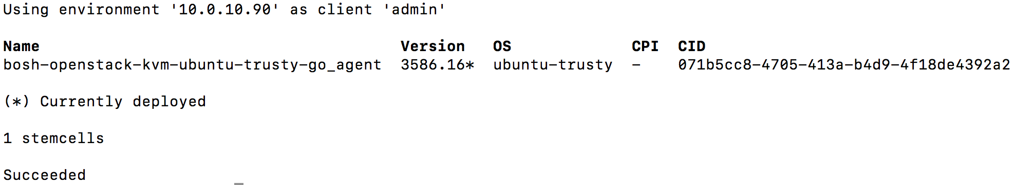
3. Deploying KUBO on Openstack (5/9) - Deploying Kubo (5/6)
Update bosh director cloud-config
$ bosh -e kubo update-cloud-config ~/workspace/kubo-deployment/manifests/cloud-config.yml
Check the desired releases and stemcell to deploy kubo on Openstack bosh
$ bosh -e kubo releases
Output
$ bosh -e kubo stemcells
Output

Slide 19
3. Deploying KUBO on Openstack (6/9) - Deploying Kubo (6/6)
Deploy Kubo on Openstack
$ bosh -e kubo -d cfcr deploy /home/abhisr/workspace/kubo-deployment/manifests/cfcr.yml
-o /home/abhisr/workspace/kubo-deployment/manifests/ops-files/iaas/openstack/cloud-provider.yml \
-v auth_url=http://your-openstack-identity-public-ip:5000/v3 \
-v openstack_domain=default -v openstack_password= Openstack-Tenant-Password \
-v region=RegionOne -v openstack_project_id=07435feff3104e61990545767f7b7471 \
-v openstack_username=Openstack-Tenant-Username -v ignore-volume-az=false
Note: Our openstack compute nodes are in singlezone. So we set “ignore-volume-az=false”.
Note: If You openstack compute nodes are in MultiZone. So we set “ignore-volume-az=true”.
Note: If You use prometheus Monitoring you must use blow option
-o /home/ubuntu/workspace/v0.21.0/kubo-deployment/manifests/ops-files/allow-privileged-containers.yml \
Deploy Kubernetes add-ons
$ bosh -e kubo -d cfcr run-errand apply-specs

Slide 20
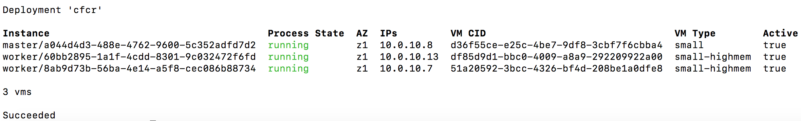
3. Deploying KUBO on Openstack (6/9) - Deploying Kubo (6/6)
Check Kubernetes Deployment
$ bosh -e kubo -d cfcr vms
Output
ssh into master and work vms
$ bosh -e kubo -d cfcr ssh master
$ bosh -e kubo -d cfcr ssh worker/61b51092-6a00-4c74-8c10-e3e6b479487e

Slide 21
3. Deploying KUBO on Openstack (7/9) - Accessing Kubernetes (1/3)
Download tls-kubernetes certificate from credhub
$ bosh -e kubo -d cfcr int <(credhub get -n "/kubo/cfcr/tls-kubernetes" --output-json) --path=/value/ca > ~/workspace/kubo-deployment/kubo/kubernetes.crt
Download kubo-admin-password password from credhub
$ bosh -e kubo -d cfcr int <(credhub get -n "/kubo/cfcr/kubo-admin-password" --output-json) --path=/value > ~/workspace/kubo-deployment/kubo/kubernetes_pwd.crt
Configure Kubernetes Cluster by using above Certificate (kubernetes.crt)
$ kubectl config set-cluster "dev" --server https://you-lb-floating-ip:8443 --embed-certs=true --certificate-authority=~/workspace/kubo-deployment/kubo/kubernetes.crt
Configure Kubernetes User and Context (Note: Use Kubernets User Password from above kubernetes_pwd.crt)
$ kubectl config set-credentials "dev" --token=your-kubernetes_pwd.crt-password
$ kubectl config set-context "dev" --cluster="dev" --user="dev
$ kubectl config use-context "dev"

Slide 22
3. Deploying KUBO on Openstack (8/9) - Accessing Kubernetes (2/3)
Obtain kubernetes node Information
$ kubectl get node -o wide
Output
Obtain kubernetes Cluster Information
$ kubectl cluster-info
Output
Get all information regarding your Namespace
$ kubectl get pods --namespace=kube-system
$ kubectl get all -n kube-system
Check 8001 port is active on your notebook, if active kill the process
$ sudo lsof -PiTCP -sTCP:LISTEN
$ sudo kill -9 your-pid-number
Accessing to Kubernetes Dashboard
$ kubectl proxy
Starting to serve on 127.0.0.1:8001
$ http://localhost:8001/api/v1/namespaces/kube-system/services/https:kubernetes-dashboard:/proxy/#!/login

Slide 23
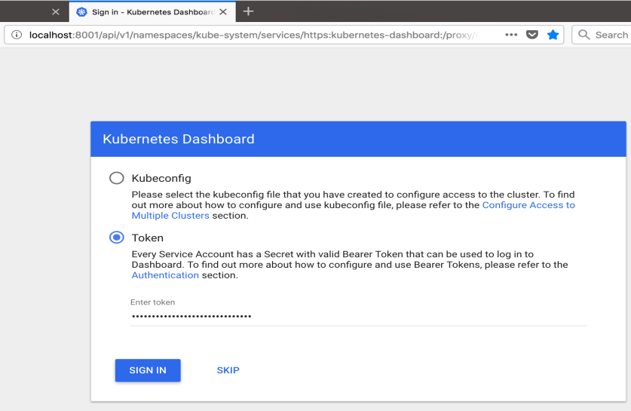
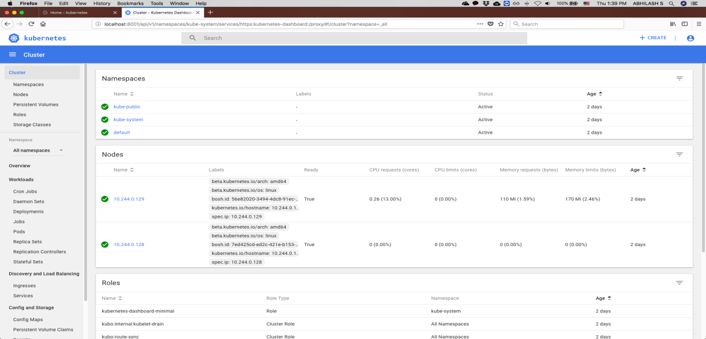
3. Deploying KUBO on Openstack (9/9) - Accessing Kubernetes (3/3)
Accessing Kubernetes Dashboard in your Browser
Select token option and paste above kubernetes_pwd.crt password to login into your kubernets cluster
Output
Kubernetes Home Dashboard
Output

Slide 24
4. KUBO Deployment Architecture on Openstack - Deployment Architecture
1
Openstack Console Services,
Manual Setting
7
5
Login Openstack Tenant
2
Inception
3
Micro
Bosh VM
Create Private Network & Subnet
Attach Private Subnet Interface to Router
4
Master Node VM
6
Worker Node VMs
Create and Configure Security Groups
Private Subnet
Create Keypair
Create two Floating IPs
Public Internet Access, Using
Router
Create LB and Associate Floating IP
Create Inception

Slide 25
THANK YOU

