Slide 1
Charting New Heights: Perspective on Aircraft Investment & Risk Mitigation
Jacob Ambert
Juvenson Edouard
Katie Pegg

Slide 2
Summary
Our project assessed risks associated with expanding into aviation. We identified low-risk aircraft based on safety records. These findings offer actionable insights for the head of the business division to guide aircraft purchases, ensuring a strategic and secure market entry.

Slide 3
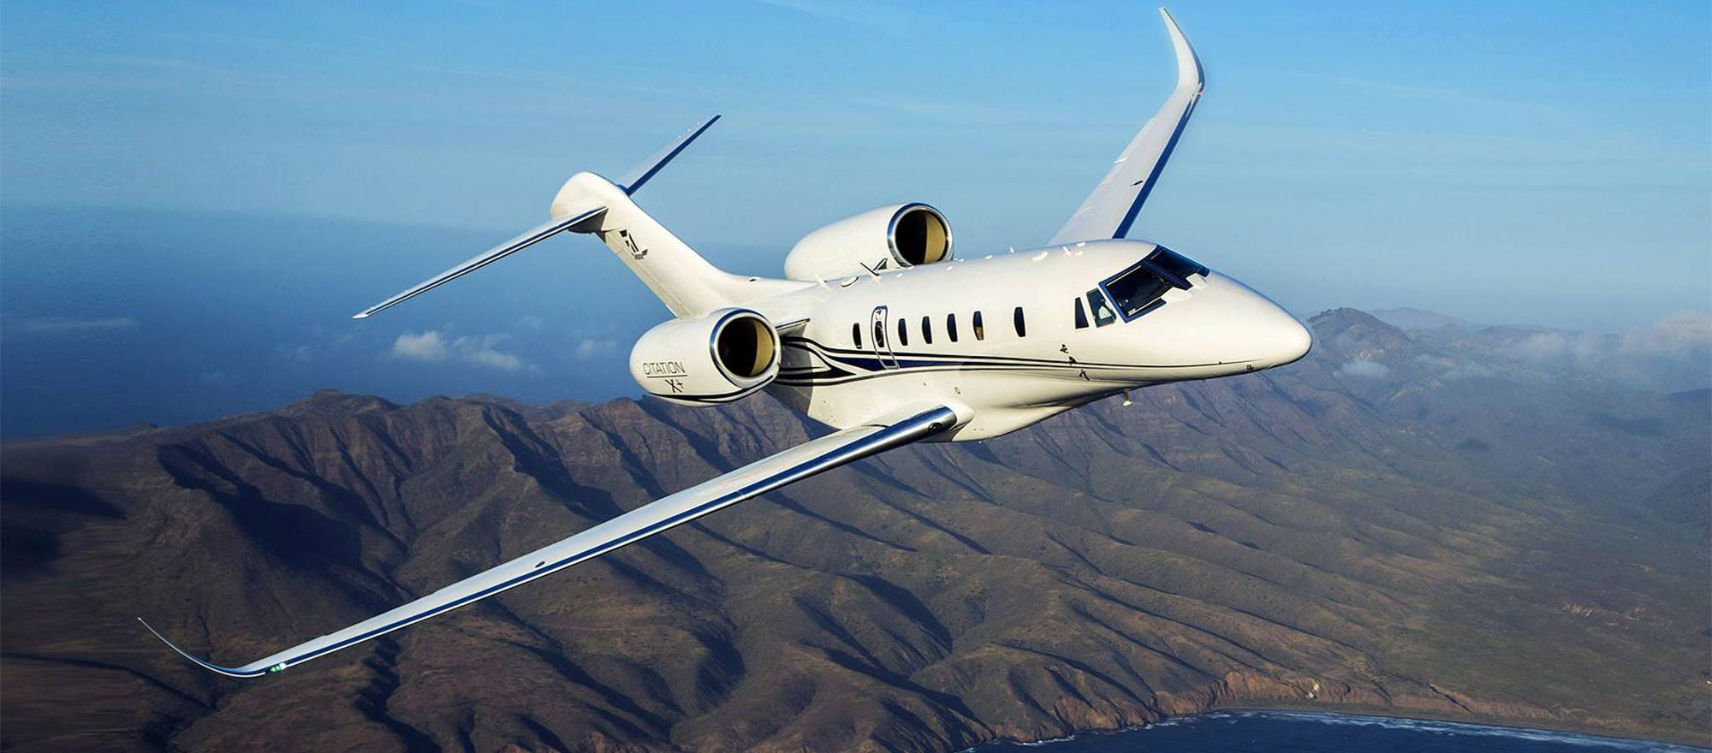
Outline
Business Problem
Data & Methods
Results
Conclusions
https://bjtonline.com/aircraft/cessna-citation-x-0

Slide 4
Business Problem
Diversify their portfolio & expand in to private and commercial aviation
Invest in lowest risk aircraft
Translate research findings into actionable insights

Slide 5
Data & Methods
Analyzed aircraft accident data from NTSB (1962-2022)
Selected top 10 major companies
Identified high risk flight phases for added safety implementation

Slide 6
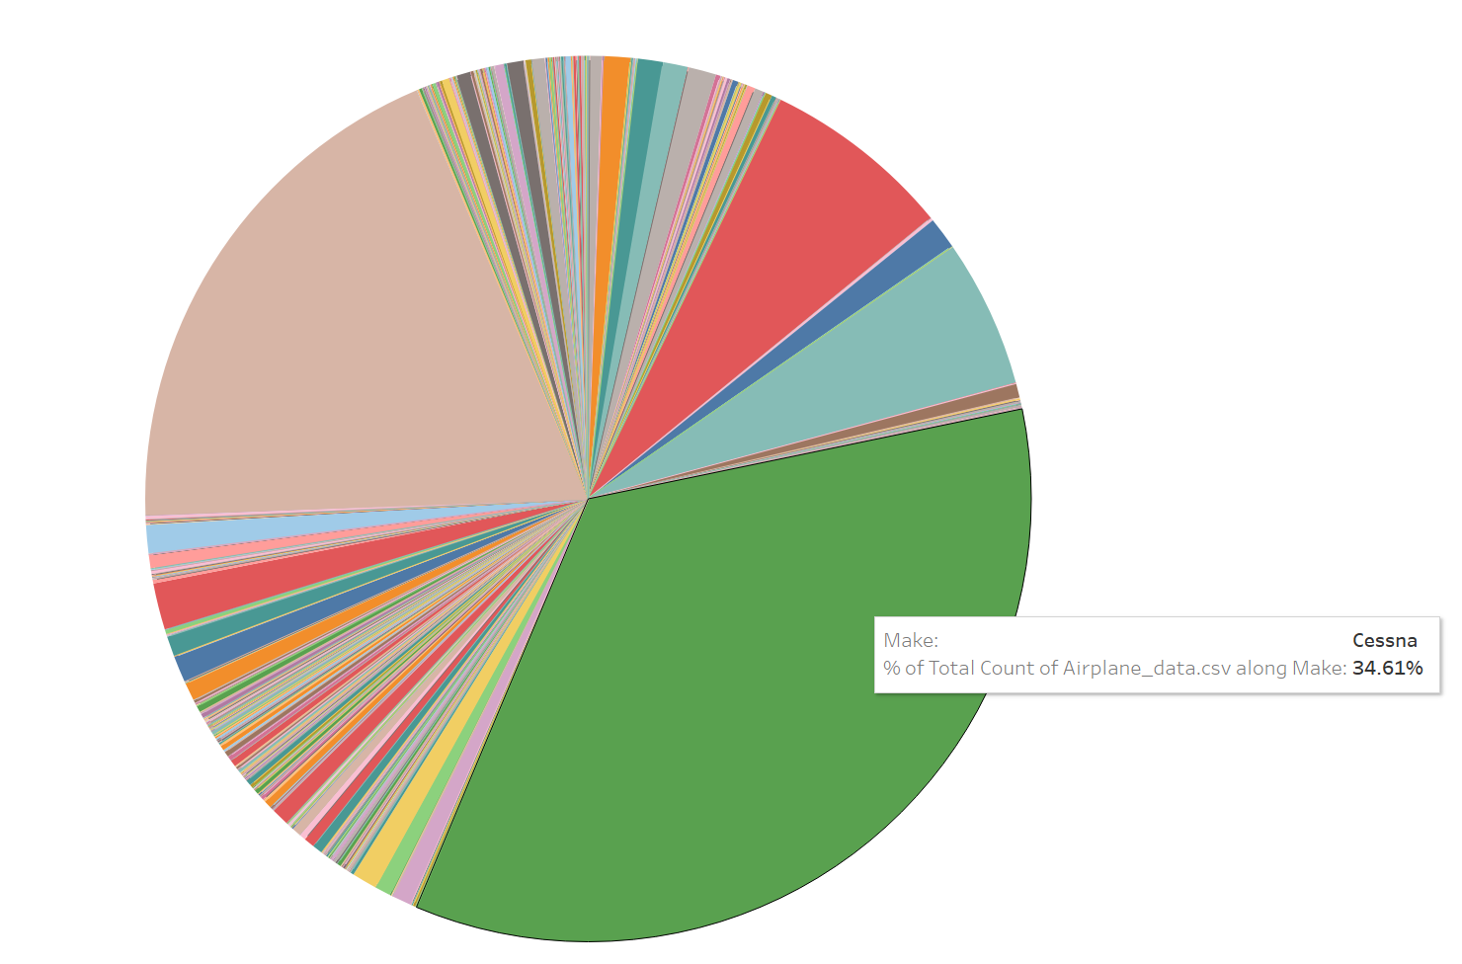
Results
All the results here.

Slide 7
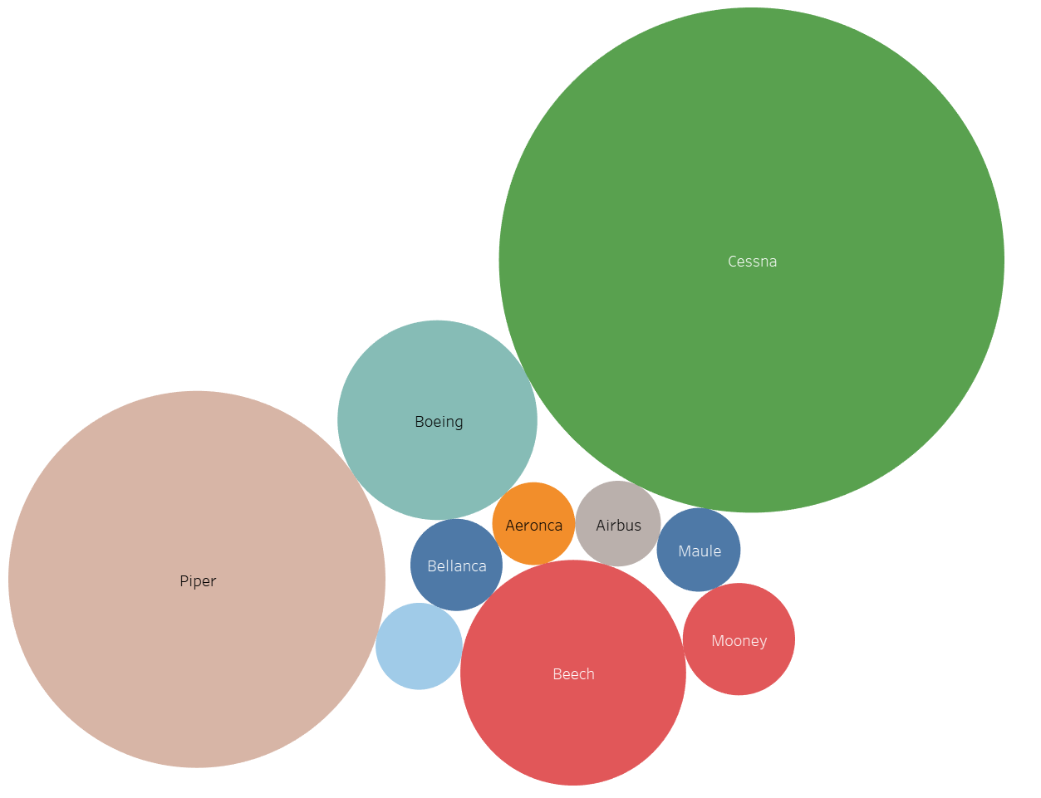
Actual Results ☺
Uninjured vs. Accidents per Make
Cessna – 47%
Piper – 26%
Boeing – 8%

Slide 8
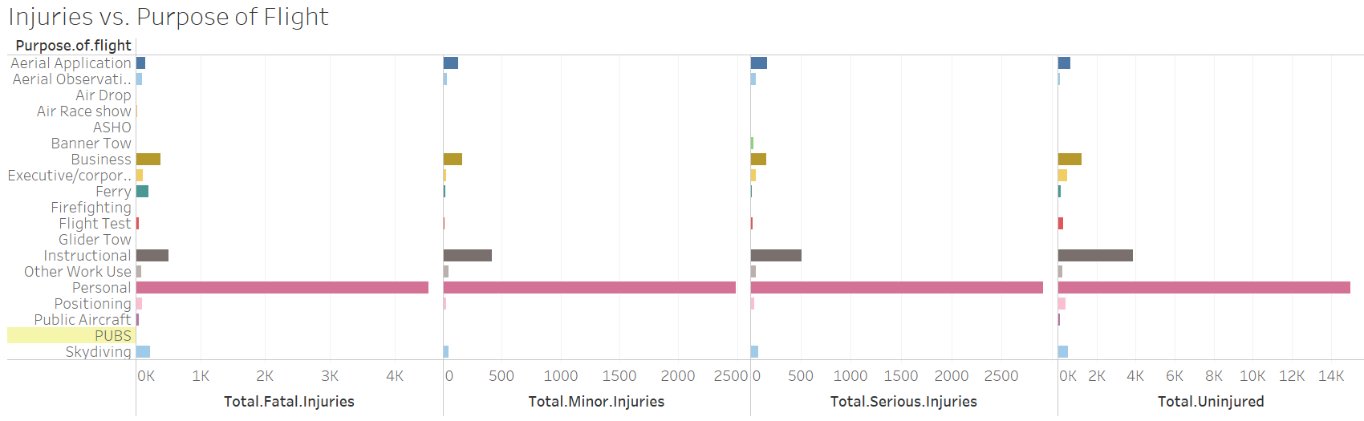
Results
Personal flights have highest injury rates
And also highest uninjured

Slide 9
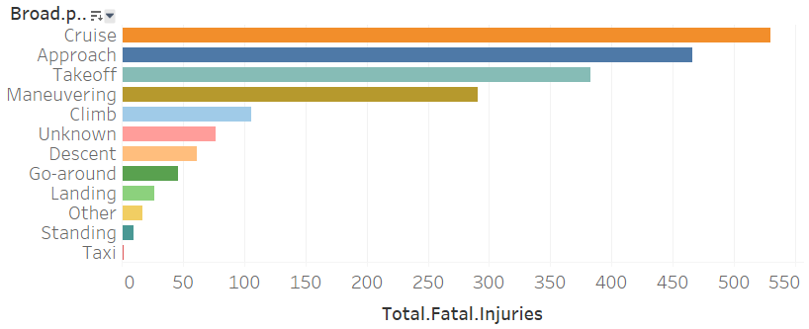
More Results
Injuries vs. Phase
Cruise, Approach, & Takeoff have highest injury rate
Gives insight on additional training & safety measures at high risk points of the flight

Slide 10

Conclusions
For smaller airplanes, invest in Cessna or Piper
Larger airplanes, go with Boeing
Focus on extra safety measures during cruise, approach, & takeoff

Slide 11
Next Steps
ROI
Risk Mitigation
Further Analysis
Find ROI for smaller & larger airplanes for our company’s entrance into the market
Develop extra training programs at high-risk flight phase points
Analyze cost of repairs for planes involved in accidents
Analyze occurrence of accidents due to pilot error
Investigate airplanes equipped with fail-safes to correct for pilot error

Slide 12
THANK YOU
Jacob Ambert (jaambert@gmail.com)
Juvenson Edouard (juvensonedouard@gmail.com)
Katie Pegg (kpegg916@gmail.com)

