Slide 1
Charting New Heights: Perspective on Aircraft Investment & Risk Mitigation
Jacob Ambert
Juvenson Edouard
Katie Pegg

Slide 2
Summary
Our project assessed risks associated with expanding into aviation. We identified low-risk aircraft based on safety records. These findings offer actionable insights for the head of the business division to guide aircraft purchases, ensuring a strategic and secure market entry.

Slide 3
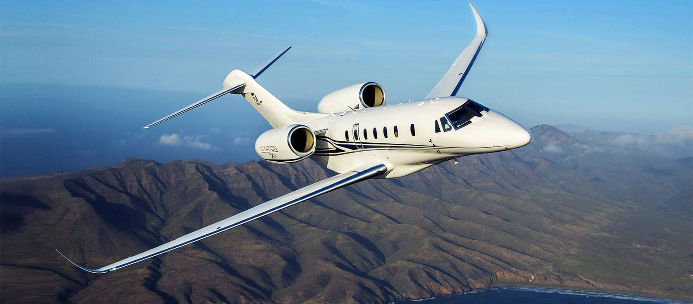
Outline
Business Problem
Data & Methods
Results
Conclusions
https://bjtonline.com/aircraft/cessna-citation-x-0

Slide 4
Business Problem
Diversify their portfolio & expand in to private and commercial aviation
Invest in the lowest risk aircraft
Translate research findings into actionable insights

Slide 5
Data & Methods
Analyzed aircraft accident data from NTSB (1962-2022)
Top 10 companies
Identified high risk flight phases for added safety implementation

Slide 6
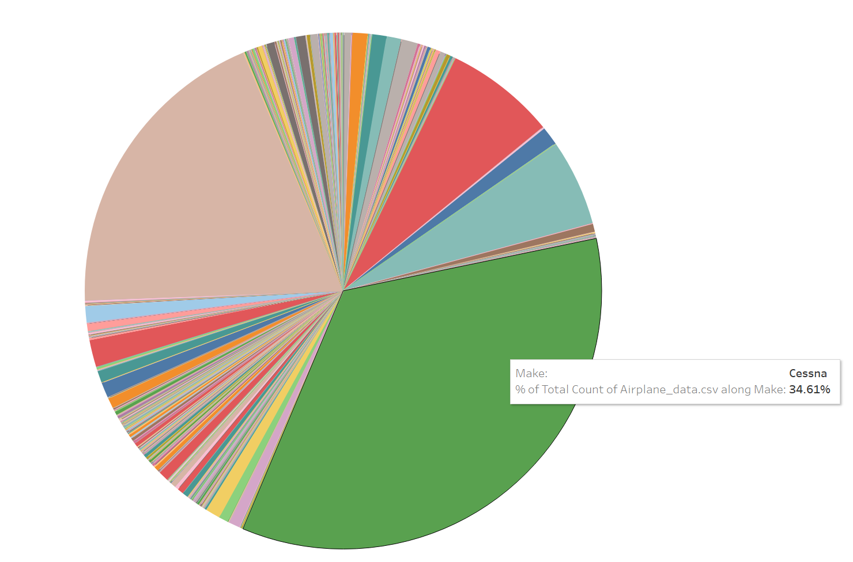
Results
All the results here.

Slide 7
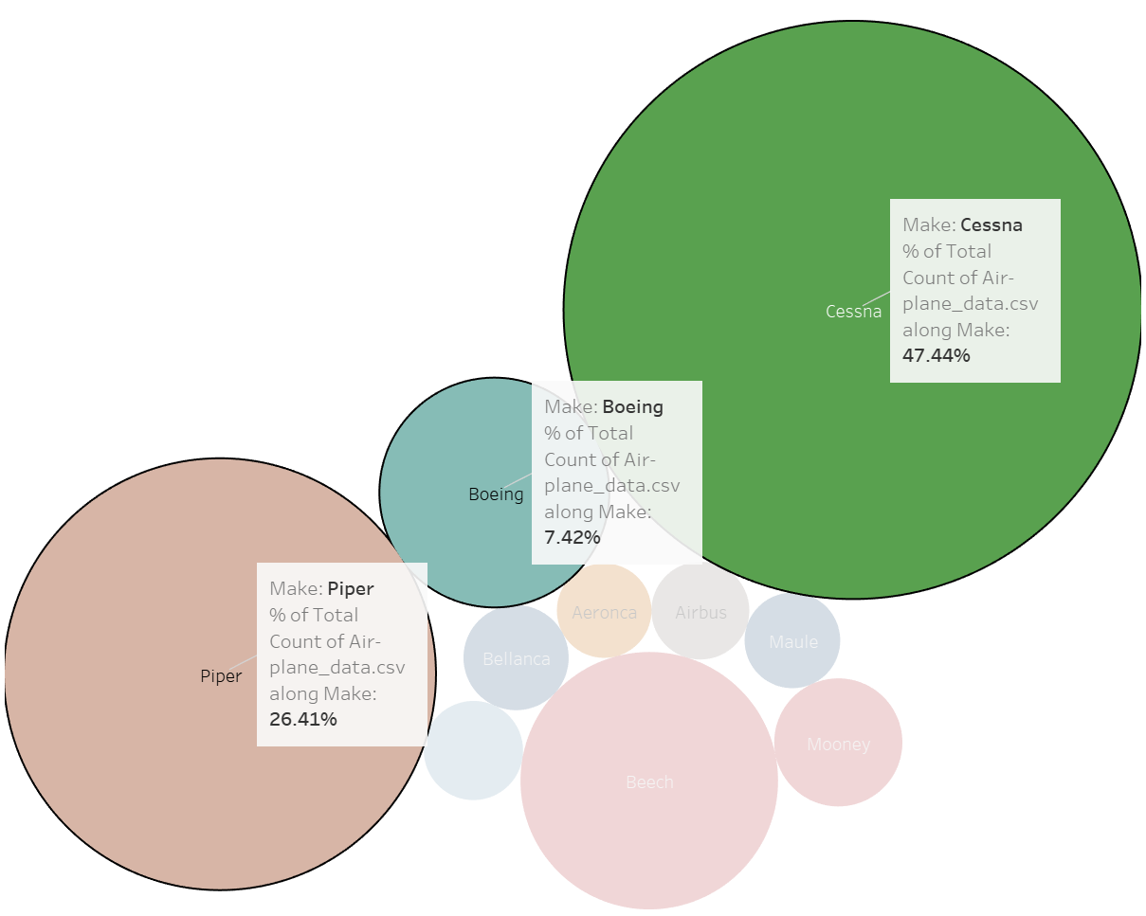
Accidents vs. Uninjured per Make

Slide 8
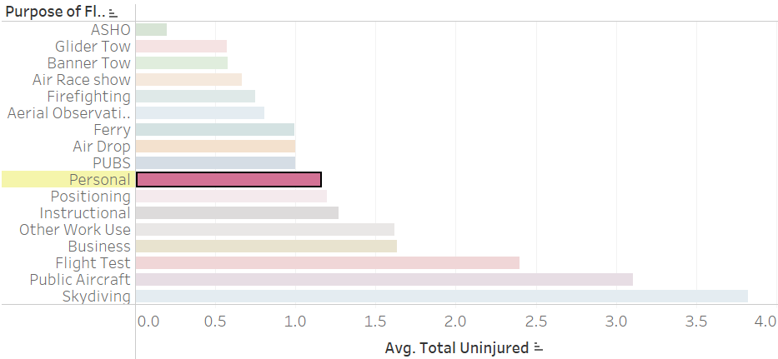
Purpose of flight vs. Average Uninjured
Personal flights have a relatively low average of uninjured passengers when involved in an accident

Slide 9
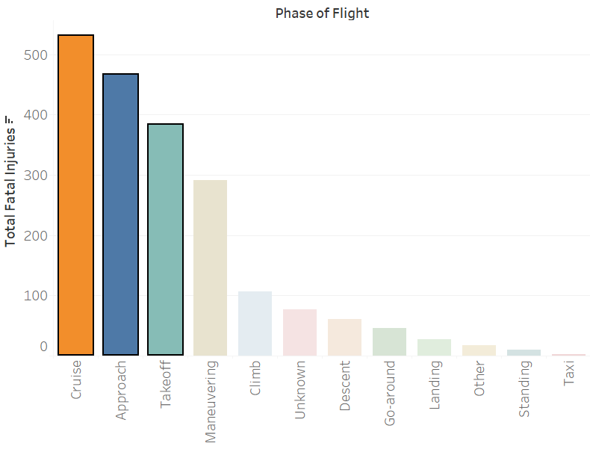
Fatalities vs. Phase of Flight
Cruise, Approach, & Takeoff have highest injury rate
Insight on additional training & safety measures at high-risk points of the flight

Slide 10

Conclusions
For smaller airplanes, invest in Cessna or Piper
For larger airplanes, invest in Boeing
Focus on extra safety measures during cruise, approach, & takeoff

Slide 11
Next Steps
ROI
Risk Mitigation
Further Analysis
Find ROI comparing smaller & larger airplanes for our company’s entrance into the market
Develop extra training programs at high-risk flight phase points
Cost of repair or replacement
Occurrence of accidents & why
Investigate airplanes equipped with extra safety features

Slide 12
THANK YOU
Jacob Ambert (jaambert@gmail.com)
Juvenson Edouard (juvensonedouard@gmail.com)
Katie Pegg (kpegg916@gmail.com)

