Slide 1
Charting New Heights: Perspective on Aircraft Investment & Risk Mitigation
Jacob Ambert
Juvenson Edouard
Katie Pegg

Slide 2
Summary
Our project assessed risks associated with expanding into aviation. We identified low-risk aircraft based on safety records. These findings offer actionable insights for the head of the business division to guide aircraft purchases, ensuring a strategic and secure market entry.

Slide 3
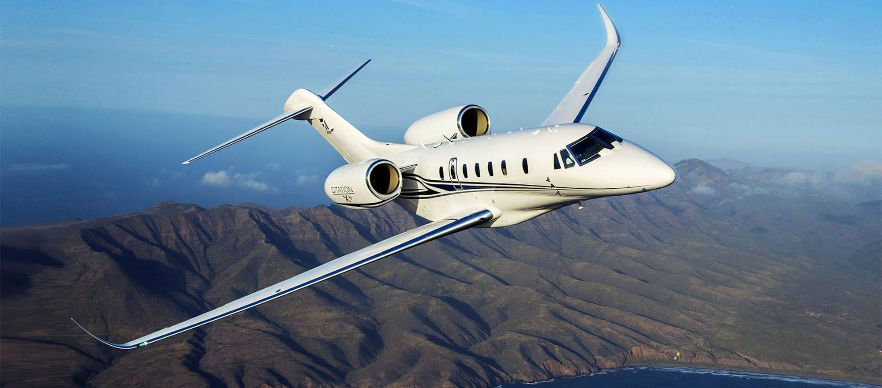
Outline
Business Problem
Data & Methods
Results
Conclusions
https://bjtonline.com/aircraft/cessna-citation-x-0

Slide 4
Business Problem
Diversify their portfolio & expand in to private and commercial aviation
Invest in the lowest risk aircraft
Translate research findings into actionable insights

Slide 5
Data & Methods
Analyzed aircraft accident data from NTSB (1962-2022)
Selected top 10 major companies
Identified high risk flight phases for added safety implementation

Slide 6
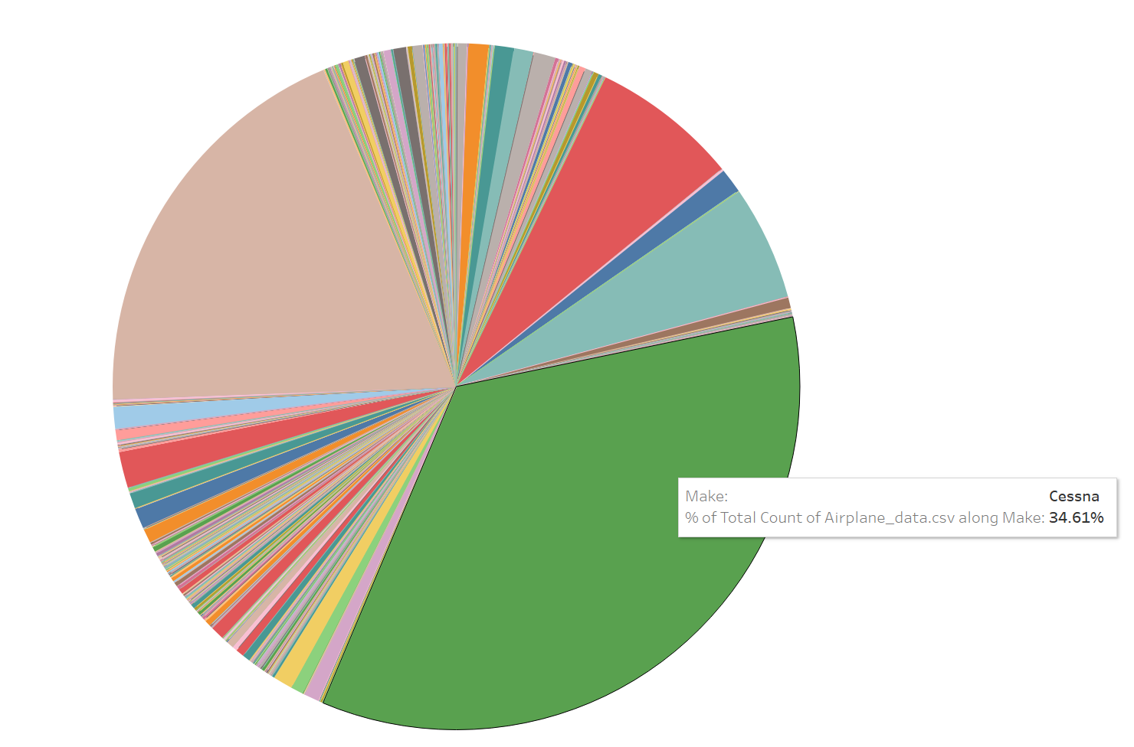
Results
All the results here.

Slide 7
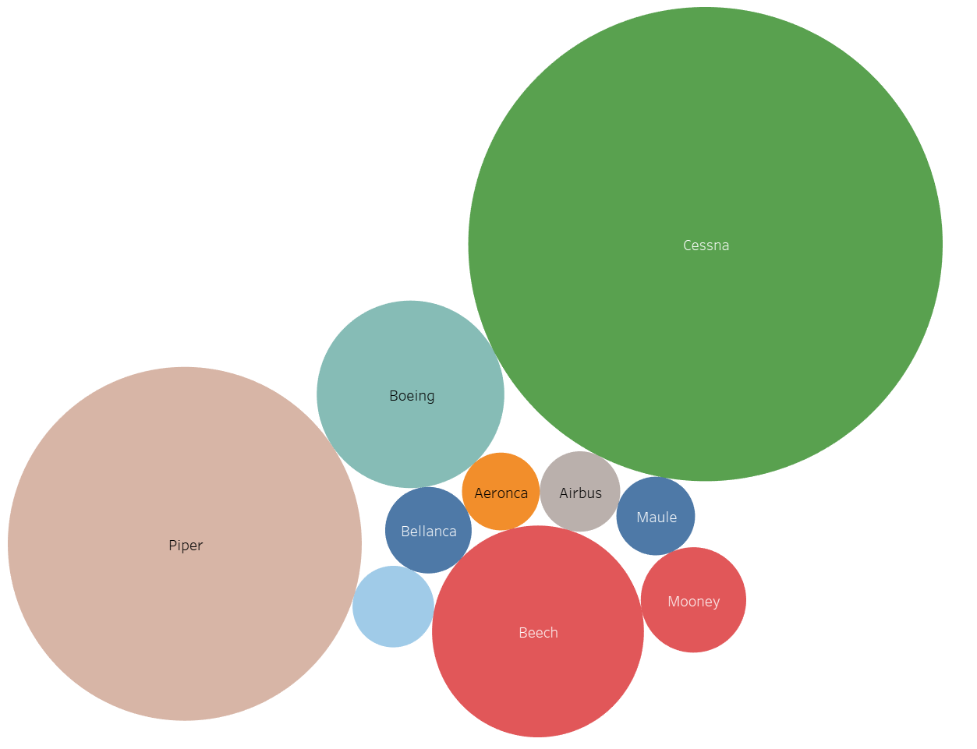
Actual Results ☺
Uninjured vs. Accidents per Make
Cessna – 47%
Piper – 26%
Boeing – 8%

Slide 8
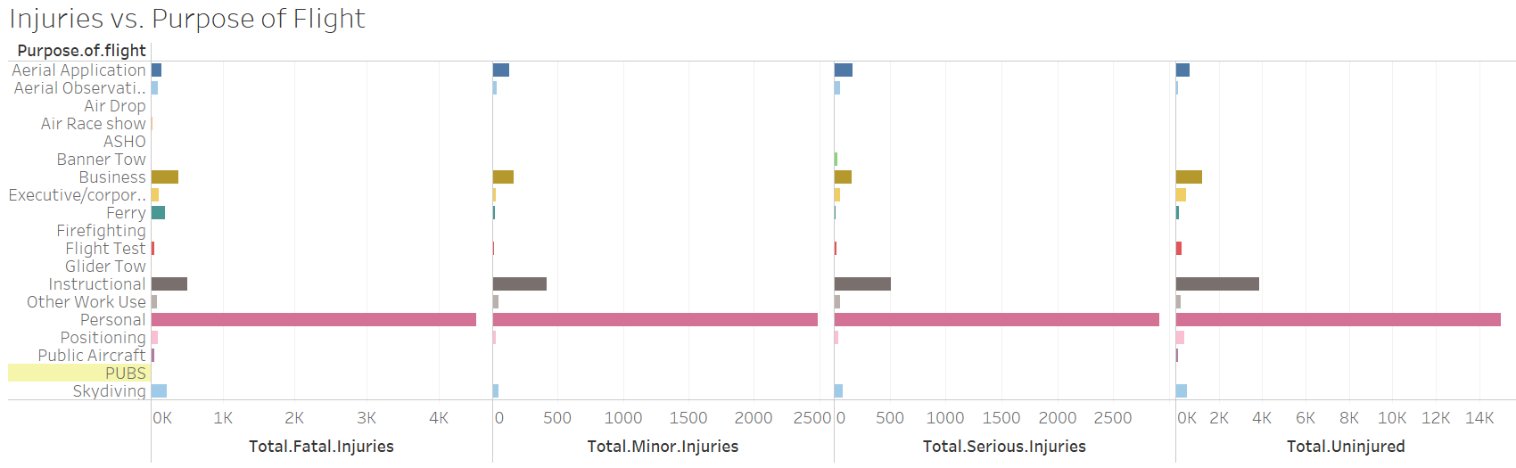
Results
Personal flights have highest uninjured when involved in an accident

Slide 9
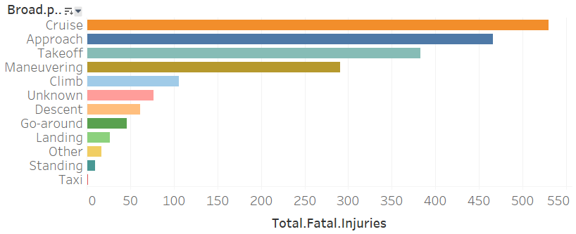
More Results
Fatalities vs. Phase of Flight
Cruise, Approach, & Takeoff have highest injury rate
Gives insight on additional training & safety measures at high-risk points of the flight

Slide 10

Conclusions
For smaller airplanes, invest in Cessna or Piper
Larger airplanes, go with Boeing
Focus on extra safety measures during cruise, approach, & takeoff

Slide 11
Next Steps
ROI
Risk Mitigation
Further Analysis
Find ROI for smaller & larger airplanes for our company’s entrance into the market
Develop extra training programs at high-risk flight phase points
Analyze cost of repairs for planes involved in accidents
Analyze occurrence of accidents due to pilot error
Investigate airplanes equipped with fail-safes to correct for pilot error

Slide 12
THANK YOU
Jacob Ambert (jaambert@gmail.com)
Juvenson Edouard (juvensonedouard@gmail.com)
Katie Pegg (kpegg916@gmail.com)

