Slide 1

SURAKSHA
AN INTELLIGENT VULNERABILITY SCANNER
Name : K PRANAV ESWAR
Reg No. : LMC25MCA-2034
Dept : S3 MCA
GUIDE : Ms BISMI K CHARLEYS

Slide 2

INTRODUCTION
A WEB-BASED CYBERSECURITY VULNERABILITY ASSESSMENT PLATFORM.
It combines different security checks in a single system:
  Web Vulnerability Scanning
  Network Reconnaissance
  SSL/TLS Security Analysis
  Protocol Analysis
  CVE Mapping
  ML-Based Risk Prediction
TRUST
Flow in simple words:
Detect → Analyse → Assess → Report
01

Slide 3
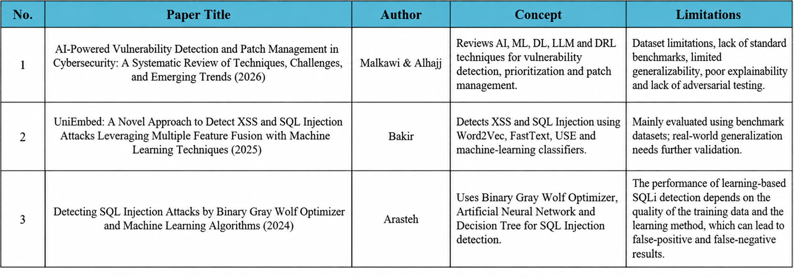
LITERATURE SURVEY
02

Slide 4
PROBLEM STATEMENT
  Requires multiple specialized tools for cybersecurity assessment.
  Raw technical outputs - difficult for non-experts to understand.
  Vulnerability detection - not indicate risk or priority.
  Security findings - fragmented across different assessment areas.
RESEARCH GAP/STUDY
  Existing research - focuses on individual security assessment techniques - often developed independently.
  An integrated platform combining multiple security analyses with ML-based risk prediction - is needed.
OBJECTIVES
  Develop the integrated cybersecurity platform SURAKSHA.
  Perform web vulnerability scanning and network reconnaissance.
  Analyze SSL/TLS security and network protocols.
  Map vulnerabilities to relevant CVE records.
  Predict security risk levels using machine learning.
  Provide centralized, risk-based security findings.
03

Slide 5
PROPOSED SYSTEM
SURAKSHA is an integrated cybersecurity assessment platform that combines multiple security analysis techniques with Ml-based risk prediction.
System includes :
  Performs web vulnerability scanning for SQL Injection, XSS, security headers and sensitive paths.
  Performs network reconnaissance using Nmap for ports, services and versions.
  Checks SSL/TLS configuration and certificate details.
  Performs protocol and service analysis.
  Maps detected services and vulnerabilities to CVE information.
  Uses Machine Learning to support risk prediction.
  Stores scan results and vulnerabilities in a centralized SQLite database.
  Generates reports with severity, risk, evidence and recommendations.
04

Slide 6
TECHNOLOGY STACK
Frontend : HTML · CSS · JavaScript · Bootstrap
Backend : Python · Flask
Database : SQLite3
Machine Learning : Scikit-learn · Joblib · Random Forest
Security Tools : Nmap · Python-Nmap · Requests
05

Slide 7
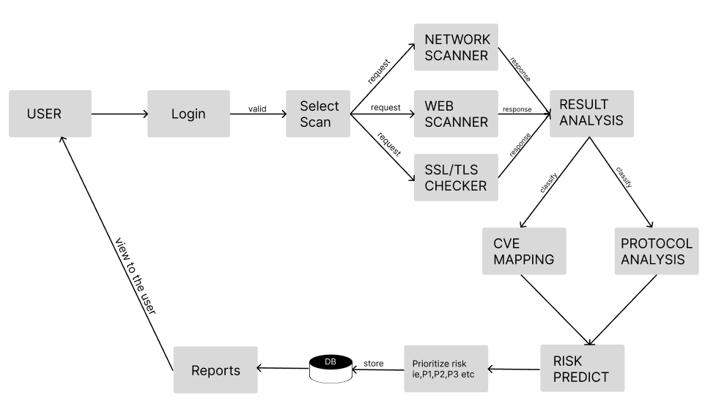
USER - ARCHITECTURAL FLOW
06

Slide 8
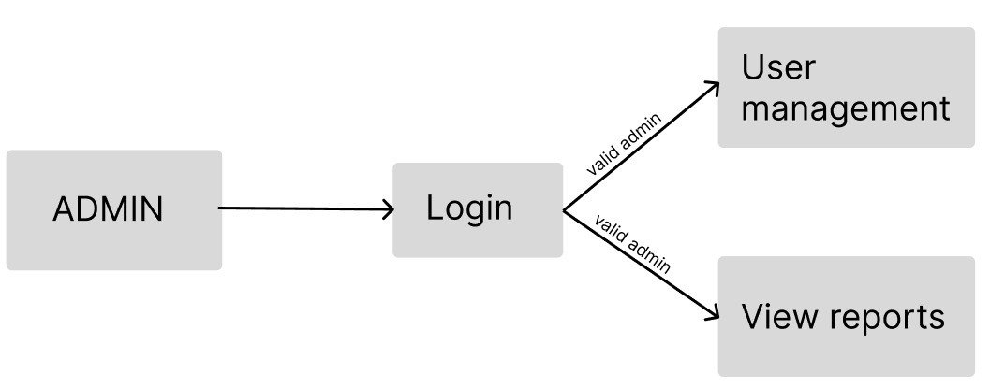
ADMIN - ARCHITECTURAL FLOW
07

Slide 9
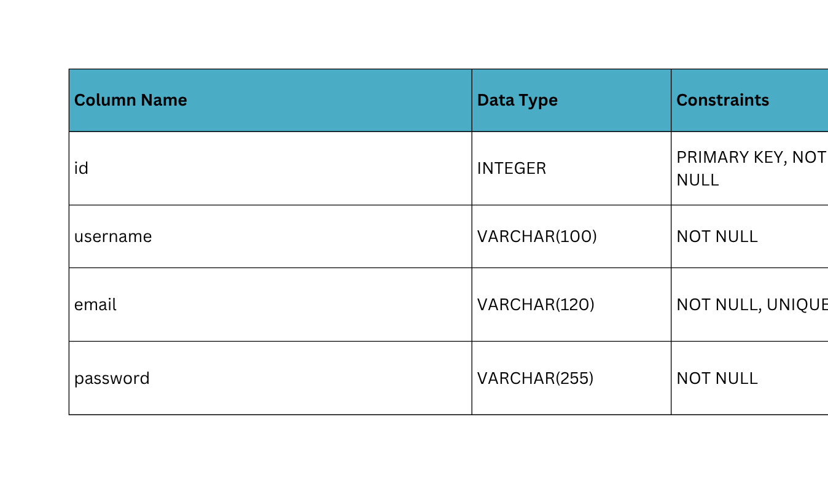
DATABASE DESCRIPTION
Schema : scanner.db
Tables : user,scan,vulnerability
User table
08

Slide 10
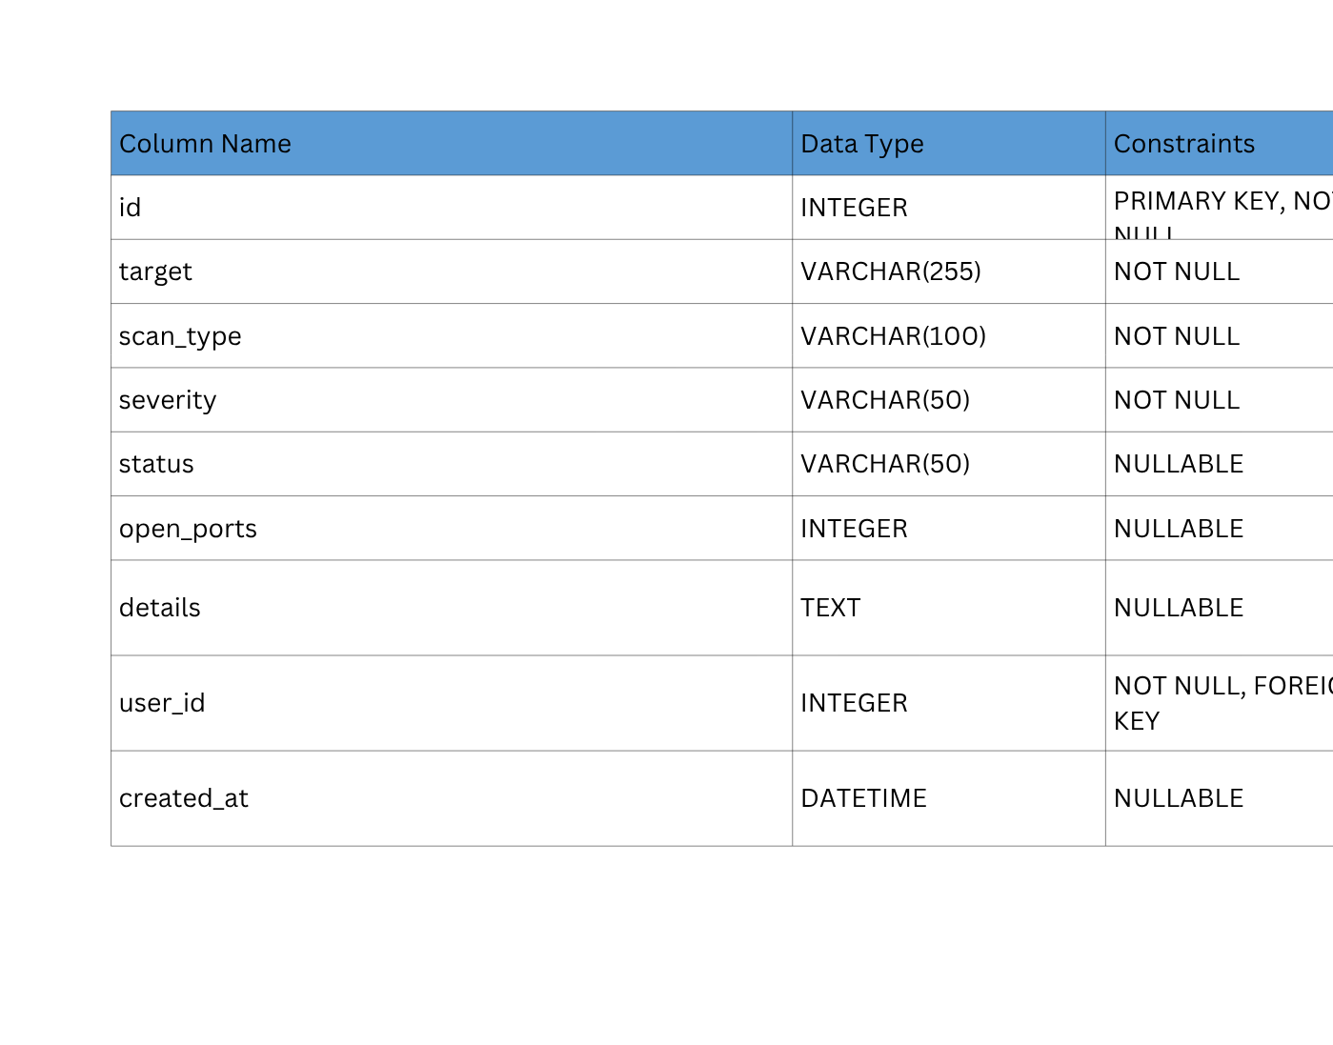
scans table
09

Slide 11
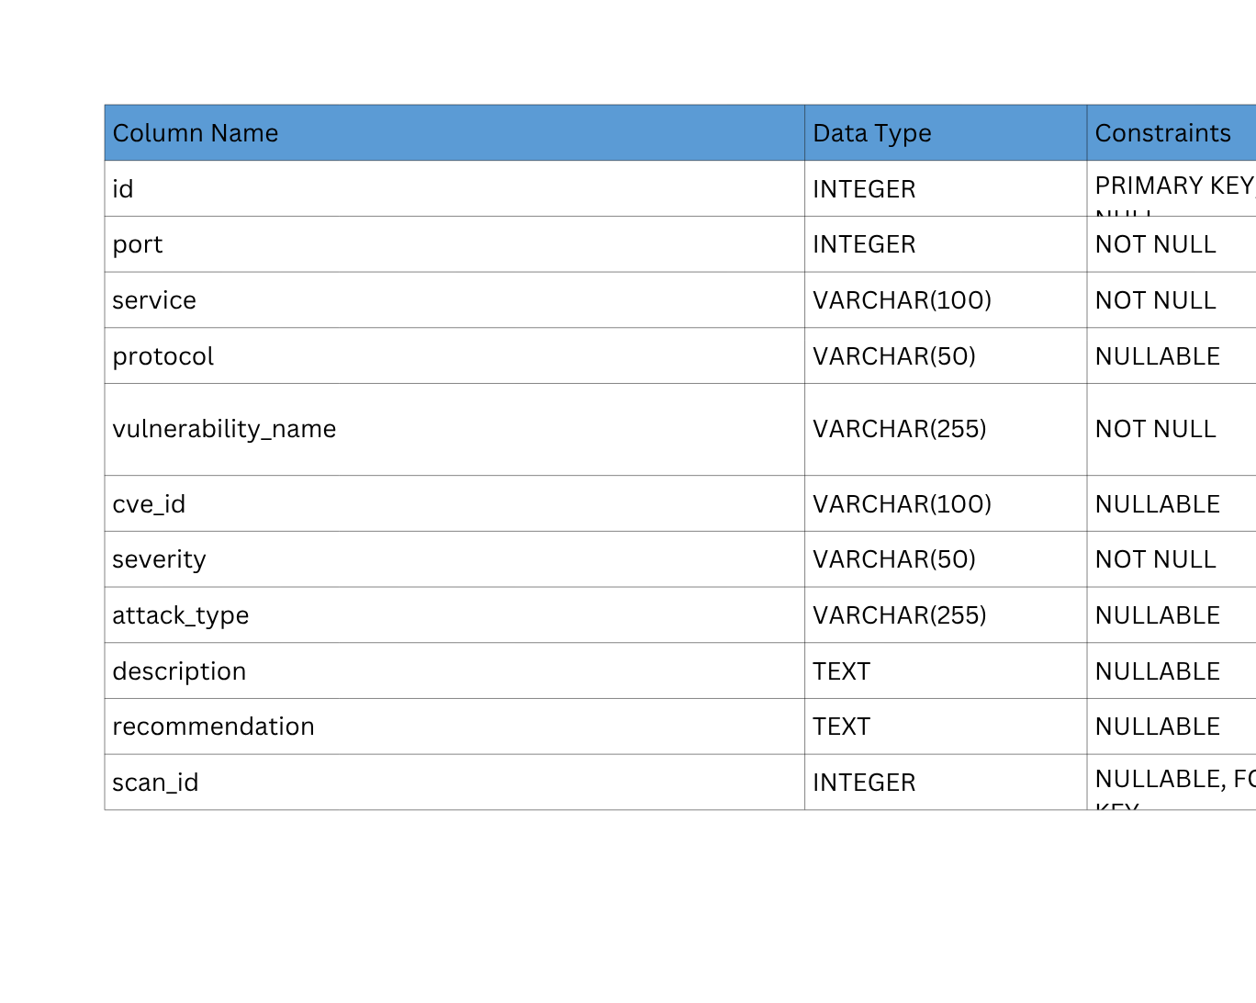
vulnerability table
10

Slide 12

MODULE DESCRIPTION
User Management
Handle reports
Admin
11

Slide 13
Network Reconnaissance
Web Vulnerability Scanning
SSL/TLS Security Analysis
Protocol Analysis
& CVE Mapping
View reports
USER
Access Remediation Recommendations
12

Slide 14
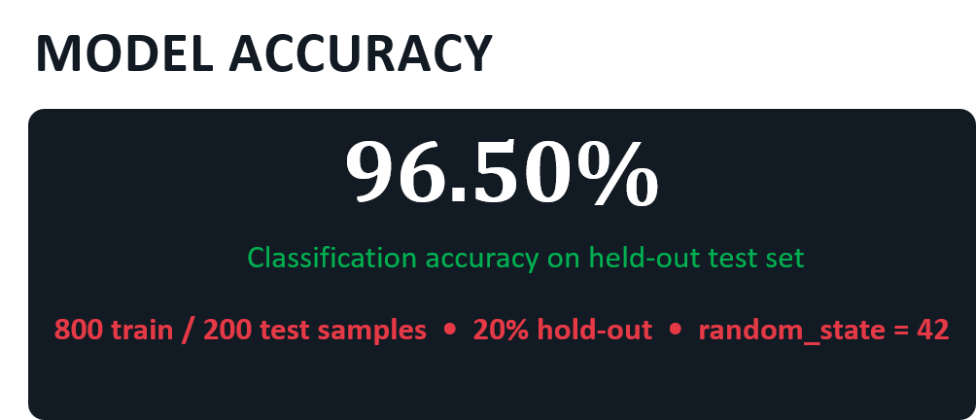
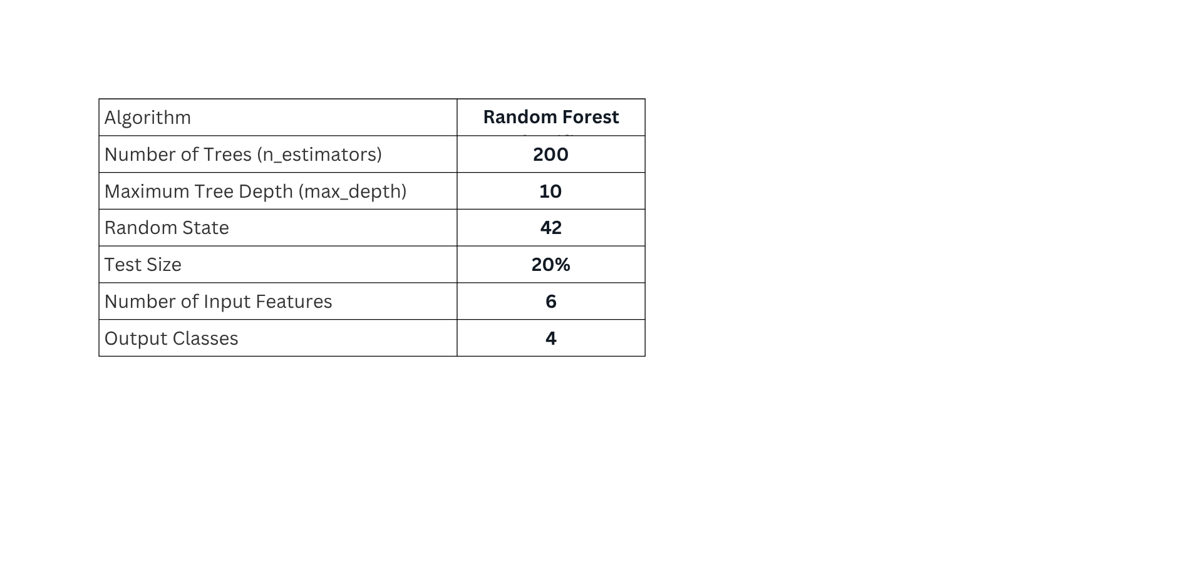
RISK PREDICTION MODULE
ALGORITHM & CONFIGURATION
Model Accuracy
TRAINING DATASET
low
medium
high
critical
13

Slide 15
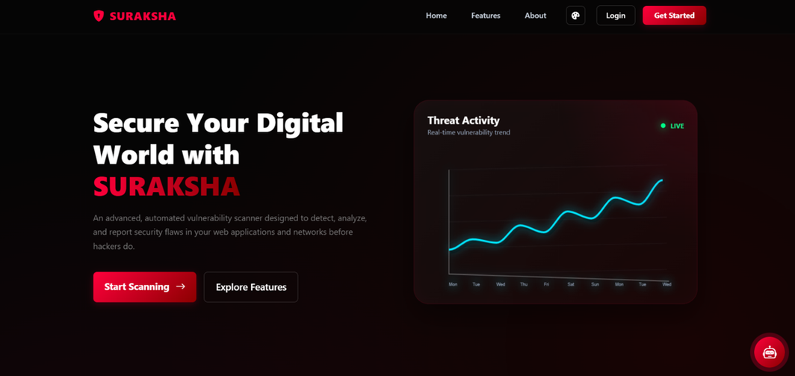
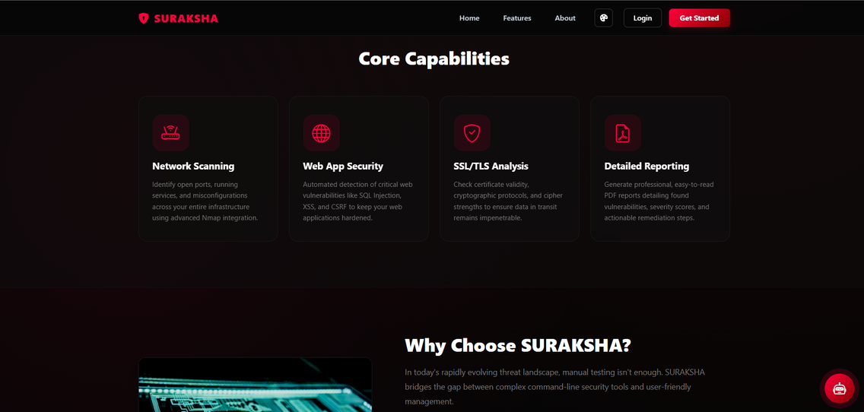
SCREENSHOTS
fig. home page
fig. features page
14

Slide 16
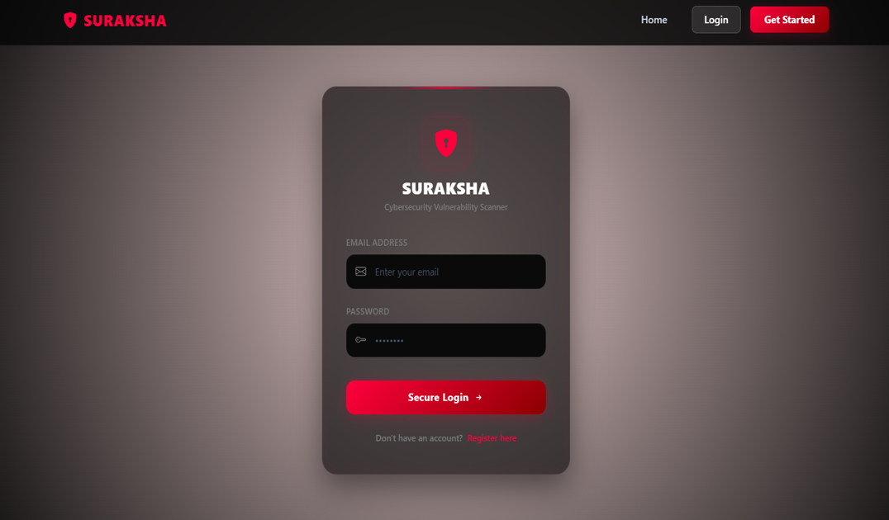
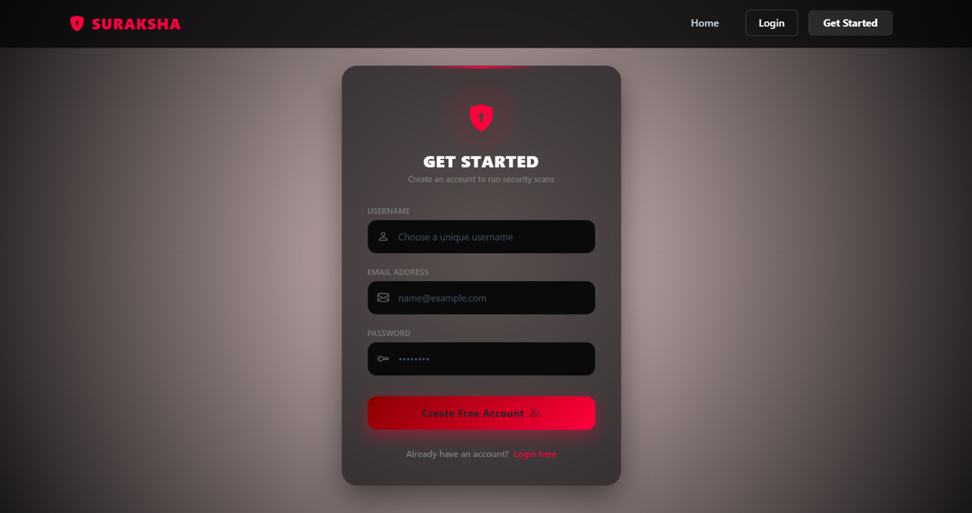
fig. login page
fig. register page
15

Slide 17
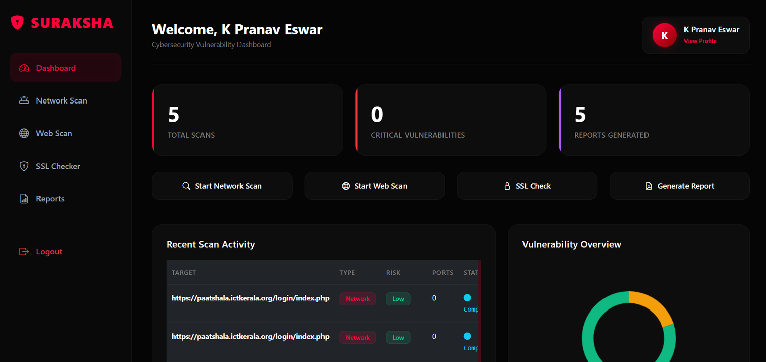
fig. dashboard page
16

Slide 18
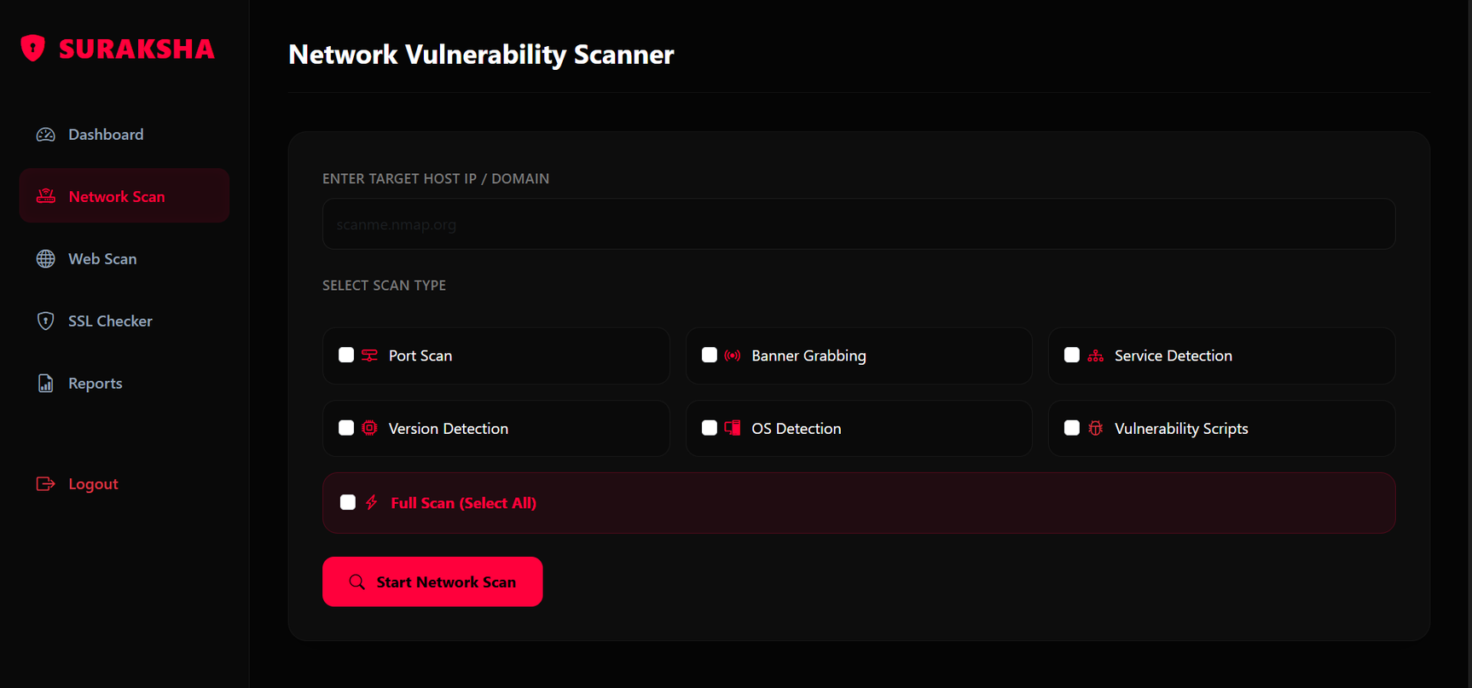
fig. network scanner page
17

Slide 19
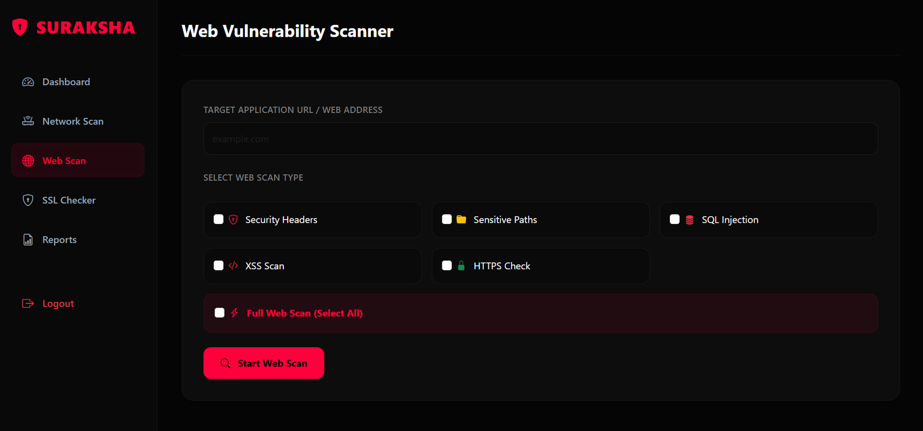
fig. web scanner page
18

Slide 20
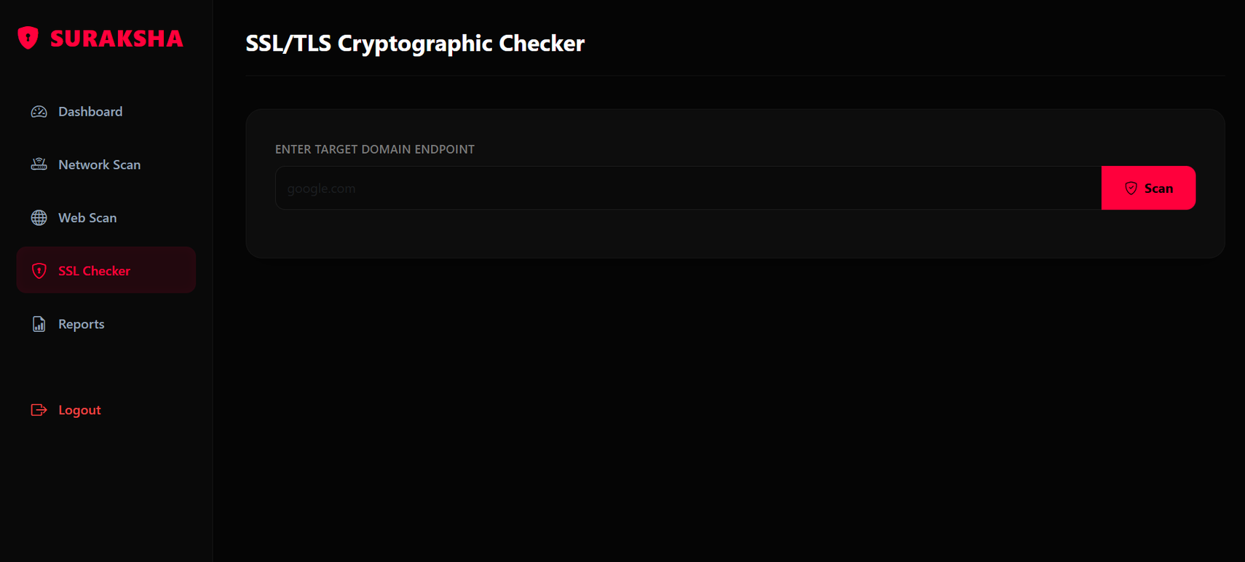
fig. SSL / TLS checker page
19

Slide 21
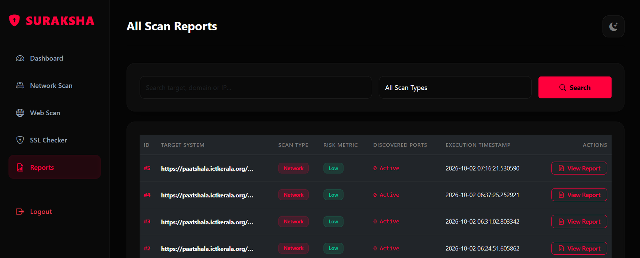
fig. reports page
20

Slide 22
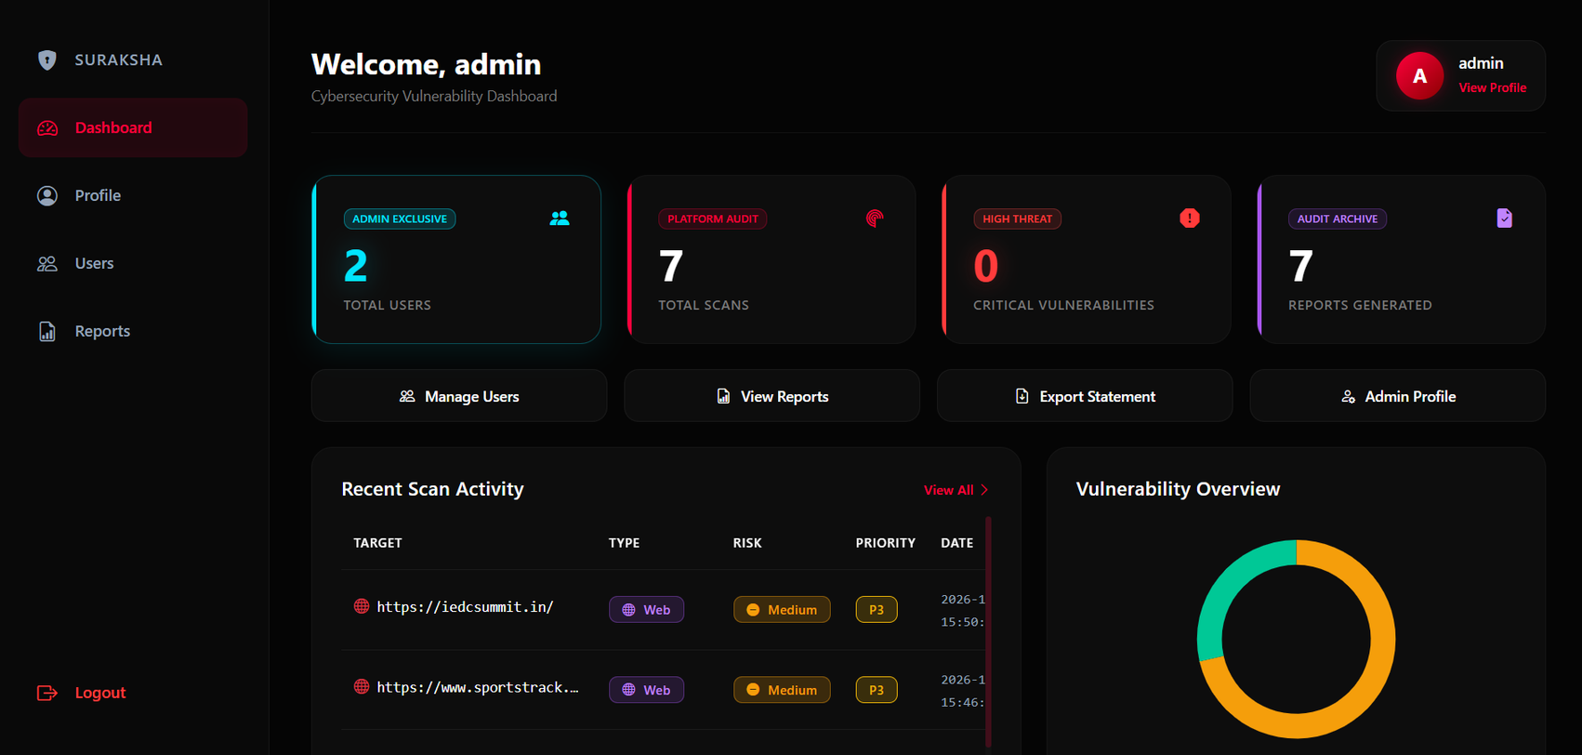
fig. admin dashboard
21

Slide 23
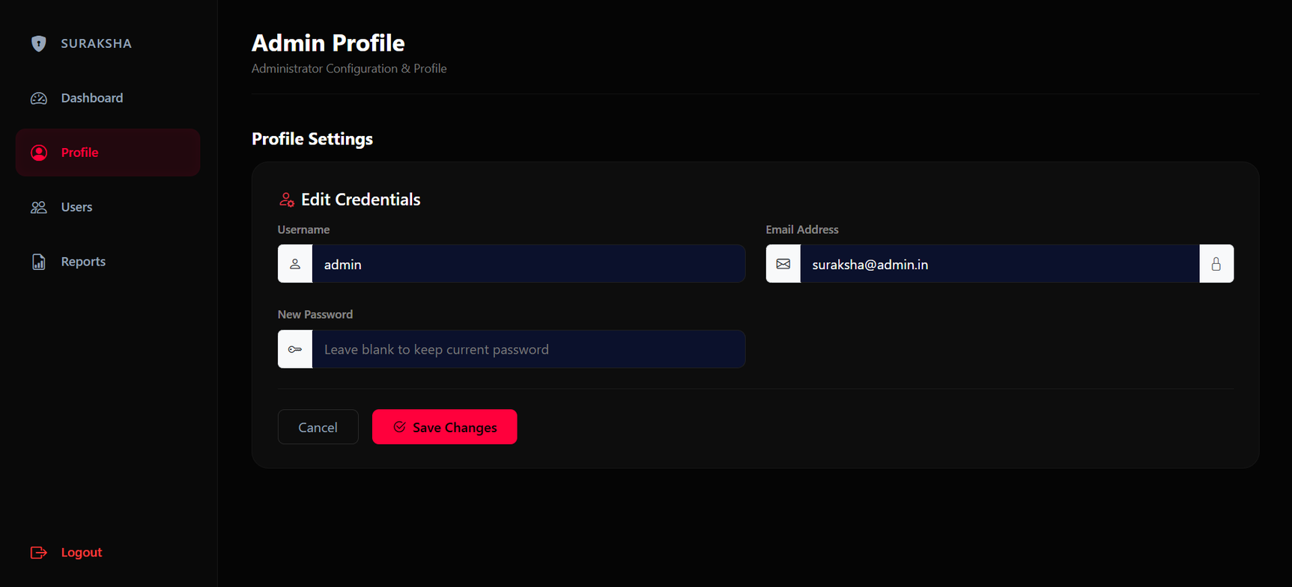
fig. admin profile
22

Slide 24
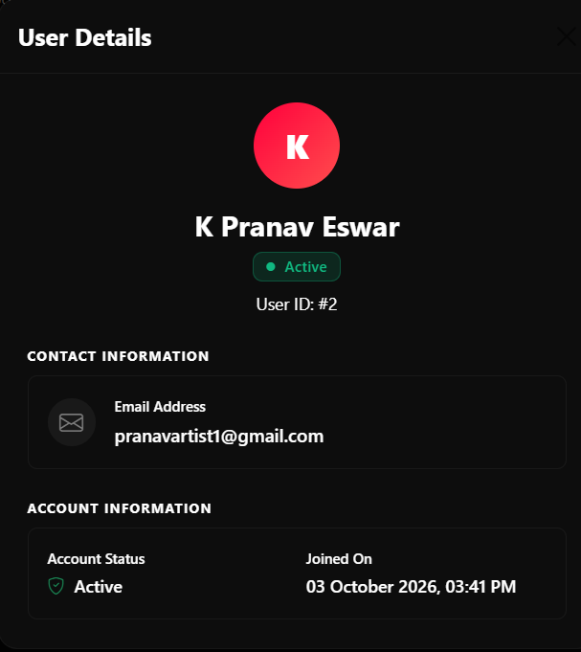
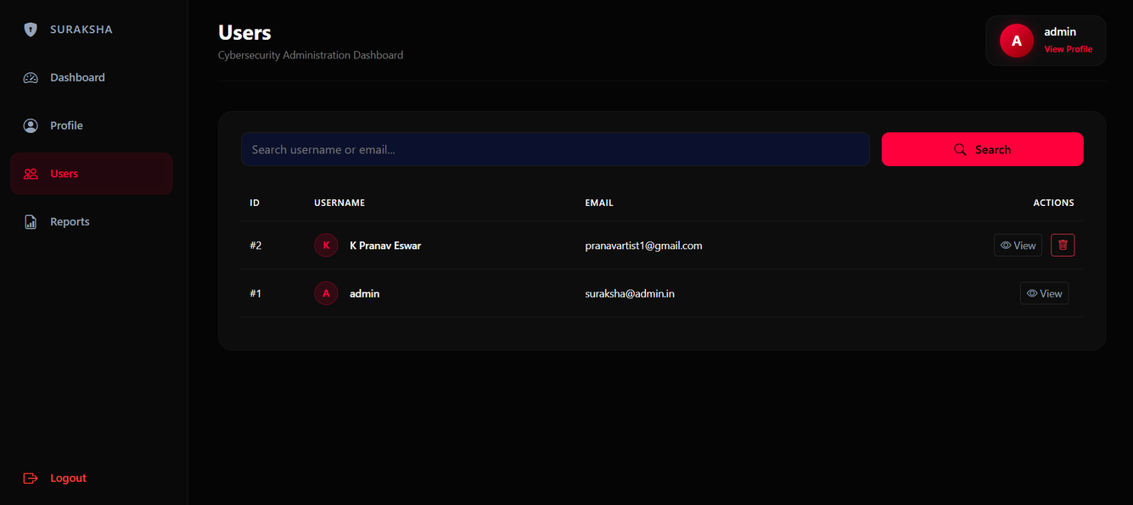
fig. admin / user management
23

Slide 25
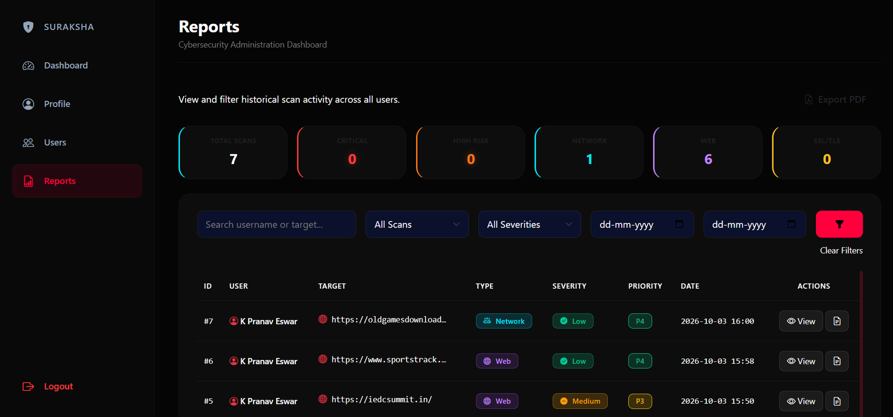
fig. admin reports
24

Slide 26
REFERENCES
  Malkawi, M.; Alhajj, R. AI-Powered Vulnerability Detection and Patch Management in Cybersecurity: A Systematic Review of Techniques, Challenges, and Emerging Trends. Mach. Learn. Knowl. Extr. 2026, 8, 19. https://doi.org/10.3390/make8010019
  Bakır, R. UniEmbed: A Novel Approach to Detect XSS and SQL Injection Attacks Leveraging Multiple Feature Fusion with Machine Learning Techniques. Arab J Sci Eng 50, 15591–15604 (2025). https://doi.org/10.1007/s13369-024-09916-4
  Arasteh, B., Aghaei, B., Farzad, B. et al. Detecting SQL injection attacks by binary gray wolf optimizer and machine learning algorithms. Neural Comput & Applic 36, 6771–6792 (2024). https://doi.org/10.1007/s00521-024-09429-z
  OWASP Foundation. (2021). OWASP Top 10:2021. https://owasp.org/Top10/
  Lyon, G. (2025). Nmap Network Scanning: The Official Nmap Project Guide to Network Discovery and Security Scanning. Nmap Project. https://nmap.org/book/
  Scikit-learn Developers. Scikit-learn User Guide. https://scikit-learn.org/stable/user_guide.html
25

Slide 27
CONCLUSION
  SURAKSHA provides an integrated platform for web and network vulnerability assessment.
  Combines web scanning, network reconnaissance, SSL/TLS analysis, protocol analysis, and CVE mapping.
  Uses rule-based security testing and machine-learning-assisted risk prediction.
  Provides centralized scan results, severity levels, risk scores, and security reports.
  Helps users identify vulnerabilities and understand their potential security impact.
  Reduces the need for multiple independent security assessment tools.
FUTURE ENHANCEMENTS
  Expand datasets and attack types to improve vulnerability detection.
  Detect obfuscated and unseen attacks using improved ML techniques.
  Improve CVE updates and security recommendations with regularly updated vulnerability information.
26

Slide 28
THANK YOU

