Slide 1
Design of JDBC – Configuration

Slide 2
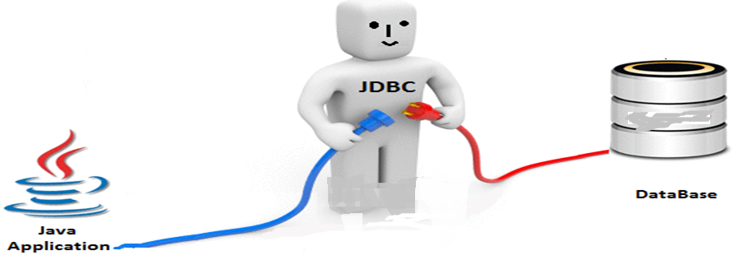
JDBC (Java Database Connectivity) is uses for connect java application with database, which is installed automatically with the JDK software.
It provides classes and interfaces to connect or communicate Java application with database.
JDBC API is a Java API that can access any kind of data stored in a Relational Database. It enables Java programs to execute SQL statements.
java.sql package

Slide 3
Classes in Jdbc
DriverManager
SQLException
Types
Date
Time
Interfaces in Jdbc
Connection
Statement
PreparedStatement
CallableStatement
Resultset
ResultSetMetaData
DatabaseMetaData
Driver
Blob
Clob

Slide 4
JDBC is used for accessing databases from Java applications
Application
JDBC
Driver
Java code calls JDBC library
JDBC loads a driver
Driver talks to a particular database
An application can work with several databases by using all corresponding drivers
Advantage: can change database engines without changing any application code (not always in practice)

Slide 5
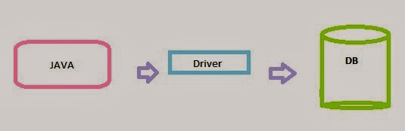
What is Driver ? The Driver is a one point contact for all interactions between the Java App. and the DB.

Slide 6
5 Steps to connect to the database in java
Register the driver class(load the Driver)
Creating connection(Establishing a connection)
Creating statement
Executing queries
Closing connection
Step 1:Register the driver class(load the Driver)
In this step we load the JDBC driver class into JVM. This step is also called as registering the JDBC driver. The forName() method of Class class is used to register the driver class. This method is used to dynamically load the driver class.
This step need to be performed only once for the whole execution of an application.
This step can be completed in two ways.
(i) Class.forName("fully qualified classname")
(ii) DriverManager.registerDriver(object of driver class)
As both these methods throw ClassNotFoundException (checked exceptions), you have to handle them using try-catch blocks.

Slide 7
Example: Sun.Jdbc.Odbc.JdbcOdbcDriver is a driver class provided by Sun MicroSystem and it can be loaded into jvm like the following.
(i) forName() method
Class.forName ("sun.jdbc.odbc.JdbcOdbcDriver");
(ii) DriveManager.registerDriver(object of driver class)
sun.jdbc.odbc.JdbcOdbcDriver jod=new sun.jdbc.odbc.JdbcOdbcDriver(); DriverManager.registerDriver(jod);
Every database has its own driver
MsAccess: Class.forName("sun.jdbc.odbc.JdbcOdbcDriver");
Oracle : Class.forName("oracle.jdbc.driver.OracleDriver");
Ms SQL Server:
Class.forName("com.microsoft.jdbc.sqlserver.SQLServerDriver");
Loading Derby JDBC drivers
Class.forName("org.apache.derby.jdbc.EmbeddedDriver")
etc.

Slide 8
2. Create the connection object
In this step connection between a java program and a database will be opened. To open the connection, we call getConnection() method of DriverManager class. For getConnection() method we need to pass three parameters.
url,username,password
url: url is used to select one register JDBC driver among multiple registered driver by DriverManager class.
username and password: username and password are used for authentication purpose.
Syntax of getConnection() method
1) public static Connection getConnection(String url)throws SQLException
2) public static Connection getConnection(String url,String name,String password) throws SQLException
Example to establish connection with the Oracle database
Connection con= DriverManager.getConnection(url, username, password);
Example:
Connection con= DriverManager.getConnection(jdbc:derby:< dsn >, “name",“password");

Slide 9
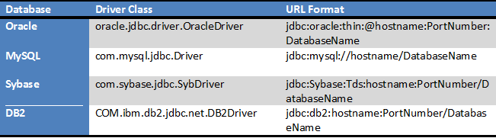
String URL = "jdbc:oracle:thin:@localhost:1521:XE";
String username = "username";
String password = "password";
Connection con = DriverManager.getConnection(URL, username, password);

Slide 10
3. Create the Statement object
To transfer sql commands from java program to database we need statement object.
To create a statement object we call createStatement() method of connection interface.
The object of statement is responsible to execute queries with the database.
Syntax of createStatement() method
public Statement createStatement()throws SQLException
Example to create the statement object
Statement stmt=con.createStatement();

Slide 11
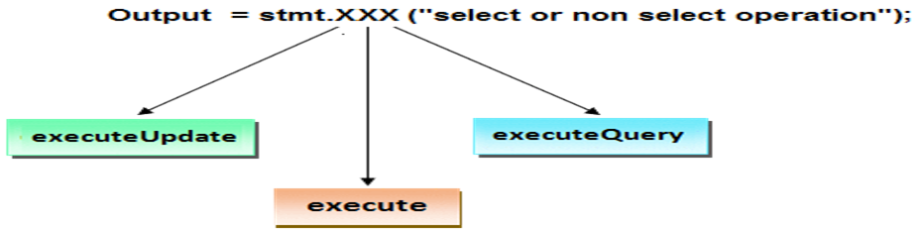
4. Executing queries
Call any one of the following three methods of Statement interface is used to execute queries to the database and to get the output.
executeUpdate(): Used for non-select operations.
executeQuery(): Used for select operation.
execute(): Used for both select or non-select operation.

Slide 12
executeQuery(), executeUpdate() and execute() are the methods of java.sql.Statement interface of JDBC API which are used to execute the SQL statements.
ResultSet executeQuery(String sql) throws SQLException
This method is used for SQL statements which retrieve some data from the database. For example is SELECT statement. This method is meant to be used for select queries which fetch some data from the database. This method returns one java.sql.ResultSet object which contains the data returned by the query.

Slide 13
int executeUpdate(String sql) throws SQLException :
This method is used for SQL statements which update the database in some way. For example INSERT, UPDATE and DELETE statements. All these statements are DML(Data Manipulation Language) statements. This method can also be used for DDL(Data Definition Language) statements which return nothing. For example CREATE and ALTER statements. This method returns an int value which represents the number of rows affected by the query. This value will be 0 for the statements which return nothing.
boolean execute(String sql) throws SQLException :
This method allows us to execute any kind of query like select, update. It returns boolean. If the return value is true, then it executed select query, get the ResultSet object and read the resulted records. If it returns false, then it can be update query, call getUpdateCount() method to get total records updated.

Slide 14
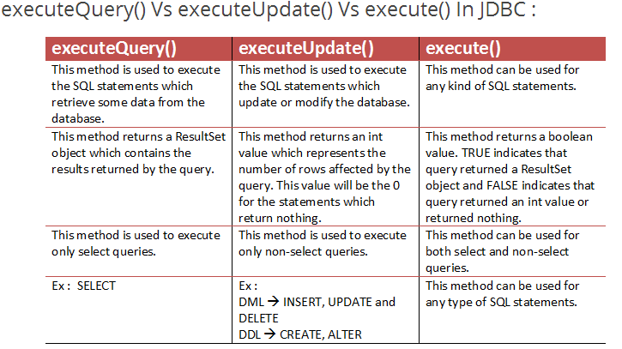

Slide 15
5.Closing connection : Close the connection.
The close() method of Connection interface is used to close the connection.
Syntax of close() method
public void close()throws SQLException
Example for close connection
con.close();

Slide 16
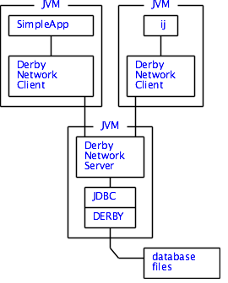
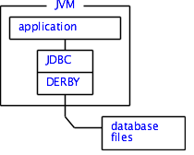
Embedded Derby - Network Derby
The Derby engine does not run in a separate process, and there are no separate database processes to start up and shut down.
The Derby database engine runs inside the same Java Virtual Machine (JVM) as the application.
An application can also access a Derby database using the client/server mode. This is achieved via a framework (Derby Network Server) that embeds Derby and handles database requests from applications, including applications running in different JVMs on the same machine or on remote machines.

Slide 17
1.Register the driver class(load the Driver)
load the driver class into JVM.
Class.forName("org.apache.derby.jdbc.EmbeddedDriver");
derbyrun.jar-in which the driver for derby database is located
we have to set the classpath for derbyclient.jar
2.Create the connection object
connection between a java program and a database will be opened.
Connection conn = DriverManager.getConnection(url, username, password);
The JDBC URL general syntax is: jdbc:subprotocol:other stuff
"jdbc:derby://localhost:1527/COREJAVA";
Subprotocol:derby
Here a subprotocol selects the specific driver for connecting to the database
Databaseserver ip address: localhost
Databaseserver port number: (by default 1527)
Databasename:COREJAVA(we can give any name)

Slide 18
3. Create the Statement object
To transfer sql commands from java program to database we need statement object.
Statement stat = conn.createStatement();
4. Executing queries
Example:
stat.execute("CREATE TABLE FIRSTTABLE(ID INT ,NAME VARCHAR(12))");
stat.execute("INSERT INTO FIRSTTABLE VALUES (10,'TEN'),(20,'TWENTY'),(30,'THIRTY')");
ResultSet result = stat.executeQuery("SELECT * FROM FIRSTTABLE ");
while (result.next())
{ System.out.println(result.getString(1)+" "+result.getString(2)); }
stat.execute("DROP TABLE FIRSTTABLE");
conn.close();
}
5.Closing connection : Close the connection.
conn.close();

Slide 19
import java.sql.*;
public class TestDB
{ public static void main (String args[])
{ Connection conn;
try{ Class.forName("org.apache.derby.jdbc.EmbeddedDriver");
String url = "jdbc:derby://localhost:1527/COREJAVA2";
String username = "xx“; String password = "xx";
conn = DriverManager.getConnection(url, username, password);
Statement stat = conn.createStatement();
stat.execute("CREATE TABLE FIRSTTABLE(ID INT ,NAME VARCHAR(12))");
stat.execute("INSERT INTO FIRSTTABLE VALUES (10,'TEN'),(20,'TWENTY'),(30,'THIRTY')");
ResultSet result = stat.executeQuery("SELECT * FROM FIRSTTABLE ");
while (result.next())
{System.out.println(result.getString(1)+" "+result.getString(2)); }
stat.execute("DROP TABLE FIRSTTABLE");
conn.close();}
catch (Exception ex)
{ ex.printStackTrace(); }
} }

Slide 20
D:\javadb2019>java TestDB
java.sql.SQLNonTransientConnectionException: The connection was refused because
the database COREJAVA2 was not found.
at org.apache.derby.client.am.SQLExceptionFactory.getSQLException(Unknown Source)
at org.apache.derby.client.am.SqlException.getSQLException(Unknown Source)
at org.apache.derby.jdbc.ClientDriver.connect(Unknown Source)
at java.sql.DriverManager.getConnection(Unknown Source)
at java.sql.DriverManager.getConnection(Unknown Source)
at TestDB.main(TestDB.java:8)

Slide 21
import java.sql.*;
public class TestDB
{ public static void main (String args[])
{ Connection conn;
try{ Class.forName("org.apache.derby.jdbc.ClientDriver");
String url = "jdbc:derby://localhost:1527/COREJAVA2;create=true";
conn = DriverManager.getConnection(url);
Statement stat = conn.createStatement();
stat.execute("CREATE TABLE FIRSTTABLE(ID INT ,NAME VARCHAR(12))");
stat.execute("INSERT INTO FIRSTTABLE VALUES (10,'TEN'),(20,'TWENTY'),(30,'THIRTY')");
ResultSet result = stat.executeQuery("SELECT * FROM FIRSTTABLE ");
while (result.next())
{System.out.println(result.getString(1)+" "+result.getString(2)); }
stat.execute("DROP TABLE FIRSTTABLE");
conn.close();}
catch (Exception ex)
{ ex.printStackTrace(); }
} }
D:\java2019>javac TestDB.java
D:\java2019>java TestDB
10 TEN
20 TWENTY
30 THIRTY

Slide 22
To execute the database program
Step 1: First database server needs to be started
Open a command shell and change to a directory that will hold the database files(in this following example the database going to stored in D:\java2019\Database)
D:\java2019\Database>"C:\Program Files\Java\jdk1.8.0_60\db\bin\startNetworkServer“
Wed Mar 13 10:36:36 IST 2019 : Security manager installed using the Basic server security policy.
Wed Mar 13 10:36:37 IST 2019 : Apache Derby Network Server - 10.11.1.2 - (1629631) started and ready to accept connections on port 1527
The default port number is 1527 we can also change the port number by the following cmd
D:\java2019\Database>"C:\Program Files\Java\jdk1.8.0_60\db\bin\startNetworkServer" -p 1567
Wed Mar 13 10:46:33 IST 2019 : Security manager installed using the Basic server security policy.
Wed Mar 13 10:46:33 IST 2019 : Apache Derby Network Server - 10.11.1.2 - (1629631) started and ready to accept connections on port 1567

Slide 23
Step2:compile and execute the java program
Open another command shell and change to a directory that will hold the database files. set the classpath for derbyrun.jar
set classpath=".;C:\Program Files\Java\jdk1.8.0_66\db\lib\derbyrun.jar”
Output:
10 TEN
20 TWENTY
30 THIRTY

Slide 24
Step3:Finally the database server needs to be stopped
Open another command shell and change
D:\java2019\Database>"C:\Program Files\Java\jdk1.8.0_60\db\bin\stopNetworkServer"
Wed Mar 13 10:56:04 IST 2019 : Apache Derby Network Server - 10.11.1.2 - (1629631) shutdown

Slide 25
Using Derby from the command line (ij)
ij is Derby’s interactive JDBC scripting tool.It is a simple utility for running scripts or interactive queries against a Derby database.
In ij every line needs to get terminated with ;.
Step 1: create a file ij.properties
that contains following statement
ij.driver=org.apache.derby.jdbc.EmbeddedDriver
ij.protocol=jdbc:derby://localhost:1527/
ij.database=COREJAVA;create=true (or) ij.database=COREJAVA;
Save this file in the directory that will hold the database files
(in our example it is D:\java2019\Database)
Open a command shell and change to a directory that will hold the database files and execute the ij.properties
D:\java2019\Database>java -jar "C:\Program Files\Java\jdk1.8.0_60\db\lib\derbyrun.jar” ij -p ij.properties

Slide 26
Example:
D:\java2019\Database>java -jar "C:\Program Files\Java\jdk1.8.0_60\db\lib\derbyrun.jar" ij -p ij.properties
ij version 10.11
CONNECTION0* - jdbc:derby://localhost:1527/COREJAVA2
* = current connection
ij> SELECT * FROM FIRSTTABLE ;
ID |NAME
------------------------
10 |TEN
20 |TWENTY
30 |THIRTY
3 rows selected
ij> exit;

Slide 27
D:\java2019>java -jar "C:\Program Files (x86)\Java\jdk1.8.0_152\db\li
b\derbyrun.jar" ij -p ij.properties
ij version 10.11
CONNECTION0* - jdbc:derby://localhost:1527/COREJAVA2;create=true
*= current connection
ij> create table ourtable(ID int,Name varchar(12));
0 rows inserted/updated/deleted
ij> insert into ourtable values(10,'sastra'),(20,'VIT');
2 rows inserted/updated/deleted
ij> select * from ourtable;
ID |NAME
------------------------
10 |sastra
20 |VIT
2 rows selected

Slide 28
D:\java2019\Database> java –jar “C:\Program Files\java\jdk1.8.0_60\db\lib\derbyrun.jar” ij –p ij.properties
ij version 10.11
CONNECTION*- jdbc:derby://localhost:1527/COREJAVA2
* = current connection
Ij> SELECT * FROM FIRSTTABLE;
ID NAME
------------------
10 |TEN
20 |TWENTY
30 |THIRTY
3 rows selected
Ij>exit;
D:\java2019\Database>

Slide 29
JDBC Driver Types
Type 1
Translates JDBC to ODBC and relies on an ODBC driver to communicate with the database. Sun includes one such driver, the JDBC/ODBC bridge, with the JDK.
The bridge requires deployment and proper configuration of an ODBC driver.
Type1 is not advisable for use.
Type 2
written partly in the Java programming language and partly in native code, that communicates with the client API of a database.
platform-specific code must be installed in addition to a Java library.
Type 3
A pure Java client library that uses a database-independent protocol to communicate database requests to a server component, which then translates the requests into a database-specific protocol.
The client library is independent of the actual database, thus simplifying deployment.
Type 4
A pure Java library that translates JDBC requests directly to a database-specific protocol.

Slide 30
Properties File
#db.properties
jdbc.drivers= org.apache.derby.jdbc.EmbeddedDriver
jdbc.url=jdbc:derby:COREJAVA
jdbc.username=xxx
jdbc.password=xxx

Slide 31
SQL data type Java data type
INTEGER or INT int
SMALLINT short
NUMERIC(m,n), DECIMAL(m,n)or DEC(m,n) java.sql.Numeric
FLOAT(n) double
REAL float
DOUBLE double
CHARACTER(n)or CHAR(n) String
VARCHAR(n) String
BOOLEAN boolean
DATE java.sql.Date
TIME java.sql.Time
TIMESTAMP java.sql.Timestamp
BLOB java.sql.Blob
CLOB java.sql.Clob
ARRAY java.sql.Array

Slide 32
java.sql.DriverManager
static Connection getConnection(String url, String user, String password)
Statement createStatement()
void close()
java.sql.Statement
ResultSet executeQuery(String sql)
int executeUpdate(String sql)
boolean execute(String sql)
int getUpdateCount()
ResultSet getResultSet()

Slide 33
java.sql.ResultSet
boolean next()
Xxx getXxx(int columnNumber)
Xxx getXxx(String columnName)
int findColumn(String columnName)
void close()

Slide 34
Prepared Statement

Slide 35
The PreparedStatement interface is a sub interface of Statement. It is used to execute parameterized query.
String sql="insert into emp values(?,?,?)";
Place holders are provided (?) for the values. Its value will be set by calling the setter methods of PreparedStatement.
The prepareStatement() method of Connection interface is used to return the object of PreparedStatement.
PreparedStatement prepareStatement(String query)throws SQLException

Slide 36
Example
Statement stat = conn.createStatement();
stat.execute("CREATE TABLE EMP(ID INT ,NAME VARCHAR(50))");
PreparedStatement stmt=conn.prepareStatement(
"INSERT INTO EMP VALUES (?,?)");
stmt.setInt(1,101);//1 specifies the first parameter in the query
stmt.setString(2,"Ram");
int i=stmt.executeUpdate();
System.out.println(i+" records inserted");

Slide 37
Prepared Statements
java.sql.Connection
PreparedStatement prepareStatement(String sql)
java.sql.PreparedStatement
void setXxx(int n, Xxx x)
void clearParameters()
ResultSet executeQuery()
int executeUpdate()

Slide 38
Executing SQL Statements

Slide 39
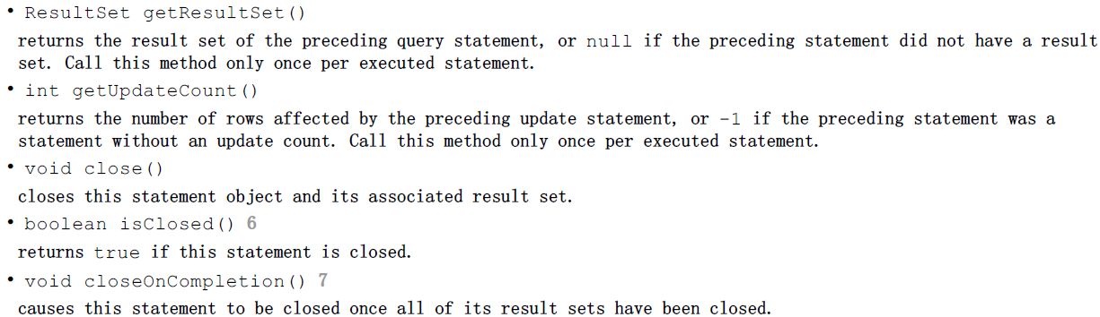

Slide 40
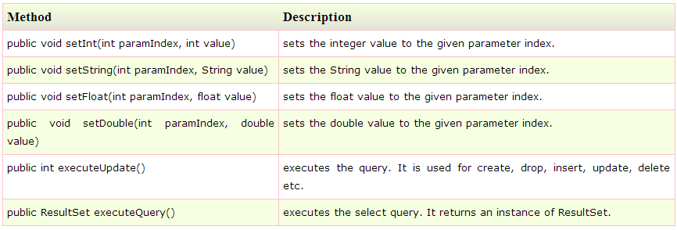
Methods of PreparedStatement interface

Slide 41
Example of PreparedStatement interface that updates the record
PreparedStatement stmt=con.prepareStatement("update emp set name=? where id=?");
stmt.setString(1,"Sonoo");//1 specifies the first parameter in the query i.e. name
stmt.setInt(2,101);
int i=stmt.executeUpdate();
System.out.println(i+" records updated");
Example of PreparedStatement interface that deletes the record
PreparedStatement stmt=con.prepareStatement("delete from emp where id=?");
stmt.setInt(1,101);
int i=stmt.executeUpdate();
System.out.println(i+" records deleted");
Example of PreparedStatement interface that retrieve the records of a table
PreparedStatement stmt=con.prepareStatement("select * from emp");
ResultSet rs=stmt.executeQuery();
while(rs.next()){
System.out.println(rs.getInt(1)+" "+rs.getString(2));
}

Slide 42
Advantages/Benefits of PreparedStatement:
⇒ This can improve the performance when we have a same SQL statement to execute for multiple times compared to Statement. As the compilation is done only for one time.
⇒ Easy to write the queries with multiple dynamic values makes the query more descriptive avoiding concatenation.
⇒ It is convenient to use PreparedStatement working with complex datatypes.
⇒ This can solve some of the SQL Injection problems.
Limitation and drawbacks of PreparedStatement:
⇒ PreparedStatement object can represent only 1 SQL statement to execute for any number of times.
⇒ PreparedStatement object can have only one SQL statement with different set of values.

Slide 43
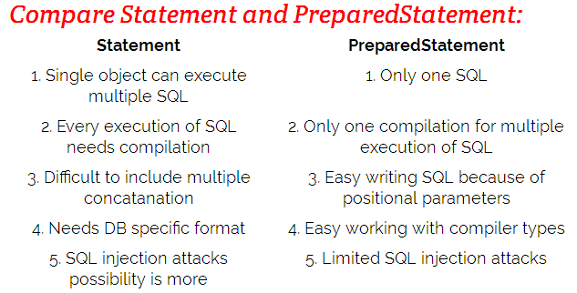

Slide 44
Scrollable and Updatable ResultSet

Slide 45
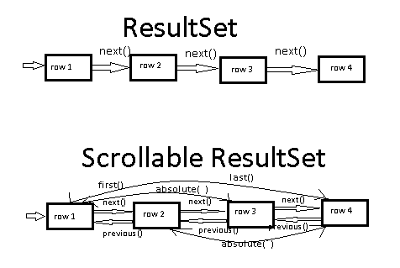
In the earlier - ResultSet allows us to read data from only in forward direction i.e. Using next() method.
The JDBC 2.0 introduces a support for advanced ResultSet that allows to read the data in any direction and even allow to update the data.

Slide 46
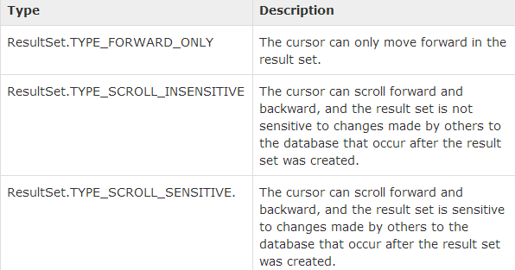
Scrollable ResultSet:
This type of ResultSet allows to scroll within the rows in any direction and in any steps.
To get the ResultSet of the required type we need to create the JDBC Statement specifying the type.
The following overloaded methods of Connection can be used to do this:
Statement createStatement(int rs_type, int rs_concur)
PreparedStatement prepareStatement(String sql, int rs_type, int rs_concur)
CallableStatement prepareCall(String sql, int rs_type, int rs_concur)
The rs_type can be any of the following values:

Slide 47
The rs_concur can be any of the following two values: ResultSet.CONCUR_READ_ONLY ResultSet.CONCUR_UPDATABLE
The Scrollable ResultSet is allowed to use the following methods to move the row pointer: 1.first() – Move the pointer to first row. 2.last() – Move the pointer to last row.
3. next() – Move the pointer to next row from current position. 4. previous() – Move the pointer to previous row from the current position. 5. absolute(int inxex) – Move the pointer to the row at given index (index starts with 1). rs.absolute(3) – Move to 3rd row
rs.absolute(-3) – Move to last 3rd row (counting from last)
rs.absolute(0) – SQLException
6. relative(int position) – Will move the pointer to (current_row_index+position) row If current position is in 2nd row and position we provide 2 then position will be 4.
All the above 6 methods have boolean return type. They return true if in case able to move to the valid row to read the data otherwise returns false.
7.int currentRow=rs.getRow()-to get the current row number
1. void beforeFirst() – This will move the pointer to the before first row. However it is not a valid position to read the values but in some algorithms we may want to go before first and start reading moving ahead.
2. void afterLast() – This will move the pointer to the after last row.
isFirst,isLast,isBeforeFirst and isAfterLast test whether the cursor is at one of these special positions

Slide 48
What is the difference between TYPE_SCROLL_SENSITIVE and TYPE_SCROLL_INSENSITIVE?
Both these ResultSet types allows to scroll within the rows in the ResultSet.
⇒ The only difference is the TYPE_SCROLL_SENSITIVE will refresh the Cursor every time it is accessed from server. Where the TYPE_SCROLL_INSENSITIVE will not.
In simple after getting the ResultSet if some other client modifies the data in the database those changes will not be effected into this ResultSet if it is TYPE_SCROLL_INSENSITIVE, will be effected in case of TYPE_SCROLL_SENSITIVE. Note: The SENSITIVE ResutlSet is more costlier to system compared to INSENSITIVE. ⇒ Thus only in case if we find that the data selected into ResultSet is possible to modification by other clients and is important to get effected to read the changes in our application, then only use TYPE_SCROLL_SENSITIVE otherwise TYPE_SCROLL_INSENSITIVE will be best. Note: All the databases and JDBC drivers may not support all the type of ResultSet.

Slide 49
Updatable ResultSet

Slide 50
To get the UpdatableResultSet we need to use ResultSet.CONCUR_UPDATABLE while creating the Statement for a ResultSet concurrency.
The Updatable ResultSet allows us to insert, update and delete the records using ResultSet.
The following three steps are required to implement Updatable ResultSet:
Step 1: Move the row pointer to the row that we want to update.
Step 2: Update the column values.
We use the following updateXxx() methods for updating the column values:
Update String value using Updatable ResultSet
updateString(int col_index, String new_value)
Update Integer value using Updatable ResultSet
updateInt(int col_index, int new_value)
Similarly for all the datatypes
Step 3: Update the row-
-We use updateRow() method of ResultSet to update the row.
we can also call the cancelRowUpdates method to cancel the updates to the row

Slide 51
Statement st = con.createStatement(ResultSet.TYPE_SCROLL_SENSITIVE, ResultSet.CONCUR_UPDATABLE);
ResultSet rs = st.executeQuery("select empno, name, sal, deptno from emp");
while(rs.next()){
System.out.print(rs.getInt(1)+" "+rs.getString(2)+" "+rs.getDouble(3)+" "+rs.getInt(4));
if(rs.getInt(4)==50){
rs.updateDouble(3, rs.getDouble(3)-1500);
rs.updateRow();
System.out.println("--- Updated");
}else{
System.out.println("Not updated");
} }
1. The updateRow() method will update the row data to the database.
2. After changing the values of the columns without calling the updateRow() method if we move the row pointer from the current row, the modifications will not be effected into the database.
3. The ResultSet may show the updated data into it or may not, it varies from database to database and drivers.

Slide 52
Using Updatable ResultSet to delete the row:
The following two steps are involved in doing this:
Step 1: Move the row pointer to the row that we want to delete.
Step 2: Delete the row. We use deleteRow() method of ResultSet to delete the current row.
Example:
Statement st = con.createStatement(ResultSet.TYPE_SCROLL_SENSITIVE, ResultSet.CONCUR_UPDATABLE);
ResultSet rs = st.executeQuery("select empno, name, sal, deptno from emp");
while(rs.next()){
System.out.println(rs.getInt(1)+" "+rs.getString(2)+" "+rs.getDouble(3)+" "+rs.getInt(4));
if(rs.getInt(1)==emp_to_delete){
rs.deleteRow();
System.out.println("--- Deleted");
}
}

Slide 53
Using Updatable ResultSet to insert a new row:
The following three steps are used to do this:
Step 1: Move to new empty row
Step 2: Update the values for the columns
Step 3: Insert the row
⇒ Moving the pointer to a new empty row:
The following method of ResultSet is used to move the row pointer to the empty row:
moveToInsertRow()
⇒ Updating the values for the columns:
The Step2 here and Step2 of updating the row are same.
⇒ Inserting the row:
The following method of ResultSet is used for inserting the row:
insertRow()

Slide 54
Statement st = con.createStatement(ResultSet.TYPE_SCROLL_SENSITIVE, ResultSet.CONCUR_UPDATABLE);
ResultSet rs = st.executeQuery("select empno, name, sal, deptno from emp");
System.out.println("-----Current Records------");
while(rs.next()){
System.out.println(rs.getInt(1)+" "+rs.getString(2)+" "+rs.getDouble(3)+" "+rs.getInt(4));
}
System.out.println("\n-----------------------");
rs.moveToInsertRow();
rs.updateInt(1,114);
rs.updateString(2,"e114");
rs.updateDouble(3,3000);
rs.updateInt(4,40);
rs.insertRow();
System.out.println("Data inserted");
Note that we cannot influence where the new data is added in the result set or the database

Slide 55
