Slide 1
Networking in JAVA

Slide 2
Networking Basics
Seven Layers of OSI Model:
Physical Layer, Data Link Layer, Network Layer, Transport Layer, Session Layer, Presentation Layer, and Application Layer
Network Layer Protocol:
Internet Protocol (IP) is a low-level unreliable routing protocol
It breaks data into small packets and sends them to an address across a network to the destination.
The Source and destination systems are identified through IP Address
Transport Layer Protocols:
Transmission Control Protocol (TCP) is a higher-level protocol that manages to robustly string together these packets, sorting and retransmitting them as necessary to reliably transmit data.
User Datagram Protocol (UDP), is used to support fast, connectionless, unreliable transport of packets.
In the Source and destination systems the process which is sending / receiving the packet is identified through the port
Application Layer Protocols
HTTP, FTP, Telnet, SMTP

Slide 3
Socket identifies an endpoint in a network.
It allows a single computer to serve many different clients at once, as well as to serve many different types of information through different ports
Few Reserved Port Numbers: Port number 21 is for FTP; 23 is for Telnet; 25 is for e-mail; 43 is for whois; 80 is for HTTP; 119 is for netnews
A server process is said to "listen" to a port until a client connects to it.
A server is allowed to accept multiple clients connected to the same port number, although each session is unique.
To manage multiple client connections, a server process must be multithreaded
Few Terms: IP Address, Domain Name Service (DNS)

Slide 4
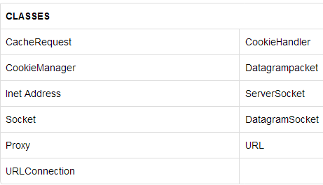
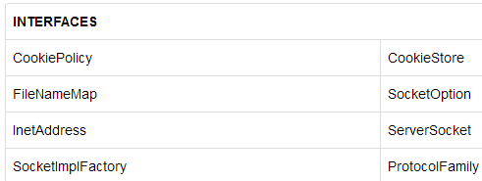
java.net package encapsulate large number of classes and interface that provides an easy-to use means to access network resources.

Slide 5
java.net package classes
InetAddress
Inet4Address
Inet6Address
SocketAddress
InetSocketAddress
MulticastSocket
URI
URL
DatagramPacket
DatagramSocket
HttpURLConnection
Socket
ServerSocket

Slide 6
InetAddress
Inet Address encapsulates both numerical IP address and the domain name for that address.
It can handle both IPv4 and Ipv6 addresses.
It has no visible constructor.
Factory methods are used to create an Inet Address object.
Factory methods are the static methods in a class that return an instance of that class.
InetAddress factory methods:
static InetAddress getLocalHost() throws UnknownHostException
static InetAddress getByName (String hostname) throws UnknownHostException
static InetAddress[ ] getAllByName (String hostname) throws UnknownHostException
Determines all the IP addresses of a host, given the host's name.

Slide 7
import java.net.*;
class TestInetAddress
{
public static void main(String[] args)throws UnknownHostException
{
InetAddress address = InetAddress.getLocalHost();
System.out.println(address);
address = InetAddress.getByName("www.scopus.com");
System.out.println(address);
InetAddress sw[] = InetAddress.getAllByName("www.sastra.edu");
for(int i=0; i< sw.length; i++)
{
System.out.println(sw[i]);
}
}
}
Output:
Admin-PC/192.168.56.1
www.scopus.com/119.18.52.59
www.sastra.edu/14.139.181.236
www.sastra.edu/220.225.137.243

Slide 8
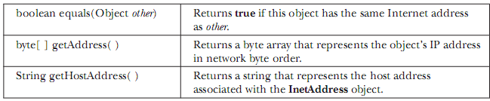
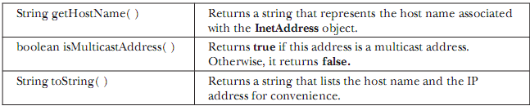
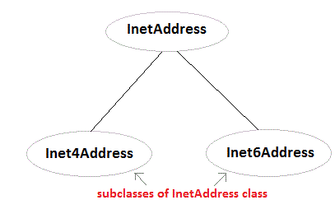
Instance Methods

Slide 9
Socket and ServerSocket Class
Socket (or Port)
Socket is a end-point for networking communication.
TCP and UDP supports 64K sockets, from socket number 0 to socket number 65,535. Socket number between 0 to 1023 are reserved for popular application protocols
e.g., Port 80 for HTTP, Port 443 for HTTPS, Port 21 for FTP, Port 23 for Telnet, Port 25 for SMTP, Port 110 for POP3, etc.
Port number on and above 1024 are available for other communications.
There are two kind of TCP sockets.
ServerSocket class is for servers;
Socket class is for client.

Slide 10
The TCP/IP Client Socket
Reliable, bi-directional, stream-based connection between two computers on a network.
To create Socket Object:
Socket(String hostName, int port) throws UnknownHostException, IOException
Socket(InetAddress ipAddress, int port) throws IOException
Methods of the Socket Class
InetAddress getInetAddress() -- Returns the InetAddress that is associated with the socket object.
int getPort() -- Returns the port number on which the socket is connected
int getLocalPort() -- Returns the local port number on which the socket is created
InputStream getInputStream() -- Returns the InputStream associated with the calling object.
OutputStream getOutputStream() -- Returns the OutputStream associated with the calling object.
void close() -- Closes the InputStream() and OutputStream() of the socket.

Slide 11
//A connection to my-site.com on port 80 through sockets is opened.
import java.io.*; import java.net.*;
public class ExSocket {
public static void main(String args[]) throws UnknownHostException
{ try { Socket mySocket = new Socket("www.my-site.com",80);
System.out.println("Connection to: " + mySocket.getInetAddress());
System.out.println("Port Number: " + mySocket.getPort());
System.out.println("Local Address: " + mySocket.getLocalAddress());
System.out.println("Local Port: " + mySocket.getLocalPort());
}catch (UnknownHostException e)
{System.out.println("Site not found!");}
catch (SocketException e)
{System.out.println("Socket error");}
catch ( IOException e)
{System.out.println("An I/O Exception Occurred!");} } }
Output:
Connection to: www.my-site.com/184.106.55.83
Port Number: 80
Local Address: /172.22.67.72
Local Port: 49742

Slide 12
The TCP/IP Server Socket
The TCP/IP server socket creates a socket that listens for incoming connections. The server socket is implemented by creating an instance of the ServerSocket class.
Methods to Create TCP Ser
ServerSocket(int port) throws IOException
Creates server socket on the specified port with a queue length of 50.
ServerSocket(int port, int maxQueue) throws IOException
Creates a server socket on the specified port with a maximum queue length of maxQueue.
maxQueue refers to the number of connections the socket can leave pending before refusing more connections.
ServerSocket(int port, int maxQueue,InetAddress localAddress)throws IOException
Where, address refers to the IP address of the server on which the socket is created.
Methods of the ServerSocket Class
socket accept() -- Accepts an incoming connection.
int getLocalPort() -- Returns the port number on which the server socket is listening.
void close() -- Closes the server socket.

Slide 13
//Program to demonstrate ServerSockets
public class SerSocket
{ public static void main(String args[])
{ int port=1080;
try
{ServerSocket mySocket = new ServerSocket(port);
System.out.println("Server initialized on port " + mySocket.getLocalPort());
mySocket.accept();
}catch (SocketException e)
{System.out.println("Socket error");}
catch ( IOException e)
{System.out.println("An I/O Exception Occurred!");}
}
}
D:\java2016\networking>javac SerSocket.java
D:\java2016\networking>java SerSocket
Server initialized on port 1080

Slide 14
Example TCP/IP client server program

Slide 15
SERVER SIDE CODE
import java.net.*;
import java.io.*;
class serversock
{
public static void main(String args[]) throws IOException
{
ServerSocket server=new ServerSocket(1235);
System.out.println("waiting for request from client");
Socket client=server.accept();
System.out.println("request accepted");
BufferedReader br=new BufferedReader(new InputStreamReader(client.getInputStream()));
while(true)
{
String st=br.readLine();
if(st.equals("exit")==true)
{
System.out.println("connection with client is lost....");
System.exit(1);
}
System.out.println("from client:"+st);
PrintStream ps=new PrintStream(client.getOutputStream());
st=st.toUpperCase();
ps.println(st);
}
}
}

Slide 16
CLIENT SIDE CODE
import java.net.*;
import java.io.*;
class clientsock
{
public static void main(String args[]) throws IOException
{
System.out.println("sending request to server....");
Socket client=new Socket("127.0.0.1",1235);
System.out.println("successfully conneted");
BufferedReader br1=new BufferedReader(new InputStreamReader(System.in));
PrintStream ps=new PrintStream(client.getOutputStream());
BufferedReader br=new BufferedReader(new InputStreamReader(client.getInputStream()));
while(true)
{
System.out.println("input the data u want to send to echo server: ");
String s=br1.readLine();
ps.println(s);
if(s.equals("exit"))
{
System.exit(1);
}
String st=br.readLine();
System.out.println("From server:"+st);
}
}
}

Slide 17
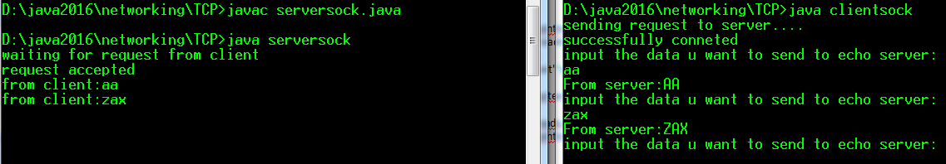

Slide 18
//Server Program
import java.net.*;
import java.io.*;
class ServerInt {
public static void main(String[] args) {
try {
int pno=Integer.parseInt(args[0]);
ServerSocket ss=new ServerSocket(pno);
System.out.println("server is ready to accept client request");
Socket s1=ss.accept();
InputStream is=s1.getInputStream();
DataInputStream dis=new DataInputStream(is);
int n=dis.readInt();
System.out.println("Value from client : "+n);
int res=n*n;
OutputStream os=s1.getOutputStream();
DataOutputStream dos=new DataOutputStream(os);
dos.writeInt(res);
s1.close();
}
catch (Exception e) {
System.out.println(e);
}
}
}

Slide 19
// Client Program
import java.net.*;
import java.io.*;
import java.util.*;
class ClientInt {
public static void main(String[] args) {
try {
String pname=args[0];
int pno=Integer.parseInt(args[1]);
Socket s=new Socket(pname,pno);
System.out.println("client obtained connection from server");
System.out.println("Enter a number ");
Scanner sn=new Scanner(System.in);
int data=sn.nextInt();
OutputStream os=s.getOutputStream();
DataOutputStream dos=new DataOutputStream(os);
dos.writeInt(data);
InputStream is=s.getInputStream();
DataInputStream dis=new DataInputStream(is);
int res=dis.readInt();
System.out.println("Result from server : "+res);
}
catch (Exception e) {
System.out.println(e);
}
}
}

Slide 20
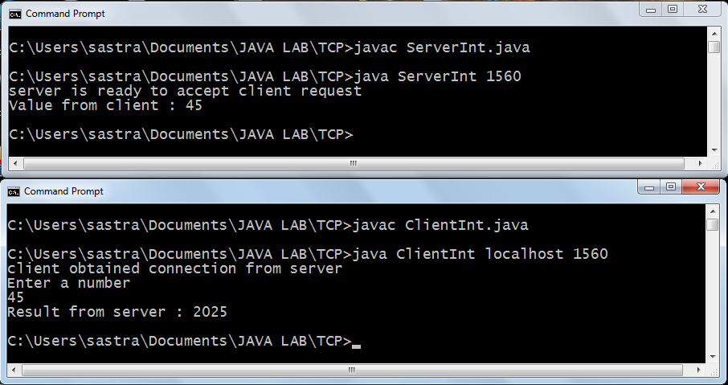

Slide 21
//TCPServer.java
import java.net.*;
import java.io.*;
import java.util.*;
public class TCPServer {
public static void main(String args[]) throws Exception {
char ch;
String msg="";
Scanner sc = new Scanner(System.in);
ServerSocket soc = new ServerSocket(3000);
System.out.println("Waiting for client connection...");
Socket r_soc = soc.accept();
OutputStream os = r_soc.getOutputStream();
InputStream is = r_soc.getInputStream();
BufferedReader br = new BufferedReader(new InputStreamReader(is));
System.out.println("Connection Established....");
while (true) {
System.out.println("Enter message to send : ");
msg = sc.nextLine()+"\n";
os.write(msg.getBytes());
if (msg.equals("Bye\n")) break;
msg="";
msg = br.readLine();
System.out.println("Message Received : "+msg);
if (msg.equals("Bye")) break;
msg="";
}
Thread.sleep(5000);
r_soc.close();
soc.close();
} }

Slide 22
import java.net.*;
import java.io.*;
import java.util.*;
public class TCPClient {
public static void main(String args[]) throws Exception {
char ch;
String msg = "";
Scanner sc = new Scanner(System.in);
Socket s = new Socket(InetAddress.getLocalHost(), 3000);
InputStream is = s.getInputStream();
BufferedReader br = new BufferedReader(new InputStreamReader(is));
OutputStream os = s.getOutputStream();
while (true){
msg = br.readLine();
System.out.println("Message Recived from server : "+msg);
if (msg.equals("Bye")) break;
System.out.println("Enter message to send : ");
msg = sc.nextLine()+"\n";
if (msg.equals("Bye\n")) break;
os.write(msg.getBytes());
msg="";
}
Thread.sleep(5000);
s.close();
} }

Slide 23
UDP
Using UDP there is no prior connection establishment between the client and server. A client may send data to the server, and the server may (or may not) receive this data. The client will never know if the data was received at the other end. The same is true for the data sent the other way from the server to the client.
Because there is no guarantee of data delivery, the UDP protocol has less protocol overhead.
There are several situations in which the connectionless UDP model is preferable over TCP
The UDP protocol provides for communication that is not guaranteed between two applications on the network. UDP is not connection-based like TCP.
Rather, it sends independent packets of data, called datagrams, from one application to another. Sending datagrams is much like sending a letter through the postal service: The order of delivery is not important and is not guaranteed, and each message is independent of any other.

Slide 24
The following two classes are used when coding a UDP connection.
DatagramPacket class represents a UDP datagram.
DatagramSocket class represents a UDP socket that is used to send or receive a datagram packet.
To create a UDP Socket bound to a port number 12345 at localhost.
DatagramSocket udpSocket = new DatagramSocket(12345, "localhost");
The DatagramSocket class provides a bind() method to bind the socket to a local IP address and a local port number.
DatagramPacket
A DatagramPacket contains three things:
destination IP address
destination port number
data.

Slide 25
Constructors of the DatagramPacket class to create a packet to send data are:
DatagramPacket(byte[] buf, int length, InetAddress address, int port)
DatagramPacket(byte[] buf, int offset, int length, InetAddress address, int port)
DatagramPacket(byte[] buf, int length, SocketAddress address)
DatagramPacket(byte[] buf, int offset, int length, SocketAddress address)
Constructors of the DatagramPacket class to create a packet to receive data are:
DatagramPacket(byte[] buf, int length)
DatagramPacket(byte[] buf, int offset, int length)
To create a packet to receive 1024 bytes of data.
byte[] data = new byte[1024];
DatagramPacket packet = new DatagramPacket(data, data.length);
To create a packet that has buffer size of 1024, and receive data starting at offset 8 and to receive only 32 bytes of data.
byte[] data2 = new byte[1024];
DatagramPacket packet2 = new DatagramPacket(data2, 8, 32);
Data in the packet always has offset and length specified. We need to use offset and length to read the data from a packet.

Slide 26
DatagramSocket
DatagramSocket defines four public constructors. They are shown here:
DatagramSocket( ) throws SocketException
DatagramSocket(int port) throws SocketException
DatagramSocket(int port, InetAddress ipAddress) throws SocketException
DatagramSocket(SocketAddress address) throws SocketException
The first creates a DatagramSocket bound to any unused port on the local computer.
The second creates a DatagramSocket bound to the port specified by port.
The third constructs a DatagramSocket bound to the specified port and InetAddress.
The fourth constructs a DatagramSocket bound to the specified SocketAddress. SocketAddress is an abstract class that is implemented by the concrete class InetSocketAddress. InetSocketAddress encapsulates an IP address with a port number.
All can throw a SocketException if an error occurs while creating the socket.
DatagramSocket defines many methods. Two of the most important methods are
void send(DatagramPacket packet) throws IOException
void receive(DatagramPacket packet) throws IOException
send( ) method sends a packet to the port specified by packet. The receive( ) method waits for a packet to be received and return the result

Slide 27
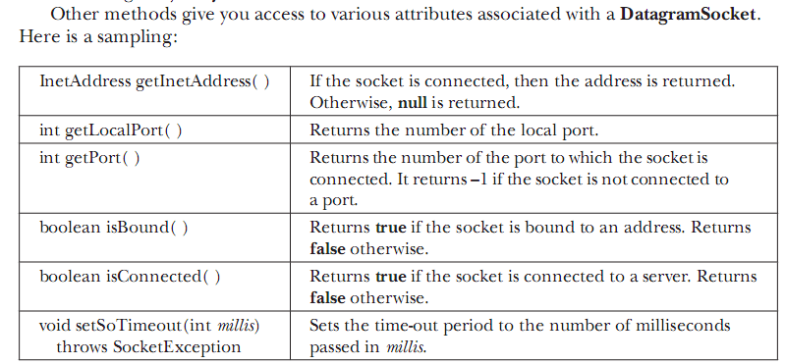

Slide 28
//UDP1.java:
import java.io.*;
import java.net.*;
class UDP1{
public static void main(String args[]) throws Exception{
BufferedReader br =new BufferedReader(new InputStreamReader(System.in));
DatagramSocket ds = new DatagramSocket();
InetAddress IPA = InetAddress.getByName("localhost");
byte[] sData = new byte[1024];
byte[] rData = new byte[1024];
String msg = br.readLine();
sData = msg.getBytes();
DatagramPacket sPacket = new DatagramPacket(sData, sData.length, IPA, 9876);
ds.send(sPacket);
DatagramPacket rPacket = new DatagramPacket(rData, rData.length);
ds.receive(rPacket);
String r_msg = new String(rPacket.getData());
System.out.println("FROM SERVER:" + r_msg);
ds.close();
}}

Slide 29
//UDP2.java:
import java.io.*;
import java.net.*;
class UDP2 {
public static void main(String args[]) throws Exception {
DatagramSocket ds = new DatagramSocket();
DatagramSocket dr = new DatagramPacket(9876);
byte[] rData = new byte[1024];
byte[] sData = new byte[1024];
while(true) {
DatagramPacket rPacket = new DatagramPacket(rData, rData.length);
dr.receive(rPacket);
String r_msg = new String( rPacket.getData());
System.out.println("RECEIVED: " + r_msg);
InetAddress IPA = rPacket.getAddress();
int port = rPacket.getPort();
String c_msg = r_msg.toUpperCase();
sData = c_msg.getBytes();
DatagramPacket sPacket =new DatagramPacket(sData, sData.length, IPA, port);
ds.send(sPacket);
}
}
}

Slide 30
import java.net.*;
import java.io.*;
import java.awt.*;
import java.awt.event.*;
public class UDPDemo extends Frame implements Runnable, ActionListener {
byte b[] = new byte[1024];
TextField s_msg; TextArea r_msg; Button send;
DatagramSocket ds_send;
DatagramSocket ds_receive;
DatagramPacket dp_send;
DatagramPacket dp_receive;
Thread receiveThread;
int s_port, r_port;
public UDPDemo(String title, int sp, int rp) {
super(title);
s_port = sp;
r_port = rp;
try {
ds_send = new DatagramSocket();
ds_receive = new DatagramSocket(r_port);
receiveThread = new Thread(this);
s_msg = new TextField(30);
r_msg = new TextArea(20, 80);
send = new Button("SEND");
s_msg.addActionListener(this);
send.addActionListener(this);
Panel p1 = new Panel();
p1.add(new Label("Message to Send "));
p1.add(s_msg);
p1.add(send);
add(p1, BorderLayout.NORTH);
Panel p2 = new Panel();
p2.add(new Label("Received Messages "));
Panel p3 = new Panel();
p3.add(r_msg);
Panel p4 = new Panel();
p4.add(p2);
p4.add(p3);
add(p4, BorderLayout.CENTER);
addWindowListener(new WindowAdapter() {
public void windowClosing(WindowEvent we) {
setVisible(false);
dispose(); }});
receiveThread.start();
}
catch(SocketException se) {
System.out.println("Exception : "+se);
}
}

Slide 31
public void run() {
while(true) {
try {
dp_receive = new DatagramPacket(b, b.length);
ds_receive.receive(dp_receive);
String msg = new String(dp_receive.getData(),
0,dp_receive.getLength());
r_msg.append(msg+"\n");
}
catch(IOException ie) {
System.out.println("Exception : "+ie);
}
}
}
public void actionPerformed(ActionEvent ae) {
try {
byte b[] = s_msg.getText().getBytes();
dp_send = new DatagramPacket(b, b.length,
InetAddress.getLocalHost(), s_port);
ds_send.send(dp_send);
s_msg.setText("");
}
catch(IOException ie) {
System.out.println("Exception : "+ie);
}
}
public static void main(String args[])
{
int s_port = Integer.parseInt(args[0]);
int r_port = Integer.parseInt(args[1]);
String title = args[2];
UDPDemo udp = new UDPDemo(title, s_port, r_port);
udp.setSize(700,500);
udp.setVisible(true);
}
}

Slide 32
URL class
Java URL Class present in java.net package, deals with URL (Uniform Resource Locator) which uniquely identify or locate resources on internet.
http://www.MHProfessional.com:80/index.htm
A URL specification is based on four components.
The first is the protocol to use, separated from the rest of the locator by a colon (:). Common protocols are HTTP, FTP, gopher.
most browsers will proceed correctly if you leave off the "http://" from your URL
specification.
The second component is the host name or IP address of the host to use; this is delimited on the left by double slashes (//) and on the right by a slash (/) or optionally a colon (:).
The third component, the port number, is an optional parameter, delimited on the left from the host name by a colon (:) and on the right by a slash (/). (It defaults to port 80, the predefined HTTP port)
The fourth part is the actual file path. Most HTTP servers will append a file named index.html or index.htm to URLs that refer directly to a directory resource.
Important Methods of URL class
getProtocol() : Returns protocol of URL
getHost() : Returns hostname(domain name) of URL
getPort() : Returns port number of URL
getFile() : Returns filename of URL

Slide 33
Constructors of URL
All constructors throws MalformedURLException, if it fails
URL(String urlSpecifier)
URL(String protocolName, String hostName, int port, String path )
URL(String protocolName, String hostName, String path)
URL(URL urlObj, String urlSpecifier)

Slide 34
import java.net.*;
class TestURL{
public static void main(String[] arg) throws MalformedURLException
{
URL hp = new URL("https://www.sastra.edu:80/2014-01-29-07-15-32/sastra.html");
System.out.println(“Protocol: ” +hp.getProtocol());
System.out.println(“Host Name: ”+hp.getHost());
System.out.println(“Port Number: “+hp.getPort());
System.out.println(“File Name: “+hp.getFile());
}
}
OUTPUT:
Protocol: https
Host Name: www.sastra.edu
Port Number: 80
File Name: /2014-01-29-07-15-32/sastra.html

Slide 35
URLConnection
URLConnection is a general-purpose class for accessing the attributes of a remote resource.
Once a connection to a remote server is made, URLConnection can be used to inspect the properties of the remote object before actually transporting it locally.

Slide 36
URLConnection Methods
int getContentLength( )
long getContentLengthLong( )
String getContentType( )
long getDate( )
long getExpiration( )
String getHeaderField(int idx)
String getHeaderField(String fieldName)
String getHeaderFieldKey(int idx)
Map<String, List<String>> getHeaderFields( )
long getLastModified( )
InputStream getInputStream( ) throws IOException

Slide 37
// Demonstrate URLConnection.
import java.net.*;
import java.io.*;
import java.util.Date;
class UCDemo {
public static void main(String args[]) throws Exception {
int c;
URL hp = new URL(http://www.internic.net");
URLConnection hpCon = hp.openConnection();
long d = hpCon.getDate();
if(d==0) System.out.println("No date information.");
else System.out.println("Date: " + new Date(d));
System.out.println("Content-Type: " + hpCon.getContentType());
d = hpCon.getExpiration();
if(d==0) System.out.println("No expiration information.");
else System.out.println("Expires: " + new Date(d));

Slide 38
d = hpCon.getLastModified();
if(d==0) System.out.println("No last-modified information.");
else System.out.println("Last-Modified: " + new Date(d));
long len = hpCon.getContentLengthLong();
if(len == -1) System.out.println("Content length unavailable.");
else System.out.println("Content-Length: " + len);
if(len != 0) {
System.out.println("=== Content ===");
InputStream input = hpCon.getInputStream();
while (((c = input.read()) != -1)) {
System.out.print((char) c);
}
input.close();
} else {
System.out.println("No content available."); }
}
}

Slide 39
HttpURLConnection
A subclass of URLConnection that provides support for HTTP connections.
Apart from the inherited methods of URLConnection, other methods are:
static boolean getFollowRedirects( )
String getRequestMethod( )
int getResponseCode( ) throws IOException
String getResponseMessage( ) throws IOException
static void setFollowRedirects(boolean how)
void setRequestMethod(String how) throws ProtocolException

Slide 40
// Demonstrate HttpURLConnection.
import java.net.*;
import java.io.*;
import java.util.*;
class HttpURLDemo {
public static void main(String args[]) throws Exception {
URL hp = new URL(http://www.google.com");
HttpURLConnection hpCon = (HttpURLConnection) hp.openConnection();
System.out.println("Request method is " + hpCon.getRequestMethod());
System.out.println("Response code is " + hpCon.getResponseCode());
System.out.println("Response Message is " + hpCon.getResponseMessage());
Map<String, List<String>> hdrMap = hpCon.getHeaderFields();
Set<String> hdrField = hdrMap.keySet();
System.out.println("\nHere is the header:");
for(String k : hdrField) {
System.out.println("Key: " + k + " Value: " + hdrMap.get(k));
}
} }

