Slide 1
CHAPTER 12 A picture is worth 1024 words

Slide 2
Objectives
After finish this chapter, student should understand the purpose of every type of diagrams, when and how to build them.
Student could choice the plan to model requirements.

Slide 3
Contents
A useful of picture in requirements representation
Modeling the requirements
From voice of the customer to analysis models
Selecting the right representations
Data flow diagram
Swimlane diagram
State-transition diagram and state table
Decision tables and decision trees
Modeling on agile projects

Slide 4
A useful of picture in requirements representation
Diagrams communicate certain types of information more efficiently than text can.
Pictures help bridge language and vocabulary barriers among team members

Slide 5
Modeling the requirements
Visual requirements models can help you identify missing, extraneous, and inconsistent requirements.
Given the limitations of human short-term memory, analyzing a list of one thousand requirements for inconsistencies, duplication, and extraneous requirements is nearly impossible.

Slide 6
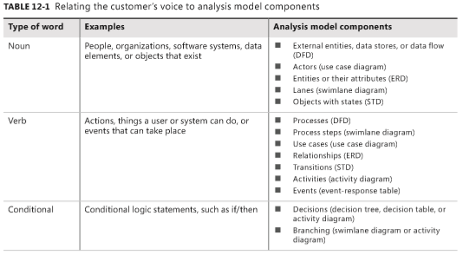
From voice of the customer to analysis models
By listening carefully to how customers present their requirements, the BA can pick out keywords that translate into specific model elements.
Notes:
Table 12-1 suggests possible mappings from customers’ word choices into model component

Slide 7
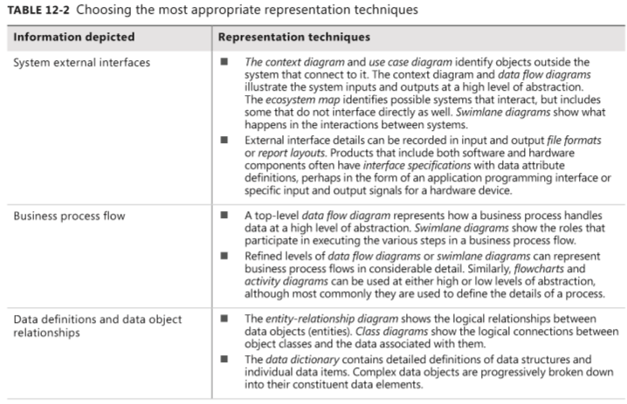
Selecting the right representations

Slide 8
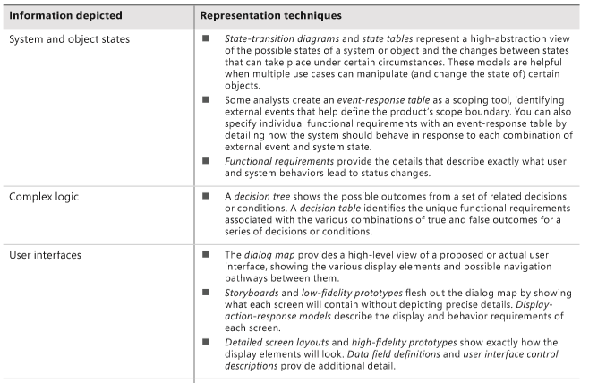
Selecting the right representations

Slide 9
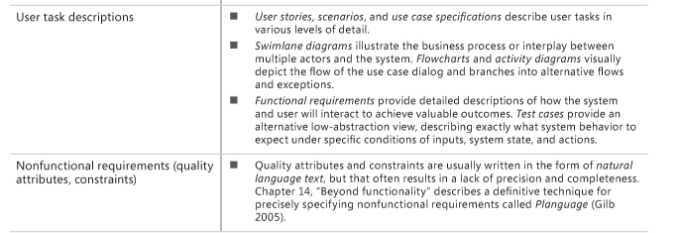
Selecting the right representations

Slide 10
Data flow diagram – context diagram
Purpose
DFDs provide a big-picture view of how data moves through a system, which other models don’t show well
A gives context to the functional requirements regarding how the user performs specific tasks.
DFDs can be used as a technique to identify missing data requirements

Slide 11
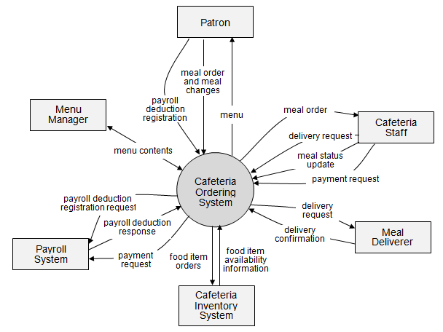
Dataflow diagram: example

Slide 12
Swimlane diagram
Purpose:
Provide a way to represent the steps involved in a business process or the operations of a proposed software system.
They are a variation of flowcharts, subdivided into visual subcomponents called lanes. The lanes can represent different systems or actors that execute the steps in the process.
Swimlane diagrams are most commonly used to show business processes, workflows, or system and user interactions.
They are similar to UML activity diagrams. Swimlane diagrams are sometimes called cross-functional diagrams.

Slide 13
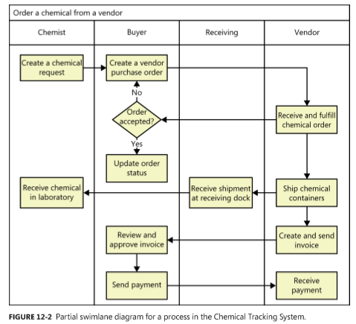
Swimlane example

Slide 14
State-transition diagram and state table
Purpose: Software systems involve a combination of functional behavior, data manipulation, and state changes. Real-time systems and process control applications can exist in one of a limited number of states at any given time.
A state change can take place only when well-defined criteria are satisfied, such as receiving a specific input stimulus under certain conditions
State transition diagram contains three type of elements:
Possible system states, shown as rectangles
Allowed state changes or transitions, shown as arrows connecting pairs of rectangles
Events or conditions that cause each transition to take place, shown as text labels on each transition arrow

Slide 15
What is a State Machine?
A directed graph of states (nodes) connected by transitions (directed arcs)
Describes the life history of a reactive object
Guard Condition
Event
Activity
State1
State2
Event(args)[guard condition]/activity
Transition
State
State
Notes:
The use of state machines vary widely: Some projects use them very extensively, while other projects may have only one or two, maybe even none.
State machines should be used when they help to better understand and communicate the analysis and design of the project. Not all objects require state machines. If an object's behavior is simple, such that it simply stores or retrieves data, the behavior of the object is state-invariant and its state machine is of little interest.
State machines may be specified for classes, subsystems, interfaces, protocols, use cases, and entire systems.
State machines can also be used during early analysis if you need to model the state-controlled behavior of an analysis class.
Briefly describe the icon representations in the diagram. Each of the state machine elements will be discussed on subsequent slides.
A state machine is a tool for describing:
States the object can assume.
Events that cause an object to transition from state to state.
Significant activities and actions that occur as a result.
A state machine is a diagram used to show the life history of a given class, the events that cause a transition from one state to another, and the actions that result from a state change. State machines emphasize the event-ordered behavior of a class instance.
The state space of a given class is the enumeration of all the possible states of an object.
A state is a condition in the life of an object. The state of an object determines its response to different events.
An event is a specific occurrence (in time and space) of a stimulus that can trigger a state transition.
A transition is a change from an originating state to a successor state as a result of some stimulus. The successor state could possibly be the originating state. A transition may take place in response to an event, and can be labeled with an event.
A guard condition is a Boolean expression of attribute values that allows a transition only if the condition is true.
An action is an atomic execution that results in a change in state, or the return of a value.
An activity is a non-atomic execution within a state machine.

Slide 16
Pseudo States
Initial state
The state entered when an object is created
Mandatory, can only have one initial state
Choice
Dynamic evaluation of subsequent guard conditions
Only first segment has a trigger
Final state
Indicates the object’s end
of life
Optional, may have more than one
Initial State
State1
Choice
Final State
State2
Notes:
There is exactly one start state and 0..* end states.
To emphasize why a start state is mandatory, ask the students to think about how they would read a diagram with no start state.
Re: "Only one initial state is permitted." This is not strictly true. When you have nested states, there can be an initial state within each nested state in addition to the one outside of them.
The initial state is the state entered when an object is created
An initial state is mandatory.
Only one initial state is permitted.
The initial state is represented as a solid circle.
A final state indicates the end of life for an object
A final state is optional.
More than one final state may exist.
A final state is indicated by a bull’s eye.

Slide 17
Identify and Define the States
Significant, dynamic attributes
Existence and non-existence of certain links
The maximum number of students per course offering is 10
numStudents < 10
numStudents > = 10
Open
Closed
Professor
Link to Professor
exists
Link to Professor
doesn’t exist
0..1
Assigned
Unassigned
0..*
CourseOffering
Notes:
The states of an object can be found by looking at its class’ attributes and relationships with other classes.
Do not forget to establish the initial and final states for the object. If there are pre-conditions or post-conditions of the initial and final states, define those as well.
It is important not only to identify the different states, but also to explicitly define what it means to be in a particular state.
The above example demonstrates two states of a CourseOffering class instance. A CourseOffering instance may have a Professor assigned to teach it or not (hence the multiplicity of 0..1 on the Professor end of the CourseOffering-Professor association). If a Professor has been assigned to the CourseOffering instance, the state of the CourseOffering instance is “Assigned.” If a Professor has not been assigned to the CourseOffering instance, the state of the CourseOffering instance is “Unassigned.”

Slide 18
Identify the Events
Look at the class interface operations
CourseOffering
0..*
Professor
+ addProfessor()
0..1
+ removeProfessor()
Events: addProfessor, removeProfessor
Notes:
Determine the events to which the object responds. These can be found in the object's interfaces or protocols.
The class must respond to all messages coming into the class instances on all of the interaction diagrams. These messages should correspond to operations on the associated classes. Thus, looking at the class interface operations provides an excellent source for the events the class instance must respond to.
In the above example, two of the CourseOffering operations are addProfessor() and removeProfessor. Each of these operations can be considered an event that a CourseOffering instance must respond to.
Note: A subset of the CourseOffering behavior is shown above.
Events are not operations, although they often map 1 to 1. Remember: Events and operations are not the same thing.

Slide 19
Identify the Transitions
For each state, determine what events cause transitions to what states, including guard conditions, when needed
Transitions describe what happens in response to the receipt of an event
CourseOffering
0..*
0..1
Professor
+ addProfessor()
+ removeProfessor()
Unassigned
removeProfessor
addProfessor
Assigned
Notes:
From the initial state to the final state, lay out the top-level states the object may be in. Connect these states with transitions triggered by the appropriate events. Continue by adding these transitions.
If there are multiple automatic transitions, each transition needs a guard condition. The conditions must be mutually exclusive.
Each state transition event can be associated with an operation. Depending on the object's state, the operation may have a different behavior. The transition events describe how this occurs.
In the above example, when a CourseOffering instance is Unassigned (meaning a Professor has not been assigned to teach it yet), and the instance receives an addProfessor event, the CourseOffering instance transitions into the Assigned state. Conversely, when a CourseOffering instance is Assigned (meaning a Professor has been assigned to teach it), and the instance receives a “removeProfessor” event, the CourseOffering instance transitions into the Unassigned state.
Note: A subset of the CourseOffering behavior is shown above.
The dashed lines show how the transition events can be traced to an operation. This is not UML.

Slide 20
Add Activities
Entry
Executed when the state is entered
Do
Ongoing execution
Exit
Executed when the state is exited
StateA
Entry/anAction
StateB
StateC
Do/anActivity
Exit/someAction
Notes:
Key concepts:
Actions
Entry and Exit Actions
Activities
Automatic transitions
Activities are interruptible; actions are not. If an action can be interrupted by an event, a new state must be defined. Activities are associated with a state; actions are associated with transitions. This holds for entry and exit actions – entry actions occur for every transition into a state, and exit actions occur for every transition out of a state.
Mealy and Moore diagrams are kinds of state machines. A Mealy machine is a state machine whose actions are attached to transitions; a Moore machine is a state machine whose actions are attached to states. In practice, you typically have a mixture. The UML’s state machines support either style.
Entry Activity – Executed when the state is entered, after any activity associated with an incoming transition and before any internal Do activity.
Do Activity – An ongoing activity that is executed as long as the state is active.
Exit Activity – Executed when the state is exited, after completion of any internal Do activity and before any activity associated with an outgoing transition.

Slide 21
Example: State Machine
Example: State machine
addStudent / numStudents = numStudents + 1
/ numStudents = 0
removeStudent [numStudents >0]/ numStudents = numStudents - 1
Unassigned
closeRegistration
addProfessor
cancel
Canceled
do/ Send cancellation notices
close
removeProfessor
[ numStudents = 10 ]
cancel
cancel
Full
close[ numStudents < 3 ]
close
addStudent /
numStudents = numStudents + 1
[ numStudents = 10 ]
closeRegistration [ has Professor assigned ]
Assigned
closeRegistration[ numStudents >= 3 ]
Committed
do/ Generate class roster
close[ numStudents >= 3 ]
removeStudent[ numStudents > 0] / numStudents = numStudents - 1
Notes:
This diagram is not in the example model. (The example model on the next slide has nested states with history state machines.)
The above is a state machine for the CourseOffering class. Here are some things to note about it:
A student can be added or removed from the course offering when the course offering is in the assigned or unassigned state.
The closing of a course occurs in two phases:
Close registration is where course offerings are committed if they have a professor and enough students or canceled if there is no professor. At this point, the course offering is not closed due to low enrollment because during schedule leveling, students may be added or removed from the course offering. Leveling is where it is verified that the maximum number of selected course offerings have been committed by selecting alternates, where necessary.
Close is where the final status of a course offering is determined. If there is a professor and there are enough students, the course offering is committed. If not, the course offering is canceled. This is meant to occur after leveling.

Slide 22
Example: State Machine with Nested States and History
superstate
/ numStudents = 0
Open
closeRegistration
Closed
close
Canceled
Unassigned
do/ Send cancellation notices
cancel
substate
cancel
close[ numStudents < 3 ]
Full
remove a professor
[ numStudents = 10 ]
close
add a professor
closeRegistration [ has Professor assigned ]
Assigned
closeRegistration[ numStudents >= 3 ]
Committed
addStudent /
numStudents = numStudents + 1
do/ Generate class roster
H
close[ numStudents >= 3 ]
removeStudent[ numStudents > 0] / numStudents = numStudents - 1
Notes:
This is the state machine that is in the example model.
Nested states can lead to substantial reduction of graphical complexity, allowing us to model larger and more complex problems.
The Closed superstate was defined to simplify the diagram (no add or remove events supported by this superstate and its substates). The Closed superstate is used for packaging reasons only (“Canceled” and “Committed” are two “flavors” of Closed).
“From a source outside an enclosing composite state, a transition may target the composite state or it may target a substate. If its target is the composite state, the nested state machine must include an initial state, to which control passes after entering the composite state and after dispatching its entry action (if any). If the target is the nested state, control passes to the nested state”. (The Unified Modeling Language User Guide; Booch, Rumbaugh, Jacobson; p. 300).
State machines can become unmanageably large and complex. Nested states may be used to simplify complex diagrams. A superstate is a state that encloses nested states called substates. Common transitions of the substates are represented at the level of the superstate. Any number of levels of nesting is permitted.
The history indicator supports the modeling of “memorized” states. A history indicator (circled H) is placed in the state region whose last executed state needs to be “remembered” after an activity has been interrupted. The use of the history feature indicates that upon return to a superstate, the most recently visited substate will be entered.
The history indicator is a “pseudo-state,” similar to the stop state. States that make use of history must have their transition arrows going to the history pseudo-state. Transitions to the history indicator cause the last state that was executed in the enclosing state region to be resumed. Transitions to the outer boundary of the state region cause a transition back to the start state of the region. If the history feature is not used, the initial substate will always be entered when the superstate is entered.
The above is the CourseOffering class state machine where nested states with history have been used to simplify the diagram. The Open superstate was created to leverage the common transitions of the Unassigned and Assigned states. The use of the history indicator demonstrates that when the common transitions occur, the CourseOffering returns to the substate that it was in when the event was received.

Slide 23
Which Objects Have Significant State?
Objects whose role is clarified by state transitions
Complex use cases that are state-controlled
It is not necessary to model objects such as:
Objects with straightforward mapping to implementation
Objects that are not state-controlled
Objects with only one computational state
Notes:
The state an object resides in is a computational state. It is defined by the stimuli the object can receive and what operations can be performed as a result. An object that can reside in many computational states is state-controlled.
The complexity of an object depends on:
The number of different states.
The number of different events it reacts to.
The number of different actions it performs that depend on its state.
The degree of interaction with its environment (other objects).
The complexity of conditional, repetitive transitions.

Slide 24
How Do State Machines Map to the Rest of the Model?
Events may map to operations
Methods should be updated with state-specific information
States are often represented using attributes
This serves as input into the “Define Attributes” step
CourseOffering
- numStudents
+ addStudent()
Open
addStudent / numStudents = numStudents + 1
Closed
[numStudents<10]
[numStudents>=10]
Notes:
Derived attributes will be discussed in the Define Attributes step.
Some state transition events can be associated with an operation. Depending on the object's state, the operation may have a different behavior. The transition events describe how this occurs.
The method description for the associated operation should be updated with the state-specific information, indicating what the operation should do for each relevant state.
Operation calls are not the only source of events. In the UML, you can model four different kinds of events:
Signals
Calls
Passing of time
Change in state
States are often represented using attributes.The state machines serve as input into the attribute identification step.

Slide 25
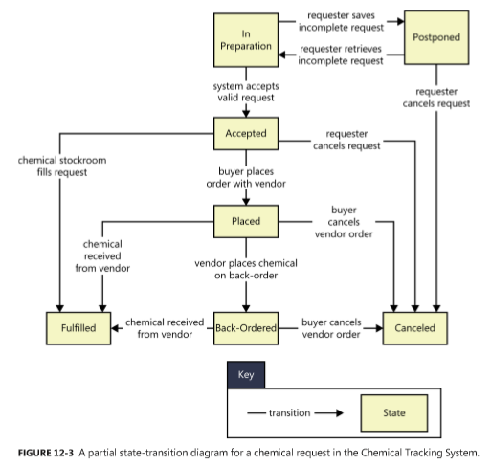
State-transition diagram example – another type

Slide 26
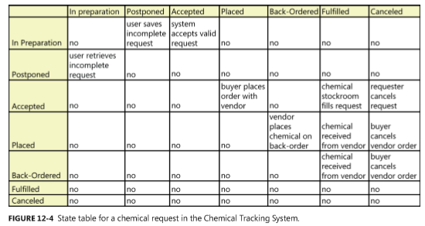
State table example

Slide 27
Several diagrams for self-studying
Dialog map
Decision tables and decision trees
Event-response tables

Slide 28
A few words about UML diagrams
UML diagrams: representation requirements
Why ?
When?
What ?

Slide 30
Use case example
Student
Register for Courses
Course Catalog
Notes:
The following are the definitions for each of the classes shown in the above diagram:
CourseOffering: A specific offering for a course, including days of the week and times.
Schedule: The courses a student has selected for the current semester.
Student: A person enrolled in classes at the university.
As mentioned earlier, sometimes there is a need to model information about an actor within the system. This is not the same as modeling the actor. (Actors are external by definition.) These classes are sometimes called “surrogates”.
For example, a course registration system maintains information about the student that is independent of the fact that the student also plays a role as an actor in the system. This information about the student is stored in a “Student” class that is completely independent of the “actor” role the student plays. The Student class will exist whether or not the student is an actor to the system.
If you choose to walk your students through a sample noun-filtering exercise, these are the entity classes that they should discover.

Slide 31
Example: Sequence Diagram
: Student
: RegisterForCoursesForm
: RegistrationController
: CourseCatalogSystem
: Course Catalog
1: // create schedule( )
2: // get course offerings( )
Create a new
3: // get course offerings(forSemester)
schedule
4: // get course offerings( )
A list of the available
5: // display course offerings( )
course offerings for this
semester are displayed
A blank schedule
6: // display blank schedule( )
is displayed for the
students to select
offerings
ref
Select Offerings
ref
Submit Schedule
Notes:
The above example shows the object interactions to support the Create a Schedule sub-flow of the Register for Courses use case. Some of the rationale for responsibility allocation is as follows:
The RegisterForCoursesForm knows what data it needs to display and how to display it. It does not know where to go to get it. That is one of the RegistrationController’s responsibilities.
Only the RegisterForCoursesForm interacts with the Student actor.
Only the CourseCatalogSystem class interacts with the external legacy Course Catalog System.
Note the inclusion of the actors. This is important as the diagram explicitly models what elements communicate with the “outside world.”
Be sure to walk through this Interaction diagram, emphasizing the responsibility allocation. Emphasize the application of the guidelines provided earlier.
Another option is to NOT show this slide immediately and to build the Interaction diagram interactively with the students on the white board, demonstrating proper allocation of responsibility. When finished, you can compare the results with this slide.
Note the use of “//” as the first two characters of the message name. This naming convention indicates that the operation is being used to describe the responsibilities of the analysis class and that these “analysis” operations WILL PROBABLY change/evolve in design.
Be sure to mention the sequence diagrams that are referenced on the bottom of the graphic.

Slide 32
RegistrationController
<<interface>>
ICourseCatalogSystem
+ // submit schedule ()
+ getCourseOfferings ( [in] forSemester : Semester) : CourseOfferingList
+ // save schedule ()
Global visibility
+ // create schedule with offerings ()
+ // get course offerings ()
0..1
Schedule
0..1
- semester : Semester
0..1
+ submit ()
Field visibility
+ currentSchedule
+ //save ()
Field
visibility
# any conflicts? ()
+ //create with offerings()
0..*
0..*
0..*
0..1
+ registrant
1
alternateCourses
+ primaryCourses
Student
0..2
0..4
- name
CourseOffering
- address
- number : String = "100"
- StudentID : int
- startTime : Time
+ addSchedule ( [in] aSchedule : Schedule )
- endTime : Time
+ getSchedule ( [in] forSemester : Semester ) : Schedule
- day : String
+ hasPrerequisites ( [in] forCourseOffering : CourseOffering ) : boolean
+ addStudent ( [in] aStudentSchedule : Schedule)
# passed ( [in] aCourseOffering : CourseOffering ) : boolean
+ removeStudent ( [in] aStudentSchedule : Schedule)
Parameter visibility
+ new ()
+ setData ()
Notes:
If the students would like an example of global visibility, tell them that all relationships to the Java RMI Naming class would be a good example.
On the presented slide, the changes made are shown in blue, but this does not show up in the black-and-white manuals.
This example demonstrates how an association on the class diagram provided on the previous slide has been refined into a dependency relationship.
During a registration session, the RegistrationController works with one Student, the registrant (the Student that is registering), and one Schedule, the current Schedule (the Student’s Schedule for the current semester). These instances need to be accessed by more than one of the RegistrationController’s operations, so field visibility is chosen from RegistrationController to Student and from RegistrationController to Schedule. Thus, the relationships remain associations.
A Student manages its own Schedules, so field visibility is chosen from Student to Schedule and the relationship remains an aggregation.
CourseOfferings are part of the semantics of what defines a Schedule (a Schedule is the courses a that a Student has selected for a semester). Thus, field visibility is chosen from Schedule to CourseOffering and the relationships remain associations.
The Student class has several operations where CourseOffering appears in the parameter list. Thus, parameter visibility is chosen from Student to CourseOffering. This relationship was actually defined earlier in the Define Operations section.
It is envisioned that the course Catalog System may need to be accessed by multiple clients in the system, so global visibility was chosen, and the relationship becomes a dependency. This is the only change that was made to the relationships shown on the previous slide.

Slide 33
<<control>>
<<boundary>>
<<boundary>>
Actor 1
Actor 2
<<entity>>
<<entity>>
Model interaction between the system and its environment.
Notes:
A boundary class is used to model interaction between the system's surroundings and its inner workings. Such interaction involves transforming and translating events and noting changes in the system presentation (such as the interface).
Boundary classes model the parts of the system that depend on its surroundings. They make it easier to understand the system because they clarify the system's boundaries and aid design by providing a good point of departure for identifying related services. For example, if you identify a printer interface early in the design, you will realize that you must also model the formatting of printouts.
Because boundary classes are used between actors and the working of the internal system (actors can only communicate with boundary classes), they insulate external forces from internal mechanisms and vice versa. Thus, changing the GUI or communication protocol should mean changing only the boundary classes, not the entity and control classes.
A boundary object (an instance of a boundary class) can outlive a use-case instance if, for example, it must appear on a screen between the performance of two use cases. Normally, however, boundary objects live only as long as the use-case instance.

Slide 34
Example: Candidate Entity Classes
Register for Courses (Create Schedule)
Student
Register for Courses
Course Catalog
Student
Schedule
CourseOffering
Notes:
The following are the definitions for each of the classes shown in the above diagram:
CourseOffering: A specific offering for a course, including days of the week and times.
Schedule: The courses a student has selected for the current semester.
Student: A person enrolled in classes at the university.
As mentioned earlier, sometimes there is a need to model information about an actor within the system. This is not the same as modeling the actor. (Actors are external by definition.) These classes are sometimes called “surrogates”.
For example, a course registration system maintains information about the student that is independent of the fact that the student also plays a role as an actor in the system. This information about the student is stored in a “Student” class that is completely independent of the “actor” role the student plays. The Student class will exist whether or not the student is an actor to the system.
If you choose to walk your students through a sample noun-filtering exercise, these are the entity classes that they should discover.

Slide 35
Example: Finding Boundary Classes
One boundary class per actor/use case pair
Student
Register for Courses
Course Catalog
RegisterForCoursesForm
CourseCatalogSystem
Notes:
The goal of Analysis is to form a good picture of how the system is composed, not to design every last detail. In other words, identify boundary classes only for phenomena in the system or for things mentioned in the flow of events of the Use-Case Realization.
Consider the source for all external events and make sure there is a way for the system to detect these events.
One recommendation for the initial identification of boundary classes is one boundary class per actor/use-case pair. This class can be viewed as having responsibility for coordinating the interaction with the actor. This may be refined as a more detailed analysis is performed. This is particularly true for window-based GUI applications where there is typically one boundary class for each window, or one for each dialog box.
In the above example:
The RegisterForCoursesForm contains a Student's "schedule-in-progress." It displays a list of Course Offerings for the current semester from which the Student may select courses to be added to his or her Schedule.
The CourseCatalogSystem interfaces with the legacy system that provides the unabridged catalog of all courses offered by the university. This class replaces the CourseCatalog abstraction originally identified in Architectural Analysis.

Slide 36
Example: Finding Control Classes
In general, identify one control class per use case.
As analysis continues, a complex use case’s control class may evolve into more than one class
Student
Register for Courses
Course Catalog
System
RegistrationController
Notes:
One recommendation is to identify one control class per use case. However, this can become more than one use case as analysis continues. Remember that more complex use cases generally require one or more control cases. Each control class is responsible for orchestrating/controlling the processing that implements the functionality described in the associated use case.
In the above example, the RegistrationController <<control>> class has been defined to orchestrate the Register for Courses processing within the system.

Slide 37
Modeling on agile projects
The difference in how traditional and agile projects perform modeling is related to when the models are created and the level of detail in them
The key point in using analysis models on agile projects—or really, on any project—is to focus on creating only the models you need, only when you need them, and only to the level of detail you need to make sure project stakeholders adequately understand the requirements.

