Slide 1
Part III. Requirements for specific project classes
CHAPTER 20 Agile
CHAPTER 21 Enhancement and reengineering projects
CHAPTER 22 Packaged solution projects
CHAPTER 23 Outsourced projects
CHAPTER 24 Business process automation projects
CHAPTER 25 Business analytics projects
CHAPTER 26 Embedded and other real-time systems projects

Slide 2
CHAPTER 20 Agile

Slide 3
Objectives
Describes the characteristics of agile approaches as they relate to the requirements activities for a software project, the major adaptations of traditional requirements practices for an agile project, and a road map of where to find more detailed guidance.
Student should recognize what and how they have to do in every stage of agile projects

Slide 4
Contents
Limitations of the waterfall
The agile development approach
Essential aspects of an agile approach to requirements
Adapting requirements practices to agile projects
Transitioning to agile: Now what?

Slide 5
Limitations of the waterfall
What it is?
What are advantages?
What are disadvantages?
When we use waterfall development?

Slide 6
The agile development approach
What is agile development approach?
What are advantages?
When we use agile development approach?

Slide 7
Essential aspects of an agile approach to requirements
Customer involvement
Documentation detail
The backlog and prioritization
Timing
Epics, user stories, and features
Expect change

Slide 8
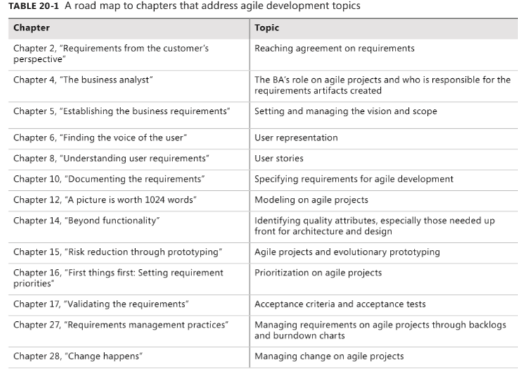
Adapting requirements practices to agile projects

Slide 9
Transitioning to agile: Now what?
Determine what your role is on the team
Identify suggested agile practices that will work best in your organization
Implement a small project first as a pilot for agile methods
…

Slide 10
CHAPTER 21 Enhancement and replacement projects

Slide 11
Objectives
Exploring some suggestions to practice the enhancement and replacement projects.
After finish this chapter, student should know what and how they have to do in enhancement and replacement projects.

Slide 12
Contents
What is Enhancement and replacement project?
Expected challenges
Requirements techniques when there is an existing system
Prioritizing by using business objectives
When old requirements don’t exist
Encouraging new system adoption
Can we iterate?

Slide 13
What is enhancement and replacement project?
An enhancement project is one in which new capabilities are added to an existing system
A replacement (or reengineering) project replaces an existing application with a new custom-built system, a commercial off-the-shelf (COTS) system, or a hybrid of those

Slide 14
Expected challenges
The changes made could degrade the performance to which users are accustomed.
Little or no requirements documentation might be available for the existing system.
Users who are familiar with how the system works today might not like the changes they are about to encounter.
You might unknowingly break or omit functionality that is vital to some stakeholder group.
Stakeholders might take this opportunity to request new functionality that seems like a good idea but isn’t really needed to meet the business objectives

Slide 15
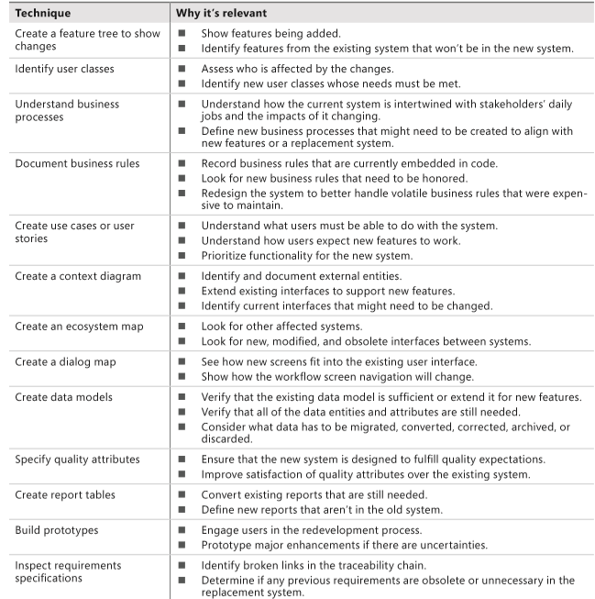
Requirements techniques when there is an existing system

Slide 16
Prioritizing by using business objectives
Mind the gap
Maintaining performance levels

Slide 17
When old requirements don’t exist
Which requirements should you specify?
How to discover the requirements of an existing system

Slide 18
Encouraging new system adoption
Why we do this?
What are advantages?
How to do this?

Slide 19
CHAPTER 22 Packaged solution projects

Slide 20
Objectives
Student should undertand what is packaged solution project and how to get requirements for this project.

Slide 21
Content
What is packaged solution project?
Requirements for selecting packaged solutions

Slide 22
Requirements for selecting packaged solutions
Developing user requirements
Considering business rules
Identifying data needs
Defining quality requirements
Evaluating solutions

Slide 23
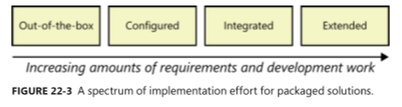
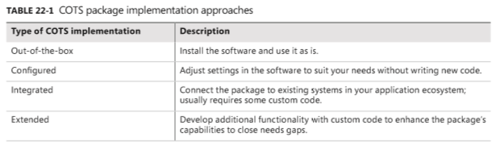
Requirements for implementing packaged solutions

Slide 24
Requirements for implementing packaged solutions
Configuration requirements
Integration requirements
Extension requirements
Data requirements
Business process changes

Slide 25
Common challenges with packaged solutions
Too many candidates
Too many evaluation criteria
Vendor misrepresents package capabilities
Incorrect solution expectations
Users reject the solution

Slide 26
CHAPTER 23 Outsourced projects
SelfStudy

Slide 27
Content
What is outsourced project?
Appropriate levels of requirements detail
Acquirer-supplier interactions
Change management
Acceptance criteria

Slide 28
CHAPTER 24 Business process automation projects
SelfStudy

Slide 29
CHAPTER 25 Business analytics projects
SelfStudy

Slide 30
CHAPTER 26 Embedded and other real-time systems projects
SelfStudy

