Slide 1
CHAPTER 12 A picture is worth 1024 words

Slide 2
Objectives
After finish this chapter, student should understand the purpose of every type of diagrams, when and how to build them.
Student could choice the plan to model requirements.

Slide 3
Contents
A useful of picture in requirements representation
Modeling the requirements
From voice of the customer to analysis models
Selecting the right representations
Data flow diagram
Swimlane diagram
State-transition diagram and state table
Decision tables and decision trees
Modeling on agile projects

Slide 4
A useful of picture in requirements representation
Diagrams communicate certain types of information more efficiently than text can.
Pictures help bridge language and vocabulary barriers among team members

Slide 5
Modeling the requirements
Visual requirements models can help you identify missing, extraneous, and inconsistent requirements.
Given the limitations of human short-term memory, analyzing a list of one thousand requirements for inconsistencies, duplication, and extraneous requirements is nearly impossible.

Slide 6
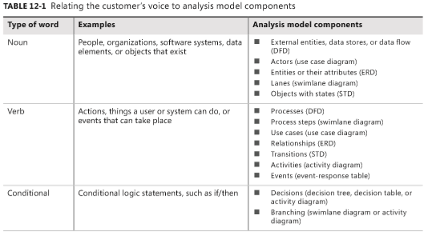
From voice of the customer to analysis models
By listening carefully to how customers present their requirements, the BA can pick out keywords that translate into specific model elements.
Notes:
Table 12-1 suggests possible mappings from customers’ word choices into model component

Slide 7
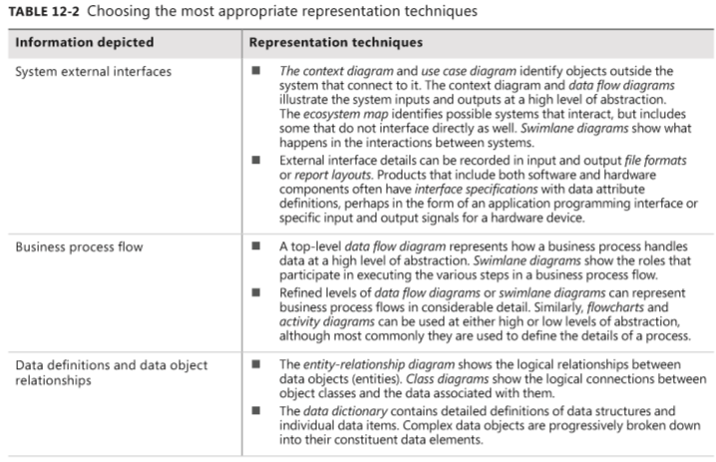
Selecting the right representations

Slide 8
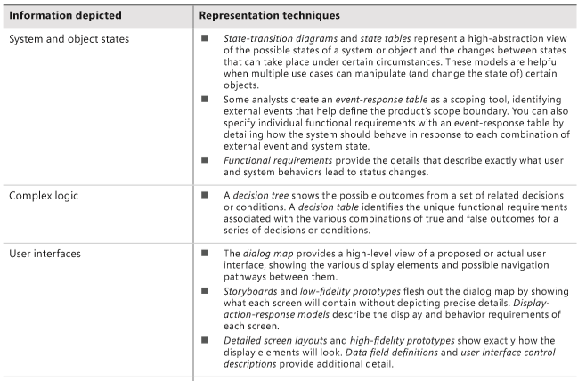
Selecting the right representations

Slide 9
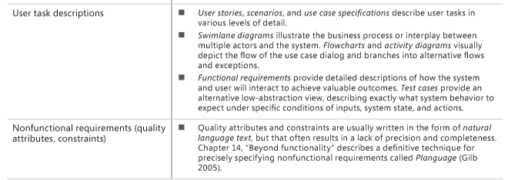
Selecting the right representations

Slide 10
Data flow diagram – context diagram
Purpose
DFDs provide a big-picture view of how data moves through a system, which other models don’t show well
A gives context to the functional requirements regarding how the user performs specific tasks.
DFDs can be used as a technique to identify missing data requirements

Slide 11
Dataflow diagram: example
input data
flow
output data
flow
copyOf
Initiator
constraints
Request
Participant
meeting
invalid
Request
Request
validRequest
Ask
operation
meeting
Check
Constraints
Notification
Request
meeting
constraintRequest
Collect
Merge
Constraints
Determine
Constraints
Constraints
Schedule
Participant
individual
Constraints
participantConstraints
system component
data repository

Slide 12
Swimlane diagram
Purpose:
Provide a way to represent the steps involved in a business process or the operations of a proposed software system.
They are a variation of flowcharts, subdivided into visual subcomponents called lanes. The lanes can represent different systems or actors that execute the steps in the process.
Swimlane diagrams are most commonly used to show business processes, workflows, or system and user interactions.
They are similar to UML activity diagrams. Swimlane diagrams are sometimes called cross-functional diagrams.

Slide 13
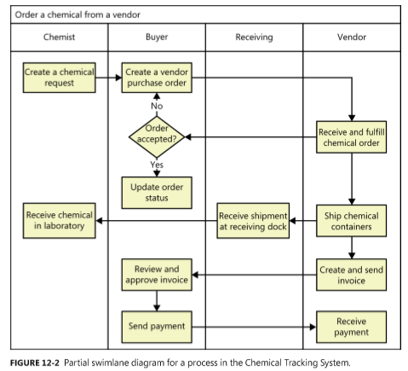
Swimlane example

Slide 14
State-transition diagram and state table
Purpose: Software systems involve a combination of functional behavior, data manipulation, and state changes. Real-time systems and process control applications can exist in one of a limited number of states at any given time.
A state change can take place only when well-defined criteria are satisfied, such as receiving a specific input stimulus under certain conditions
State transition diagram contains three type of elements:
Possible system states, shown as rectangles
Allowed state changes or transitions, shown as arrows connecting pairs of rectangles
Events or conditions that cause each transition to take place, shown as text labels on each transition arrow

Slide 15
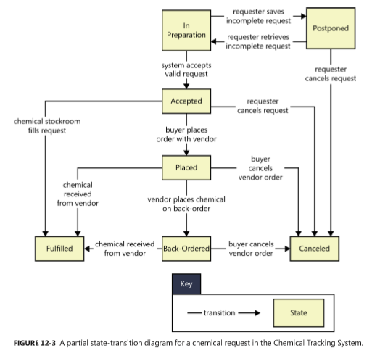
State-transition diagram example

Slide 16
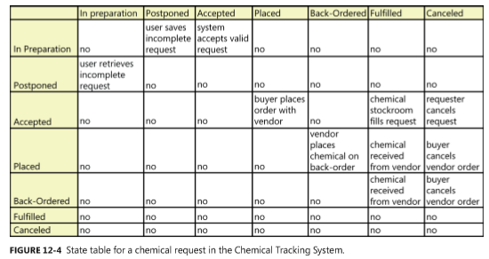
State table example

Slide 17
Several diagrams for self-studying
Dialog map
Decision tables and decision trees
Event-response tables

Slide 18
A few words about UML diagrams
UML diagrams: representation requirements
Why ?
When?
What ?

Slide 19
Modeling on agile projects
The difference in how traditional and agile projects perform modeling is related to when the models are created and the level of detail in them
The key point in using analysis models on agile projects—or really, on any project—is to focus on creating only the models you need, only when you need them, and only to the level of detail you need to make sure project stakeholders adequately understand the requirements.

