Slide 1
CHAPTER 15 Risk reduction through prototyping

Slide 2
Objectives
This chapter describes how prototyping provides value to the project and different kinds of prototypes you might create for different purposes.
It also offers guidance on how to use them during requirements development, as well as ways to make prototyping an effective part of your software engineering process

Slide 3
Contents
Prototyping: What and why
Mock-ups and proofs of concept
Throwaway and evolutionary prototypes
Paper and electronic prototypes
Working with prototypes
Prototype evaluation
Risks of prototyping
Prototyping success factors

Slide 4
Prototyping: What and why
Purpose:
Clarify, complete, and validate requirements
Explore design alternatives
Create a subset that will grow into the ultimate product
Three classes of prototype attributes
Scope
Future use
Form

Slide 5
Mock-ups and proofs of concept
Definition: people say “software prototype,” they are usually thinking about a mock-up of a possible user interface. A mock-up is also called a horizontal prototype.
A proof of concept, also known as a vertical prototype, implements a slice of application functionality from the user interface through all the technical services layers
Purpose:
demonstrate the functional options the user will have available, the look and feel of the user interface (colors, layout, graphics, controls), and the navigation structure
explore some specific behaviors of the intended system, with the goal of refining the requirements
represent the developer’s concept of how a specific use case might be implemented
…

Slide 6
Throwaway prototypes
Purpose: build a throwaway prototype to answer questions, resolve uncertainties, and improve requirements quality (Davis 1993)
A wireframe is a particular approach to throwaway prototyping commonly used for custom user interface design and website design.
You can use wireframes to reach a better understanding of three aspects of a website:
The conceptual requirements
The information architecture or navigation design
The high-resolution, detailed design of the pages

Slide 7
Evolutionary prototypes
Purpose: provides a solid architectural foundation for building the product incrementally as the requirements become clear over time (McConnell 1996).
Agile development provides an example of evolutionary prototyping. Agile teams construct the product through a series of iterations, using feedback on the early iterations to adjust the direction of future development cycles.
Evolutionary prototyping is well suited for web development projects

Slide 8
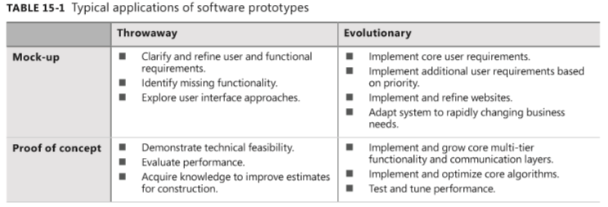
Evolutionary prototypes

Slide 9
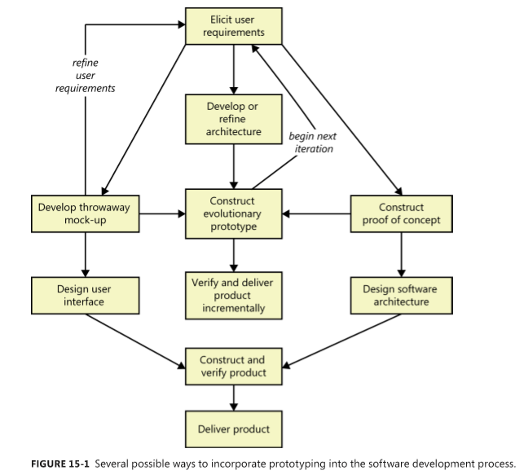

Slide 10
Paper and electronic prototypes
Paper prototype
Pros
Cons
Electronic prototype

Slide 11
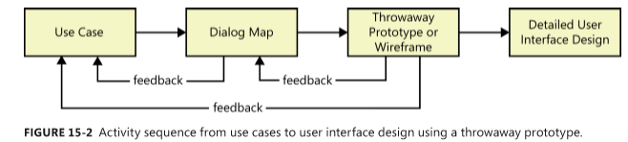
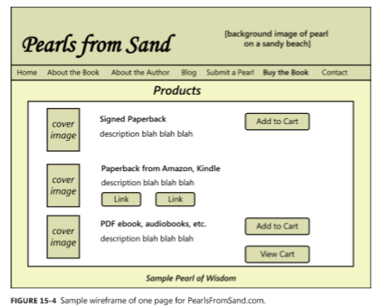
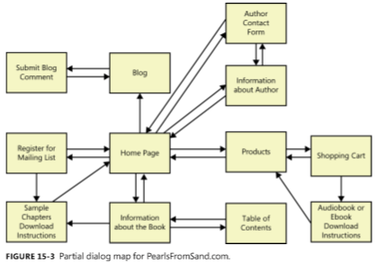

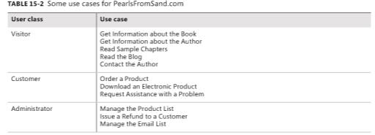
Working with prototypes

Slide 12
Prototype evaluation
You might ask the following questions:
Does the prototype implement the functionality in the way you expected?
What functionality is missing from the prototype?
Can you think of any possible error conditions that the prototype doesn’t address?
Are any unnecessary functions present?
How logical and complete does the navigation seem to you?
Are there ways to simplify any of the tasks that require too many interaction steps?
Were you ever unsure of what to do next?

Slide 13
Risks of prototyping
Pressure to release the prototype
Distraction by details
Unrealistic performance expectations
Investing excessive effort in prototypes

Slide 14
Prototyping success factors
Include prototyping tasks in your project plan.
State the purpose of each prototype before you build it, and explain what will happen with the outcome: either discard (or archive) the prototype, retaining the knowledge it provided, or build upon it to grow it into the ultimate solution.
Plan to develop multiple prototypes.
Create throwaway prototypes as quickly and cheaply as possible.
Don’t include input data validations, defensive coding techniques, error-handling code, or extensive code documentation in a throwaway prototype.
Don’t prototype requirements that you already understand, except to explore design alternatives.
Use plausible data in prototype screen displays and reports.
Don’t expect a prototype to replace written requirement

