Slide 1
CHAPTER 17 Validating the requirements

Slide 2
Objectives
Help student understand detecting errors in the requirements specifications will save time and money.
Student could enhance starting test planning and test-case development in parallel with requirements development, they will detect many errors shortly after they’re introduced.

Slide 3
Contents
Why validate the requirements?
Validation and verification
Reviewing requirements
Prototyping requirements
Testing the requirements
Validating requirements with acceptance criteria

Slide 4
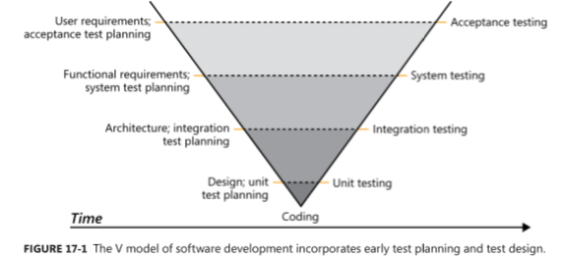
Why validate the requirements?

Slide 5
Validation and verification
Verification determines whether the product of some development activity meets its requirements (doing the thing right).
Validation assesses whether a product satisfies customer needs (doing the right thing).
Requirements validation activities:
The software requirements accurately describe the intended system capabilities and properties that will satisfy the various stakeholders’ needs.
The software requirements are correctly derived from the business requirements, system requirements, business rules, and other sources.
The requirements are complete, feasible, and verifiable.
All requirements are necessary, and the entire set is sufficient to meet the business objectives.
All requirements representations are consistent with each other.
The requirements provide an adequate basis to proceed with design and construction

Slide 6
Reviewing requirements
Reviewing requirements is a powerful technique for identifying ambiguous or unverifiable requirements, requirements that aren’t defined clearly enough for design to begin, and other problems
Informal review approaches:
A peer deskcheck
A passaround
A walkthrough
The inspection process
Defect checklist
Requirements review tips
Requirements review challenges

Slide 7
The inspection process
Participants
The author of the work product and perhaps peers of the author
People who are the sources of information that fed into the item being inspected
People who will do work based on the item being inspected
People who are responsible for interfacing systems that will be affected by the item being inspected
Inspection roles
Author
Moderator
Reader
Recorder
Entry criteria
Inspection stages

Slide 8
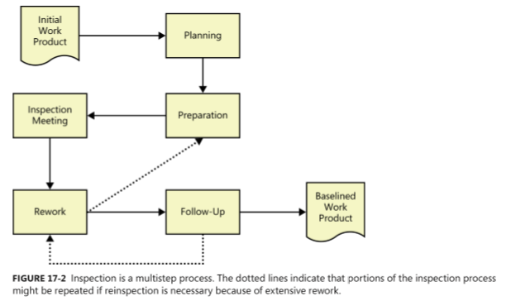
The inspection process: Inspection stages

Slide 9
Defect checklist
Completeness
Correctness
Quality attributes
Organization and Traceability
Other issues

Slide 10
Requirements review tips
Plan the examination
Start early
Allocate sufficient time
Provide context
Set review scope
Limit re-reviews
Prioritize review areas

Slide 11
Requirements review challenges
Large requirements documents
Large inspection teams
Geographically separated reviewers
Unprepared reviewers

Slide 12
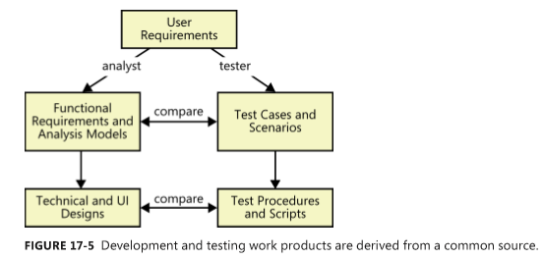
Testing the requirements

Slide 13
Validating requirements with acceptance criteria
Acceptance criteria
Acceptance tests

