Slide 1
CHAPTER 19 Beyond requirements development

Slide 2
Objectives
Exploring some approaches for bridging the gap between requirements development and a successful product release
Student should understand the influence of requirements on project plans, designs, code, and test.

Slide 3
Contents
The effects of requirements on software development
Estimating requirements effort
From requirements to project plans
From requirements to designs and code
From requirements to tests
From requirements to success

Slide 4
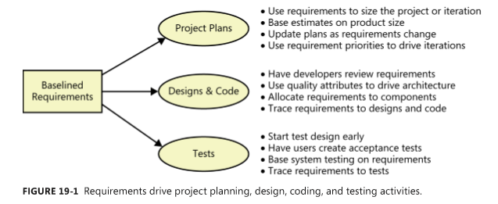
The effects of requirements on software development

Slide 5
Estimating requirements effort
Requirements engineering activity is distributed throughout the project in different ways, depending on whether the project is following a sequential (waterfall), iterative, or incremental development life cycle

Slide 6
From requirements to project plans
Estimating project size and effort from requirements
The number of individually testable requirements (Wilson 1995)
Function points (Jones 1996b; IFPUG 2010)
Story points (Cohn 2005; McConnell 2006) or use case points (Wiegers 2006)
The number, type, and complexity of user interface elements
Estimated lines of code needed to implement specific requirements
Requirements and scheduling
Estimated product size
Known productivity of the development team, based on historical performance
A list of the tasks needed to completely implement and verify a feature or use case
Reasonably stable requirements, at least for the forthcoming development iteration
Experience, which helps the project manager adjust for intangible factors and the unique aspects of each project

Slide 7
From requirements to designs and code
Architecture and allocation
Software design
User interface design
From requirements to tests
From requirements to success

