Slide 1
CHAPTER 6 Finding the voice of the user

Slide 2
Objectives
Student should understand that the success in software requirements, and hence in software development, depends on getting the voice of the user close to the ear of the developer.
Student should enhance step by step to find the voice of the user
Student could classify users and try to understand what type of information the users from each department might supply based on their role in the organization and their department’s perspective on the projects
Enhance the differences in user representation on agile projects

Slide 3
Contents
User classes
User personas
Connecting with user representatives
The product champion
User representation on agile projects

Slide 4
Finding the voice of the user
Steps:
Identify the different classes of users for your product
Select and work with individuals who represent each user class and other stakeholder groups
Agree on who the requirements decision makers are for your project.

Slide 5
User classes: Classifying users
Their access privilege or security levels (such as ordinary user, guest user, administrator)
The tasks they perform during their business operations
The features they use
The frequency with which they use the product
Their application domain experience and computer systems expertise
The platforms they will be using (desktop PCs, laptop PCs, tablets, smartphones, specialized devices)
Their native language
Whether they will interact with the system directly or indirectly

Slide 6
User classes: Identifying user classes for your project
A useful technique for this is a collaboration pattern (Ellen Gottesdiener )
The external entities shown outside your system on a context diagram are candidates for user classes.
A corporate organization chart can also help you discover potential users and other stakeholders (Beatty and Chen 2012).

Slide 7
User personas
A persona is a description of a hypothetical, generic person who serves as a stand-in for a group of users having similar characteristics and needs.
Using personas understand the requirements and to design the user experience to best meet the needs of specific user communities.

Slide 8
Connecting with user representatives
Why do each user class needs someone to speak for requirements?
Typical communication pathways between users and developers

Slide 9
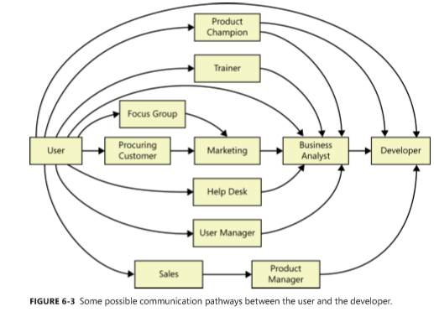
Typical communication pathways between users and developers

Slide 10
Product champion
Definition: product champions?
What does the product champion do?
External product champion
Product champion expectations
Multiple product champions
Selling the product champion idea
Product champion traps to avoid
Notes:
Each of our projects included a few key members of our user community to provide the requirements. We called these people product champions

Slide 11
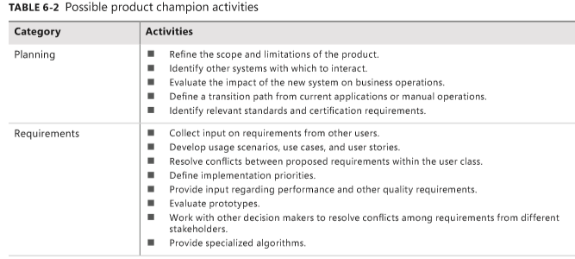
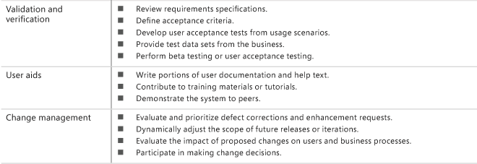
Product champion expectations

Slide 12
User representation on agile projects
Product owner
Differentiate between the product owner and product champion

Slide 13
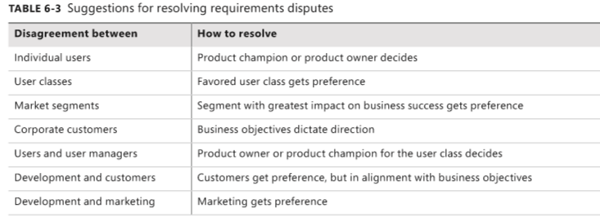
Resolving conflicting requirements

