Slide 1
CHAPTER 7 Requirements elicitation

Slide 2
Objectives
Student should understand the importance of requirements elicitation in requirement engineering.
Student should enhance the list of requirements elicitation techniques and how to use them.
Students should understand which techniques work well? Why? Which ones do not work so well? Why not?
Which techniques that should use in agile projects, other projects.

Slide 3
Contents
Requirements elicitation overview
Requirements elicitation techniques
Planning elicitation on your project
Preparing for elicitation
Performing elicitation activities
Following up after elicitation
Classifying customer input
Some cautions about elicitation
Finding missing requirement

Slide 4
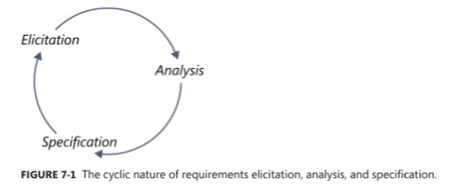
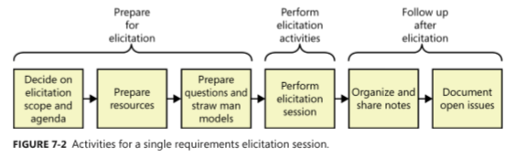
Requirements elicitation overview
Notes:
The heart of requirements development is elicitation, the process of identifying the needs and constraints of the various stakeholders for a software system. Elicitation is not the same as “gathering requirements.” Nor is it a simple matter of transcribing exactly what users say. Elicitation is a collaborative and analytical process that includes activities to collect, discover, extract, and define requirements. Elicitation is used to discover business, user, functional, and nonfunctional requirements, along with other types of information. Requirements elicitation is perhaps the most challenging, critical, error-prone, and communication-intensive aspect of software development

Slide 5
Requirements elicitation techniques: Interviews
Establish rapport
Stay in scope
Prepare questions and straw man models ahead of time
Suggest ideas
Listen actively

Slide 6
Requirements elicitation techniques: Workshops
Establish and enforce ground rules
Fill all of the team roles
Plan an agenda
Stay in scope
Use parking lots to capture items for later consideration
Timebox discussions
Keep the team small but include the right stakeholders
Keep everyone engaged

Slide 7
Requirements elicitation techniques: Focus groups
A representative group of users who convene in a facilitated elicitation activity to generate input and ideas on a product’s functional and quality requirements.
Focus group sessions must be interactive, allowing all users a chance to voice their thoughts.
Focus groups are useful for exploring users’ attitudes, impressions, preferences, and needs
Useful for commercial products and don’t have ready access to end users within your company.

Slide 8
Requirements elicitation techniques: Observations
Focus on task elicitation in the system-as-is
Understanding a task is often easier by observing people performing it (rather than verbal or textual explanation)
cf. tying shoelaces
Passive observation: no interference with task performers
Watch from outside, record (notes, video), edit transcripts, interpret
Protocol analysis: task performers concurrently explain it
Ethnographic studies: over long periods of time, try to discover emergent properties of social group involved
about task performance + attitudes, reactions, gestures, ...
Active observation: you get involved in the task, even become a team member
Notes:
May reveal ...
tacit knowledge that would not emerge otherwise
e.g. ethnographic study of air traffic control => implicit mental
model of air traffic to be preserved in system-to-be
hidden problems through tricky ways of doing things
culture-specific aspects to be taken into account
J Contextualization of acquired info
L Slow & expensive: to be done over long periods of time,
at different times, under different workload conditions
L Potentially inaccurate (people behave differently when observed)
L Data mining problem, interpretation problem
L Focus on system-as-is

Slide 9
Requirements elicitation techniques: Questionnaires
Submit a list of questions to selected stakeholders, each with a list of possible answers (+ brief context if needed)
Multiple choice question: one answer to be selected from answer list
Weighting question: list of statements to be weighted...
qualitatively (‘high’, ‘low”, ...), or
quantitatively (percentages)
to express perceived importance, preference, risk etc.
Effective for acquiring subjective info quickly, cheaply, remotely from many people
Helpful for preparing better focussed interviews (see next)

Slide 10
Requirements elicitation techniques: Questionnaires
Subject to ...
multiple biases: recipients, respondents, questions, answers
unreliable info: misinterpretation of questions, of answers, inconsistent answers, ....
=> Guidelines for questionnaire design/validation:
Select a representative, statistically significant sample of people; provide motivation for responding
Check coverage of questions, of possible answers
Make sure questions, answers, formulations are unbiased & unambiguous
Add implicitly redundant questions to detect inconsistent answers
Have your questionnaire checked by a third party

Slide 11
System interface analysis
Purpose
What it is?
How to process
Practice with student’s assignment

Slide 12
User interface analysis
Purpose
What it is?
How to process
Practice with student’s assignment

Slide 13
Document analysis
Purpose
What it is?
How to process
Practice with student’s assignment

Slide 14
Brainstorming
Purpose
What it is?
How to process
Practice with student’s assignment

Slide 15
Prototyping
Purpose
What it is?
How to process
Practice with student’s assignment

Slide 16
Storyboards
Purpose
What it is?
How to process
Practice with student’s assignment

Slide 17
Planning elicitation on your project
Elicitation objectives
Elicitation strategy and planned techniques
Schedule and resource estimates
Documents and systems needed for independent elicitation
Expected products of elicitation efforts
Elicitation risks

Slide 18
Preparing for elicitation
Plan session scope and agenda
Prepare resources
Learn about the stakeholders
Prepare questions
Prepare straw man models

Slide 19
Performing elicitation activities
Educate stakeholders
Take good notes
Exploit the physical space

Slide 20
Following up after elicitation
Organizing and sharing the notes
Documenting open issues

Slide 21
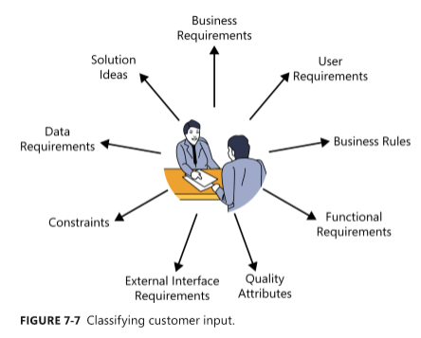
Classifying customer input

Slide 22
How do you know when you’re done?
No simple signal will indicate when you’ve completed requirements elicitation.
Perhaps you are done if:
The users can’t think of any more use cases or user stories. Users tend to identify user requirements in sequence of decreasing importance.
Users propose new scenarios, but they don’t lead to any new functional requirements. A “new” use case might really be an alternative flow for a use case you’ve already captured.
Users repeat issues they already covered in previous discussions.

Slide 23
How do you know when you’re done?
Suggested new features, user requirements, or functional requirements are all deemed to be out of scope.
Proposed new requirements are all low priority.
The users are proposing capabilities that might be included “sometime in the lifetime of the product” rather than “in the specific product we’re talking about right now.”
Developers and testers who review the requirements for an area raise few questions

Slide 24
Some cautions about elicitation
Balance stakeholder representation
Define scope appropriately
Avoid the requirements-versus-design argument
Research within reason

Slide 25
Assumed and implied requirements
Assumed requirements are those that people expect without having explicitly expressed them. What you assume as being obvious might not be the same as assumptions that various developers make.
Implied requirements are necessary because of another requirement but aren’t explicitly stated. Developers can’t implement functionality they don’t know about.

Slide 26
Finding missing requirements
Decompose high-level requirements into enough detail to reveal exactly what is being requested
Ensure that all user classes have provided input
Trace system requirements, user requirements, event-response lists, and business rules to their corresponding functional requirements to make sure that all the necessary functionality was derived.
Check boundary values for missing requirements
Represent requirements information in more than one way

Slide 27
Finding missing requirements
Sets of requirements with complex Boolean logic (ANDs, ORs, and NOTs) often are incomplete
Create a checklist of common functional areas to consider for your projects
A data model can reveal missing functionality

