Slide 1
CHAPTER 9 Playing by the rules

Slide 2
Objectives
After finish this chapter, student should understand the influence of business rule on many type of software requirements
Student could identify at least one of each business rule type from the taxonomy in Figure 9-1 for student’s project
Set up a traceability matrix to indicate which functional requirements enforce each business rule that student identified.
Identify the rationale behind each functional requirements to discover other, implicit business rules

Slide 3
Contents
A business rules taxonomy
Documenting business rules
Discovering business rules
Business rules and requirements
Tying everything together

Slide 4
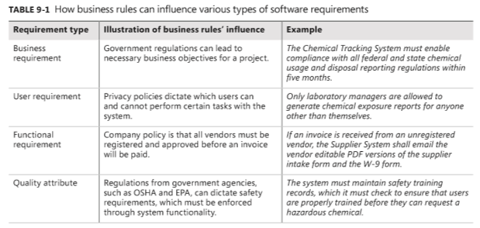
Business rules overview

Slide 5
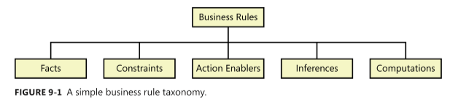
A business rules taxonomy
Definition:
From the business perspective
From the information system perspective
Atomic business rules
A simple business rule taxonomy

Slide 6
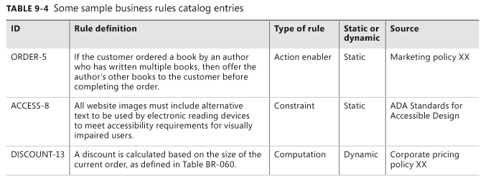
Documenting business rules

Slide 7
Discovering business rules
“Common knowledge” from the organization, often collected from individuals who have worked with the business for a long time and know the details of how it operates.
Legacy systems that embed business rules in their requirements and code. This requires reverse-engineering the rationale behind the requirements or code to understand the pertinent rules. This sometimes yields incomplete knowledge about the business rules.
Business process modeling, which leads the analyst to look for rules that can affect each process step: constraints, triggering events, computational rules, and relevant facts.
Analysis of existing documentation, including requirements specifications from earlier projects, regulations, industry standards, corporate policy documents, contracts, and business plans.
Analysis of data, such as the various states that a data object can have and the conditions under which a user or a system event can change the object’s state.
Compliance departments in companies building systems subject to regulation.

Slide 8
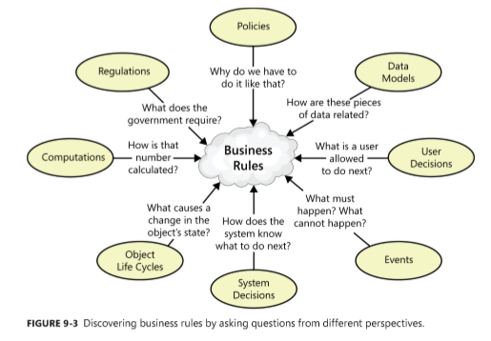
Discovering business rules

Slide 9
Business rules and requirements
After identifying and documenting business rules, determine which ones must be implemented in the software.
Business rules and their corresponding functional requirements sometimes look a lot alike. However, the rules are external statements of policy that must be enforced in software, thereby driving system functionality.
Every BA must decide which rules pertain to his application, which ones must be enforced in the software, and how to enforce them.

Slide 10
Tying everything together
To prevent redundancy, don’t duplicate rules from your business rules catalog in the requirements documentation.
Instead, refer back to specific rules as being the source of certain functionality or algorithms.
You can define the links between a functional requirement and its parent business rules in several ways-
If you are using a requirements management tool, create a requirement attribute called “Origin” and indicate the rules as being the origin of derived functional requirements.
Define traceability links between functional requirements and the connected business rules in a requirements traceability matrix or a requirements mapping matrix
If the business rules and requirements are stored in word processing or spreadsheet files, define hyperlinks from business rule ID references in the requirements back to the descriptions of the business rules stored elsewhere. Be aware that hyperlinks are prone to breaking if the location of the rules collection changes.

