Slide 1
Chapter 29 Links in the requirements chain

Slide 2
Objectives
Addressing the subject of requirements tracing (or traceability).
Student should enhance that the requirements trace information documents the dependencies and logical links between individual requirements and other system elements.
Student should understand that trace information facilitates impact analysis to identify all the work products regarding implementation of requirement change

Slide 3
Contents
Tracing requirements
Motivations for tracing requirements
The requirements traceability matrix
A requirements tracing procedure

Slide 4
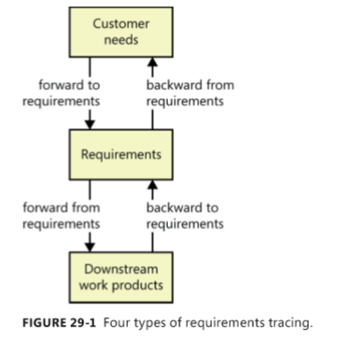
Tracing requirements
Why tracing requirements?
Is requirements tracing feasible? Is it necessary?
Types of requirements tracing

Slide 5
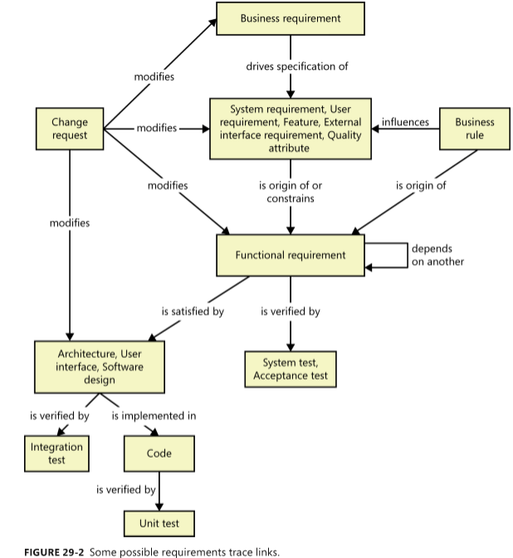

Slide 6
Motivations for tracing requirements
Finding missing requirements
Finding unnecessary requirements
Certification and compliance
Change impact analysis
Maintenance
Project tracking
Reengineering
Reuse
Testing

Slide 7
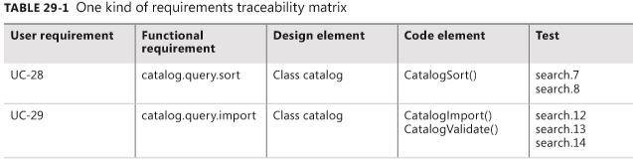
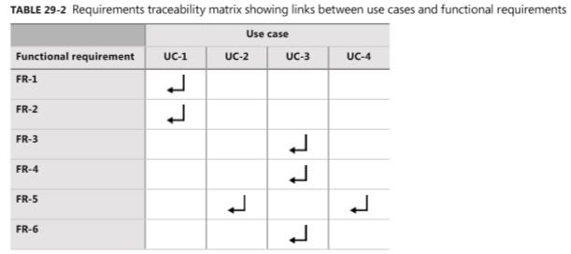
The requirements traceability matrix
Requirements traceability matrix=requirements trace matrix = a traceability table: Represent the links between requirements and other system elements

Slide 8
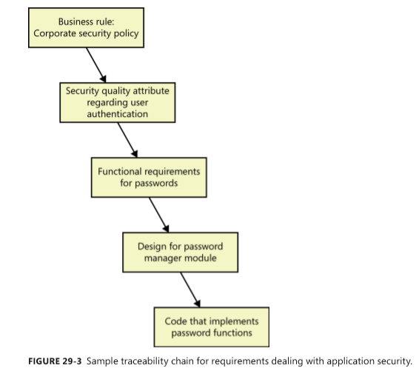
Traceability chain involving nonfunctional requirements

Slide 9
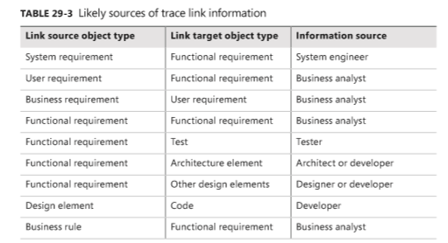
Trace link information

Slide 10
A requirements tracing procedure
See list of steps in page 499 and try to process with your project’s requirements.

