Slide 1
Chapter 30 Tools for requirements engineering

Slide 2
Objectives
Present several benefits of using requirements tools and identifies some general capabilities you can expect to find in such products.
Student should understand the purpose of these tools.
Student should enhance that there are dozens of commercial requirements tools are available. However, choicing whatever tools we have to annual maintenance fees and periodic upgrades, software installation and configuration, administration, vendor support and consulting, and training for users

Slide 3
Contents
Requirements development tools
Requirements management tools
RM tool capabilities
Selecting and implementing a requirements tool

Slide 4
Requirements development tools
Elicitation tools
Prototyping tools
Modeling tools

Slide 5
Requirements management tools
Benefits of using an RM tool
Manage versions and changes
Store requirements attributes
Facilitate impact analysis
Identify missing and extraneous requirements
Track requirements status
Control access
Communicate with stakeholders
Reuse requirements
Track issue status
Generate tailored subsets

Slide 6
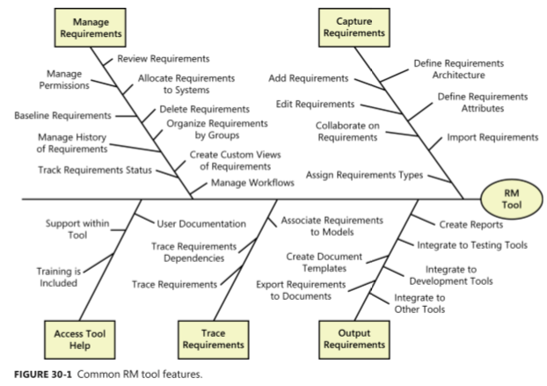
Requirements management tools
RM tool capabilities

Slide 7
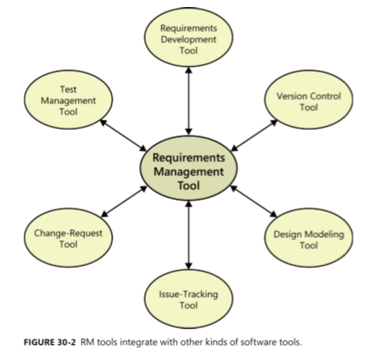
RM tool capabilities

Slide 8
Selecting and implementing a requirements tool
Selecting a tool
Setting up the tool and processes
Facilitating user adoption

