Slide 1
CHAPTER 1 The essential of software requirement

Slide 2
Objectives
Understand some key terms used in the software requirements domain.
Distinguish product requirements from project requirements.
Distinguish requirements development from requirements management.
Be alert to several requirements-related problems that can arise

Slide 3
Contents
Why is requirement engineering?
Software requirements defined
Requirements development and management
When bad requirements happen to good people
Benefits from a high-quality requirements process

Slide 4
Why is requirement engineering?
Distribution of Defects
Distribution of Effort to Fix Defects
Code
7%
Code
1%
Other
4%
Requirements
56%
Other
10%
Design
13%
Requirements
82%
Design
27%
Source: Martin & Leffinwell

Slide 5
Software requirements defined
Brian Lawrence: “anything that drives design choices” (Lawrence 1997)
“Requirements are a specification of what should be implemented. They are descriptions of how the system should behave, or of a system property or attribute. They may be a constraint on the development process of the system” Ian Sommerville and Pete Sawyer (1997)

Slide 6
The scope of RE: the WHY, WHAT, WHO dimensions
System-as-is
System-to-be
WHY
a new system?
problems,
opportunities,
system knowledge
Objectives
satisfy
requirements,
constraints,
assumptions
WHAT
services?
assignment
WHO
will be responsible
for what ?

Slide 7
List of assignments
Yoga & Gym center
Cars garage management
Hair salon management
Spa salon management
Bakery making and ordering management
Canteen automation system
Book ordering system
Student information management
Aodai online
Toys and doll retailer management
Games center for children
Online pharmacy system
Dormitory management
Notes:
Day-boarder management system in elementary school

Slide 8
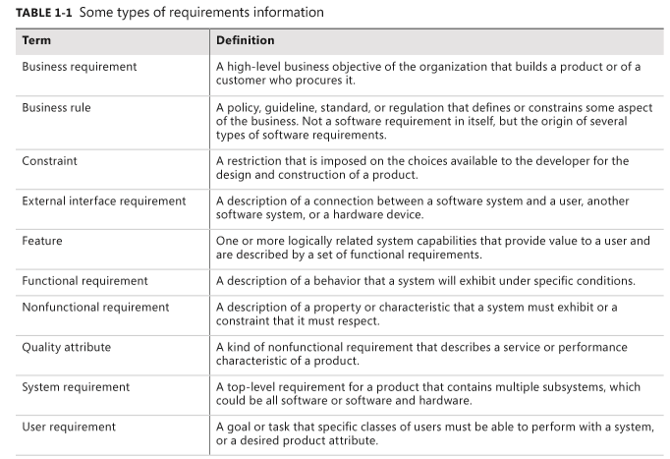
Types of requirements

Slide 9
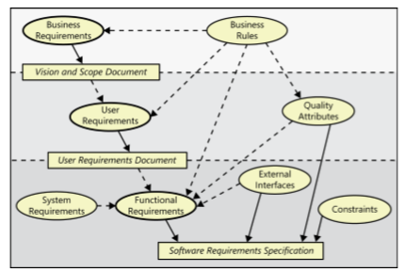
Levels and types of requirements

Slide 10
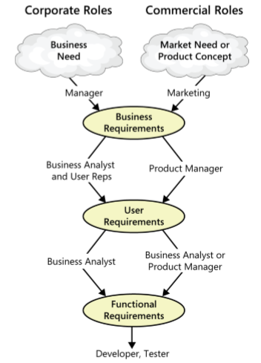
The participation of stakeholders in requirements development
Notes:
Working with three levels

Slide 11
Product vs. project requirements
Product requirements:
properties of a software system to be built
Projects requirements:
do have other expectations and deliverables that are not a part of the software the team implements, but that are necessary to the successful completion of the project as a whole
Notes:
Teacher should explain more detail about every type of requirements

Slide 12
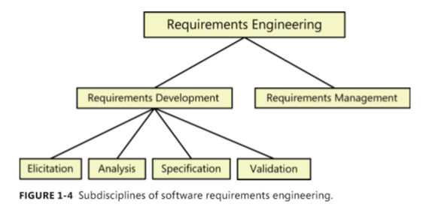
Requirements development and management
Notes:
Teacher should explain every step

Slide 13
Elicitation
Identifying the product’s expected user classes and other stakeholders.
Understanding user tasks and goals and the business objectives with which those tasks align.
Learning about the environment in which the new product will be used.
Working with individuals who represent each user class to understand their functionality needs and their quality expectations.

Slide 14
Analysis
Analyzing the information received from users to distinguish their task goals from functional requirements, quality expectations, business rules, suggested solutions, and other information
Decomposing high-level requirements into an appropriate level of detail
Deriving functional requirements from other requirements information
Understanding the relative importance of quality attributes
Allocating requirements to software components defined in the system architecture
Negotiating implementation priorities
Identifying gaps in requirements or unnecessary requirements as they relate to the defined scope

Slide 15
Specification
Translating the collected user needs into written requirements and diagrams suitable for comprehension, review, and use by their intended audiences.

Slide 16
Validation
Reviewing the documented requirements to correct any problems before the development group accepts them.
Developing acceptance tests and criteria to confirm that a product based on the requirements would meet customer needs and achieve the business objectives.

Slide 17
Requirements management
Defining the requirements baseline, a snapshot in time that represents an agreed-upon, reviewed, and approved set of functional and nonfunctional requirements, often for a specific product release or development iteration
Evaluating the impact of proposed requirements changes and incorporating approved changes into the project in a controlled way
Keeping project plans current with the requirements as they evolve
Negotiating new commitments based on the estimated impact of requirements changes
Defining the relationships and dependencies that exist between requirements
Tracing individual requirements to their corresponding designs, source code, and tests
Tracking requirements status and change activity throughout the project

Slide 18
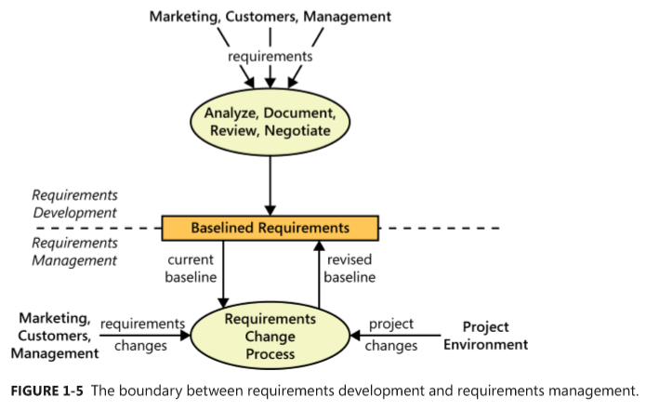
Requirements management & requirements development

Slide 19
When bad requirements happen to good people
Insufficient user involvement
Inaccurate planning
Creeping user requirements
Ambiguous requirements
Gold plating
Overlooked stakeholders
Notes:
Gold plating takes place when a developer adds functionality that wasn’t in the requirements specification (or was deemed out of scope) but which the developer believes “the users are just going to love
Overlooked stakeholders
Most products have several groups of users who might use different subsets of features, have different frequencies of use, or have varying levels of experience. If you don’t identify the important user classes for your product early on, some user needs won’t be met

Slide 20
Benefits from a high-quality requirements process
Fewer defects in requirements and in the delivered product.
Reduced development rework.
Faster development and delivery.
Fewer unnecessary and unused features
Lower enhancement costs
Fewer miscommunications.
Reduced scope creep.
Reduced project chaos.
Higher customer and team member satisfaction.
Products that do what they’re supposed to do.
Notes:
Creep: to move slowly, quietly and carefully, because you do not want to be seen or heard

