Slide 1
CHAPTER 2 Requirements from the customer’s perspective

Slide 2
Objectives
After finish this chapter, student should understand that the customer-development relationship is so critical to software project success.
This chapter also discusses the critical issue of reaching agreement on a set of requirements planned for a specific release or development iteration
Requirements Bill of Rights for Software Customers and a corresponding Requirements Bill of Responsibilities for Software Customers could bring to student the importance of customer—and specifically end user—involvement in requirements development.

Slide 3
Contents
The expectation gap
Who is the customer
The customer-development partnership
Requirements Bill of Rights for Software Customers
Requirements Bill of Responsibilities for Software Customers
Creating a culture that respects requirements
Identifying decision makers
Reaching agreement on requirements

Slide 4
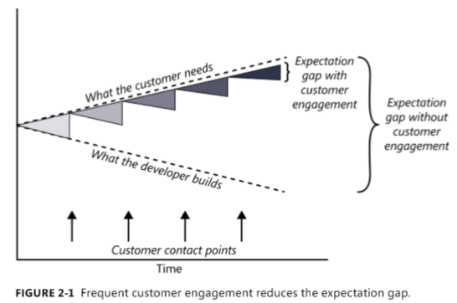
The expectation gap

Slide 5
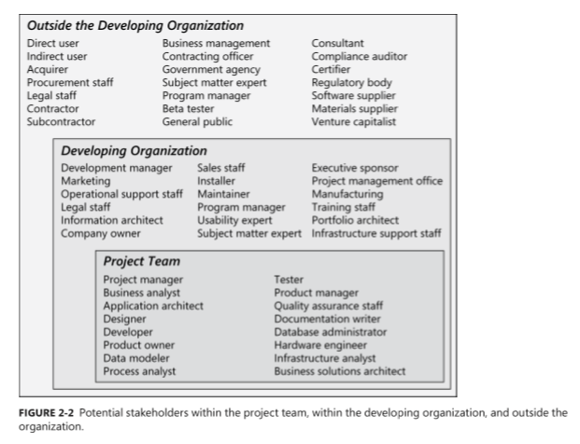
Who is the customer?

Slide 6
The customer-development partnership
Customers have the right to:
Expect BAs to speak your language.
Expect BAs to learn about your business and your objectives.
Expect BAs to record requirements in an appropriate form.
Receive explanations of requirements practices and deliverables.
Change your requirements.
Expect an environment of mutual respect.
Hear ideas and alternatives for your requirements and for their solution.
Describe characteristics that will make the product easy to use.
Hear about ways to adjust requirements to accelerate development through reuse.
Receive a system that meets your functional needs and quality expectations.
Notes:
Teacher should explain every the right of customers in requirements engineering activities

Slide 7
The customer-development partnership
Customers have the responsibility to:
Educate BAs and developers about your business.
Dedicate the time that it takes to provide and clarify requirements.
Be specific and precise when providing input about requirements.
Make timely decisions about requirements when asked.
Respect a developer’s assessment of the cost and feasibility of requirements.
Set realistic requirement priorities in collaboration with developers.
Review requirements and evaluate prototypes.
Establish acceptance criteria.
Promptly communicate changes to the requirements.
Respect the requirements development process
Notes:
Teacher should explain every the responsibility of customers in requirements engineering activities

Slide 8
Identifying decision makers
decision leader
decision rule
Notes:
■ The decision leader makes the choice, either with or without discussion with others. ■■ The group votes and the majority rules. ■■ The group votes, but the result must be unanimous to approve the decision. ■■ The group discusses and negotiates to reach a consensus. Everyone can live with the decision and commits to supporting it. ■■ The decision leader delegates authority for making the decision to one individual. ■■ The group reaches a decision, but some individual has veto authority over that decision.

Slide 9
Reaching agreement on requirements
Customers agree that the requirements address their needs.
Developers agree that they understand the requirements and that they are feasible.
Testers agree that the requirements are verifiable.
Management agrees that the requirements will achieve their business objectives.
The requirements baseline
What if you don’t reach agreement?
Agreeing on requirements on agile projects

Slide 10
The requirements baseline (p39)
A requirements baseline is a set of requirements that has been reviewed and agreed upon and serves as the basis for further development
A meaningful baselining process gives all the major stakeholders confidence in the following ways:
Customer management or marketing is confident that the project scope won’t explode out of control, because customers manage the scope change decisions.
User representatives have confidence that the development team will work with them to deliver the right solution, even if they didn’t think of every requirement before construction began.
Development management has confidence because the development team has a business partner who will keep the project focused on achieving its objectives and will work with development to balance schedule, cost, functionality, and quality.
Business analysts and project managers are confident that they can manage changes to the project in a way that will keep chaos to a minimum.
Quality assurance and test teams can confidently develop their test scripts and be fully prepared for their project activities.

Slide 11
What if you don’t reach agreement?

Slide 12
Agreeing on requirements on agile projects

