Slide 1
Chapter 31 Improving your requirements processes

Slide 2
Objectives
Student could understand how requirements relate to various other project processes and stakeholders.
Student enhance some basic concepts about software process improvement and a suggested process improvement cycle.
Student enhance a list several useful requirements “process assets” that yorganization should have available.
Enhance a process improvement road map for implementing improved requirements engineering processes.

Slide 3
Contents
How requirements relate to other project processes
Requirements and various stakeholder groups
Gaining commitment to change

Slide 4
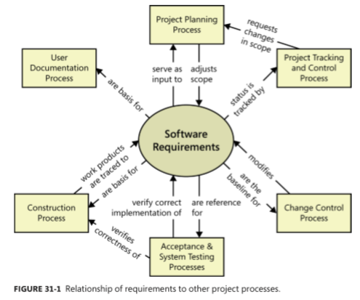
How requirements relate to other project processes

Slide 5
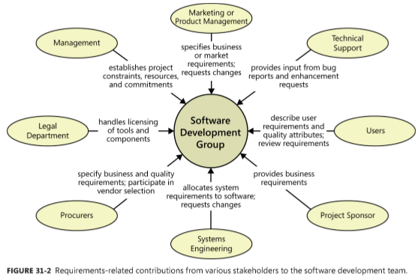
Requirements and various stakeholder groups

Slide 6
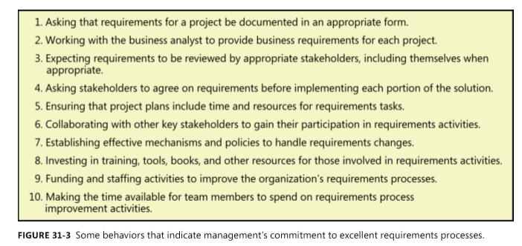
Gaining commitment to change

Slide 7
Fundamentals of software process improvement
Process improvement should be evolutionary and continuous
People and organizations change only when they have an incentive to do so
Process changes should be goal-oriented
Treat your improvement activities as mini-projects.

Slide 8
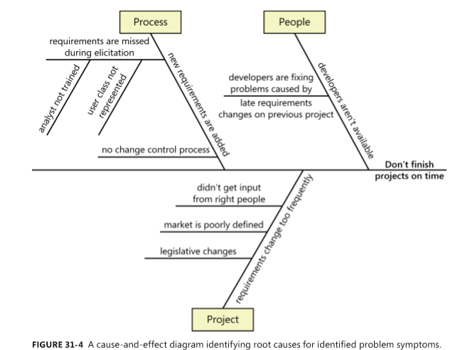
Root cause analysis
Root cause analysis seeks to identify the underlying factors that contribute to an observed problem, distinguishing symptoms from their causes

Slide 9
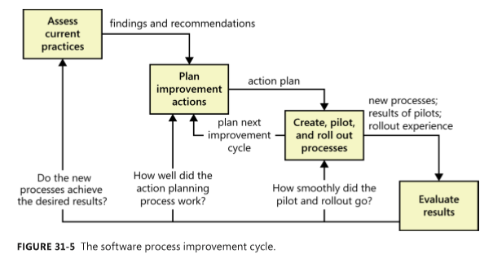
The process improvement cycle

Slide 10
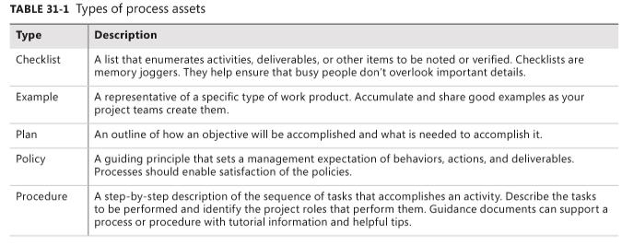
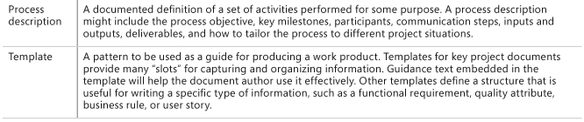
Requirements engineering process assets

Slide 11
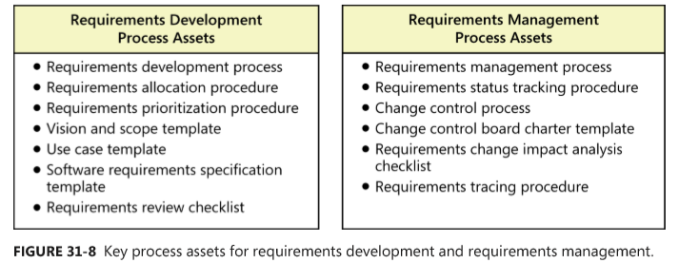
Requirements engineering process assets

Slide 12
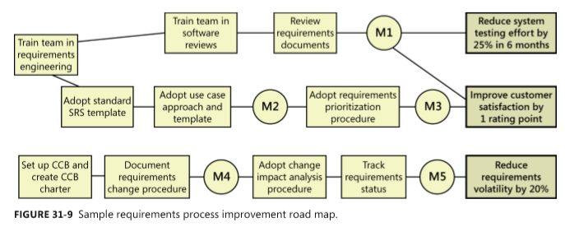
Creating a requirements process improvement road map

