Slide 1
FINAL REVIEW · FULL DEMONSTRATION
Intelligent Router Path Selection using Machine Learning
97.0 path quality vs 78.3 for OSPF on unseen traffic
github.com/K-RANGARAJAN/smart-path-selector

Slide 2
RECAP
Static metrics can’t see congestion
R
RIP
Hop count
THIS PROJECT
Measure every candidate path, predict its quality next interval, route on the prediction.
O
OSPF
Configured cost
B
BGP
Policy, AS path
Random Forest regression on latency, bandwidth, loss, jitter, hop count and their trends. Compared head-to-head with RIP, OSPF and BGP on identical traffic.
…none react to live congestion, loss or jitter.
Final review
2

Slide 3
COMPLETION
Everything planned at DA 1 is built
✓
✓
✓
✓
✓
✓
Simulator
Dataset
Model
Engine
Evaluation
Dashboard
12 routers · 4 ASes · congestion episodes
280k rows, next-tick target
Random Forest · R² 0.897
Best predicted path, anti-flapping
vs RIP, OSPF, BGP, no-ML, oracle
Live, congestion injection
31
4.4 ms
PT
automated tests passing
to score 9 candidate paths
Packet Tracer parser + validation workflow
Final review
3

Slide 4
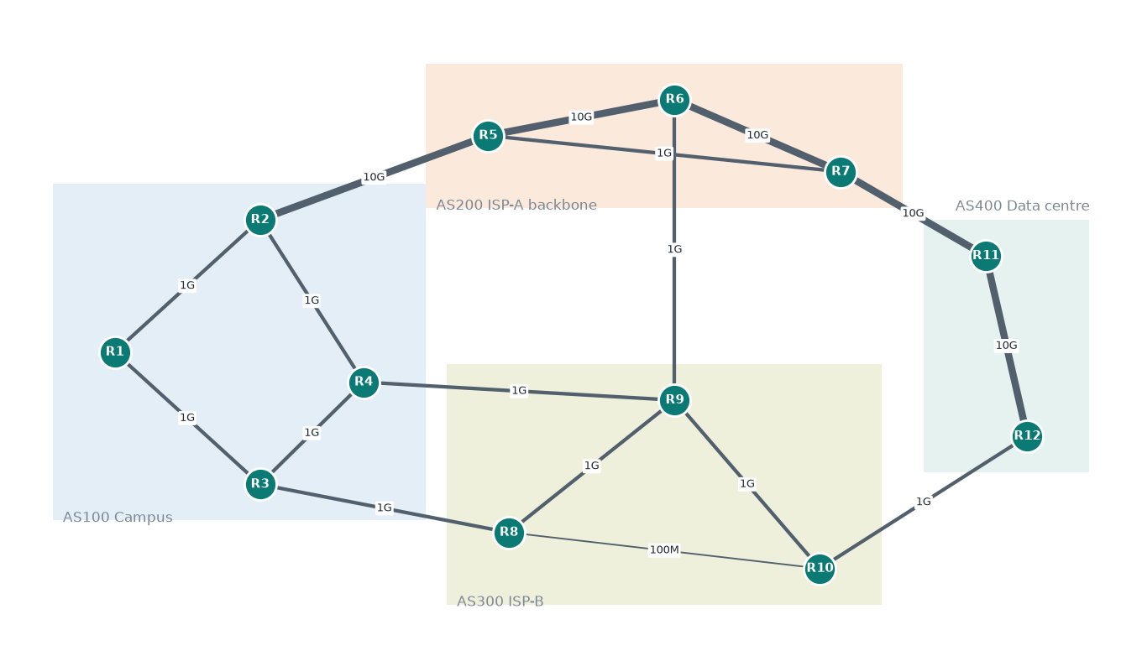
SETUP
Test network: each protocol disagrees
Flow R1 → R12
4 hops over the 100 Mbps R8–R10 link
RIP
Cheapest cost: the busy 10 Gbps AS200 backbone
OSPF
Local preference: AS300, the cheaper ISP
BGP
Final review
4

Slide 5
MODEL
The model: accurate, and it ignores hop count
R² 0.897 test · 0.912 ± 0.009 in 5-fold CV
Final review
5
Notes:
Hop count, the one metric RIP uses, contributes essentially nothing (0.0001) to predicting how a path will actually perform.

Slide 6
ROUTING RESULTS
ML routing nearly matches the hindsight-best path
+18.6
quality points over OSPF
98%
of the gap from OSPF to the best possible path closed
0.3%
of time degraded (OSPF 19%, RIP 41%)
Final review
6

Slide 7
ROUTING RESULTS
Lower latency, far less loss
Strategy | Quality | Latency ms | p95 latency ms | Loss % | Near-optimal % | Route changes /1k
ML | 97.0 | 37.5 | 51 | 0.37 | 97.6 | 30
Greedy (no ML) | 96.7 | 37.5 | 54 | 0.43 | 94.9 | 243
OSPF | 78.3 | 88.1 | 291 | 4.29 | 61.1 | 0
BGP | 76.7 | 98.0 | 296 | 3.29 | 65.0 | 0
RIP | 64.7 | 90.5 | 294 | 2.60 | 36.4 | 0
Oracle (hindsight) | 97.3 | 35.2 | 48 | 0.31 | 100.0 | 119
vs OSPF: 57% lower mean latency, 83% lower tail latency, 91% less packet loss.
Final review
7
Notes:
Near-optimal: realised quality within 1 point of the best candidate at that tick. Oracle route changes show how often the true best path moves.

Slide 8
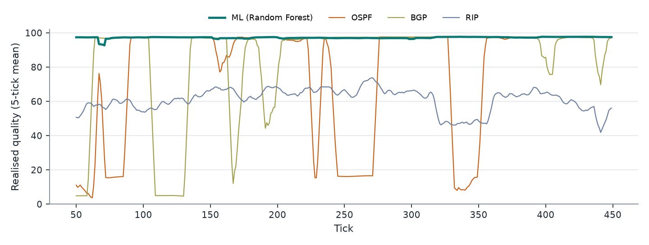
OVER TIME · FLOW R1 → R12
Static routes ride every congestion episode
OSPF and BGP collapse to 5–20 whenever their fixed path is congested; RIP is stuck near 60 on its 100 Mbps link. ML stays near 97 by moving away in time.
Final review
8

Slide 9
STRESS TEST
Congestion drill on the backbone
Injected
+60% load on R5-R6 for 40 ticks, 20 independent traffic runs
3.3 ticks
for ML to leave the link when it was on it (3 of 20 runs; otherwise it was already elsewhere). The episode itself ramps up over 4 ticks.
Final review
9

Slide 10
HONEST COMPARISON
Is it the ML, or just measuring?
A no-ML router that plugs current measurements into the quality formula already gets close. What the model adds:
Route changes per 1,000 decisions
Near-optimal picks
Prediction error (MAE)
30 vs 243
97.6 vs 94.9
4.7 vs 5.6
ML vs no ML
ML vs no ML
ML vs no ML
8× more stable: less reordering and control-plane churn
Better at choosing among close paths
Learns how noisy, trending probes translate into next-tick quality
Final review
10
Notes:
Mean quality is close: ML 97.0 vs 96.7. Most of the gain over OSPF comes from being measurement-driven at all; the Random Forest adds stability and accuracy, and it learns the quality mapping from data instead of needing a hand-written formula.

Slide 11
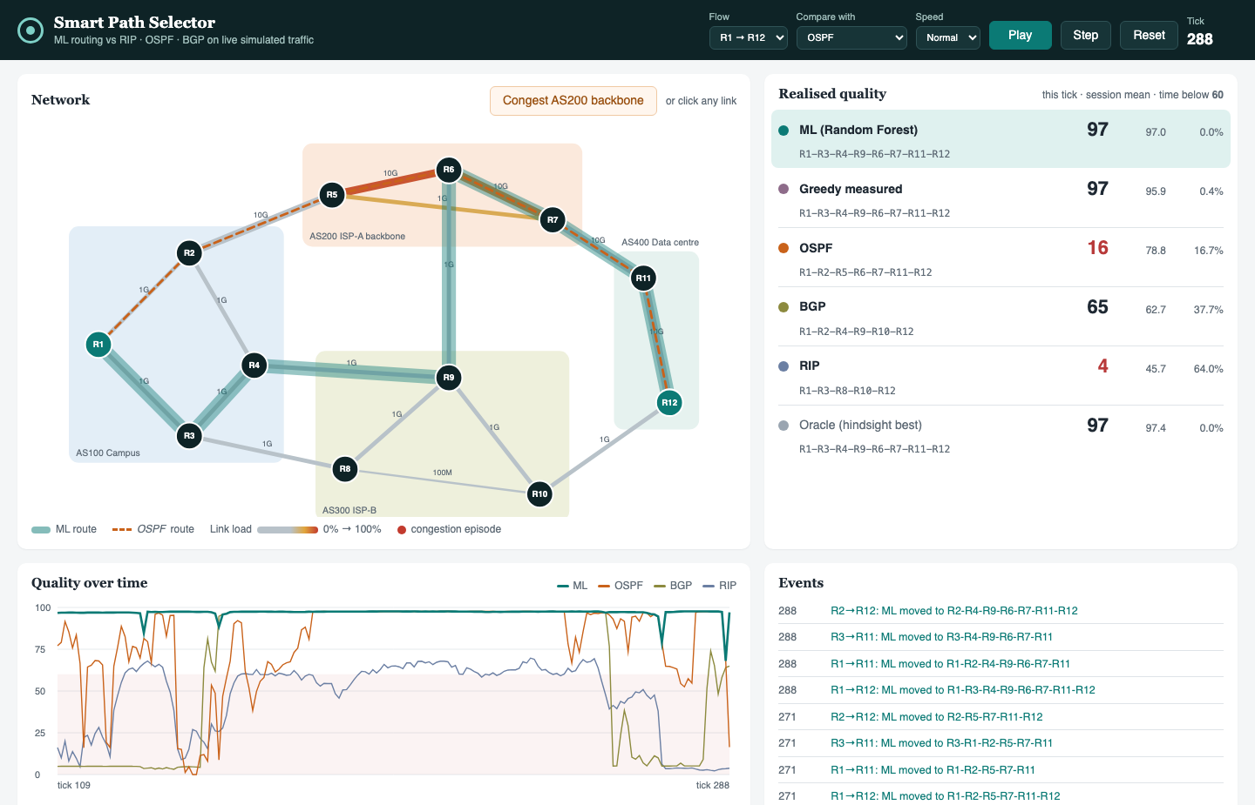
DEMONSTRATION
Live dashboard
1
Play
All strategies route the same live traffic
2
Congest AS200 backbone
Link turns red; OSPF’s quality collapses
3
Watch ML reroute
Teal route moves; event log records it
4
Candidate table
Measured → predicted → what actually happened
Final review
11
Notes:
Switch to the running dashboard (python -m smartpath dashboard) and follow docs/demo_script.md.

Slide 12
VALIDATION
Packet Tracer validation workflow
1
Build
Sample path | Latency | Loss | Free bw | Predicted
ISP-B | 37 ms | 0% | 502 Mbps | 97.1
100 Mbps shortcut | 31 ms | 0% | 56 Mbps | 59.7
AS200 backbone | 119 ms | 20% | 588 Mbps | 45.4
Same 12-router topology; interface bandwidth set so OSPF costs match
2
Verify protocols
tracert under RIP and OSPF matches the simulator’s chosen routes
3
Capture
ping, tracert, show interfaces per candidate path
Scope
Sample files are hand-written in Packet Tracer’s output format to exercise the parser. Packet Tracer can confirm protocol choices, not congestion behaviour.
4
Score
python -m smartpath validate <folder>
Final review
12

Slide 13
OUTLOOK
Limitations and next steps
Limitations
Future work
Synthetic traffic; quality score is a modelling choice
Chosen routes don’t add load back (no herd effects)
Probe overhead not modelled
Enforcing end-to-end paths needs SDN / segment routing
No link failures or convergence delays
Load feedback and many-flow stability
Failures and protocol convergence
Online retraining as traffic drifts
SDN controller on Mininet to enforce paths
Reinforcement learning for multi-flow placement
Final review
13

Slide 14
CONCLUSION
Routing on predicted quality beats routing on static metrics
97.0
91%
0.897
path quality (OSPF 78.3)
less packet loss than OSPF
R² on unseen traffic
Thank you · Questions

