Slide 1
DA 2 · 50% PROGRESS REVIEW
Intelligent Router Path Selection using Machine Learning
50%
Simulator, dataset, protocol baselines and trained model
github.com/K-RANGARAJAN/smart-path-selector
Notes:
This review covers the data and modelling half: simulator, dataset, the RIP/OSPF/BGP baselines and the trained Random Forest with its accuracy metrics.

Slide 2
PROGRESS
Where the project stands
Completed
For the final review
✓
Multi-AS topology (12 routers, 17 links)
Recommendation engine
✓
Traffic & congestion model
Closed-loop routing evaluation
✓
Link / path metrics, quality score
Live dashboard
✓
RIP, OSPF, BGP decision logic
Packet Tracer validation
✓
Dataset: 280,000 rows
✓
Random Forest trained & evaluated
✓
16 unit tests passing
DA 2 · 50% progress
2

Slide 3
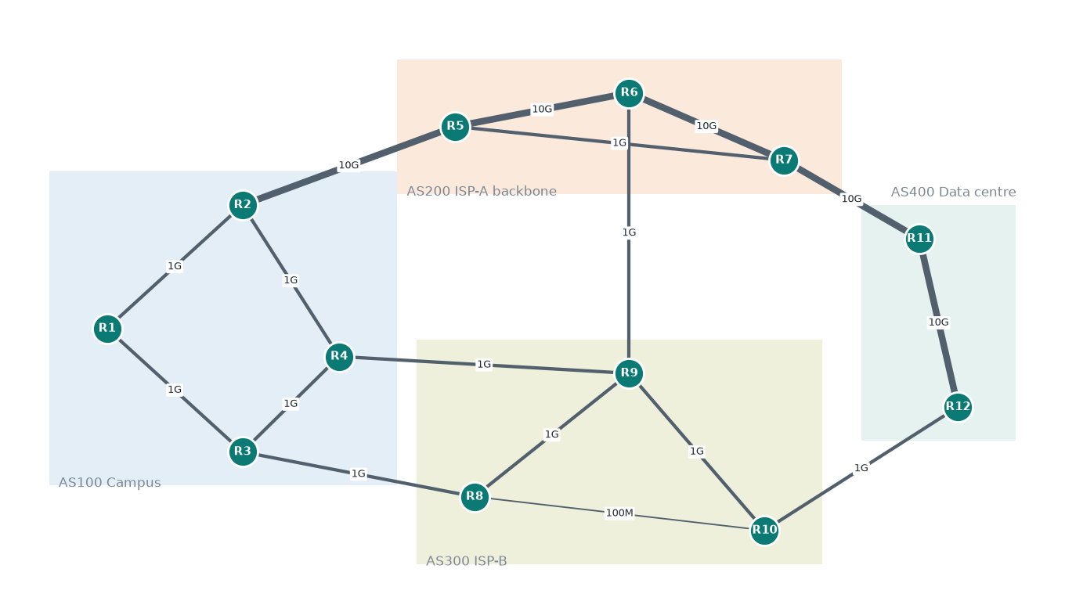
TOPOLOGY
Four ASes, three protocol opinions
RIP
Fewest hops
R1→R12 via the 100 Mbps R8–R10 link
OSPF
Lowest cost
R1→R12 via the 10 Gbps AS200 backbone
BGP
Local preference
R1→R12 via AS300, the cheaper ISP
DA 2 · 50% progress
3
Notes:
The AS200 backbone is fast but shared, and it is where congestion episodes happen most. AS300 is slower but quieter and has one 100 Mbps shortcut. Each protocol picks a different route for the same flow.

Slide 4
SIMULATION MODEL
From traffic to a quality score
1
Traffic
Link utilisation u: AR(1) around base load + daily cycle + congestion episodes
TARGET
Quality score, next tick
2
Link metrics
Queue delay ∝ u/(1−u), jitter ∝ queue delay, loss spikes near u ≈ 0.9, spare bandwidth
E-model R-factor
delay, jitter and loss impairments (ITU-T G.107)
× √ bandwidth sufficiency
for a 150 Mbps flow
3
Path metrics
Latency adds, loss compounds, jitter in quadrature, bandwidth = bottleneck
4
Probes
Noisy measurements: ±8% latency, ±25% jitter, loss from 100 pings
DA 2 · 50% progress
4
Notes:
The model sees what probes report now, and must predict the true quality the path delivers in the next tick. That makes it a forecasting task under measurement noise, not a formula lookup.

Slide 5
DATA
Dataset
280k
9
4
8–9
rows
features
flows
candidate paths per flow
 | Train | Test
Traffic seed | 1 | 2 (independent)
Ticks | 6,000 | 2,000
Rows | 210,000 | 70,000
Target distribution
Mean 73.0 · median 96.6
26.5% of samples below 60 (degraded)
DA 2 · 50% progress
5
Notes:
Train and test come from different random traffic, so test accuracy measures generalisation to traffic the model has never seen.

Slide 6
MODEL ACCURACY
Random Forest predicts next-tick quality best
0.897
test R²
4.7
MAE (quality points)
0.912 ± 0.009
5-fold time-blocked CV R²
DA 2 · 50% progress
6
Notes:
Random Forest MAE 4.7 vs 5.6 for the formula applied to current measurements and 10.3 for linear regression. The formula baseline is strong; the Random Forest improves on it by learning how noisy, trending measurements translate into next-tick quality.

Slide 7
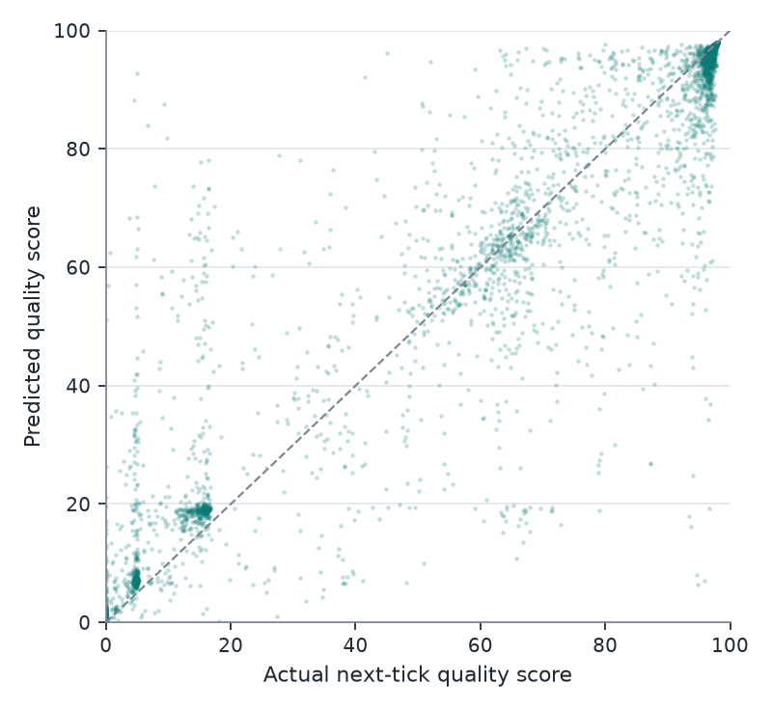
MODEL ACCURACY
Predictions track reality across the range
Healthy paths
Tight cluster at 95–98: the model is confident when paths are clean.
Congested paths
Clusters near 5–20 are saturated and 100 Mbps paths; predictions land close by.
Largest errors
When a path’s state changes sharply before the next tick (error vs. size of change: r = 0.92).
DA 2 · 50% progress
7

Slide 8
EXPLAINABILITY
Latency and bandwidth matter; hop count doesn’t
HOP COUNT
0.0001
The only metric RIP uses tells the model almost nothing about how a path will perform.
DA 2 · 50% progress
8

Slide 9
BASELINE ANALYSIS
Static protocols leave a large gap to the best path
161–395
times the best path changes in 2,000 ticks — no fixed route can keep up
~21 pts
average gap between OSPF and the best path each tick
DA 2 · 50% progress
9
Notes:
RIP is good for R1→R11 only because the fewest-hop route happens to skip the congested backbone; for R1→R12 and R3→R11 it crosses the 100 Mbps link. Closing this gap is the goal of the recommendation engine in the final phase.

Slide 10
LESSONS SO FAR
Challenges and fixes
Nothing to learn
BGP = OSPF
The first calibration congested the backbone permanently, so one fixed path was always best.
Both protocols initially picked identical routes.
→ Retuned loads: backbone usually good, with bursts.
→ Local preference now favours the cheaper ISP.
200 MB model
Strong no-ML baseline
Fully grown trees were too large to ship.
The formula on current measurements already reaches R² 0.876.
→ Depth/leaf limits: 16 MB, same accuracy.
→ Kept as a named baseline for honest comparison.
DA 2 · 50% progress
10

Slide 11
NEXT: FINAL REVIEW
Put the model in the routing loop
1
Recommendation engine
2
Closed-loop evaluation
Score all candidates every tick, switch only on a clear win
ML vs RIP, OSPF, BGP and a non-ML adaptive router on fresh traffic
3
Live dashboard
4
Packet Tracer check
Link load, path scores and decisions, with congestion injection
Score real ping / tracert measurements with the model

