Slide 1


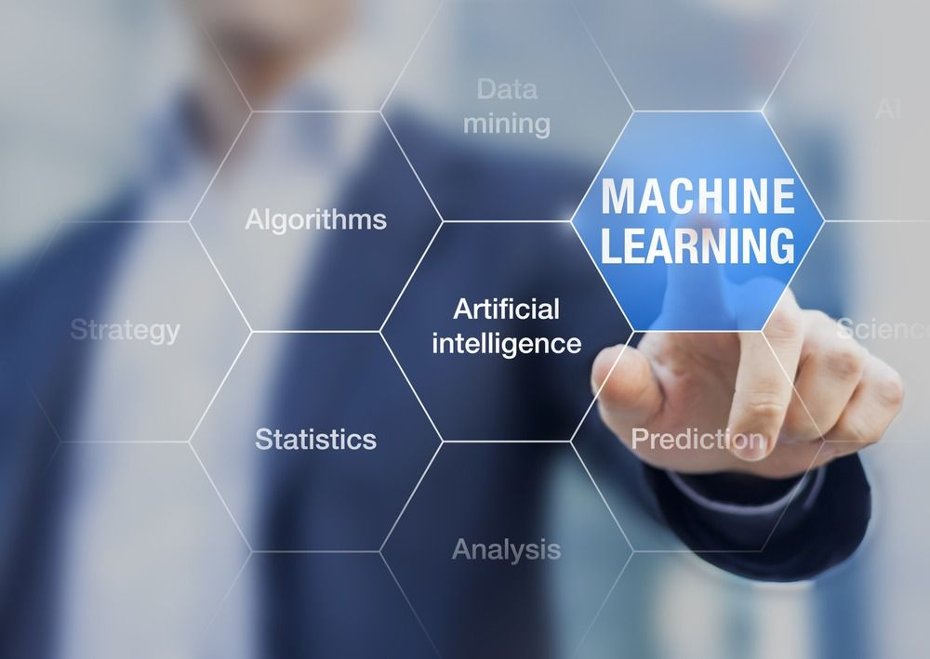

Fundamentals of Python for Machine Learning, Data Science & Web Development

Slide 2

PYTHON: INTRODUCTION
Python : Overview and History
Characteristics
Applications
Python for Machine Learning

Slide 3
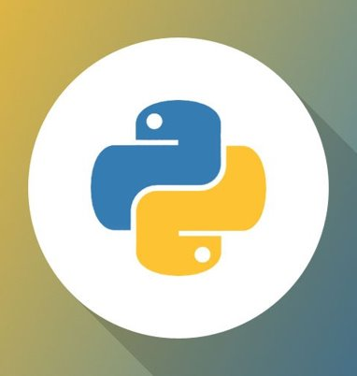
Python programming language
Python is a general-purpose, high-level programming language.
It is known for its simple syntax and its emphasis on code
readability. Python is often used for web development,
data science, and machine learning.

Slide 4
PYTHON characteristics
1. Easy to learn
Simple structure, Easy Key words and cleared defined syntax make it easy and attract students
2. Free and open source
Python language is freely available at official web address Python official site.
3. Object oriented
Python supports both procedure-oriented and object-oriented programming which is one of the key python features. It also supports multiple inheritances.
4. Portable
Python run equally on different platforms like windows, Linux, Unix etc.
5. Expressive language
Python codes simple it makes them more readable and understandable

Slide 5
PYTHON CHARACTERISTICS
6. Interpreted
Interpreted read and executes code line by line this makes debugging easy
7. Extensible
You can write some of your python code in other languages like C++ , it makes python more extendable to other fields.
8. Integrated
It can be easily integrated with languages like C, C++,Java.
9. GUI programming
Python offers various libraries for making graphical user interface.
10. Large standard library
Python downloads with a large library that you can use so you don’t have to write your own code for every single thing.

Slide 6
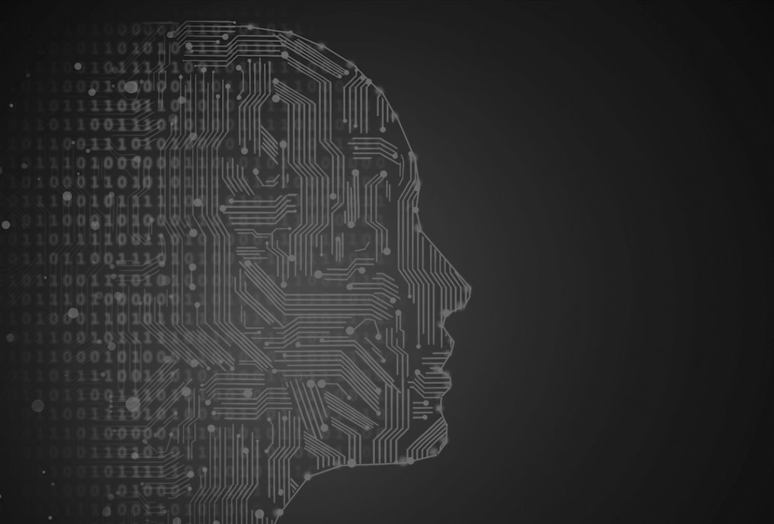
PYTHON
APPLICATIONS

Slide 7
PYTHON applications
1. Web Applications
We can use Python to develop web applications. It also provides Frameworks such as Django, Pyramid to design and develop web applications.
2. Machine Learning
Different applications can be implemented in machine learning using python.
3. Scientific computing
Some libraries like Scipy , Pandas are full package of engineering and mathematics
4. Business applications
OpenErp, Tryton, Picalo are good example of python business applications.
5. Games and 3D graphics
PyGame library for games and GUI library to develop user interface in python based application.
6. Desktop applications
You tube, drop box, bit torrent, bazaar, and cinema 4D are the desktop applications which are developed in python.

Slide 8
PYTHON ​
FOR MACHINE LEARNING

Slide 9
PYTHON for machine learning
1. Simple and consistent​
​
Python offers concise and readable code. While complex algorithms and versatile workflows stand behind machine learning and AI, Python’s simplicity allows developers to write reliable systems. Developers get to put all their effort into solving an ML problem instead of focusing on the technical nuances of the language.​
​
2. Extensive selection of libraries and frameworks​
​
To reduce development time, programmers turn to a number of Python frameworks and libraries. A software library is pre-written code that developers use to solve common programming tasks. Python, with its rich technology stack, has an extensive set of libraries for artificial intelligence and machine learning. Here are some of them:​
​
Keras, TensorFlow, and Scikit-learn for machine learning​
NumPy for high-performance scientific computing and data analysis​
SciPy for advanced computing​
Pandas for general-purpose data analysis​
Seaborn for data visualization

Slide 10
3. Platform independence​
​
Platform independence refers to a programming language or framework allowing developers to implement things on one machine and use them on another machine without any (or with only minimal) changes. One key to Python’s popularity is that it’s a platform independent language. Python is supported by many platforms including Linux, Windows, and macOS. Python code can be used to create standalone executable programs for most common operating systems, which means that Python software can be easily distributed and used on those operating systems without a Python interpreter.​
​
4. Great community and popularity​
​
In the Developer Survey 2020 by Stack Overflow, Python was among the top 5 most popular programming languages, which ultimately means that you can find and hire a development company with the necessary skill set to build your AI-based project.

Slide 11

DATA TYPES IN PYTHON​

Slide 12
Data types in python
Python Data types divided into two parts​
​
1.Immutable (Unable to change, you cannot add or remove the value )​
2.Mutable (Liable to change , you can add or remove the values )​
​
Immutable Mutable​
Numbers Lists​
Strings Dictionaries​
Tuple Sets​
​
In python we have type() function to find out type of value passed in variable. Common data types include:​
​
int (for integer) float​
str (for string) list​
tuple dict (for dictionary)​
set bool (for Boolean True/False)

Slide 13
Arithmetic operators
Operators ​ | Explanation ​
Addition (+ )​ | Adds values on either side of the operator​
Subtraction (-)​ | Subtracts the right hand operator with left hand operator​
Multiplication (*)​ | Multiplies values on either side of the operator​
Division (/)​ | Divides left hand operand with right hand operator​
Modulus (%)​ | Divides left hand operand by right hand operand and returns remainder​
Exponent (**)​ | Performs exponential (power) calculation on operators​

Slide 14
• PRINT: Print function used to print the texts, variables, output in the python program.
print('Hello world')
• TYPE(): Type function is used to get the type of the object.
a=10
b=20.0
c='name'
print(type(a))
print(type(b))
print(type(c))
• INPUT(): To take the input from the user we use input() function.
Example :
name=input('enter the name of the student :')
print(name)

Slide 15
• Type casting and Type conversion:
Type casting and type conversion are both processes of converting a value from
one data type to another. However, there are some key differences between the two.
Type casting is when the programmer manually converts a value from one data type to another. This is done using the built-in functions int(), float(), str(), bool(), and complex().
Examples1:
A=10
A=str(A)
Examples2:
a=11
b=20.23
c=a+b
print(c)

Slide 16
Functions in python:​
​
A function in Python is a block of code that is executed when it is called. Functions
can be used to perform a specific task.
​
Example:
def adder(a, b):
c=a+ b
return c # a and b are the arguments of the function.
adder(1,2)

Slide 17
Questions:
Write a python function which take only name as
argument( from the user) and display the output "Hello Ashish".
​​
2. Make a calculator using the function.

Slide 18
Loops in python
Python provides different types of loop in python programming. ​
​
for loop​
while loop​
nested loops​
​
FOR Loops :​
​
A for loop is used for iterating over a sequence (that is either a list, a tuple, a dictionary, a set, or a string).​
​
Input:​
fruits = ["apple", "banana", "cherry"]​
for x in fruits:​
print(x)​
​
Output:​
apple banana cherry

Slide 19
WHILE Loops :​
While loops repeat as long as a certain Boolean condition is met.​
​
Input:​
count = 0​
while count < 5:​
print(count)​
count += 1​
​
Output:​
0​
1​
2​
3​
4​
​
"break" and "continue" statements : break is used to exit a for loop or a while loop, whereas continue is used to skip the current block, and return to the "for" or "while" statement.

Slide 20
The statement a = 2 means that the variable a is assigned the value 2.
Integer==9 is used to for the comparison.
CONDITIONAL STATEMENTS IN PYTHON:
n=int(input("enter the marks"))
if n==100:
print('You are the topper')
else:
print('You need to work')

Slide 21
Example: Write a python function to calculate the sum of first 10
numbers.
sum=0
for i in range(1,10):
sum+=i
print(sum)
Range() : It is used to generate the sequence of the number.
for i in range(5):
print(i)

Slide 22
n= int(input('enter the number: '))
flag=0
for i in range(2,n):
if (n% i==0):
flag+=1
Break
if flag==0:
print('number is prime')
else:
print('number is not prime')

Slide 23
Lists in python
The Python List is a general data structure widely used in Python programs. They are found in
other languages, often referred to as dynamic arrays. They are both mutable and a sequence data type that allows them to be indexed and sliced. The list can contain different types of objects, including other list objects.​
​
Constructing a list :​
​
Input:​
# Assign a list to an variable named my_list​
my_list = [1,2,3]​
Print(my_list)​
​
Output:​
[1,2,3]​
​
Basic List Methods :​
​
1. append(value) – appends a new element to the end of the list.​
list1.append(‘value to be appended)

Slide 24
2. index(value, [startIndex]) – gets the index of the first occurrence of the input value. If the input value is not in the list a ValueError exception is raised. If a second argument is provided, the search is started at that specified index.​
list1.index(5)​
​
3. insert(index, value) – inserts value just before the specified index. Thus after the insertion the new element occupies position index.​
list1.insert(2, 5) # insert 5 at position 2​
​
4. pop([index]) – removes and returns the item at index. With no argument it removes and returns the last element of the list.​
list1.pop(5)​
​
5. remove(value) – removes the first occurrence of the specified value. If the provided value cannot be found, a ValueError is raised.​
list1.remove(0)

Slide 25
​
6. reverse() – reverses the list in-place and returns None.​
list1.reverse()​
​
Example:
Mark=[]
N=int(input('enter the no. of students'))
for i in range(N):
Ele=int(input('enter the marks'))
Mark.append(Ele)
print(Mark)
​

Slide 26
Tuples in python
Tuple is a sequence of python objects like list with immutable feature. We cannot add or remove an item in tuple.​
​
In Python tuples are very similar to lists, however, unlike lists they are immutable meaning they cannot be changed. You would use tuples to present things that shouldn't be changed, such as days of the week, or dates on a calendar.​
​
Constructing a Tuple:​
​
Input:​
# Create a tuple​
t = (1,2,3)​
# Check len just like a list​
len(t)​
​
Output:​
[1,2,3]​
3

Slide 27
Dictionaries in python
Dictionaries in python are unordered collection of items,a dictionary is closed by curly brackets. Dictionary hold pair of Key and Value (key:value). Key and value are separated by (:) , whereas each item in dictionary is separated by comma (,).​
​
A Python dictionary consists of a key and then an associated value. That value can be almost any Python object.​
​
Constructing a Dictionary:​
​
Input:​
# Make a dictionary with {} and : to signify a key and a value​
my_dict = {'key1':'value1','key2':'value2'}​
# Call values by their key​
my_dict['key2']​
​
Output:​
'value2'

Slide 28
Basic Dictionary Methods :
Function and Methods ​ | Description​
len(dict)​ | Gives the total length of the dictionary.(items)​
str(dict)​ | Produces a printable string representation of a dictionary​
dict.clear()​ | Removes all elements of dictionary dict​
dict.copy()​ | Returns a shallow copy of dictionary dict​
dict.get()​ | For key key, returns value or default if key not in dictionary​
dict.items()​ | Returns a list of dict's (key, value) tuple pairs​
dict.key()​ | Returns list of dictionary dict's keys​
dict.update()​ | Adds dictionary in other dict.​
dict.values()​ | Returns list of dictionary dict's values​

Slide 29
Sets & Booleans in python
Python Sets:​
​
A Set is an unordered collection of items. Every element is unique. A Set is created by placing all the items (elements) inside curly braces {}, separated by comma. Sets are an unordered collection of unique elements. We can construct them by using the set() function. ​
​
Creating a Python Set :​
​
Input:​
x = set()​
# We add to sets with the add() method​
x.add(1)​
X​
​
Output:​
{1}

Slide 30
Numpy
NumPy is a well-known general-purpose array-processing package. very useful for handling linear algebra, Fourier transforms, and random numbers. ​
Introduces objects for multidimensional arrays and matrices, as well as functions that allow to easily perform advanced mathematical and statistical operations on those objects.​
It provides vectorization of mathematical operations on arrays and matrices which significantly improves the performance.​
Many other python libraries are built on NumPy​
​
Arrays :​
​
A numpy array is a grid of values, all of the same type, and is indexed by a tuple of nonnegative integers. The number of dimensions is the rank of the array; the shape of an array is a tuple of integers giving the size of the array along each dimension.

Slide 31
PANDAS​
Pandas used mostly for Data Analysis, provides tools for data manipulation: reshaping, merging, sorting, slicing, aggregation etc. It allows handling missing data. Pandas library is built on top of Numpy, meaning Pandas needs Numpy to operate.​
​
Pandas support and perform well with different kinds of data including the below :​
​
Tabular data with columns of heterogeneous data. For instance, consider the data coming from the SQL table or Excel spreadsheet.​
​
Ordered and unordered time series data. The frequency of time series need not be fixed, unlike other libraries and tools. Pandas is exceptionally robust in handling uneven time-series data​
​
Arbitrary matrix data with the homogeneous or heterogeneous type of data in the rows and columns​
​
Any other form of statistical or observational data sets. The data need not be labeled at all. Pandas data structure can process it even without labeling.

Slide 32
matplotlib
Matplotlib.pyplot is a plotting library used for 2D graphics in python programming language. It can be used in python scripts, shell, web application servers and other graphical user interface tool-kits. ​
​
We can generate plots, histograms, power spectra, bar charts, errorcharts, scatterplots, etc., with just a few lines of code. Matplotlib is a data visualization library that is used for 2D plotting to produce publication-quality image plots and figures in a variety of formats. ​
​
Python Matplotlib: Bar Graph ​
A bar graph uses bars to compare data among different categories. It is well suited when you want to measure the changes over a period of time. It can be represented horizontally or vertically. Also, the important thing to keep in mind is that longer the bar, greater is the value.​
​
Python Matplotlib – Histogram​
Histograms are used to show a distribution whereas a bar chart is used to compare different entities. Histograms are useful when you have arrays or a very long list.

Slide 33
Python Matplotlib : Scatter Plot ​
​
Usually we need scatter plots in order to compare variables, for example, how much one variable is affected by another variable to build a relation out of it. The data is displayed as a collection of points, each having the value of one variable which determines the position on the horizontal axis and the value of other variable determines the position on the vertical axis.​
​
​
Python Matplotlib-Pie Chart ​
​
A pie chart refers to a circular graph which is broken down into segments i.e. slices of pie. It is basically used to show the percentage or proportional data where each slice of pie represents a category.

Slide 34
SCIKIT-LEARN
Scikit-learn is a library in Python that provides many unsupervised and supervised learning algorithms.
It’s built upon some of the technology we already are familiar with, like NumPy, pandas, and Matplotlib!​
​
Scikit-learn was built on top of two Python libraries – NumPy and SciPy and has become the most popular Python machine learning library for developing machine learning algorithms.​
​
The functionality that scikit-learn provides include:​
​
Regression, including Linear and Logistic Regression​
​
Classification, including K-Nearest Neighbors​
​
Clustering, including K-Means and K-Means++​
​
Model selection​
​
Preprocessing, including Min-Max Normalization

Slide 35
TensorFlow
TensorFlow is a free and open-source software library for machine learning. It can be used across
a range of tasks but has a particular focus on training and inference of deep neural networks.​
​
It was developed for Google’s internal use by the Google Brain team.Is a popular computational framework for creating machine learning models. ​
​
It has a comprehensive, flexible ecosystem of tools, libraries and community resources that lets researchers push the state-of-the-art in ML and developers easily build and deploy ML powered applications.​
​
Supports a variety of different toolkits for constructing models at varying levels of abstraction.​
​
It has a flexible architecture with which it can run on a variety of computational platforms CPUs, GPUs, and TPUs. TPU stands for Tensor processing unit, a hardware chip built around TensorFlow for machine learning and artificial intelligence.

Slide 36






THANK YOU!
THANK YOU!
For Further Information:
https://tih.iitr.ac.in/
www.uniconvergetech.in
www.theiotacademy.co
You can also visit us at:

