Slide 1

Kubernetes Taints
Master node scheduling control for CKA certification

Slide 2
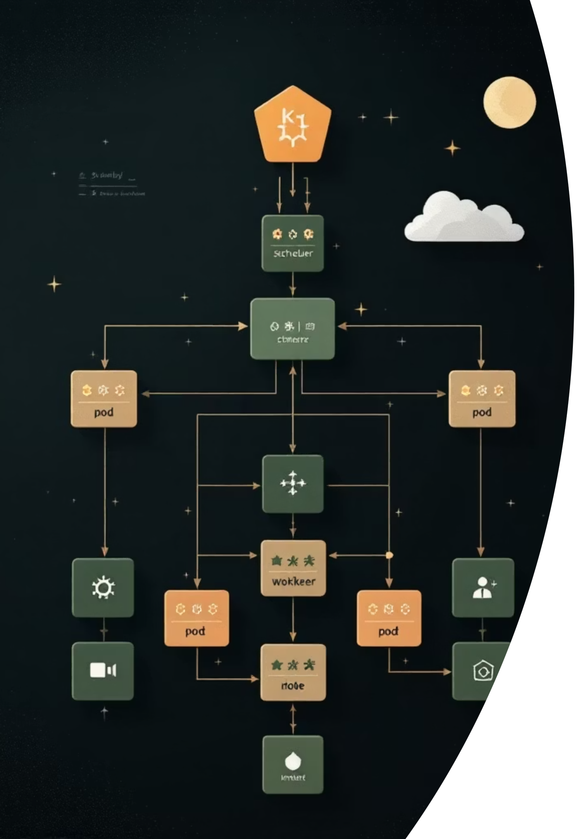
Problem: Why We Need to Restrict Pods from Nodes
Hardware Specialisation
Dedicated nodes with GPU or high-memory configurations should only run compatible workloads
Cluster Maintenance
Prevent new pods from scheduling during node upgrades or maintenance windows
Security Isolation
Keep sensitive workloads separated from regular pods for compliance requirements
Resource Protection
Reserve nodes for specific teams or applications without interference from other workloads
Without taints, the Kubernetes scheduler freely assigns pods to any available node that meets resource requirements. This flexibility becomes a problem when you need fine-grained control over where specific workloads run. Taints provide the mechanism to repel pods from nodes, working in conjunction with tolerations that allow specific pods to overcome these restrictions.

Slide 3


Definition: What Are Taints?
A taint is a repelling force applied to a node that prevents pods from scheduling onto it, unless those pods specifically tolerate the taint.
Key Concept
Taints repel pods from nodes. Tolerations attract specific pods to tainted nodes.
Think of taints as forbidden zones for most pods. Only pods carrying the matching "permission pass" (toleration) can enter.
Taints are key-value pairs combined with an effect that determines how strongly the node rejects pods. This system works alongside node affinity (which attracts pods to nodes) to give you complete scheduling control.

Slide 4
Taint Syntax: The Complete Structure
key=value:effect
01
02
03
Key
Value
Effect
Descriptive label for the taint purpose (e.g., dedicated, gpu, critical)
Optional qualifier providing more detail (e.g., gpu=true, team=backend)
How the taint behaves: NoSchedule, PreferNoSchedule, or NoExecute
Example Taints
# Simple key-only taint dedicated:NoSchedule # Key-value pair taint gpu=true:NoSchedule # Multiple taints on same node dedicated=backend:NoSchedule hardware=gpu:NoExecute
Taints can include or exclude values. Omit the value portion when the key alone conveys the restriction. Use key-value pairs when you need more granular control over which pods can tolerate the taint.

Slide 5

Taint Effects: Three Levels of Restriction
PreferNoSchedule
Soft preference - The scheduler tries to avoid this node but will schedule pods here if no other options exist. Best for "nice to have" restrictions when resources are tight.
NoSchedule
Hard restriction - No new pods can schedule to this node unless they tolerate the taint. Existing pods continue running normally. Most commonly used effect for dedicated node scenarios.
NoExecute
Aggressive eviction - Prevents new scheduling AND evicts existing pods that don't tolerate the taint. Use carefully during maintenance or when nodes become unavailable.

Slide 6
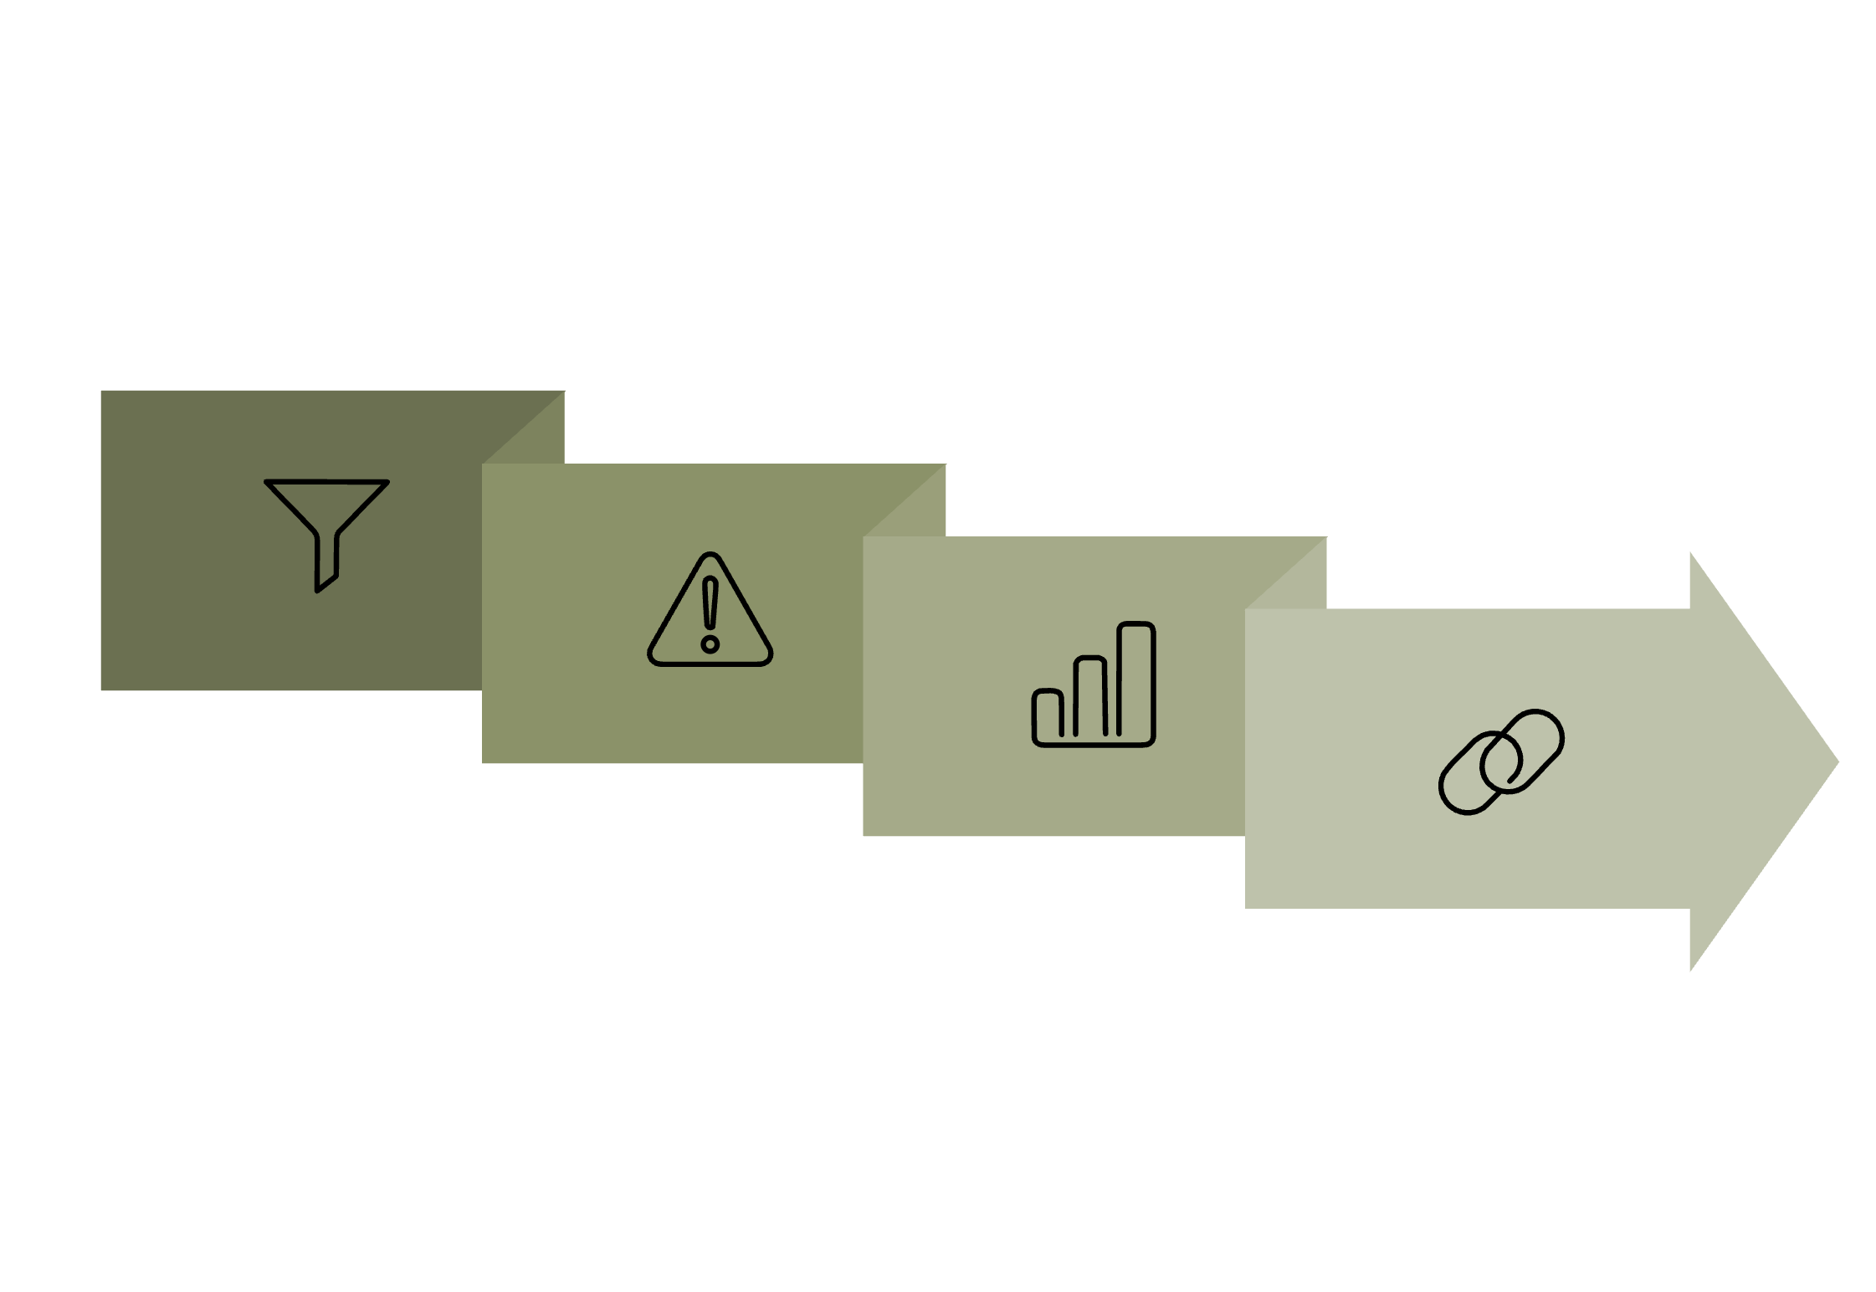

How Taints Work Internally
Scheduler Behavior Explained
When the Kubernetes scheduler processes a pod creation request, it follows a filtering and scoring process to identify suitable nodes. Taints are evaluated during the filtering phase, where nodes that don't meet requirements are eliminated from consideration.
Node Filtering
Taint Evaluation
Pod Scheduling
Scheduler checks all nodes against pod requirements
Tainted nodes reject pods without matching tolerations
Only acceptable nodes remain for pod placement
Key Implementation Details
Taints are stored as node annotations in etcd
The scheduler watches for taint changes and updates its scheduling decisions
Nodes can have multiple taints simultaneously
Pod tolerations must match taint key, value, and effect exactly
TolerationSeconds allows temporary tolerations that expire
Evaluate Taints
Bind Pod
Filter Nodes
Score Candidates

Slide 7

Adding and Removing Taints
Command Examples
Add a Taint
kubectl taint nodes node1 dedicated=backend:NoSchedule
Remove a Taint
kubectl taint nodes node1 dedicated=backend:NoSchedule-
View Node Taints
kubectl describe node node1 | grep Taint
List All Nodes with Taints
kubectl get nodes -o custom-columns=NAME:.metadata.name,TAINTS:.spec.taints
Common Command Patterns
# Add taint to multiple nodes kubectl taint nodes node1 node2 node3 dedicated:NoSchedule # Add tolerationSeconds (eviction after 300s) kubectl taint nodes node1 dedicated:NoExecute --overwrite # Remove all taints from a node kubectl taint nodes node1 dedicated:NoSchedule- kubectl taint nodes node1 gpu:NoSchedule- # Verify taint was applied kubectl describe node node1 | grep Taint

Slide 8

Real-World Example: Dedicated Node Scenario
Business Requirement
Your organisation runs a backend API service requiring high CPU and memory resources. You've provisioned 3 dedicated worker nodes with enhanced specifications and want to ensure only backend pods schedule to these nodes.
Implementation Steps
01
02
Apply Taints to Dedicated Nodes
Add Tolerations to Backend Deployment
kubectl taint nodes backend-worker-1 backend=api:NoSchedule kubectl taint nodes backend-worker-2 backend=api:NoSchedule kubectl taint nodes backend-worker-3 backend=api:NoSchedule
apiVersion: apps/v1 kind: Deployment metadata: name: backend-api spec: replicas: 3 template: spec: tolerations: - key: "backend" operator: "Equal" value: "api" effect: "NoSchedule" containers: - name: api-container image: backend-api:latest
03
Verify Scheduling
kubectl get pods -o wide kubectl describe node backend-worker-1 | grep -i taint

Slide 9
Summary: Key Takeaways
Taints Repel, Tolerations Attract
Three Effect Levels
Master the Commands
Taints prevent pods from scheduling to nodes. Tolerations allow specific pods to overcome these restrictions.
PreferNoSchedule (soft), NoSchedule (hard), NoExecute (eviction)
kubectl taint adds taints, kubectl describe node views them, kubectl taint - removes them
Syntax: key=value:effect
Key describes purpose, value provides detail, effect determines behavior

