Slide 1

Kubernetes Node Affinity
A Comprehensive Guide for CKA Certification and Production Usage

Slide 2
Why Node Affinity Exists: Limitations of Node Selector
In the early days of Kubernetes, the nodeSelector field provided a simple way to constrain pods to specific nodes. However, this basic mechanism quickly revealed its limitations in complex production environments.
When nodeSelector Falls Short
Need complex logic? Node Affinity provides the flexibility
Key Limitations of nodeSelector
Only supports exact equality matching - you can't express ranges or more complex conditions
No support for logical operators like AND/OR combinations
Cannot express preferences, only hard requirements
Doesn't support set-based matching operations
No fine-grained control over scheduling behavior
These constraints meant that nodeSelector was insufficient for sophisticated scheduling requirements. For example, you couldn't express "schedule this pod on nodes with SSD storage OR nodes with high CPU capacity" or "prefer nodes in availability zone A but fall back to zone B if necessary".
Node Affinity was introduced to overcome these limitations, providing flexible, powerful scheduling constraints that can handle real-world complexity while maintaining backward compatibility with existing nodeSelector configurations.

Slide 3
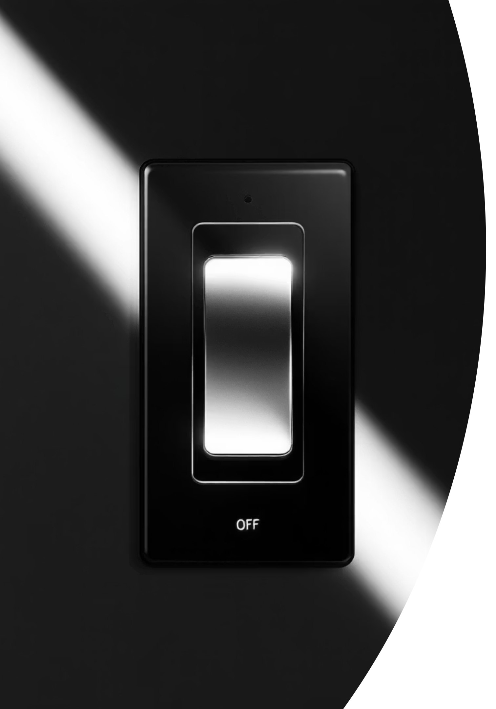
Equality-Based Matching
A pod is scheduled only when a node's label value matches the requested value exactly.
Equality-based matching is used to place workloads on nodes with a precise label value, so scheduling decisions stay narrow and intentional. This makes it useful when you need strict placement rules rather than flexible selection.
Operators used
In
NotIn
Example
- key: disktype
operator: In
values:
- ssd
Meaning
Pod runs only on nodes where disktype = ssd

Slide 4
Set-Based Matching
Set-based matching lets you schedule pods using a group of acceptable values, a presence check, or a numeric condition instead of one exact label value. It is more flexible than equality-based matching and is useful for practical placement rules.
Each operator category serves a different purpose. In and NotIn compare label values against an allowed or excluded set. Exists and DoesNotExist check whether a label is present at all, regardless of its value. Gt and Lt compare numeric label values and are useful when labels represent measurable quantities such as CPU count or disk size.
Operators used
In
NotIn
Exists
DoesNotExist
Gt
Lt
Set Matching Example (Exists)
- key: zone
operator: In
values:
- east
- west
Meaning: Meaning Pod can run on nodes where zone = east OR zone = west
Set Matching Example (Numeric Condition)
- key: cpu-count
operator: Gt
values:
- "4"
Meaning: Pod runs only on nodes where cpu-count > 4.

Slide 5



What is Node Affinity?
Node Affinity is a powerful scheduling mechanism that allows you to control which nodes your pods can be scheduled on, based on node labels and sophisticated matching rules.
Targeted Scheduling
Flexible Constraints
Runtime Control
Direct pods to specific nodes based on labels like region, zone, hardware type, or custom attributes
Define both hard requirements (must match) and soft preferences (should match when possible)
Rules are evaluated during scheduling, with options for how changes affect running pods
Think of Node Affinity as an intelligent traffic director for your pods. Instead of letting the scheduler place pods anywhere, you provide detailed instructions about preferred or required destinations based on node characteristics.
The beauty of Node Affinity lies in its two-tiered approach: you can specify mandatory rules that must be satisfied (pod won't schedule otherwise), and optional preferences that the scheduler should honor when possible but can ignore if necessary. This flexibility is crucial for production systems where availability and resource constraints often require trade-offs.
Node Affinity works by evaluating node labels against your defined rules. Every node in a Kubernetes cluster can have multiple labels attached, creating a rich metadata system that Affinity rules can leverage to make intelligent scheduling decisions.

Slide 6

Two Types of Node Affinity
Kubernetes provides two distinct affinity types, each serving different use cases and offering different guarantees about pod scheduling behavior.
Required During Scheduling Ignored During Execution
Preferred During Scheduling Ignored During Execution
Hard requirement - the pod will only be scheduled if the node matches the specified rules. If no matching nodes are available, the pod remains in a Pending state.
Soft preference - the scheduler will try to schedule the pod on matching nodes but can place it elsewhere if necessary. This provides flexibility while expressing intent.
Characteristics
Characteristics
Evaluated during initial pod scheduling
Must be satisfied or pod won't schedule
Node label changes after scheduling are ignored
Running pods continue even if node labels change
Use for critical infrastructure requirements
Weighted preference (1-100) influences scheduler priority
Pod can schedule on non-matching nodes
Changes to node labels don't affect running pods
Use for optimization and cost considerations
Common Use Cases: Preferring nodes in the same availability zone for lower latency, favoring newer hardware, cost-optimized scheduling across node pools
Common Use Cases: Database pods requiring SSD storage, GPU workloads needing specialized hardware, compliance requirements for specific regions
The "Ignored During Execution" part of both names is crucial: it means that if node labels change after a pod is running, Kubernetes won't automatically evict or reschedule that pod. This prevents unnecessary pod churn but means you need taints and tolerations for runtime node restrictions.

Slide 7
YAML Syntax Breakdown
Node Affinity is defined in your pod specification under spec.affinity.nodeAffinity. Let's break down the structure with a complete example.
apiVersion: v1
kind: Pod
metadata:
name: affinity-demo-pod
spec:
affinity:
nodeAffinity:
requiredDuringSchedulingIgnoredDuringExecution:
nodeSelectorTerms:
- matchExpressions:
- key: kubernetes.io/e2e-az-name
operator: In
values:
- e2e-az1
- e2e-az2
preferredDuringSchedulingIgnoredDuringExecution:
- weight: 1
preference:
matchExpressions:
- key: topology.kubernetes.io/zone
operator: In
values:
- zone1
- weight: 50
preference:
matchExpressions:
- key: hardware-type
operator: Exists
containers:
- name: nginx
image: nginx
Required Rules Structure
Preferred Rules Structure
The requiredDuringSchedulingIgnoredDuringExecution section contains nodeSelectorTerms, which is a list of terms where at least one must match (OR logic).
The preferredDuringSchedulingIgnoredDuringExecution section contains a list of preferences, each with a weight (1-100) and preference.
Each term contains matchExpressions - a list of expressions that must all match (AND logic). This creates flexible combinations of requirements.
Higher weights mean stronger preferences. The scheduler sums weights from all matching preferences to determine the best node.

Slide 8






Operators Explained
Node Affinity provides several operators for matching node labels. Understanding these operators is essential for writing effective rules.
In
NotIn
Label value must be in the specified list of values. This is the most common operator for exact matches.
Label value must NOT be in the specified list. Useful for excluding nodes with certain characteristics.
operator: In
values:
- zone1
- zone2
- zone3
operator: NotIn
values:
- development
- testing
Exists
DoesNotExist
Label key must exist on the node, regardless of its value. Useful for feature detection.
Label key must NOT exist on the node. Useful for avoiding nodes with certain features.
operator: Exists
# No values field needed
operator: DoesNotExist
# No values field needed
Gt (Greater Than)
Lt (Less Than)
Label value must be greater than the specified value. Values are compared lexicographically as strings.
Label value must be less than the specified value. Values are compared lexicographically as strings.
operator: Gt
values:
- 100
operator: Lt
values:
- 500
Important Note: Gt and Lt operators compare values as strings, not numbers. This means "10" > "9" is false because string comparison is alphabetical. For numeric comparisons, consider using annotations or external tools.

Slide 9



Logical Behavior: AND vs OR Conditions
Understanding how Kubernetes combines multiple affinity rules is crucial for writing correct configurations. The logic can be counterintuitive at first.
matchExpressions: AND Logic
nodeSelectorTerms: OR Logic
Multiple Preferences: Weighted Sum
All expressions in a single matchExpressions list must match for the term to succeed
At least one term in the list must match for the required rules to pass
All preferences are evaluated and their weights summed for matching nodes
Example: AND Logic
Example: OR Logic
matchExpressions:
- key: zone
operator: In
values:
- zone1
- zone2
- key: hardware-type
operator: In
values:
- production
nodeSelectorTerms:
- matchExpressions:
- key: zone
operator: In
values:
- zone1
- matchExpressions:
- key: zone
operator: In
values:
- zone2
Result: Node must have zone in (zone1, zone2) AND hardware-type = production
Result: Node can have zone = zone1 OR zone = zone2
This combination of AND and OR logic gives you tremendous flexibility. You can express complex requirements like "must be in zone1 or zone2 AND must have SSD storage OR must be a high-memory node in any zone".

Slide 10
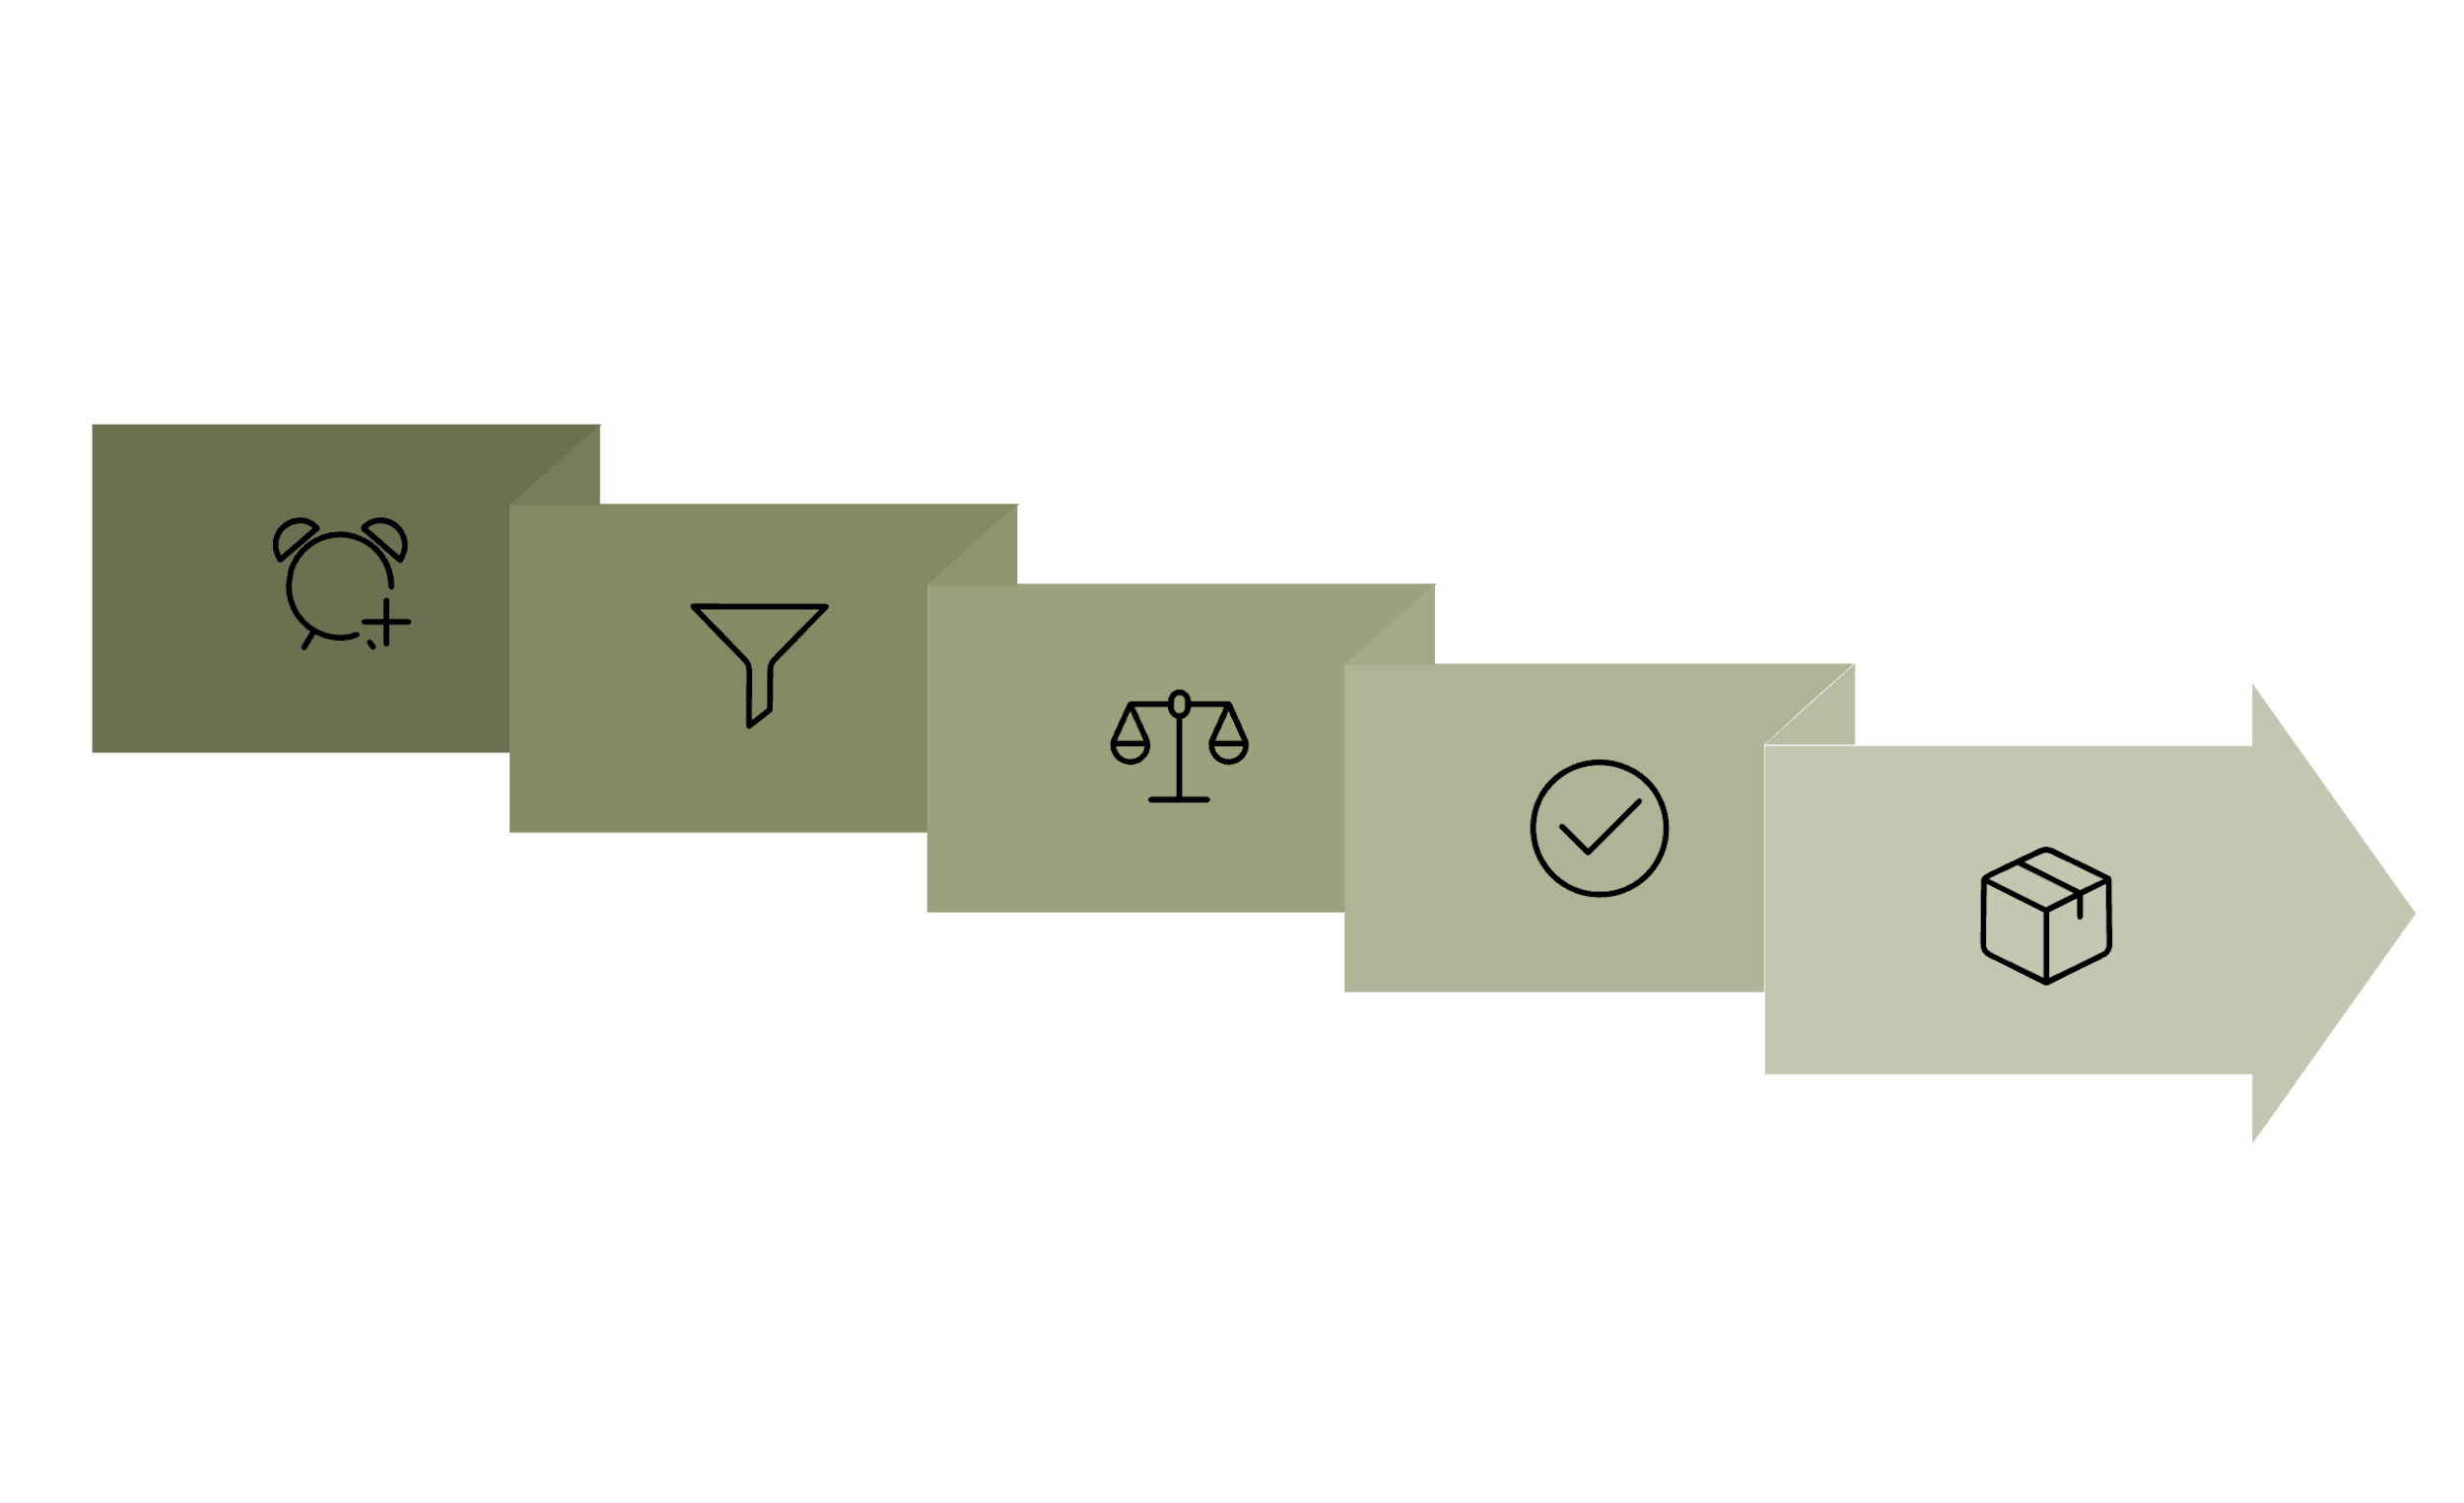
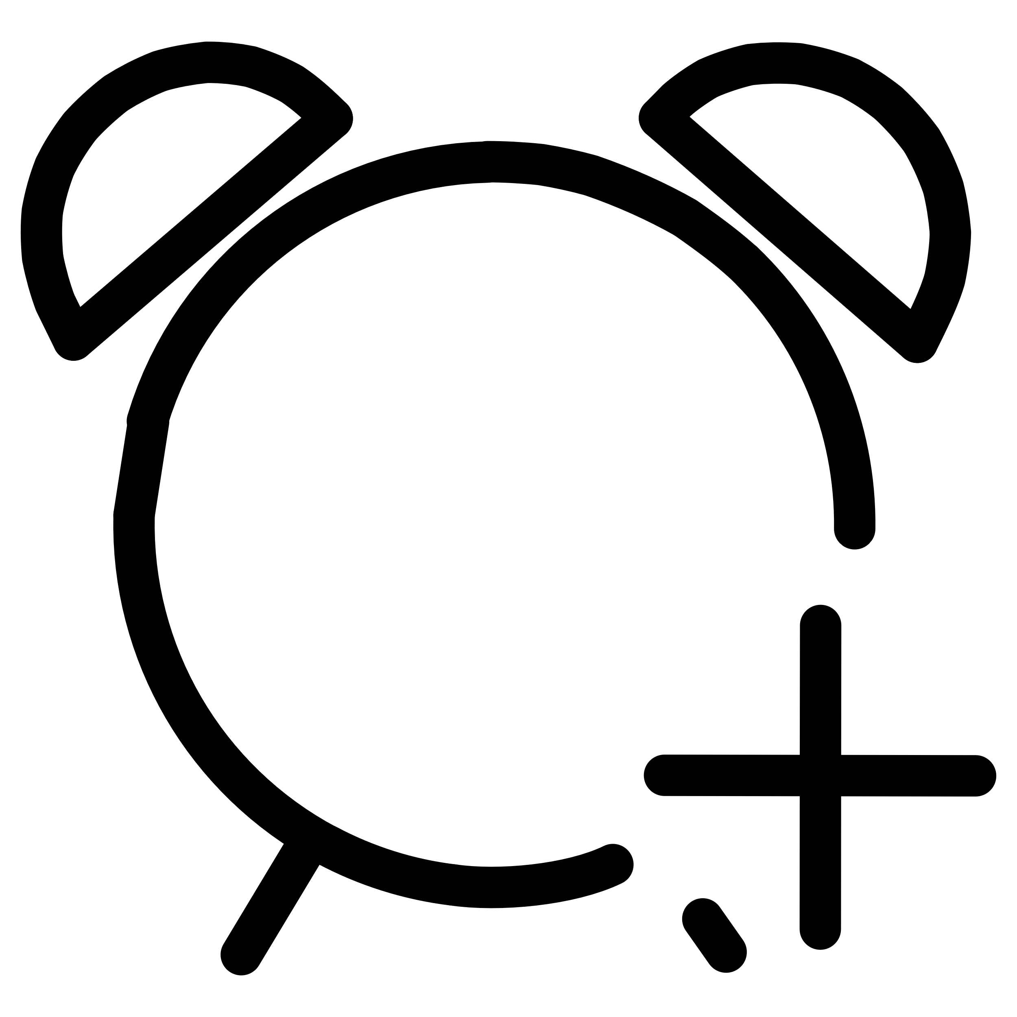




Scheduling Flow: How the Scheduler Evaluates Rules
Understanding the scheduler's decision-making process helps debug scheduling issues and write more effective affinity rules.
Pod Creation
Node Scoring
Placement / Pending
Node Filtering
Node Selection

Slide 11
Pod Anti-Affinity
Understanding Pod Placement Rules
Pod anti-affinity is a Kubernetes feature that dictates pods should avoid running on the same node or in the same availability zone as other specified pods. This ensures better distribution and resilience for your applications.
It's crucial for high availability and fault tolerance. By spreading replicas of an application across different nodes, the failure of a single node won't take down the entire service, enhancing reliability.
Unlike pod affinity, which attracts pods to specific nodes based on labels, anti-affinity actively repels them from co-locating with certain other pods, promoting isolation.
Kubernetes supports two primary types: hard anti-affinity (a strict rule, preventing scheduling if violated) and soft anti-affinity (a preference, attempting to avoid co-location but allowing it if necessary).

Slide 12

Soft Pod Anti-Affinity
Preferred Scheduling with Flexible Distribution
Flexible Rule
Fallback Behavior
The scheduler attempts to spread similar pods across different nodes, but it's not mandatory. This provides balanced distribution while maintaining scheduling flexibility.
If no better option exists due to resource constraints or other limitations, pods can still be placed on the same node, ensuring workloads can run.
Improved Availability
Helps improve availability and load distribution by reducing the risk of single-node failures affecting multiple similar pods simultaneously.

Slide 13




Hard Pod Anti-Affinity
Strict Scheduling with Guaranteed Isolation
Strict Enforcement
Fault Tolerance
The scheduler strictly enforces separation of similar pods, ensuring they cannot be placed on the same node under any condition.
Ensures high fault tolerance and isolation by preventing single points of failure from affecting multiple instances of the same application.
Scheduling Impact
Less flexibility in scheduling which may lead to pending pods if suitable nodes aren't available, requiring careful cluster planning.

Slide 14
Summary & Key Takeaways
Node Affinity Replaces nodeSelector
Provides flexible, powerful scheduling constraints with both hard requirements and soft preferences
Two Rule Types
requiredDuringScheduling = hard requirement (pod pending if unsatisfiable), preferredDuringScheduling = soft preference (scheduler optimizes)
Multiple Operators
In, NotIn, Exists, DoesNotExist, Gt, Lt allow sophisticated matching logic
AND/OR Logic
matchExpressions use AND logic, nodeSelectorTerms use OR logic, weights sum for preferences
Debug with Events
kubectl describe pod shows why pods can't schedule - check node labels with kubectl get nodes --show-labels
Best Practices
Start with preferred affinity and move to required only when necessary
Use descriptive label keys following standard conventions
Test affinity rules before applying to production workloads
Document why specific affinity rules exist
Avoid over-constraining - ensure enough nodes can satisfy requirements
Consider node label consistency across clusters
Use taints/tolerations for runtime node restrictions
Monitor for pods stuck in Pending state
Remember: Node Affinity is evaluated only during initial scheduling. For runtime node restrictions, you need taints and tolerations. Master both concepts for the CKA exam and production Kubernetes management.

