Slide 1
Music Streaming Application
Presented by: Ram Prasad K
Department of Computer Science and Engineering
Sathyabama Institude of Science and Technology
Year: 2025

Slide 2
Abstract
The Music Streaming Application provides users with a seamless experience to listen, search, and manage songs online.
It allows playlist creation, song recommendations, and user authentication.
Technologies used include HTML, CSS, JavaScript (frontend) and Node.js, MongoDB (backend).

Slide 3
Existing System
- Limited offline access
- Multiple apps for music discovery
- Lack of personalization
- Manual playlist management
- No data-driven insights

Slide 4
Proposed System
- Unified platform for streaming and managing songs
- Smart recommendation system
- Responsive user interface
- Secure user authentication
- Playlist creation and sharing

Slide 5
Advantages
- Fast and easy music access
- Personalized recommendations
- Simple and attractive UI
- Secure and scalable system

Slide 6
Disadvantages
- Requires stable internet
- Server maintenance needed
- High storage usage
- Limited offline support

Slide 7
Hardware Requirements
- Processor: Intel i3 or higher
- RAM: Minimum 4 GB
- Hard Disk: 20 GB free space
- Display: 1024x768 or higher

Slide 8
Software Requirements
- OS: Windows / macOS / Linux
- Frontend: HTML, CSS, JavaScript
- Backend: Node.js, Express.js
- Database: MongoDB
- Tools: VS Code, GitHub, Browser

Slide 9
Modules
1. User Authentication Module
2. Music Library Module
3. Search & Filter Module
4. Playlist Management Module
5. Music Player Module
6. Admin Module

Slide 10
Module Description
- User Authentication: Secure login/signup
- Music Library: Browse songs by genre, artist, album
- Search & Filter: Quick access to songs
- Playlist Management: Create & edit playlists
- Music Player: Play, pause, skip
- Admin: Manage songs & users

Slide 11
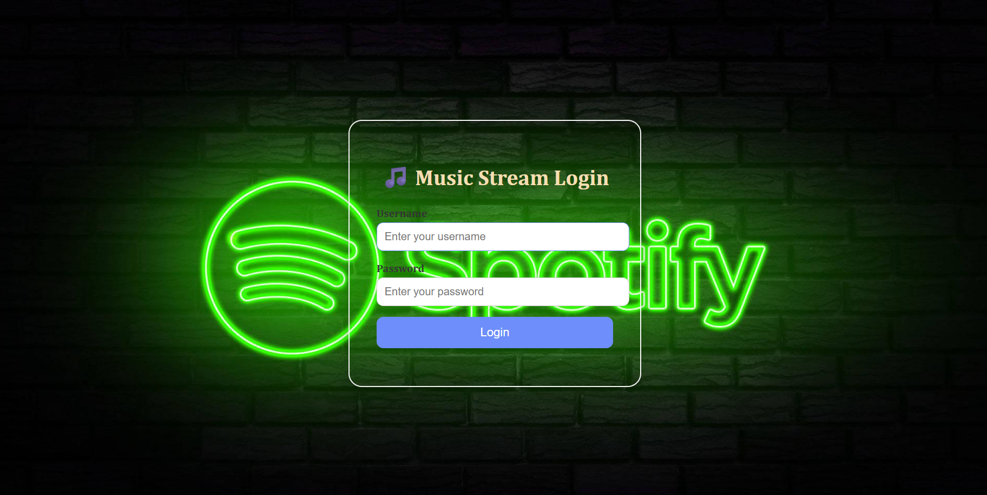
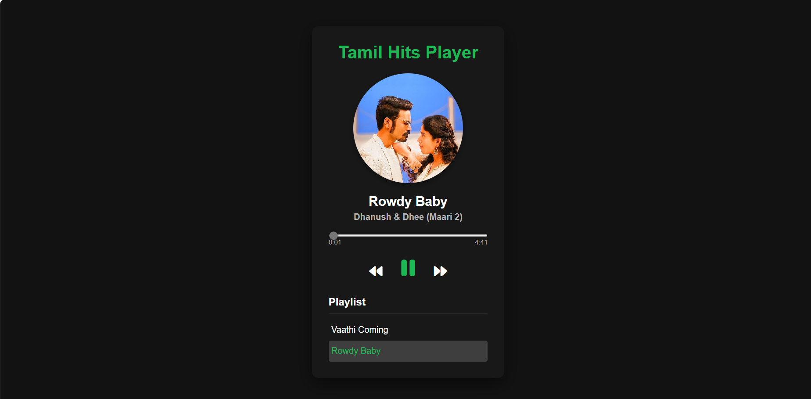
Sample Output (Screenshot)

Slide 12
Conclusion
The Music Streaming Application provides an interactive and reliable platform for music lovers.
It combines efficiency, user-friendliness, and security.
Future improvements: AI-based recommendations, offline downloads, and social features.

