Slide 1
Triggers in sql
RASHAD K

Slide 2
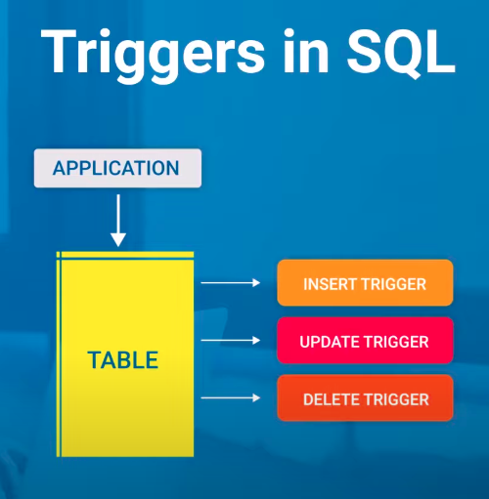
WHAT IS A TRIGGER
SQL codes that are automatically executed in response to certain events on a particular table
Maintain Integrity of Data

Slide 3
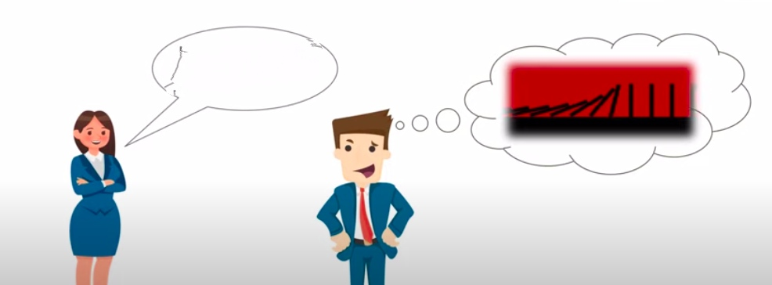
TRigger
Hey Jeevan,Do you know what triggers are ?

Slide 4
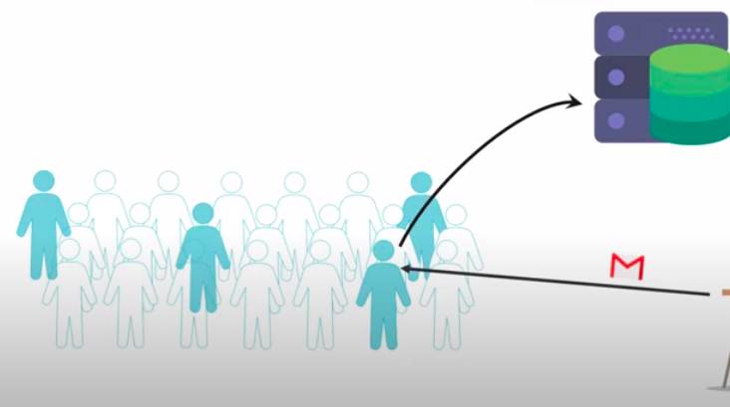

TRIGGers

Slide 5
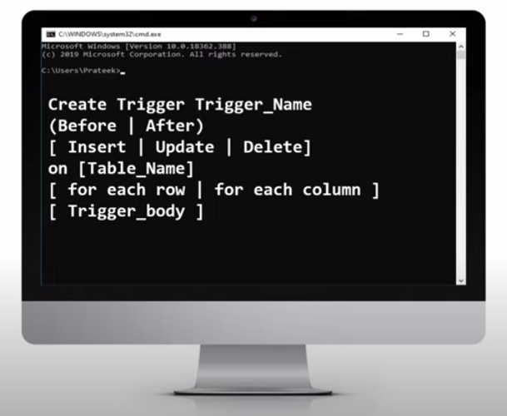
Syntax of a trigger in sql

Slide 6
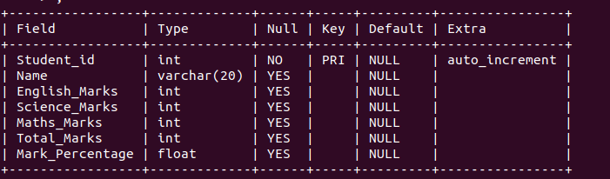
Example of a trigger
Consider the student table of database of a school .
Structure of student Table

Slide 7
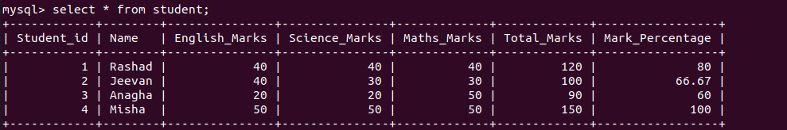
Example of trigger
Student Table

Slide 8
EXAMPLE of trigger
CREATE TRIGGER updater
before INSERT
on
Student
for each row
set new.Total_Marks = new.English_Marks + new.Science_Marks + new.Maths_Marks, new.Percentage = new.Total_Marks * 100 / 150;

