Slide 1
Methods in Java
Mia Wang
Feb. 1st, 2023

Slide 2
Agenda
Introduction
Review Variables
Methods
Method Parameters
Return Keyword
Method Overloading

Slide 3
Variables in Java
int - stores integers, such as 123 or -123
double - stores floating point numbers, with decimals, such as 19.99 or -19.99
char - stores single characters, such as ‘a’ or ‘B’.
Char values are surrounded by single quotes
string - stores text, such as "Hello World".
String values are surrounded by double quotes
bool - stores values with two states: true or false
Notes:
The Float data type occupies 4 bytes or 32 bits space in the memory, whereas the Double data type occupies 8 bytes or 64 bits space in the memory.

Slide 4
Variable Declaration and Assignment
#A demonstration of different data types
int myNum = 13; | // Integer (whole number without decimals)
double pi = 3.14159; | // Floating point number (with decimals)
char myLetter = ‘M'; | // Character
string myText = ”Michigan"; | // String (text)
bool myBoolean = true; | // Boolean (true or false)

Slide 5
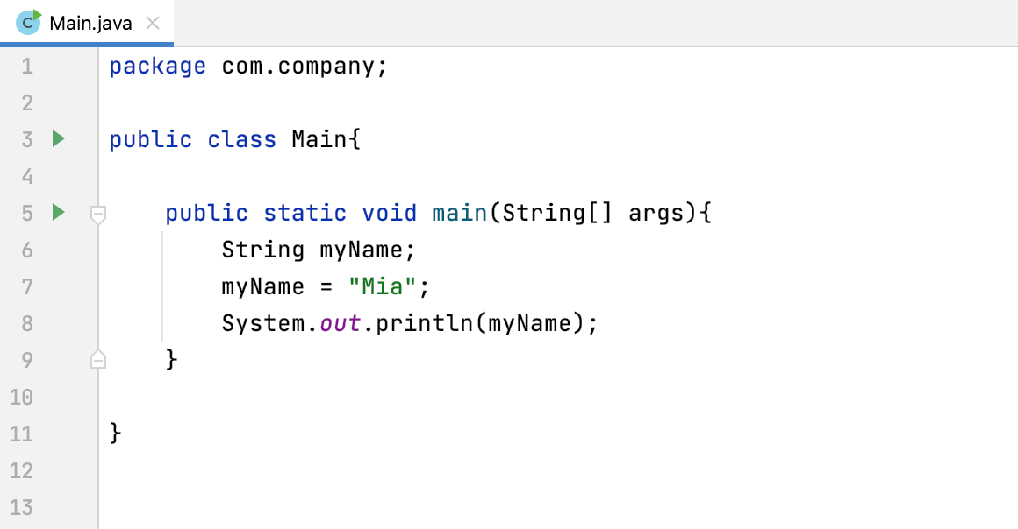
Display Variable
Notes:
Code Sample 1

Slide 6
Display Variable
public class Main{ public static void main(String[] args){ String myName; myName = "Mia"; System.out.println(myName); } }
Variable Declaration
Variable Assignment
Output Statement
Notes:
It is not mandatory to use com. company, you can use your own package name. Package is used to organize classes belonging to the same category or similar functionality. Classes can be downloaded faster as a group rather than one at a time.

Slide 7
Floating Point
Legal | Illegal | Allowed | ?
double pi; pi = 3.14159; | int b = 3.14; | double b = 99; | double m = 1 / 3;
int a = 2023; double pi = 3.14159; |  |  | double n = 1.0 / 3.0;

Slide 8
Methods (Functions)
A method is a block of code which only runs when it is called.
You can pass data, known as parameters, into a method.
Methods are used to perform certain tasks/actions, which can be used many times after declaration.
Function vs Method
In Java, the word method refers to the same kind of thing that the word function is used for in other languages. Specifically, a method is a function that belongs to a class. A function is a reusable portion of a program, sometimes called a procedure or subroutine.*
*http://www.cs.fsu.edu/~myers/cgs3416/notes/methods.html

Slide 9
Create a Method
package com.company; public class Main { static void miaMethod(){ System.out.println("I have two Golden Retrievers!"); } }
miaMethod() is the name of the method we are creating.
void means that the function does not have a return value.
Notes:
C++ provides some pre-defined functions, such as main() , which is used to execute code. But you can also create your own functions to perform certain actions.
To create (often referred to as declare) a function, specify the name of the function, followed by parentheses ().

Slide 10
Call a Method
package com.company;
public class Main { static void miaMethod(){ System.out.println("I have two Golden Retrievers!"); } public static void main(String[] args) { // write your code here miaMethod(); } }
What is the output?
Notes:
C++ provides some pre-defined functions, such as main() , which is used to execute code. But you can also create your own functions to perform certain actions.
To create (often referred to as declare) a function, specify the name of the function, followed by parentheses ().

Slide 11
Call a Method Multiple Times
package com.company;
public class Main { static void miaMethod(){ System.out.println("I have two Golden Retrievers!"); } public static void main(String[] args) { // write your code here miaMethod(); miaMethod(); miaMethod(); } }
What is the output now?
Notes:
A function can be called multiple times!

Slide 12
Call a Method Inside Another Method
package com.company; public class Main { static void miaMethod1(){ System.out.println("I have two Golden Retrievers!"); } static void miaMethod2(){ miaMethod1(); System.out.println("I also have four cats!"); } public static void main(String[] args) { miaMethod2(); } }
Can you guess the output?

Slide 13
Parameters and Arguments
Parameters refers to the list of variables in a method declaration.
Arguments are the actual values that are passed in when the method is invoked.
When you invoke a method, the arguments used must match the declaration's parameters in type and order.*
*https://docs.oracle.com/javase/tutorial/java/javaOO/arguments.html

Slide 14
Parameters and Arguments
package com.company; public class Main { static void miaMethod(String firstName){ System.out.println(firstName + " Federer"); } public static void main(String[] args) { String lastName = "Roger"; miaMethod(lastName); } }
In miaMethod method, String firstName is a parameter.
In main method, String lastName is an argument.
“The name of the variable we pass as an argument has nothing to do with the name of the parameter.”*
*Allen Downey, Think C++, p28.

Slide 15
Parameters and Arguments
package com.company; public class Main { static void miaMethod(String firstName){ System.out.println(firstName + " Federer"); } public static void main(String[] args) { String lastName = "Roger"; miaMethod(lastName); } }
In miaMethod method, String firstName is a parameter.
In main method, String lastName is an argument.
“The name of the variable we pass as an argument has nothing to do with the name of the parameter.”*
*Allen Downey, Think C++, p28.

Slide 16
Multi Parameters and Arguments
package com.company; public class Main { static void miaMethod(String firstName, int age){ System.out.println(firstName + " Federer" + " is " + age + '.'); } public static void main(String[] args) { String lastName = "Roger"; int age = 40; miaMethod(lastName, age); } }
In miaMethod method, String firstName and int age are parameters.
In main method, String lastName and int age are arguments.

Slide 17
The Return Keyword
The void keyword indicates that the function doesn’t return a value.
We can also use other data type (such as int , string , etc.) instead of void , and use the return keyword inside the method.

Slide 18
Return Value
package com.company; public class Main { static int miaSum(int a, int b){ return a + b; } public static void main(String[] args) { int m = 100; int n = 20; miaSum(m, n); } }
For miaSum method, the return type is int.
We are return the sum of a and b when calling the function.
Can you guess the output?

Slide 19
Method Overloading
Method Overloading can be used to create multiple methods that have the same name with different parameters.

Slide 20
Method Overloading
package com.company; public class Main { static int miaSum(int a, int b){ return a + b; } static String miaSum(String a, String b){ return a + b; } public static void main(String[] args) { int sum1 = miaSum(5, 10); String sum2 = miaSum("Hello", "Java"); System.out.println(sum1); System.out.println(sum2); } }
Instead of defining two methods that should do the same thing, it is better to overload one.
In the example, we overload the miaSum method to work for both int and string.

Slide 21

THANK YOU!

