Slide 1

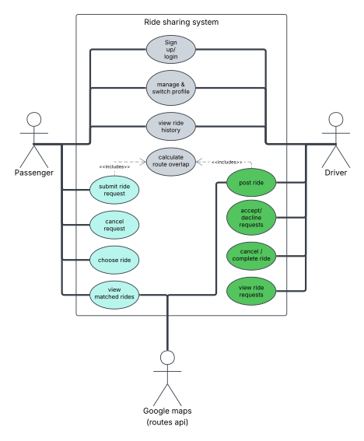
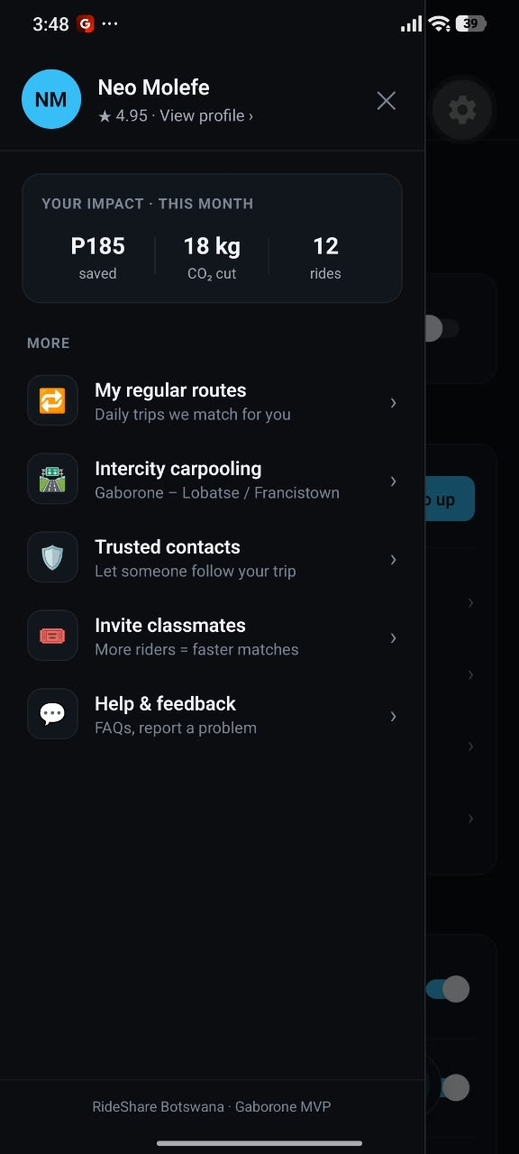
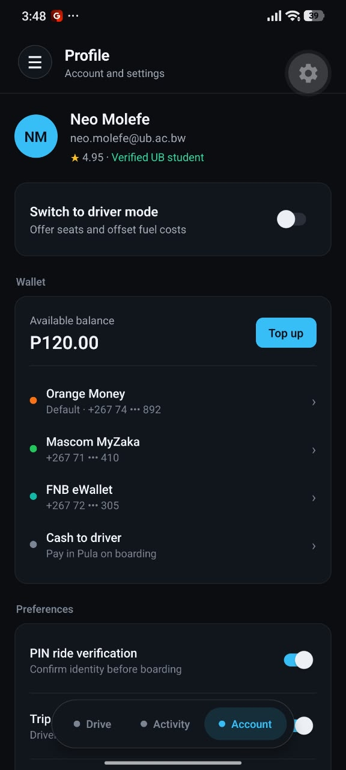
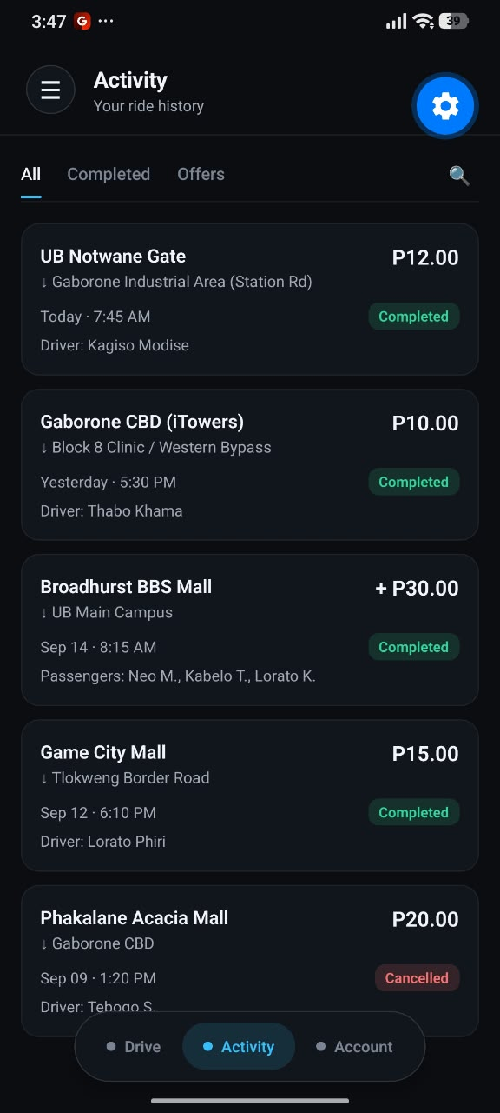
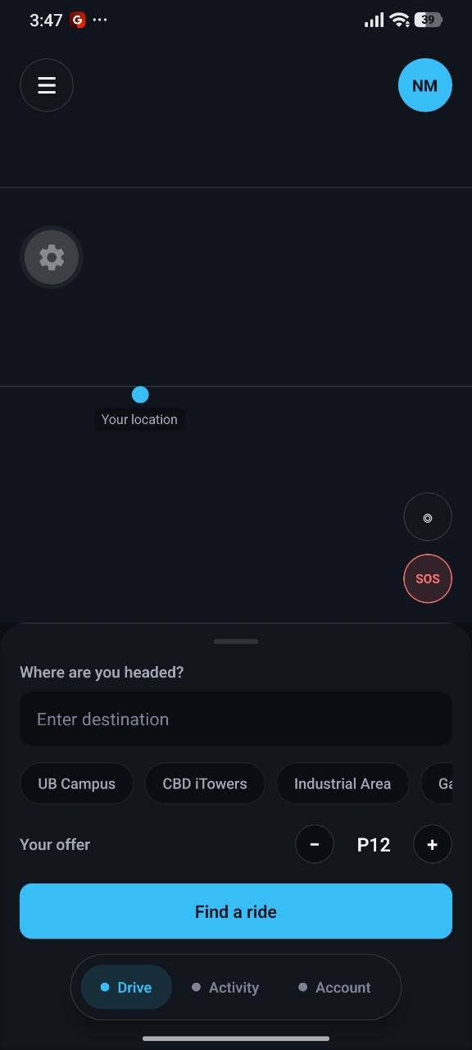
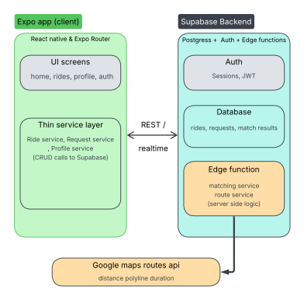
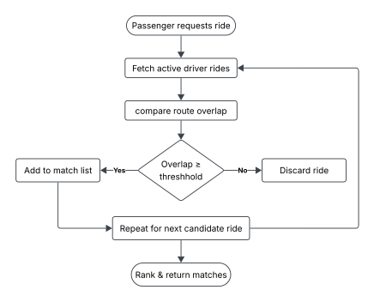
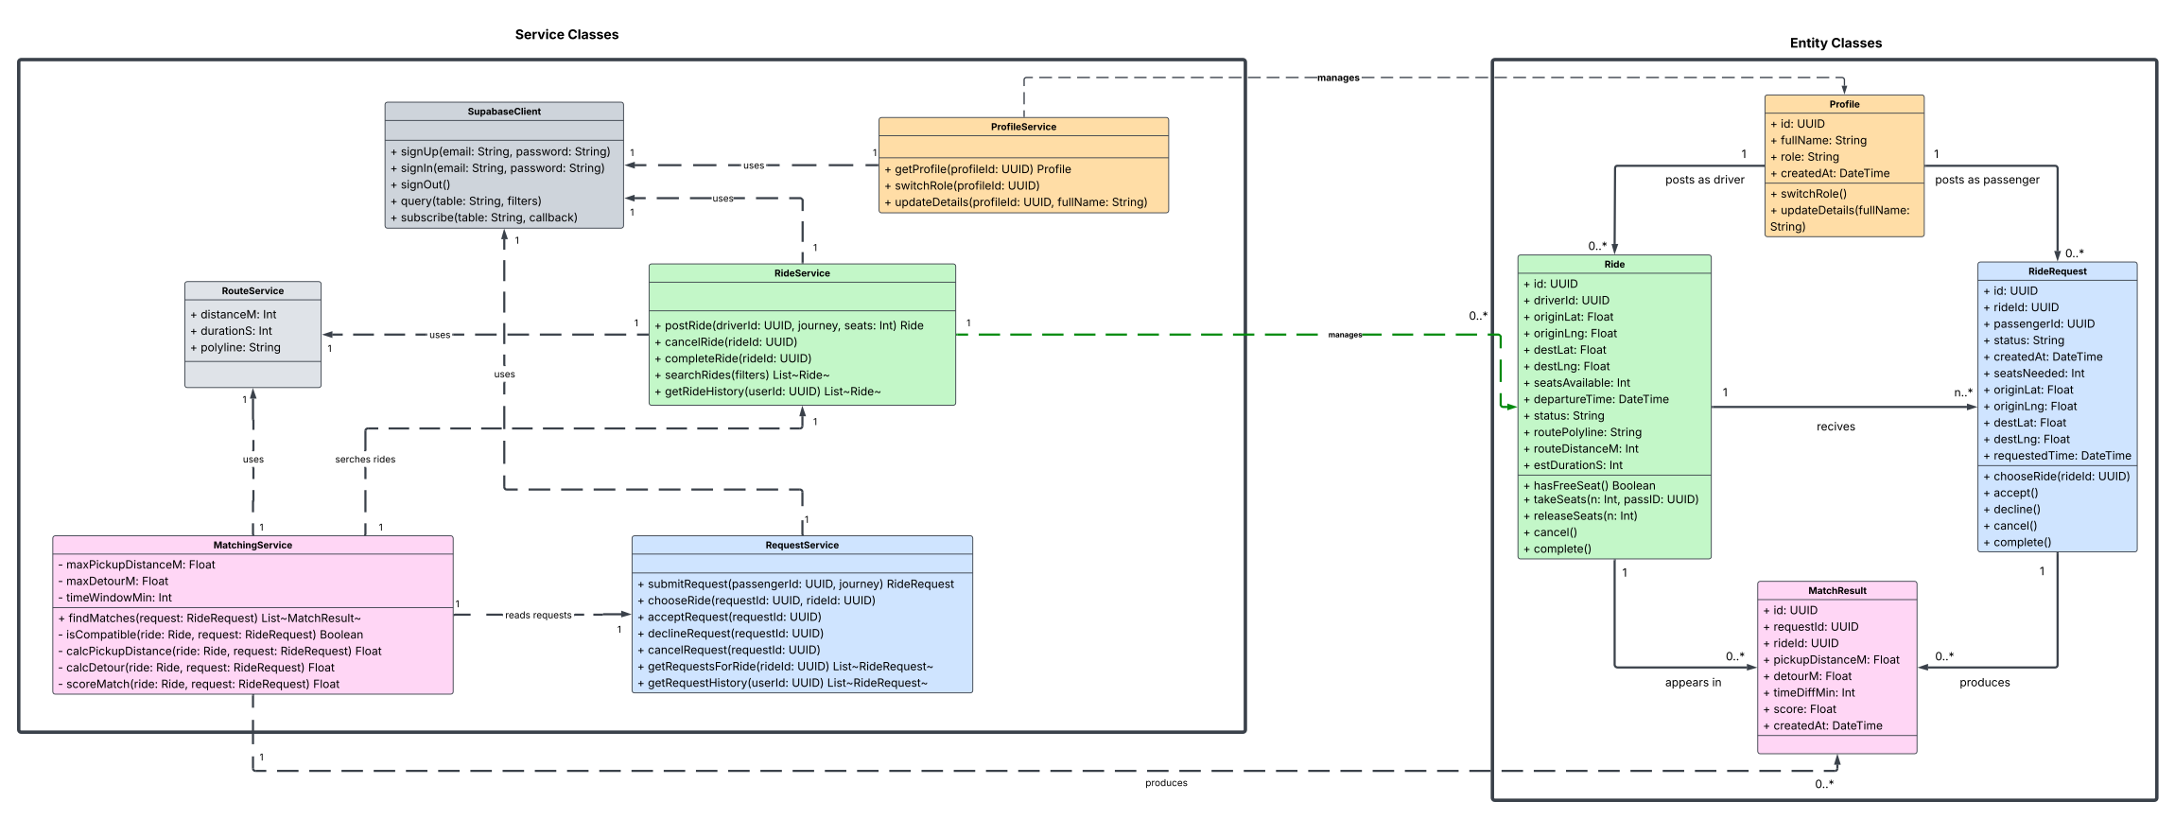
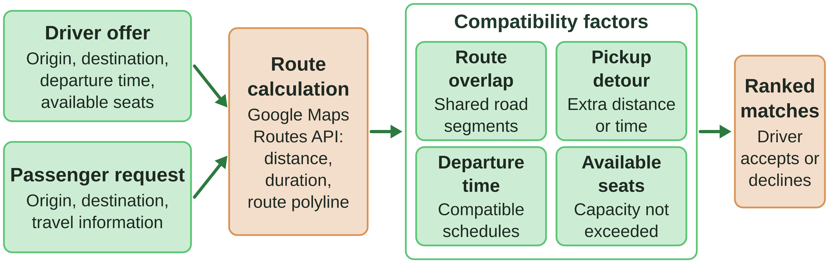
BSBS • SYSTEM DEVELOPMENT PROJECT
TECH STACK
P2P RIDE-SHARING FOR BOTSWANA
Expo + React Native + Supabase + Google Maps API
DURATION
A geolocation-based mobile app that matches drivers’ spare seats with passengers on compatible routes to share commuting costs
[Duration]
Group Members: Katlego Renee Baitirile | Jaden Panashe M Williams | Kaene Serumola | Boago Pablo Nkhii
SUPERVISOR
BSBS • CSE • 2026
Mr. Resego Rabalone
1
INTRODUCTION & PROBLEM STATEMENT
3
SYSTEM DESIGN
4
RESULTS & DISCUSSION
Background
Commuters in Gaborone depend on private vehicles or public transport, which can be costly and hard to coordinate.
Ride-sharing lets people on similar routes share vehicle capacity, cutting costs and vehicles needed (Agatz et al., 2012).
Problem Statement
Botswana lacks a convenient, localised and affordable peer-to-peer ride-sharing service for everyday commuters.
Ride-hailing apps dispatch a driver to a passenger; they do not match seats on journeys already planned with compatible passengers.
16 functional and 8 non-functional requirements.
Drivers offer seats; passengers request rides.
Matching on route, time, seats and detour.
Expo + React Native app for Android and iOS.
Supabase for authentication and PostgreSQL data.
Google Maps Routes API for routes.
Status: requirements and literature review documented; prototype under development.
Evaluation plan: test cases, a SUS usability survey and response-time testing.
Whether commuters find the approach useful will be judged through testing and user feedback.
2
LITERATURE REVIEW
Dynamic ride-sharing pairs travellers with similar itineraries and schedules (Agatz et al., 2012).
Good matches need route, time, seat and detour compatibility, not proximity alone (Hong et al., 2017; Stiglic et al., 2016).
Gap: no local platform built on existing journeys and available seats.
Figure 6. [The working artifact in use]
Criterion | Method | Target | Result
Functionality | Test cases (RQ01–RQ16) | All core requirements met | Core features working; matching in progress
Usability | SUS survey and core-task testing | Core tasks completed with minimal difficulty | Pending user testing
Performance | Match response time (NFR01) | Within the defined prototype target | Matching slow; being optimised
System | Strength | Limitation
Uber / Bolt | On-demand requests, live driver matching, scheduled rides | Driver travels to the passenger; not built on seats on planned journeys
inDrive | Passenger-proposed prices; drivers accept, decline or counter | Price negotiation rather than route and seat compatibility
BlaBlaCar | Drivers publish journeys with seats; costs are shared | Full platform; not tailored to urban commuting in Botswana
Proposed artifact | Matches drivers’ planned journeys with passengers by route, time and seats for local commuting
Figure 2. [High-level architecture]
Figure 3. [Use case diagram]
5
CONCLUSION
Effective ride-sharing needs journey compatibility, not proximity alone.
Contribution: a localised P2P commuting app built on existing journeys.
Requirements are defined; testing will show whether they are met.
6
RECOMMENDATIONS & FUTURE WORK
Recommend simple, measurable and explainable matching rules.
Limits: relies on connectivity, the Routes API and GPS accuracy.
Next: live ride tracking (like Uber and inDrive) and driver and passenger rating.
Figure 1. [Conceptual framework]
Figure 4. [System flowchart]
Figure 5. [Class diagram]
REFERENCES
Agatz, N., Erera, A., Savelsbergh, M., & Wang, X. (2012). Optimization for dynamic ride-sharing: A review. European Journal of Operational Research, 223(2), 295–303.
Google. (2026a). Routes API: Compute Routes. Google for Developers. https://developers.google.com/maps/documentation/routes/reference/rest/v2/TopLevel/computeRoutes
Google. (2026b). Routes API: Compute Route Matrix. Google for Developers. https://developers.google.com/maps/documentation/routes/reference/rest/v2/TopLevel/computeRouteMatrix
Hong, Z., Chen, Y., Mahmassani, H. S., & Xu, S. (2017). Commuter ride-sharing using topology-based vehicle trajectory clustering. Transportation Research Part C: Emerging Technologies, 85, 573–590.
Stiglic, M., Agatz, N., Savelsbergh, M., & Gradisar, M. (2016). Making dynamic ride-sharing work: The impact of driver and rider flexibility. Transportation Research Part E, 91, 190–207.
Zangenehnejad, F., & Gao, Y. (2021). GNSS smartphones positioning: Advances, challenges, opportunities, and future perspectives. Satellite Navigation, 2, Article 24.

