Slide 1
Multi-Modal Attention Networks
Presented by:
K SHANMUKHA NAVEEN
205002087

Slide 2
DATASET
OCTAND-EYE-FUNDUS-DATASET:
A rich repository comprising 1548 Eye Fundus images and 1113 Macular OCT images captured between 2015 and 2022. This dataset is a product of collaboration between CONACYT CF-2019-1759 grant, PAPIIT IN 205420, IMO (Instituto Mexicano de Oftalmología), APEC (Asociación Para Evitar la Ceguera), and INDEREB (Instituto de la Retina del Bajío). It represents a valuable resource for training and evaluating our predictive models.

Slide 3
OBJECTIVE
The objective of this project is to address the critical and rapidly progressing nature of retinal diseases, which can lead to severe damage and vision loss. Given the uncertainty in the availability of proper healthcare systems for all sections of society, a retinal disease detection model is proposed as a potential solution. The utilized Fundus dataset comprises 1548 images categorized into three classes. In the comparison of pre-trained models, VGG16 outperformed InceptionV3 with a recognition accuracy of 93.4%. Additionally, the implementation of a Custom Multi-Scale Attention Network model achieved a commendable accuracy score of 91%. These results highlight the potential of leveraging advanced deep learning models for efficient and accurate detection of retinal diseases.

Slide 4
MOTIVATION
This research project addresses the critical issue of retinal diseases, particularly focusing on Diabetic Macular Edema (DME) and Diabetic Retinopathy (DR), which can lead to severe vision loss and blindness. The human eye, a marvel of biological engineering, relies on the intricate functioning of its components, with the retina playing a pivotal role in vision. With the rising global prevalence of diabetes and its associated complications, efficient methods for diagnosing and predicting retinal diseases become crucial. Leveraging advanced medical imaging techniques, including Eye Fundus and Macular Optical Coherence Tomography (OCT) images, the project utilizes transfer learning and multiscale attention networks to develop predictive models. The proposed models, including VGG16 and a Custom Multi-Scale Attention Network, demonstrate high accuracy (93.4% and 91%, respectively) in categorizing retinal diseases.

Slide 5
IMPLEMENTATION
This employs two deep learning models, VGG16 and a custom Multi-Scale Attention Network (MSAN), for the classification of retinal diseases using eye fundus and macular OCT images. VGG16, pre-trained on ImageNet, is customized with additional layers for the task, achieving an impressive 93.40% accuracy. The MSAN architecture, designed specifically for this classification, incorporates multi-scale information and an attention mechanism, yielding a notable accuracy of 91%. Both models undergo training on the OCTAND-EYE-FUNDUS-DATASET, employing data augmentation techniques and the Adam optimizer. Also, this presents comprehensive results, including confusion matrices and metrics, highlighting the models' efficacy in accurate retinal disease classification and emphasizing their potential for real-time detection, crucial for preventing vision loss and enabling prompt diagnosis.

Slide 6
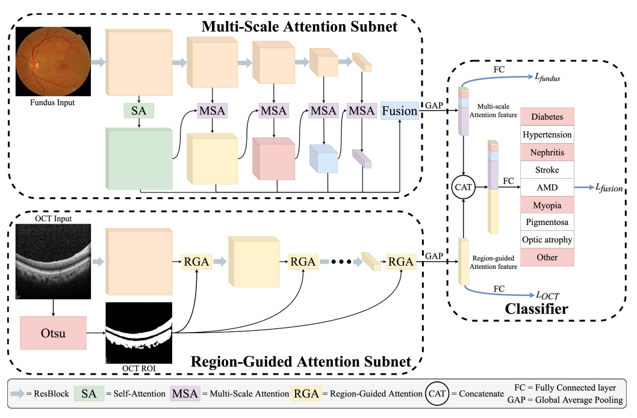

Slide 7
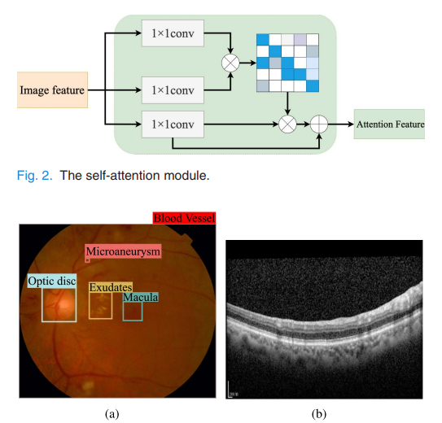

Slide 8
OBSERVATIONS
The observations on the implementation of the models on the OCTAND-EYE-FUNDUS-DATASET reveal promising results. The VGG16 model, with a carefully adjusted set of hyperparameters, achieves a high accuracy of 93.40%. This indicates the model's robust ability to classify eye fundus images and macular OCT images into three categories: Diabetic Macular Edema (DME), Diabetic Retinopathy (DR), and Healthy. Similarly, the custom Multi-Scale Attention Network (MSAN) demonstrates strong performance with an accuracy of 91%. The attention mechanism integrated into the MSAN architecture proves effective in focusing on critical image regions, contributing to its overall success. Confusion matrices for both models illustrate their proficiency in correctly categorizing instances of DME, DR, and healthy cases, further emphasizing the reliability of the proposed algorithms in the identification of retinal diseases. The study suggests that these models, when applied to real-time detection, hold substantial potential for preventing vision loss through the timely diagnosis of diabetic retinal disorders.

Slide 9
RESULTS OBTAINED
In the VGG16 model, properly classifying 210 occurrences as DME, 6 as DR, and 72 as healthy. Similar results were seen in the Custom-MSAN model, where 210 instances were accurately identified as DME, 9 as DR, and 64 as healthy. Using the Adam optimizer with a learning rate of 0.001 during 20 training epochs, our suggested VGG16 model optimizer yielded improved results compared to the stochastic gradient descent optimizer attained an impressive accuracy of 93.40%. the confusion matrix, critical model parameters such as accuracy, recall, F1-score, and support score offers a thorough analysis of DME, DR, and healthy categories for eye disease issues

Slide 10
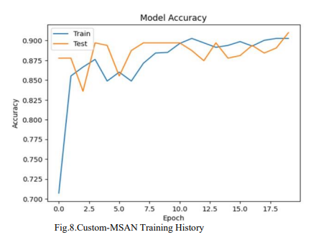
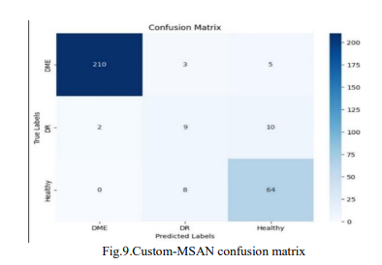

Slide 11
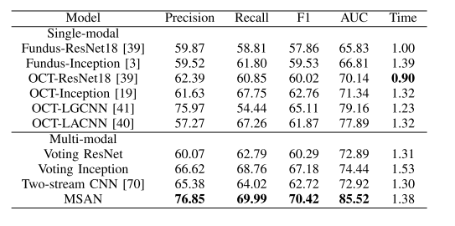
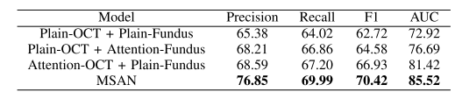
Evaluation Metrics

Slide 12
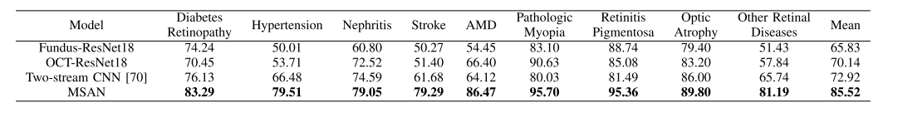

Slide 13
CONCLUSIONS
In conclusion, the observations from implementing the VGG16 and custom Multi-Scale Attention Network (MSAN) models on the OCTAND-EYE-FUNDUS-DATASET are highly promising. The VGG16 model achieved an impressive accuracy of 93.40%, showcasing its robustness in accurately classifying eye fundus and macular OCT images into categories of Diabetic Macular Edema (DME), Diabetic Retinopathy (DR), and Healthy. Similarly, the custom MSAN demonstrated strong performance with an accuracy of 91%, leveraging its unique architecture, including a multi-scale attention mechanism, to effectively capture important features and relationships within the images. Confusion matrices for both models underscore their reliability in correctly identifying instances of retinal diseases, further emphasizing their potential utility in real-time detection. The integration of transfer learning techniques, attention mechanisms, and careful hyperparameter tuning contributes to the models' efficacy. These findings suggest that the proposed methodologies hold significant promise for the early and accurate detection of diabetic retinal disorders, offering a valuable tool in preventing vision loss and facilitating timely clinical intervention.

