Slide 1
Customer Shopping Behavior
Data Analyst Business Insights & Growth Recommendations
Sales growth • Customer retention • Discount optimization • Return-order measurement
Customer Shopping Behavior Analysis | Data Analyst Presentation | 1

Slide 2
Executive Summary
What the analysis shows and where the business can act
3,900
$59.76
3.75
57%
Customer purchase records
Average purchase amount
Average review rating
Purchases without discount
Observed signals
Business opportunity areas
• Blouse, Shirt and Dress are among the highest-revenue items in the supplied dashboard.
• Every 3 Months is the largest purchase-frequency group shown in the dashboard.
• 2,223 of 3,900 purchases have no discount applied (57%).
• The dataset contains 25 products, 4 categories and 50 locations.
• Use high-revenue products to build bundles and cross-sell offers.
• Test targeted promotions instead of blanket discounts.
• Use repeat-purchase behavior to design retention campaigns.
• Track return rate and return reasons before making return-reduction claims.
Customer Shopping Behavior Analysis | Data Analyst Presentation | 2

Slide 3
Dataset & Data Preparation
The notebook documents the preparation workflow
Dataset profile
Analytical preparation
• 3,900 rows and 18 original columns.
• Age range: 18–70; mean age: 44.1.
• Purchase amount range: $20–$100; mean: $59.76.
• 25 products across 4 categories.
• 37 missing review ratings were handled using category-level median imputation.
• New fields: age_group and purchase_frequency_days.
• Standardized column names to snake_case.
• Removed promo_code_used because it matched discount_applied for all rows.
• Loaded the prepared table into PostgreSQL for SQL analysis.
• SQL layer covers revenue, ratings, discounts, subscriptions, segmentation, product ranking and age-group revenue.
Customer Shopping Behavior Analysis | Data Analyst Presentation | 3

Slide 4
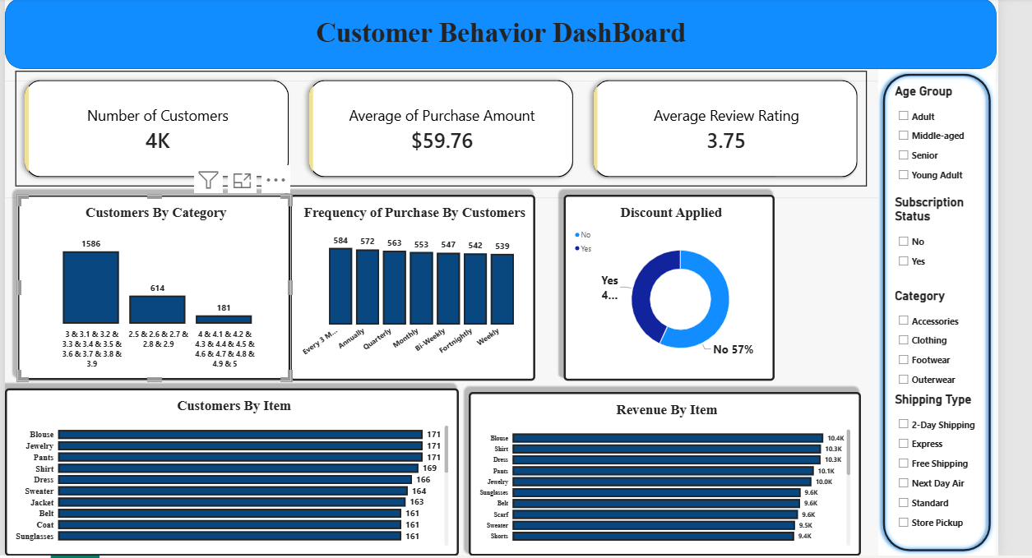
Dashboard Snapshot
Power BI view supplied with the project
Customer Shopping Behavior Analysis | Data Analyst Presentation | 4

Slide 5
Key Customer & Product Observations
Interpretation limited to metrics visible in the supplied dashboard and notebook
CUSTOMER BEHAVIOR
PRODUCT PERFORMANCE
DISCOUNT BEHAVIOR
RETENTION
• Every 3 Months: 584 purchases shown.
• Annually: 572.
• Quarterly: 563.
• Monthly: 553.
• Bi-Weekly: 547.
• Fortnightly: 542.
• Weekly: 539.
• Blouse: about $10.4K revenue.
• Shirt: about $10.3K.
• Dress: about $10.3K.
• Pants: about $10.1K.
• Jewelry: about $10.0K.
• These are dashboard values, rounded.
• 57% of purchases show no discount.
• About 43% show a discount.
• Discount analysis should compare margin and purchase value, not only order count.
• Q2 and Q6 specifically examine discounted purchases.
• Previous purchases are available.
• Subscription status is available.
• This supports repeat-buyer and subscriber analysis.
• Q7 segments New, Returning and Loyal customers.
Customer Shopping Behavior Analysis | Data Analyst Presentation | 5

Slide 6
How to Increase Sales
Data-driven initiatives to test using the existing fields
1. Increase basket value
2. Improve repeat purchases
3. Target discounts
• Bundle high-revenue products such as Blouse/Shirt/Dress with complementary items.
• Measure average order value before vs. after bundling.
• Use previous_purchases and purchase frequency to identify customers due for their next purchase.
• Test reminder campaigns around the observed purchase cycles.
• Avoid treating every customer equally.
• Test discounts for customers/items where incremental revenue exceeds discount cost.
4. Subscription conversion
5. Cross-sell by category
6. Monitor product-level revenue
• Compare subscribers vs. non-subscribers using average spend, total revenue and repeat purchases.
• Use the SQL Q5 framework to measure the relationship.
• Use the category + item ranking query to identify the most purchased products within each category.
• Create category-based recommendations.
• Track revenue and order volume by item weekly/monthly.
• Separate high-volume products from high-value products.
Customer Shopping Behavior Analysis | Data Analyst Presentation | 6

Slide 7
Return Orders: What We Can and Cannot Conclude
Important data limitation in the current project
Current dataset
What to add next
• The supplied notebook contains no return_status / returned_order field.
• There is no return date or return reason.
• Therefore, the current analysis cannot calculate return rate or identify the actual products causing returns.
• Size, item, category, season, shipping type, payment method and review rating are available and can become return-driver features once return records are joined.
• Return Status: Yes / No
• Return Reason: size, quality, damaged, wrong item, late delivery, changed mind, etc.
• Return Date and Delivery Date
• Return Quantity and Refund Amount
• Order ID linking each purchase to its fulfillment/return record
• Then calculate return rate by item, size, category, shipping type, location and season.
Customer Shopping Behavior Analysis | Data Analyst Presentation | 7

Slide 8
How to Reduce Return Orders Once Return Data Is Available
Operational actions tied to measurable return drivers
Size-related returns
Analyze return rate by size + item. Improve size charts and product measurements where return concentration is high.
Product-quality returns
Compare return rate with review rating and product. Investigate items with both low ratings and high returns.
Wrong-item / fulfillment
Track SKU/order accuracy and fulfillment errors; improve picking and packing checks.
Delivery-related returns
Compare returns by shipping type and delivery delay; investigate late-delivery patterns.
Expectation mismatch
Use product descriptions, images and material/specification details to reduce customer expectation gaps.
Success metric
• Target lower return rate without reducing customer satisfaction or revenue.
Customer Shopping Behavior Analysis | Data Analyst Presentation | 8

Slide 9
Recommended KPI Framework
Use these metrics to measure whether the actions are working
Revenue
Average Order Value
Purchase Frequency
Repeat Purchase Rate
Total purchase amount
Revenue / orders
Orders per customer / period
Customers with repeat purchases / customers
Discount Rate
Discount Efficiency
Return Rate
Return Value
Discounted orders / total orders
Incremental revenue vs. discount cost
Returned orders / total orders
Refund amount / revenue
Review Rating
Subscription Rate
Average rating by product
Subscribers / customers
Customer Shopping Behavior Analysis | Data Analyst Presentation | 9

Slide 10
Data Analyst Action Plan
A practical next step from dashboard → decision → measurement
Phase 1 — Establish baseline
Phase 2 — Test interventions
Phase 3 — Measure impact
• Calculate revenue, AOV, repeat purchase rate and discount rate.
• Add return-order data to the model.
• Create product/category/size return-rate views.
• Test product bundles.
• Test targeted discounts.
• Test repeat-purchase reminders.
• Improve product/size information for high-return items.
• Compare KPI movement before and after each intervention.
• Track revenue and return rate together.
• Keep changes that improve business outcomes without creating excessive discount cost.
Key message: the current project already supports sales, customer and discount analysis; return reduction requires a return-order dataset before causal conclusions can be made.
Customer Shopping Behavior Analysis | Data Analyst Presentation | 10

