Slide 1
KEYLOGGER
CAPSTONE PROJECT
Presented By:
SOWNDHARYA K- Jeppiaar Institute of Technology – B.TECH.IT

Slide 2
OUTLINE
Problem Statement
Proposed System/Solution
System Development Approach
Algorithm & Deployment
Result
Conclusion
Future Scope
References

Slide 3
PROBLEM STATEMENT
Develop a simple keylogger application using Python's Tkinter for the GUI, pynput for capturing keyboard events, and JSON for storing logged keystrokes. The keylogger should start and stop logging upon user interaction..

Slide 4
PROPOSED SOLUTION
Design a Python script that utilizes Tkinter to create a GUI for starting and stopping the keylogger. Use pynput library to capture keyboard events and store them in JSON format. Implement functions to start and stop the keylogger, and update the GUI accordingly.

Slide 5
SYSTEM APPROACH
*GUI Setup:* Use Tkinter to create a simple GUI with "Start" and "Stop" buttons.
*Keylogger Logic:* Implement functions to capture keyboard events (press, hold, release) using pynput library.
*Data Logging:* Store the logged keystrokes in both a text file (key_log.txt) and a JSON file (key_log.json).
*Start/Stop Functionality:* Implement functions to start and stop the keylogger, updating the GUI accordingly.
*Deployment:* Run the application to deploy the keylogger with the GUI interface..

Slide 6
ALGORITHM & DEPLOYMENT
1. *Initialize Variables:* Initialize variables like keys_used, flag, and keys
.2. *Event Listeners:* Define event listeners for key press and release using on_press and on_release functions.
3. *Logging Functions:* - generate_text_log(key): Write keys to a text file. - generate_json_file(keys_used): Write keys to a JSON file.
4. *Start/Stop Functions:* - start_keylogger(): Start the keylogger and update GUI. - stop_keylogger(): Stop the keylogger and update GUI.
5. *GUI Setup:* Create a Tkinter window with labels and buttons.6. *Run Application:* Start the Tkinter event loop to run the application.

Slide 7
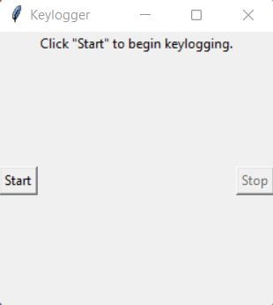
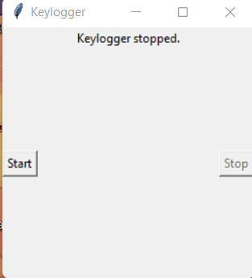
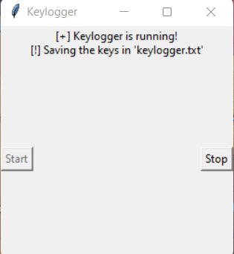
RESULT
The application provides a simple GUI interface to start and stop the keylogger. It logs keystrokes in real-time and stores them in both text and JSON formats.

Slide 8
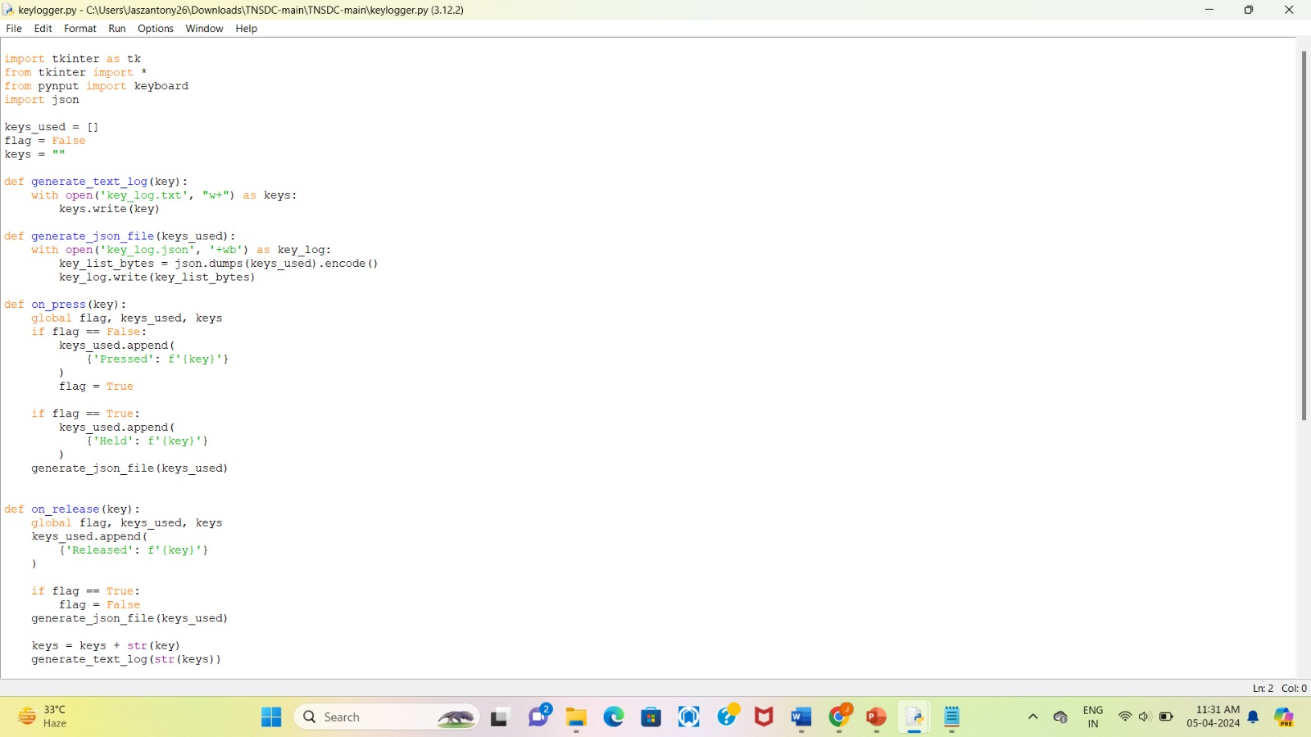
OUTPUT

Slide 9
CONCLUSION
The keylogger application successfully captures keyboard events and provides a user-friendly interface for controlling the logging process. It demonstrates the use of Tkinter for GUI development and pynput for keyboard event handling..

Slide 10
FUTURE SCOPE
1. Enhance Logging: Add timestamps to logged keystrokes for better analysis.
2. Improve User Interface: Enhance the GUI with more features like displaying logged keystrokes in real-time.
3. Security Measures: Implement encryption for logged data to ensure privacy.
4. Cross-platform Compatibility: Adapt the application to work on different operating systems.
5. Error Handling: Implement robust error handling mechanisms for better reliability.

Slide 11
REFERENCES
A Survey on Keylogger and its Detection Techniques by Vishal Bharti, Aditya Kumar Gupta, and Shailendra Mishra https://www.ijcaonline.org/archives/volume75/number5/12835-1514
Analysis of Keylogger Attacks and Countermeasures by Hongliang Liu, Ruiying Du, and Quansheng Zhuang https://www.semanticscholar.org/paper/Analysis-of-Keylogger-Attacks-and-Countermeasures-Liu-Du/54c7255bace229c82e4a5fd812ba8dd8829180c1
Detection of Keyloggers: A Review by Shukor Abd Razak, Ku Ruhana Ku-Mahamud, and Ramlan Mahmod https://www.researchgate.net/publication/220955239_Detection_of_Keyloggers_A_Review
A Comprehensive Study on Keylogger Attack and Defense by Shuo Chen, Rui Wang, XiaoFeng Wang, and Kehuan Zhang https://www.usenix.org/legacy/events/sec11/tech/full_papers/Chen.pdf

Slide 12
THANK YOU

