Slide 1

MILESTONE 1 · WEEKS 1–2
Data Integration & Incident Modeling
Threat Intel Framework — Advanced Threat Incident Analytics and
Security Visualization Framework
Milestone Submission Presentation
Presented By : Team C (Neeraj Sharma, Abhishek ,Vaishnavi , Swetha and Akanksha)
Under the supervision of our mentor : Mr. Sughandar

Slide 2




OBJECTIVE
What This Milestone Delivers
Weeks 1–2 focus: turn 5 disconnected raw sources into one validated, analysis-ready data model.
Integrate all datasets
Bring incident, operational, environmental, external-feed, and geo data into one model.
Build the star schema
One Fact_Incident table linked to 5 standardized dimension tables.
Create validated relationships
Every foreign key resolves correctly — cardinality and cross-filter direction confirmed.
Lay the dashboard foundation
KPIs, ETL status, and star-schema visuals ready for Power BI reporting.
THREAT INTEL FRAMEWORK · MILESTONE 1

Slide 3
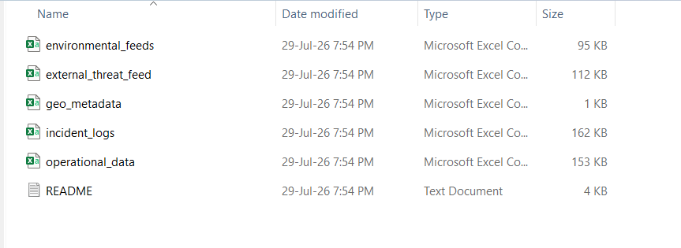
Raw Data regarding Advanced Threat Incident Analytics and
Security Visualization Framework
Now we have to apply feature Engineering Techniques on this RAW DATASET to make it a cleaned DATASET for further process.

Slide 4
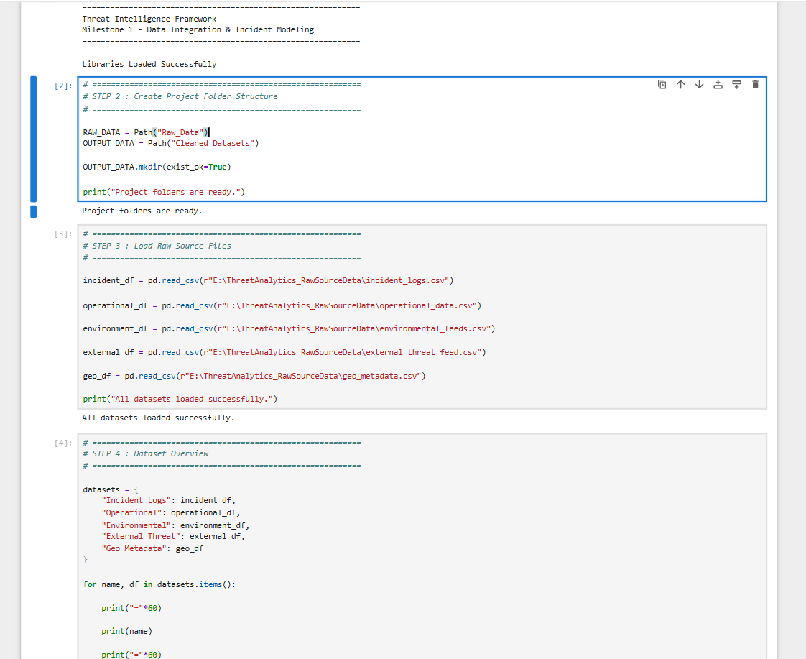
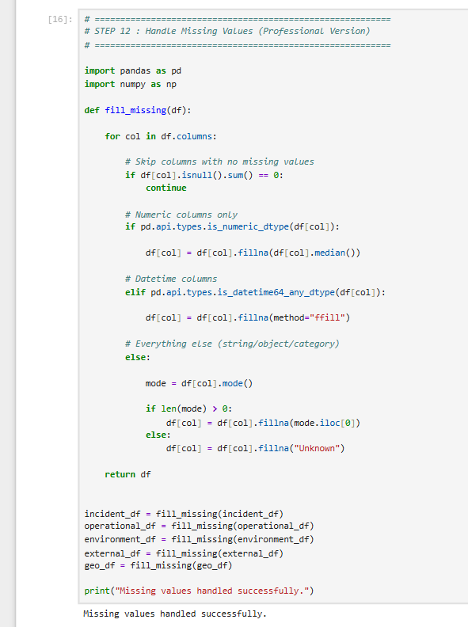
FEATURE ENGINEERING TASKS

Slide 5
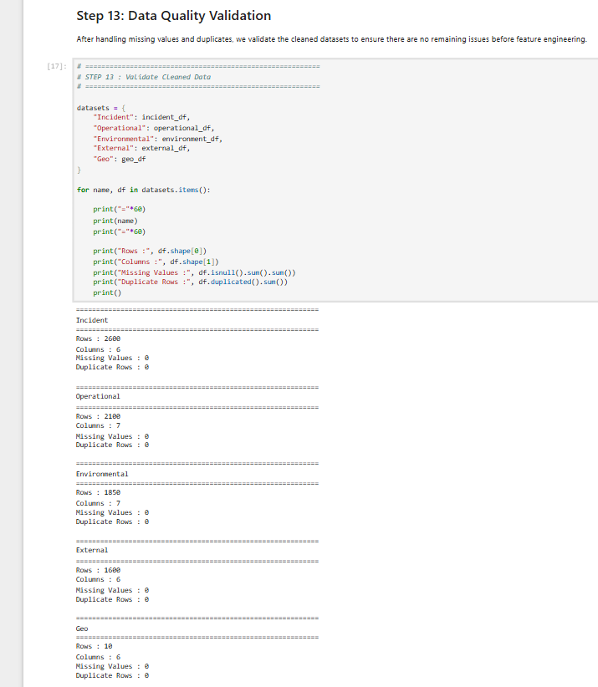
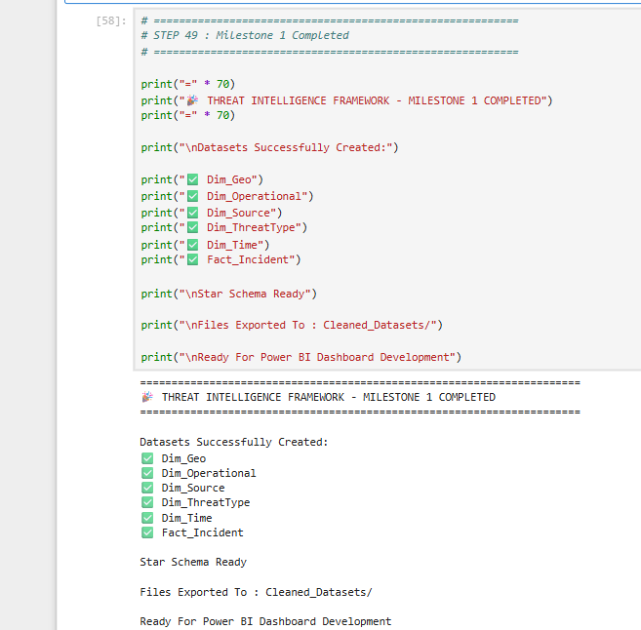
Load Raw Datasets.
Preprocess the Raw Data (Remove duplicate values, Handling missing values, Data quality validation.
Then integrate the cleaned datasets and Exported the cleaned data to folder for Data Visualization and Analysis.

Slide 6
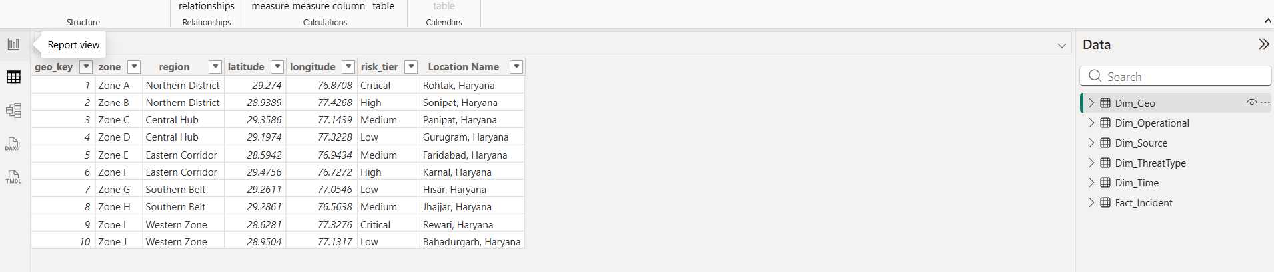
DIMENSION TABLE
Geography — Dim_Geo
10 operational zones, resolved to real coordinates and risk tiers.
KEY POINTS
10 zones (A–J), each mapped to a region and a real nearest-city location.
Includes latitude/longitude for map visuals.
risk_tier (Critical/High/Medium/Low) drives hotspot analysis in later milestones.
100% complete — the one fully clean reference source.
THREAT INTEL FRAMEWORK · MILESTONE 1

Slide 7
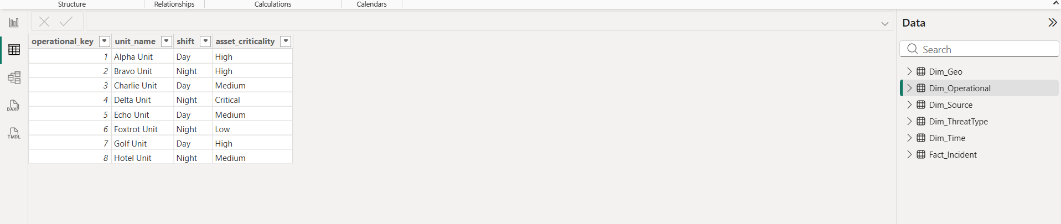
DIMENSION TABLE
Operational — Dim_Operational
The 8 response units that handle incidents in the field.
KEY POINTS
8 response units across Day/Night shifts.
asset_criticality flags which units are highest-priority.
Links to Fact_Incident via operational_key to power response-time analysis.
THREAT INTEL FRAMEWORK · MILESTONE 1

Slide 8
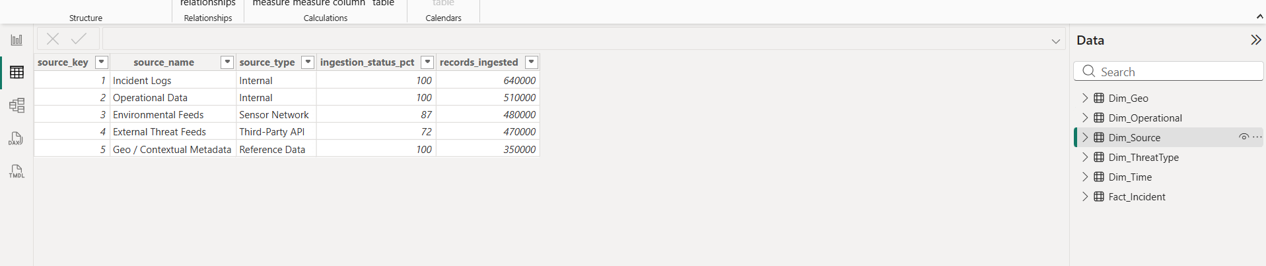
DIMENSION TABLE
Source — Dim_Source
Tracks exactly where every record came from, and how complete it is.
KEY POINTS
5 source systems: Incident Logs, Operational Data, Environmental Feeds, External Threat Feeds, Geo Metadata.
ingestion_status_pct is a real, computed completeness metric — not assumed.
Powers the ETL Pipeline Status view (next slides).
THREAT INTEL FRAMEWORK · MILESTONE 1

Slide 9
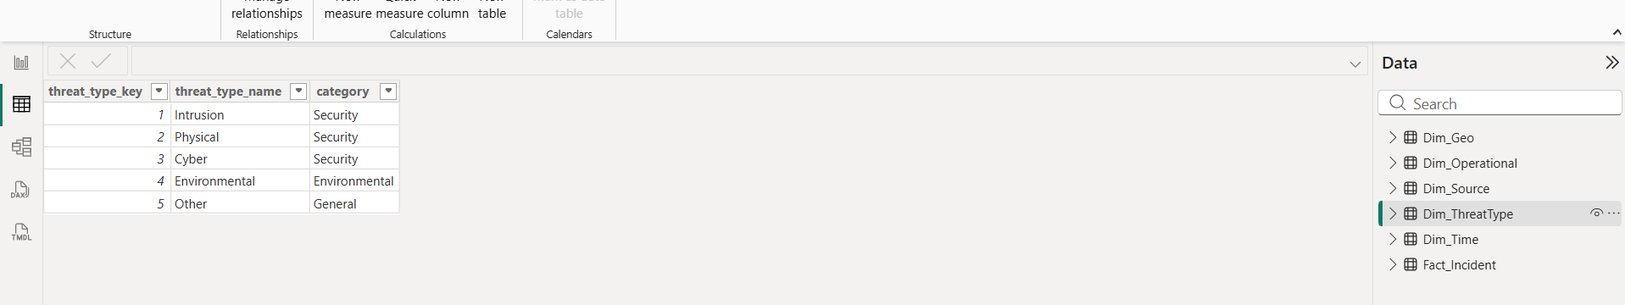
DIMENSION TABLE
Threat Type — Dim_ThreatType
The 5 standardized categories every incident is classified into.
KEY POINTS
Intrusion, Physical, Cyber, Environmental, Other.
Grouped further into Security / Environmental / General categories.
Built directly from the Step 2 category-standardization mapping.
THREAT INTEL FRAMEWORK · MILESTONE 1

Slide 10
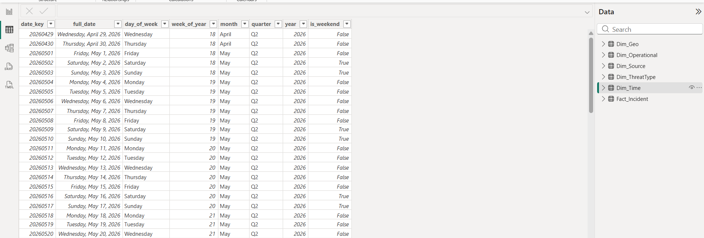
DIMENSION TABLE
Time — Dim_Time
A full calendar table spanning the entire data range.
KEY POINTS
One row per calendar day across the full incident date range.
Includes day of week, week/month/quarter/year, and a weekend flag.
Enables all daily, weekly, and monthly trend visuals.
THREAT INTEL FRAMEWORK · MILESTONE 1

Slide 11
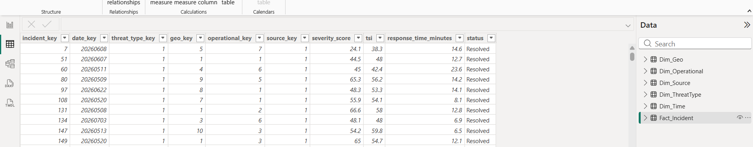
FACT TABLE
Incident — Fact_Incident
The central table — one row per incident, grain confirmed.
KEY POINTS
Grain: exactly one row per incident.
Foreign keys to all 5 dimensions: date, threat type, geo, operational unit, source.
severity_score and tsi (Threat Severity Index) calculated per incident.
response_time_minutes joined in from the operational system.
THREAT INTEL FRAMEWORK · MILESTONE 1

Slide 12
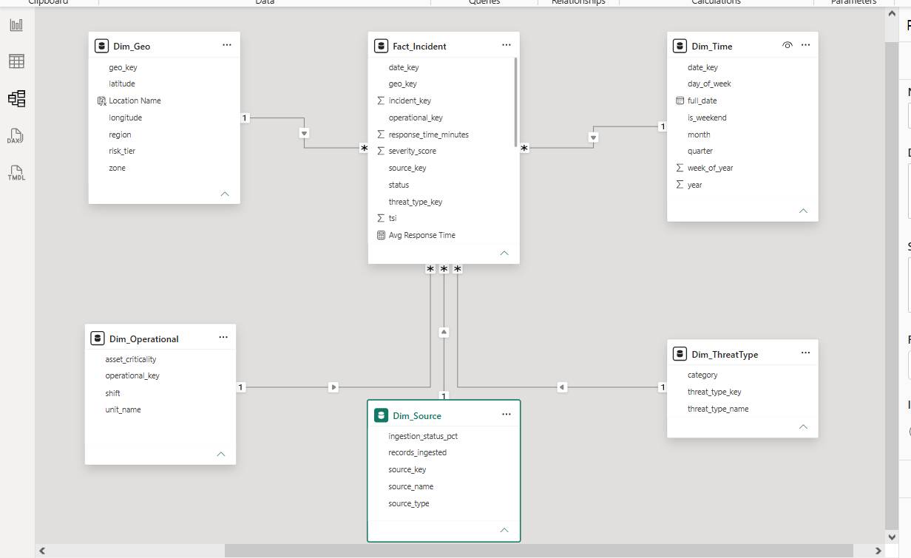
DATA MODEL
Star Schema — Validated Relationships
1 fact table, 5 dimensions, all relationships confirmed one-to-many with single-direction filtering.
THREAT INTEL FRAMEWORK · MILESTONE 1

Slide 13
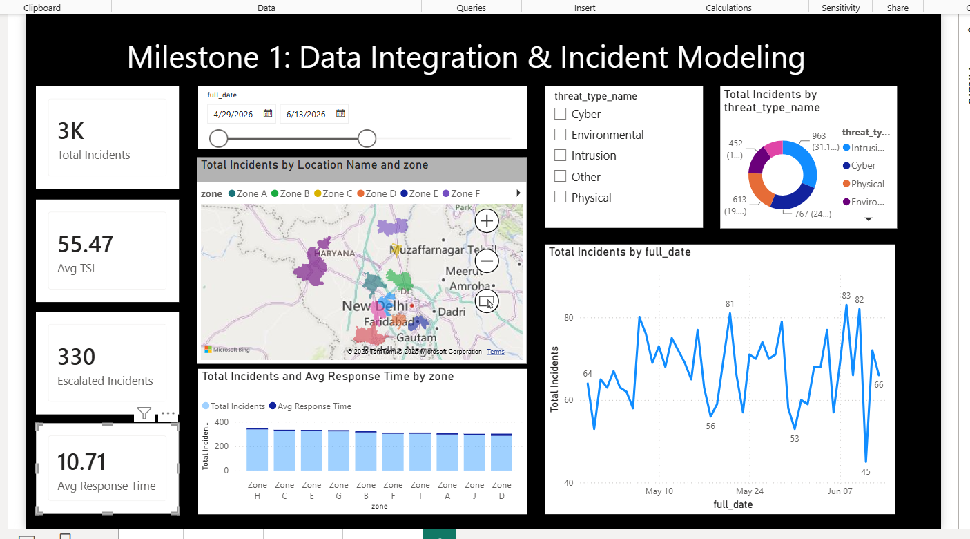
LIVE OUTPUT
Milestone 1 Dashboard Preview
The star schema and cleaned data, live in Power BI.
THREAT INTEL FRAMEWORK · MILESTONE 1

Slide 14

SUCCESS CRITERIA
Milestone 1 Evaluation
Measured against the 3 criteria defined for Week 2.
All datasets integrated successfully
5/5 sources loaded and joined into one model.
Incident classifications standardized across sources
100% of incidents mapped to 1 of 5 clean categories.
Star schema relationships validated
All 5 relationships confirmed; ~82% of incidents resolve a full location match — the remainder are real-world gaps, retained and flagged rather than hidden.
THREAT INTEL FRAMEWORK · MILESTONE 1

Slide 15
Milestone 1 Complete
THANKS from TEAM C (Neeraj Sharma, Abhishek ,Vaishnavi , Swetha and Akanksha)
THREAT INTEL FRAMEWORK · MILESTONE 1

