Slide 1
Milestone 2
Threat Intelligence & Temporal Analytics
Cyber Threat Analytics platform with incident Visualization System
Dataset exploration • Threat severity • Time-series analysis • Anomaly detection • Z-score analysis • Dashboard
Presented By : Team C (Neeraj Sharma)
Under the supervision of our mentor : Mr. Sughandar
Milestone 2 Presentation — 14 August 2026
1

Slide 2
1. Milestone 2 Objectives
What we focused on in this milestone
Explore the threat-intelligence dataset and understand the purpose of its major fields.
Analyze incident activity using daily, weekly, and monthly time-series views.
Measure threat severity and interpret the Threat Sensitivity Index (TSI) as a risk-oriented metric.
Identify unusual incident behavior using Z-score anomaly detection with ±2 reference limits.
Build a dashboard that converts raw security data into actionable, decision-oriented visual insights.
2

Slide 3
2. Threat Intelligence & Incident Analysis
Threat intelligence converts raw security-event data into information that supports detection, prioritization, and response.
The analysis considers incident categories such as Cyber, Environmental, Intrusion, Other, and Physical.
Zones are used to compare where incidents are concentrated and where escalation is higher.
Severity and TSI help the security team prioritize incidents rather than treating every event equally.
58.70
Average TSI
Overall risk: Medium
3,000
Total incidents
597–624
Visible zone totals
55–67
Visible escalated range
5
Threat-type categories
3
Z-score anomalies
0.10%
Incident-based anomaly rate 3 / 3,000 × 100
3

Slide 4
3. Temporal Analytics: Daily, Weekly & Monthly
Why different time windows are useful
Daily analysis gives fine-grained visibility and is used here for Z-score based anomaly detection.
Weekly aggregation supports short-term monitoring and comparison of incident volume from week to week.
Monthly aggregation supports long-term trend analysis, management reporting, and evaluation of changing risk.
Using multiple time windows helps distinguish short-lived spikes from sustained trends.
4

Slide 5
4. Anomaly Detection & Z-Score
Detecting behavior that differs from normal activity
An anomaly is an observation that is unusually different from the normal pattern.
Example: if daily incidents normally stay around a stable range and one day shows a sharp spike, that day should be flagged for investigation.
Z-score measures how far an observation is from the mean in units of standard deviation.
For this dashboard, an observation is flagged when |Z| > 2, matching the +2 and −2 reference lines shown in the chart.
Important: an anomaly is a signal for investigation, not proof that an attack occurred.
Anomaly Rate = 3 / 3,000 × 100 = 0.10%
Based on the project definition of 3 anomalous events out of 3,000 incidents.
Z = (x − μ) / σ
Dashboard result: 3 observations cross the ±2 Z-score threshold.
5

Slide 6
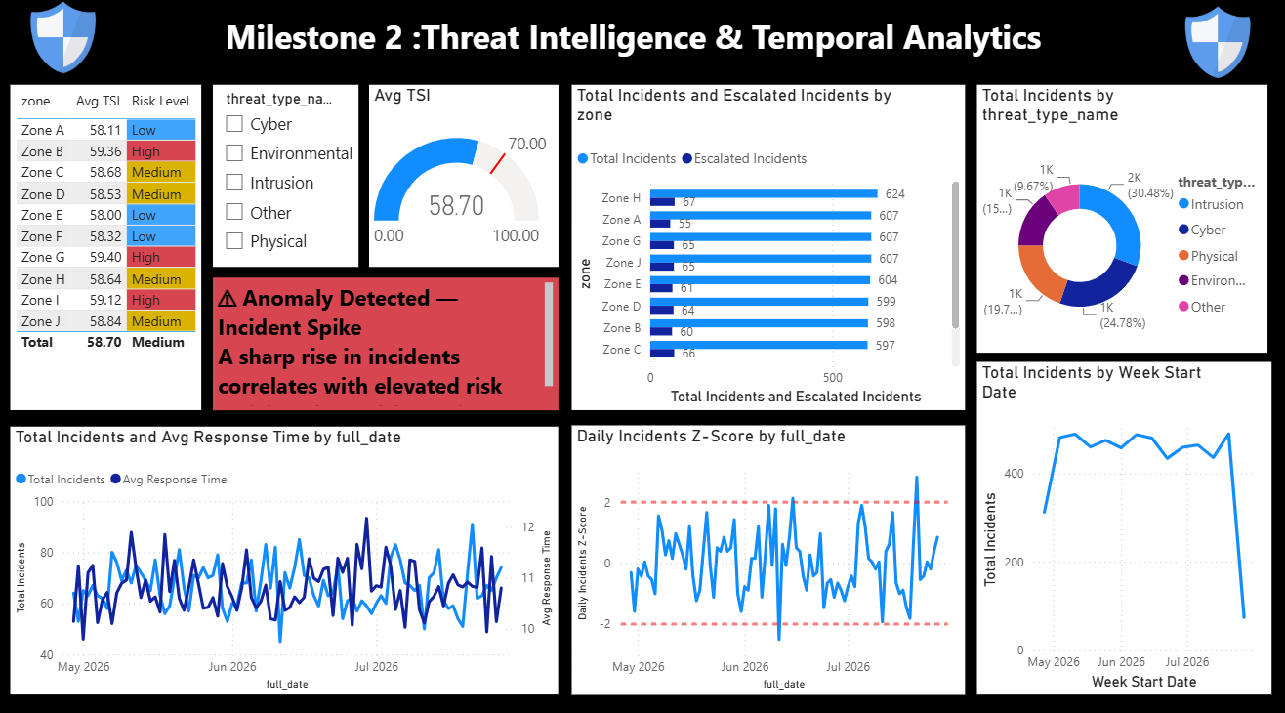
5. Dashboard Overview
Milestone 2 dashboard developed from the threat-intelligence data
6

Slide 7
6. Key Findings from the Dashboard
The dashboard's Avg TSI gauge and overall zone summary both show 58.70, with the overall risk level classified as Medium.
Visible zone incident totals range from 597 to 624; Zone H has the highest visible total at 624.
Visible escalated incidents range from 55 to 67, showing that escalation differs across zones.
The dashboard contains five threat-type categories: Intrusion, Cyber, Physical, Environmental, and Other.
The weekly chart shows incident totals mostly around 300–550, followed by a sharp drop in the latest point. The latest value should be checked for data completeness before calling it a true decline.
Threat-type distribution: Intrusion is the largest visible category (30.48%), followed by Cyber (24.78%).
7

Slide 8
8. Visualization Selection & Purpose
Visualization
Data
Purpose
Line chart
Daily / weekly incident volume
Show temporal trends
Bar chart
Total vs escalated incidents by zone
Compare zone activity
Donut chart
Incident share by threat type
Show category composition
Gauge
Average TSI / risk metric
Quick risk overview
Z-score line chart
Daily incident Z-scores with ±2 limits
Identify anomalies
Dual-axis line chart
Incidents vs average response time
Compare workload and response behavior
9

Slide 9
9. Today's Milestone 2 Tasks Completed / Presented
14 August 2026
Explained threat intelligence, cybersecurity incident categories, and threat severity levels.
Explained time-series analysis using daily, weekly, and monthly cybersecurity data.
Identified a cybersecurity trend: changes in incident volume over time.
Identified a cybersecurity anomaly: a sudden incident spike relative to normal activity.
Applied Z-score anomaly analysis using the dashboard's ±2 reference limits.
Mapped each visualization to its analytical purpose: line, bar, donut, gauge, dual-axis, and Z-score charts.
Calculated and incorporated the incident-based anomaly rate: 3 flagged events / 3,000 incidents = 0.10%.
Key presentation message: anomaly detection identifies unusual behavior for investigation; it does not by itself
confirm an attack.
10

Slide 10
10. Conclusion & Next Steps
The dashboard consolidates threat volume, TSI/risk, zone activity, threat-type composition, response time, and temporal behavior.
Temporal analysis highlights both short-term fluctuations and longer-term patterns.
Three observations crossed the ±2 Z-score threshold, giving an incident-based anomaly rate of 0.10%; these observations still require contextual validation.
Overall objective: turn raw threat data into actionable security intelligence and prioritize events that require investigation.
Thank you
11

