Slide 1
Cyber Threat Analytics platform with incident Visualization System
MILESTONE 3
Geospatial Intelligence
& Response Analytics
From threat location to risk-aware resource deployment
Presented By : Team C (Neeraj Sharma)
Under the supervision of our mentor : Mr. Sughandar
01
02
03
04
WHERE are the threats?
HOW risky are they?
HOW are we responding?
ARE resources deployed efficiently?
Milestone 3

Slide 2
1. Milestone 3 Objective
Moving from descriptive threat analytics to operational decision support
WHERE
HOW RISKY
HOW WE RESPOND
ARE RESOURCES EFFICIENT?
Response performance
Resource deployment
Threat hotspots
Risk surface
Identify locations/zones with concentrated incident activity.
Use risk tier, zone context and incident concentration.
Track response time, SLA and escalation behavior.
Compare risk, workload and deployed units.
Decision chain
Incidents → Location → Risk → Response → Resources → Action
The dashboard should help a security manager move from “what happened?” to “what should we do next?”
Milestone 3 | Geospatial Intelligence & Response Analytics
2

Slide 3
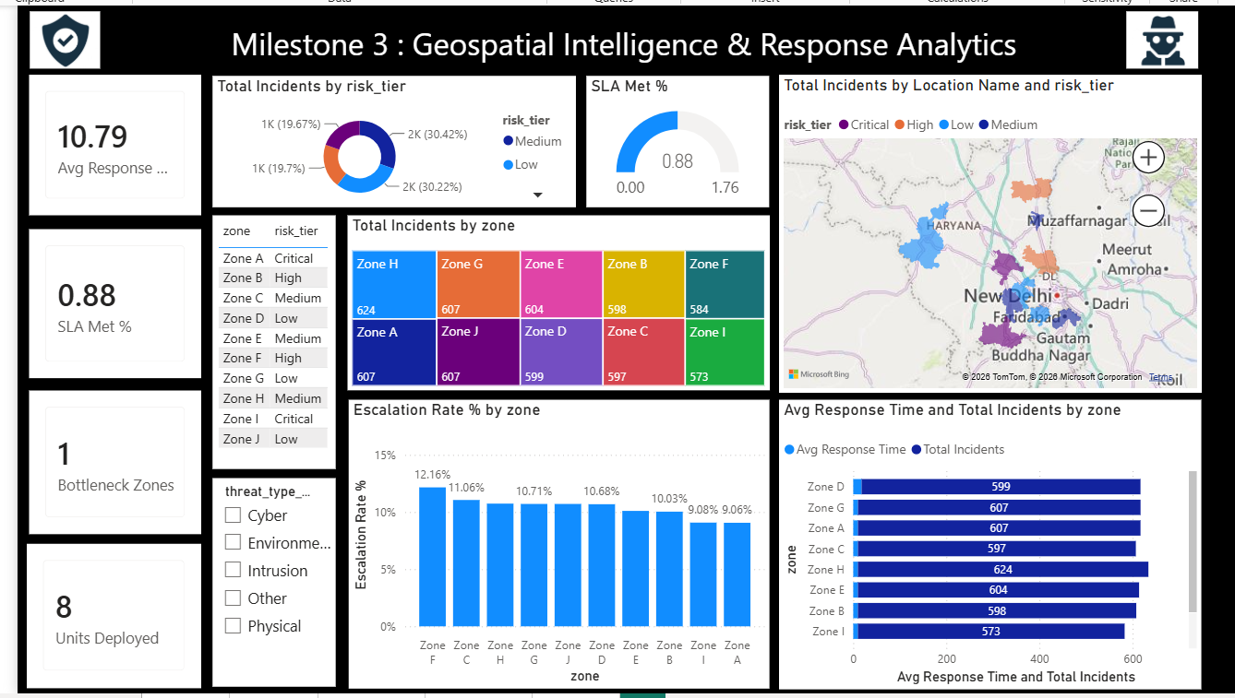
2. Current Dashboard — Milestone 3 Evidence
The current dashboard directly supports the four operational questions
Milestone 3 | Geospatial Intelligence & Response Analytics
3

Slide 4
3. WHERE are the threats?
Geospatial threat hotspot analysis
GEOSPATIAL VIEW
ZONE VIEW
HOTSPOT LOGIC
Location-level map
Incident concentration
Risk + place
Identify geographical concentration of incidents.
Compare incident volume across operational zones.
High concentration plus high risk = priority hotspot.
Displayed zone incident counts
Hotspot interpretation
Zone H
Zone D
• Zone H has the highest displayed incident count: 624.
• Zones G, A and J each show 607 incidents.
• Incident count identifies concentration; it does not by itself prove highest risk.
• Use risk tier and location context to prioritize the hotspot.
624
599
Zone G
Zone B
607
598
Zone A
Zone C
607
597
Zone J
Zone F
607
584
Zone E
Zone I
604
573
Map accuracy requires verified latitude/longitude and a documented geographic source.
Milestone 3 | Geospatial Intelligence & Response Analytics
4

Slide 5
4. HOW risky are they?
Risk surface analysis
RISK TIER
RISK SCORE
ANOMALY
PRIORITY
Critical / High / Medium / Low
TSI context
Z-score
Risk + location
Use the tier to distinguish severity beyond volume.
Use the validated TSI/risk score alongside volume.
Use unusual observations as investigation triggers.
Focus resources where exposure is highest.
Risk surface decision matrix
Incident activity
Risk tier
Operational meaning
High
Critical / High
Immediate / priority attention
High
Medium
Investigate and monitor
Low
Critical / High
Risk-driven attention
Low
Low / Medium
Routine / enhanced monitoring
Key principle: incident count answers “how much”; risk tier answers “how serious”; together they support prioritization.
Milestone 3 | Geospatial Intelligence & Response Analytics
5

Slide 6
5. HOW are we responding?
Response performance and SLA monitoring
AVG RESPONSE TIME
SLA MET
ESCALATION RATE
10.79
0.88
~9–12%
Displayed dashboard KPI; validate source timestamps and definition.
Displayed KPI; label as 88% only after confirming measure format.
Displayed zone-wise escalation chart.
Response performance measures
SLA formula
• Average response time by zone
• SLA compliance / SLA breach count
• Escalation rate by zone
• Incidents handled per resource/team
• Unresolved or delayed incidents
SLA % = Incidents meeting SLA ÷ Total applicable incidents × 100
Example: 90 / 100 × 100 = 90%
Define response time consistently: detection/report time → response start time. Do not mix response time with resolution time.
Milestone 3 | Geospatial Intelligence & Response Analytics
6

Slide 7
6. ARE resources deployed efficiently?
Risk-to-resource matching
RESOURCE–RISK MATCH
RESOURCE WORKLOAD
RESOURCE PERFORMANCE
High risk + few resources
Incidents handled
Response + SLA
Priority mismatch requiring attention.
Measure workload per team/resource.
Evaluate whether deployed resources deliver timely outcomes.
Deployment matrix
Risk
Resources
Decision
Low
High
Consider reallocation
Medium
Adequate
Maintain / monitor
High
Low
Increase priority resources
Very High
Low
Immediate resource priority
The dashboard displays “8 Units Deployed”; validate the underlying resource data before treating this as an operationally accurate count.
Milestone 3 | Geospatial Intelligence & Response Analytics
7

Slide 8
7. Resource Performance — How is each resource handling incidents?
Evaluate workload and outcomes, not just the number of units
Workload
Incidents handled per team/resource
Speed
Average response time
Compliance
SLA met %
Escalation
Escalations handled
Outcome
Resolved vs unresolved
Recommended resource table
Resource / Team | Incidents handled | Avg response | SLA % | Escalations | Utilization
Milestone 3 | Geospatial Intelligence & Response Analytics
8

Slide 9
8. Interactive Analysis Filters
Let the manager investigate a specific operational slice
FILTER
FILTER
FILTER
Date / Week / Month
Zone
Location
FILTER
FILTER
FILTER
Risk Tier
Threat Type
Resource / Team
Example management question
“Show High/Critical incidents in Zone G during the selected period and compare response performance with deployed resources.”
Filters turn a static report into an investigation tool.
Milestone 3 | Geospatial Intelligence & Response Analytics
9

Slide 10
9. Key Insights & Observations
Evidence → interpretation → action
1
Threat concentration
Zone H has the highest displayed incident count: 624.
→ Prioritize hotspot investigation and validate geography.
2
Risk context
Risk tiers distinguish severity beyond raw incident volume.
→ Prioritize Critical/High activity even if volume is not the highest.
3
Response
Average response time is displayed as 10.79; SLA KPI is 0.88.
→ Validate definitions and source timestamps; monitor by zone.
4
Escalation
Displayed zone escalation rates are roughly 9–12%.
→ Investigate high-escalation zones with slower response.
5
Resources
8 units are displayed as deployed.
→ Compare actual availability/workload with risk before reallocating.
Milestone 3 | Geospatial Intelligence & Response Analytics
10

Slide 11
10. Evaluate Risk Handling Efficiency
Does the dashboard lead to better decisions?
A dashboard is efficient when it connects risk to action.
Detect
Locate
Assess
Respond
Deploy
Review
Incident / anomaly
Zone / hotspot
Risk tier / TSI
Response / SLA
Resource allocation
Outcome / KPI
Efficiency indicators
• High-risk zones receive proportionally higher attention.
• Response times remain within defined targets.
• SLA breaches are identified quickly.
• Resources are not concentrated in low-risk areas while high-risk zones lack coverage.
• Hotspots and anomalies lead to documented investigation/actions.
Milestone 3 | Geospatial Intelligence & Response Analytics
11

Slide 12
Milestone 3 — Final Decision Framework
WHERE?
HOW RISKY?
HOW RESPONDING?
RESOURCES?
Hotspot map
Risk surface
Response KPIs
Deployment matrix
Identify threat concentration
Prioritize Critical/High exposure
Track speed, SLA & escalation
Match resources to risk & workload
Final takeaway
The objective is not only to count incidents. It is to identify where threats are concentrated, determine how risky they are, measure how effectively we respond, and ensure resources are deployed where they are most needed.
Data validation remains essential before operational decisions: geography, timestamps, SLA definitions and resource counts must match the source data.

