Slide 1
MILESTONE 4
Risk Intelligence &
Executive Analytics
Cybersecurity risk assessment • Predictive threat analytics • Executive decision support
OBJECTIVE 01
OBJECTIVE 02
OBJECTIVE 03
Assess
Predict
Decide
Convert historical incidents into an executive view of current risk.
Use historical time-series data to estimate future risk.
Highlight hotspots, compliance and operational priorities.
Prepared for mentor review
Threat Intelligence Dashboard • Milestone 4
1

Slide 2
Milestone 4 — What We Built
OVERVIEW
Executive layer built on the incident, temporal and geospatial analysis from Milestones 1–3.
AVG TSI
SLA MET
UPTIME
PRIOR PERIOD
CRITICAL HOTSPOTS
58.70
0.88
0.90
0.49
2
Current aggregate threat/risk indicator.
Dashboard KPI for service-level compliance.
Security platform availability KPI.
Incidents vs prior-period KPI shown on dashboard.
Locations requiring priority attention.
Executive questions answered
Data → intelligence pipeline
What is our current overall risk?
Where are the critical areas / hotspots?
Are security operations meeting the required SLA?
Is the risk pattern increasing over time?
What does the forecast suggest about future risk?
Historical incident records
Daily and weekly time-series aggregation
Risk / TSI calculation and classification
Geospatial and hotspot analysis
Forecasting and executive KPI visualization
Threat Intelligence Dashboard • Milestone 4
2

Slide 3
Risk Intelligence at a Glance
RISK
The dashboard turns incident-level data into decision-oriented indicators.
Executive interpretation
From KPI → Action
Avg TSI of 58.70 represents the dashboard's current aggregate risk indicator.
Two critical hotspots are flagged for priority monitoring.
SLA Met % is displayed as 0.88; this should be interpreted consistently with the KPI's scale/format.
The dashboard shows a forecast TSI of 72.22, indicating a higher expected risk level than the current average.
Risk should be managed using both severity and location—not incident count alone.
01
Measure
Current risk / SLA / hotspots
02
Locate
Identify critical locations
03
Predict
Estimate future risk
04
Prioritize
Focus monitoring & resources
Threat Intelligence Dashboard • Milestone 4
3

Slide 4
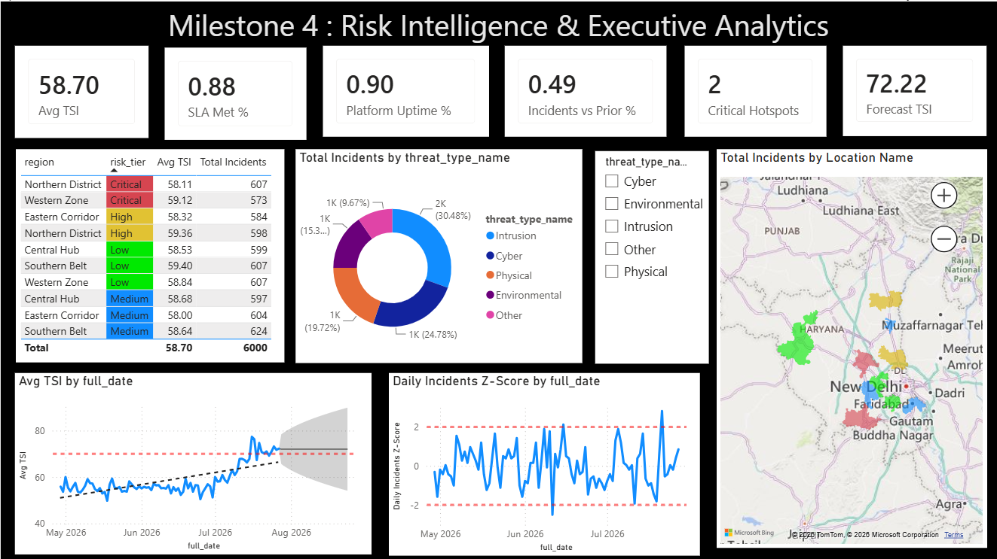
Dashboard Evidence — Risk & Geography
EVIDENCE
The current Power BI page combines regional risk, threat composition and geographic concentration.
Current dashboard snapshot used as the evidence base for the executive analysis.
Threat Intelligence Dashboard • Milestone 4
4

Slide 5
Historical Data Preparation
TEMPORAL
Two time resolutions support different decisions: daily detects short-lived events; weekly supports strategic trend and forecasting.
DAILY DATA
WEEKLY DATA
KEY FIELDS
Incident-by-date
Week-start aggregation
Date • Risk • Count
Used to detect sudden spikes, unusual days and Z-score anomalies. Best for operational monitoring.
Used to smooth daily noise and reveal broader risk/incident trends for forecasting.
Recommended weekly series: Weekly Risk Score and Weekly Incident Count.
Methodology
Validate date field and sort chronologically.
Create a daily incident count / daily risk measure.
Create a Week Start Date and aggregate incidents and risk score by week.
Keep the same date filters and business definitions across visuals.
Use weekly data for forecasting so isolated daily spikes do not dominate the long-term signal.
Threat Intelligence Dashboard • Milestone 4
5

Slide 6
Predictive Analytics & Forecasting
PREDICTION
Predictive analytics uses historical patterns to estimate what is likely to happen next.
Historical data
→
Weekly aggregation
→
Forecast model
→
Future risk
Chosen forecasting approach
Two forecast targets
Use Power BI's built-in time-series forecasting on the weekly series.
Why: simple to implement, directly integrated with the dashboard, and easy for a mentor/executive to interpret.
Forecast horizon: configure the required 8 weekly periods.
Do not treat forecast values as guarantees; they are estimates with uncertainty.
Weekly Risk Score → predicts future risk intensity.
Weekly Incident Count → predicts future workload / volume.
Showing both separates 'how risky?' from 'how many incidents?'
The current dashboard already surfaces Forecast TSI = 72.22.
Threat Intelligence Dashboard • Milestone 4
6

Slide 7
Forecast Visualization
FORECAST
The executive view should clearly separate observed history from predicted future values.
HISTORICAL / ACTUAL
FORECAST
What the final Power BI chart must show
Week Start Date on X-axis
Actual weekly risk score as a solid line
Forecast weekly risk score as the forecast series
Confidence interval / uncertainty band
Repeat the same design for weekly incident count
Clearly mark where actual data ends and forecast begins
Actual weekly values
Predicted weekly values
← historical period
future 8 weeks →
Threat Intelligence Dashboard • Milestone 4
7

Slide 8
Key Forecast Observations
INSIGHTS
Observations are written as decision statements, not just descriptions of the graph.
OBSERVATION 01
OBSERVATION 02
OBSERVATION 03
Risk is rising
Prepare capacity
Monitor uncertainty
The dashboard's historical TSI series shows an upward movement toward the end of the observed period. The forecast KPI is 72.22, above the current Avg TSI of 58.70.
A forecast of incident count should be monitored alongside risk score. Higher predicted volume can increase workload even when severity is stable.
Forecasts are estimates. A widening confidence band means greater uncertainty and should trigger closer monitoring rather than automatic escalation.
Important: the screenshot supports the Forecast TSI value and historical trend, but does not show the 8 weekly forecast-count values. Those should be generated in the final Power BI forecast visual.
Threat Intelligence Dashboard • Milestone 4
8

Slide 9
Executive Decision Framework
DECISION
How a security manager should act on the dashboard.
High risk + critical hotspot
Immediate investigation, enhanced monitoring and priority resource allocation.
Risk increasing + forecast increasing
Prepare additional response capacity and increase monitoring frequency.
SLA below target
Review response bottlenecks, team workload and escalation handling.
High incident count but low risk
Optimize operational workload; do not equate volume alone with criticality.
Executive principle: measure → locate → predict → prioritize → act → monitor.
Threat Intelligence Dashboard • Milestone 4
9

Slide 10
Milestone 4 — Final Summary
CONCLUSION
From historical incidents to forward-looking risk intelligence.
What was delivered
Final message to the mentor
Executive cybersecurity KPI layer
Historical daily and weekly temporal analysis
Risk and hotspot context inherited from previous milestones
Predictive analytics / forecasting workflow
8-week forecast design for weekly risk score and incident count
Decision-oriented observations and recommended actions
The dashboard does not only report what happened.
It explains the current risk position and where attention is required.
It adds a forward-looking layer through forecasting.
Executives can use the KPIs to prioritize resources and monitoring.
The final step is to validate the forecast settings and display the complete 8-week weekly forecast series.
THANK YOU
Threat Intelligence Dashboard • Milestone 4
10

