Slide 1



CUNY-BOOKS
Notes:
These slides are only a template for the content you should include. Feel free to style as you like.
On the front page include your Project Name, your name (team member names), and the program logos.

Slide 2
Introduction/Motivation
CUNY students can easily buy and exchange used textbooks with other
Usually students post books on campus wall to sell, and this application is a better choice
The application is to be used for all CUNY students across all campus
Its free to use
Notes:
In the intro portion you want to answer these questions. You can do this with text, diagrams, or pictures.
You should break this up into two or more slides if necessary.

Slide 3






Tech Stack
Notes:
You want to highlight the Tech Stack that you used. I recommend adding logos to catch audience attention.
[The questions on the left are only guidelines, you don’t need to explicitly answer them in the slide.]
You should be able to answer why you chose a particular component vs other choices. “My instructor told me to” or “it was a class requirement” is not a great answer. That being said, you can say in hindsight you would choose a different component, and why that is.

Slide 4
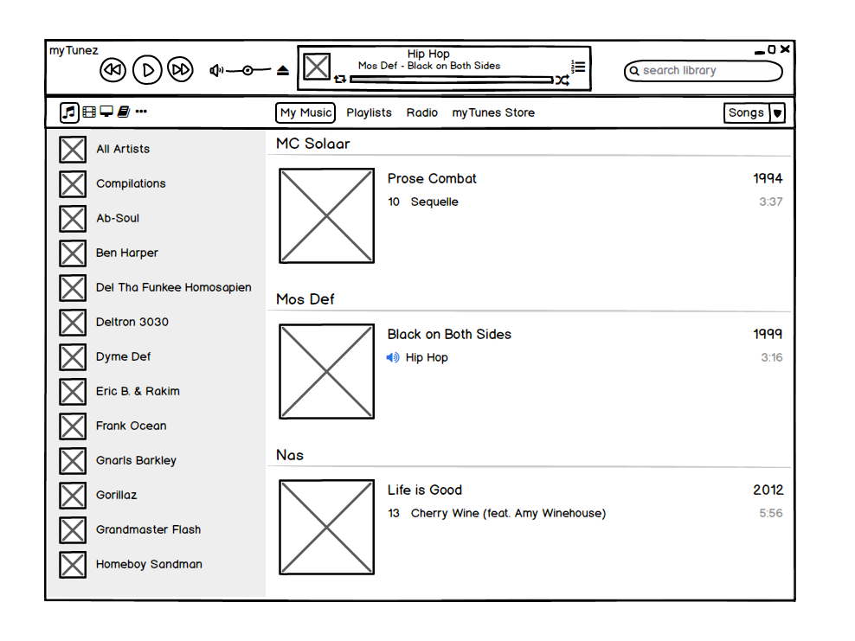
[Work Done]
Mockups
UI/UX flow
Data Schemas
What were your constraints/tradeoffs?
Notes:
Feel free to tell the story of how the application was developed.

Slide 5
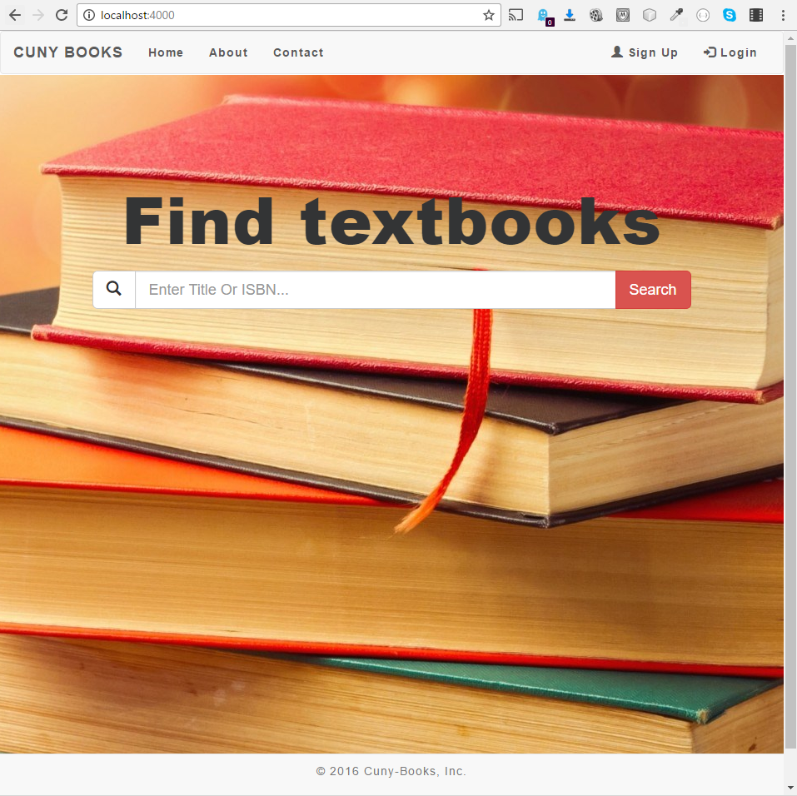
Live Demo
Notes:
Show off your work.

Slide 6
What's Next
Continue adding features
Extend the application, so be used by any college student
Notes:
Talk about your “next steps” whether that is related to this project or not
Perhaps you will continue this project
Or, you will apply what you learned to another project
Or, you have job interviews lined up,
Or, you have a job you will be starting (it’s never to soon to look at the competition)
---------------
Another option:
write a bit about "ideal next steps".
How would you go forward if you were to receive $50,000 in funding next week to invest in this project as a startup?
What actions would you take, either tech-wise or to scale?
How would you attract customers?

Slide 7

Team Members
Asefaw asefaw.mekuria@gmail.com
Andy andyyu199623@yahoo.com
Seung jseunga@hotmail.com
Yahya YAHYA.MUSED@gmail.com
Notes:
This is your contact card. If you add social media networks, make sure they are work related and position you for the job you want.
Optionally, at the bottom you can add other technologies you want to advertise that you know and want to work in.

