Slide 1

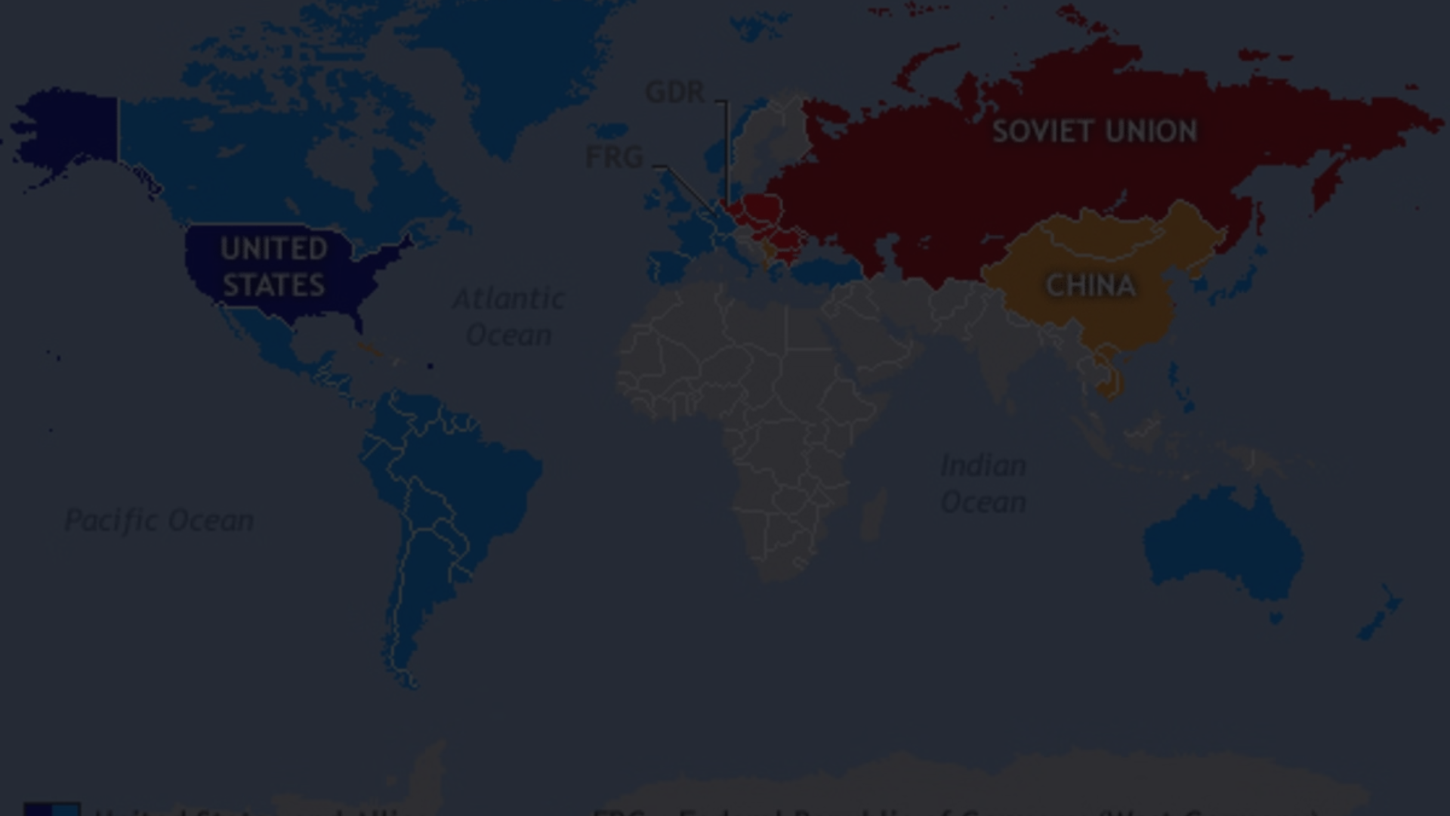
Analyzing the Practical Efficacy of Political Belief Systems in the Cold War
This presentation examines the economic and military impact of political belief systems during the Cold War era, drawing insights from the diverse perspectives of 15 leading language models.

Slide 2

Geopolitical Dynamics: Influence of Belief Systems
Political Propagandas
Proxy Wars
Education
1
2
3
4
5
Security Concerns
Military Interventions

Slide 3
Understanding Language Models
Language models, characterized by their sophisticated algorithms and comprehensive data analysis, excel in comprehending and generating human language. These models are pivotal across various applications, including chatbots, translation systems, sentiment analysis, and content generation. Continual advancements in AI-driven language processing technologies ensure their versatility and efficacy in reshaping communication paradigms, from virtual assistants to personalized recommendation systems, driving innovation in how we interact with and understand written text.

Slide 4
Introduction to LLaMa
Meta AI's language model family, debuted in Feb 2023 with 7, 13, 33, and 65B parameter models. Despite its size, the 13B model beats GPT-3 on NLP benchmarks. Model weights were shared with researchers but leaked publicly. Llama 2, with 7, 13, and 70B parameter models, followed in July 2023.

Slide 5
Dolphin-PHI and its Unique Features
Specialized Domain Knowledge: Dolphin-PHI is tailored for processing and understanding medical and healthcare-related text, making it a valuable tool for professionals in the healthcare industry.
Compliance and Security: Dolphin-PHI's design prioritizes compliance with healthcare data regulations and ensures the secure handling of sensitive patient information, addressing critical concerns in the medical field.
Impact on Healthcare: The integration of Dolphin-PHI into healthcare workflows has the potential to streamline processes, enhance diagnostic accuracy, and improve patient outcomes, marking a significant advancement in medical technology.

Slide 6
Unveiling GEMMA's Capabilities
Multilingual Proficiency: GEMMA's unique strength lies in its ability to comprehend and generate text in multiple languages, breaking down language barriers and facilitating global communication and collaboration.
Cross-Domain Applications: GEMMA's versatility extends to various domains, from customer service chatbots to language translation services, showcasing its adaptability and wide-ranging utility.
Cultural Sensitivity and Nuance: GEMMA's understanding of cultural nuances and context enables it to produce culturally appropriate and sensitive text, fostering effective cross-cultural communication.

Slide 7
Exploring Llama2-Chinese+
Advancements in Multilingual Models: Llama2-Chinese exemplifies the progress in multilingual language models, catering specifically to the Chinese language and its intricacies, thereby contributing to the inclusivity of language technology.
Cross-Cultural Communication: Llama2-Chinese's impact extends beyond language processing, fostering cross-cultural understanding and collaboration between Chinese-speaking communities and the global population.
Challenges and Opportunities: The development of Llama2-Chinese presents both challenges and opportunities in the realm of multilingual communication, prompting discussions on linguistic diversity and technological inclusivity.

Slide 8
Reconciling Diverse Perspectives: LLM Opinions
1
Nuanced Assessments
2
Contextual Considerations
LLMs provide a multifaceted understanding, acknowledging both the successes and failures of belief-driven policies.
LLMs emphasize the importance of historical, cultural, and geopolitical factors in evaluating policy efficacy.
3
Ethical Implications
4
Future Lessons
LLMs highlight the ethical dilemmas inherent in using economic and military power to advance ideological agendas.
LLMs suggest leveraging insights from the Cold War to inform more cooperative and sustainable global strategies.

Slide 9
Limitations and Caveats: Acknowledging Complexities
Data Gaps
Ideological Biases
Incomplete or unreliable datasets pose challenges in comprehensively evaluating the Cold War's economic and military dynamics.
The inherent biases of political belief systems can skew the interpretation of historical events and their impacts.
Contextual Nuances
Limitations of LLMs
The complex interplay of geopolitical, social, and cultural factors requires a holistic approach to analysis.
While insightful, LLM opinions may not fully capture the experiential knowledge of those who lived through the Cold War.

Slide 10



Conclusion and Recommendations
Acknowledge Complexity
Recognize the multifaceted nature of the Cold War and the need for nuanced analysis.
Leverage Diverse Insights
Incorporate LLM perspectives alongside historical accounts and empirical data for a comprehensive understanding.
Promote Cooperation
Explore ways to foster global collaboration and mitigate the risks of ideological conflicts.

