Slide 1
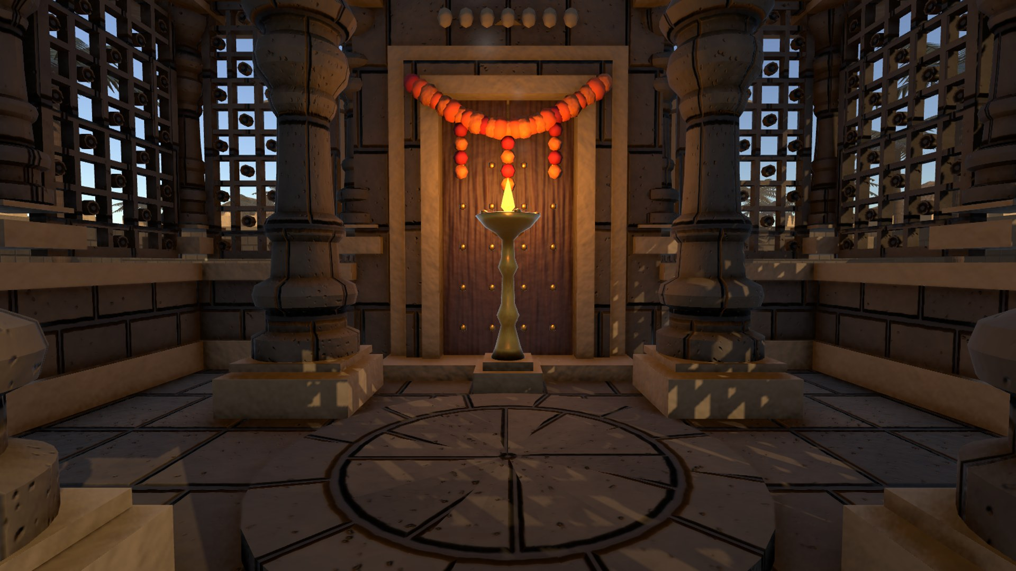
COMPUER GRAPHICS AND VIRTUAL REALITY
LAB COMPONENT
Virtual Heritage Karnataka
Walk through Belur, Halebidu and Hampi in VR, on desktop, or in a browser
TEAM MEMBERS
P KOTI DARSHAN | 1RV23CS162 NISCHAL RE | 1RV23CS156
Notes:
Introduce the project: an interactive Karnataka temple tour built in Unity that runs in VR, on a desktop, and in a web browser. Everything in it is generated by code.

Slide 2
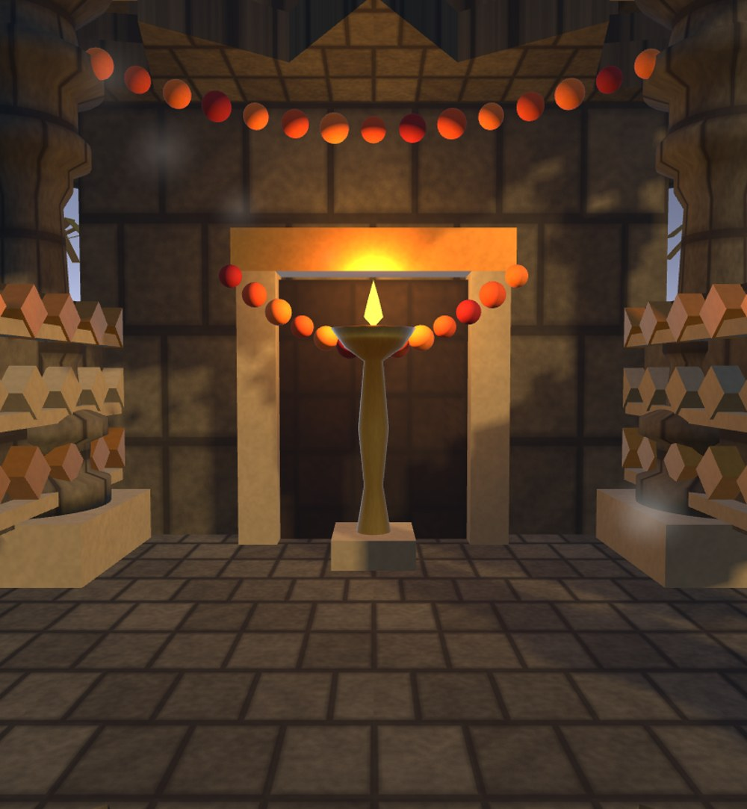
Abstract
Many of Karnataka's finest temples are hard for students and the public to visit, and their stonework is too intricate to grasp from photographs.
Virtual Heritage Karnataka is a Unity 6 application that lets users walk through three temple studies: Chennakeshava (Belur), Hoysaleswara (Halebidu) and Virupaksha (Hampi). Users inspect architectural elements, compare Then and Now states, and read a timeline with a confidence label for every claim. One codebase runs on PC VR through OpenXR, on a desktop, and in a browser through WebGL 2.
3
9
3
temples
elements
platforms
Notes:
One-line pitch: a Karnataka temple tour that runs in VR, on desktop and in the browser. The numbers: 3 temples, 9 inspectable elements, 3 platforms from one codebase. Stress that the geometry is illustrative, not a measured reconstruction.

Slide 3




Problem and objectives
The gap
Represent
Heritage sites are far away, crowded, or too complex to read in person.
Existing VR heritage work rarely offers multi-period comparison, close inspection of elements, or Karnataka-specific content.
Switch Then and Now and scrub a historical timeline
Digitally model three Karnataka temple traditions
Explore
Walk the courtyard in VR, on desktop or in a browser
Inspect
Rotate, scale and wireframe nine elements
Compare
Switch Then and Now and scrub a historical timeline
Notes:
Problem: access and complexity. Four objectives map directly to the four features the demo shows: represent, explore, inspect, compare.

Slide 4
Tech stack
01
Platforms
Windows desktop · PC VR (Quest Link, Index, Vive, Windows MR) ·
Browser (Chrome / Edge, WebGL 2)
02
Engine and language
Unity 6 (6000.6.1f1) · C#: Mono on Windows, IL2CPP to WebAssembly on the web
03
Rendering
Universal Render Pipeline 17.6 · HDR, ACES tonemapping, bloom, 4-cascade soft shadows
04
XR and input
OpenXR 1.18 · XR Interaction Toolkit 3.6 ·
Input System 1.20 · uGUI (screen-space and world-space)
05
Content
JSON catalog · code-built meshes (MeshBuilder) · FBM-noise textures · synthesized audio
06
Build, test, host
Unity batchmode + PowerShell · smoke test (98 checks) ·
GitHub -> Vercel static hosting
Notes:
Read the stack bottom-up or top-down. Platforms are what the user touches. Unity 6 plus C# is the engine; Mono on Windows and IL2CPP to WebAssembly for the browser. URP gives the lighting and post-processing. OpenXR with XR Interaction Toolkit handles headsets, and the Input System covers keyboard, mouse and controllers. Content is not imported: meshes, textures and sound are generated by code. Builds are scripted, a smoke test gates them, and Vercel hosts the web build.

Slide 5
Tools used and where
Tool | Used for | Where in the project
Unity 6 (6000.6.1f1) | Engine, editor, scene | Scenes/Heritage.unity
C# | All logic and procedural geometry | Runtime/ (11 scripts)
URP 17.6 | Lighting, shadows, post-effects | Settings/HeritageURP*.asset
OpenXR + XR Interaction Toolkit | Headset, ray select, teleport | HeritageRig.cs, HeritageTarget.cs
Input System | Keyboard, mouse, controllers | HeritageRig.cs
uGUI | Desktop panel and in-VR panel | HeritageUI.cs
JSON (JsonUtility) | Temples, elements, timelines | Resources/temples.json
Unity batchmode + PowerShell | Windows and WebGL builds, tests | Tools/Build.ps1, Editor/
Git + Vercel | Version control, web hosting | web/, vercel.json
Notes:
Every tool maps to a file you can open. Point at the project tree: Assets/Heritage/Runtime holds the eleven C# scripts, Resources/temples.json the data, Settings the URP assets, Tools/Build.ps1 the build.

Slide 6
System architecture
INPUT
CORE
CONTENT AND WORLD
OUTPUT
Desktop
HeritageApp
TempleCatalog
URP
← temples.json
Keyboard · mouse
bootstrap + orchestrator
HeritageGeometry
renderer
+ MeshBuilder
VR headset
HeritageRig
locomotion · collision
HeritageAtmosphere
OpenXR controllers
Display
HeritageUI
sky · light · palms
desktop + world-space panel
HeritageAudio
monitor, headset or browser
Input System 1.20 · XRI 3.6
HeritageTarget
synthesized sound
hover · select · teleport
Notes:
Walk left to right. Input from keyboard and mouse, or OpenXR controllers, goes through the Input System and XR Interaction Toolkit into HeritageApp. The scene file is nearly empty: HeritageApp starts itself after the scene loads and creates the rig, UI and audio. It reads temples.json through TempleCatalog, builds the temples with HeritageGeometry and MeshBuilder, and adds the sky, lights and palms with HeritageAtmosphere. URP renders the result to a monitor, a headset or a browser canvas. The same code path serves all three.

Slide 7
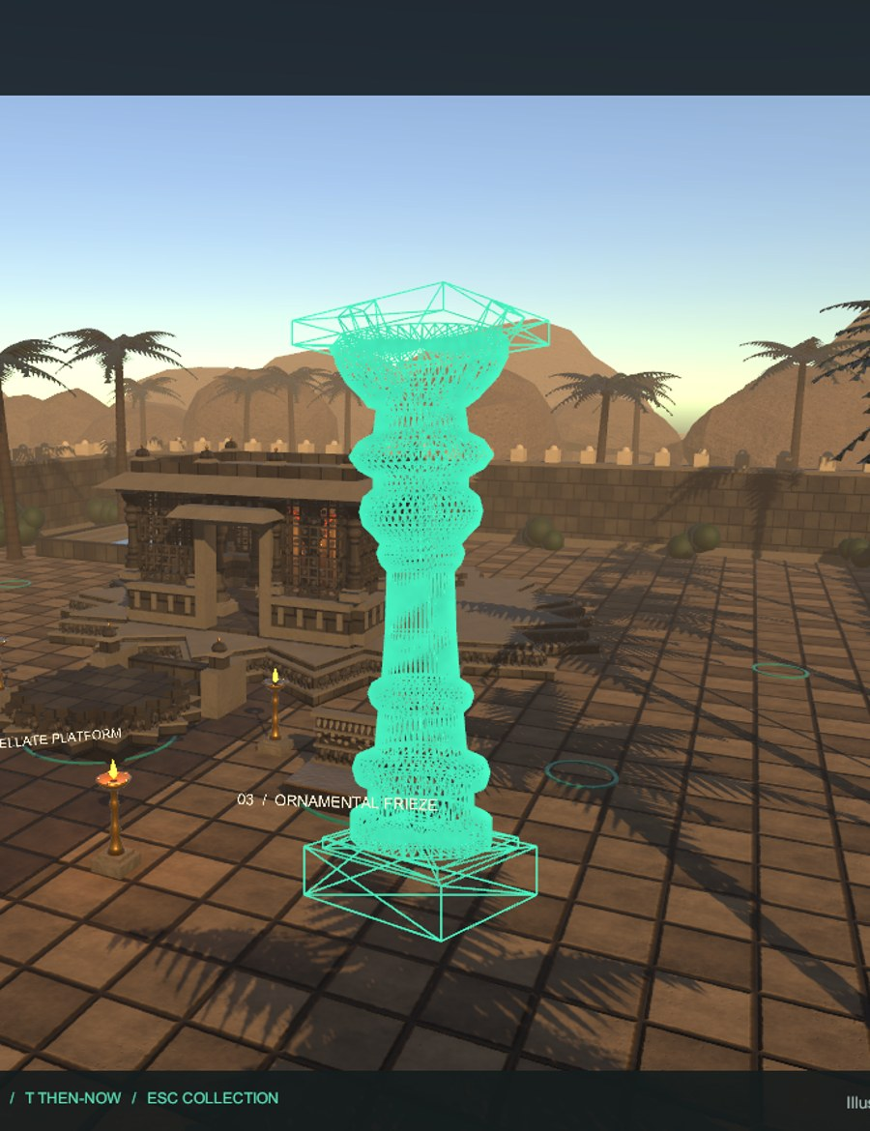



Everything is generated at runtime
Data
temples.json lists temples, elements, timelines and confidence labels; TempleCatalog loads it.
Geometry
MeshBuilder makes boxes, lathes, stellate prisms, ellipsoids and icospheres.
Surface
Tileable FBM noise generates stone albedo and normal maps.
Scene
HeritageApp assembles temples, lamps, palms and wall at start-up.
Lathe-turned pillar, wireframe
Notes:
No downloaded models, textures or audio. The picture shows a lathe-turned pillar in the in-app wireframe view, so you can see the mesh the code generated. This keeps the repo small and the web build light.

Slide 8
Build and deployment pipeline
Windows
Desktop / VR
Source
Unity 6 build
Mono backend
Launch Desktop.cmd · Launch VR.cmd
C# · JSON · URP settings · Git
batchmode via Build.ps1
WebGL 2
Vercel → Browser
IL2CPP → WebAssembly
static files from web/
Smoke test gate --heritage-smoke tours every temple and exhibit and fails on errors. 98 / 98 pass.
Notes:
One source tree produces two builds. The Windows build serves desktop and PC VR through the launcher scripts. The WebGL build is copied into web/ and Vercel serves it as static files, so a push to main updates the live demo. The smoke test is the quality gate.

Slide 9
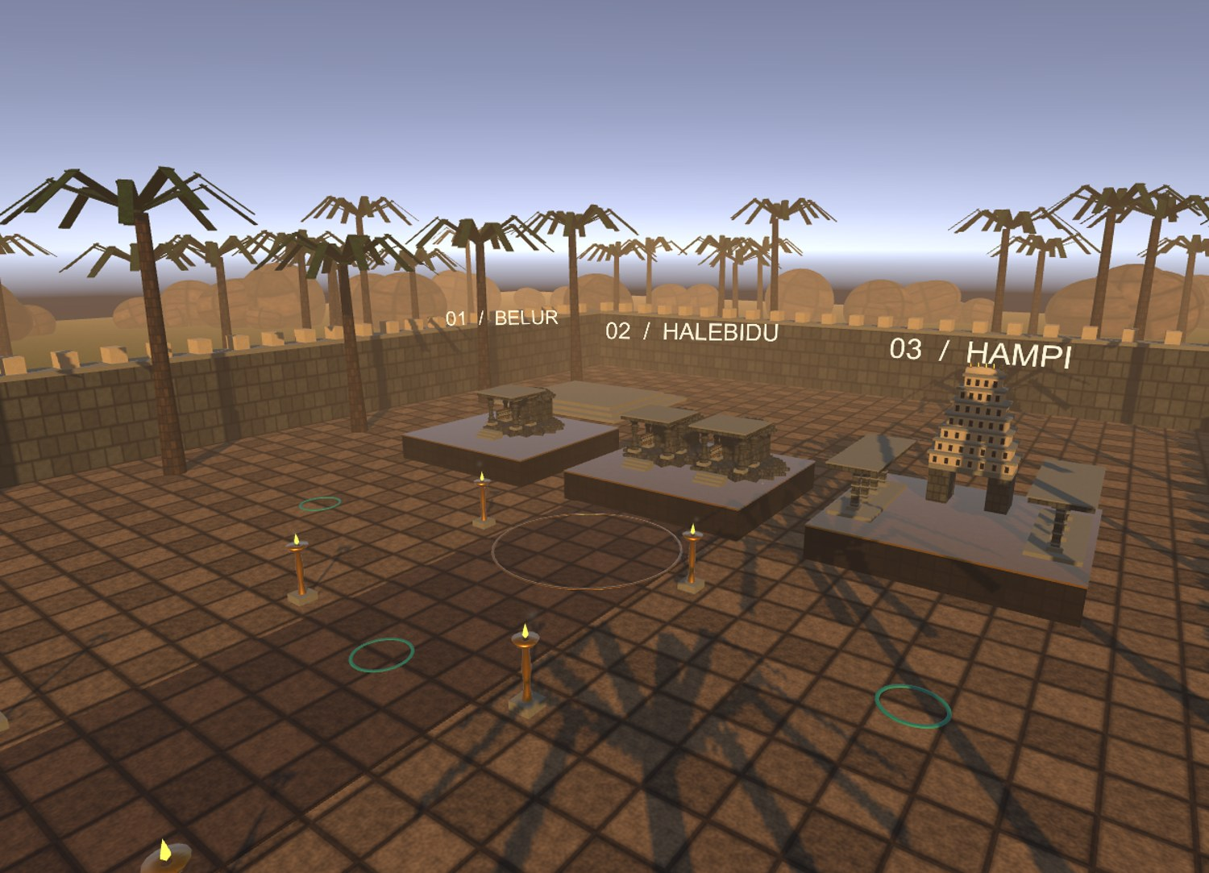
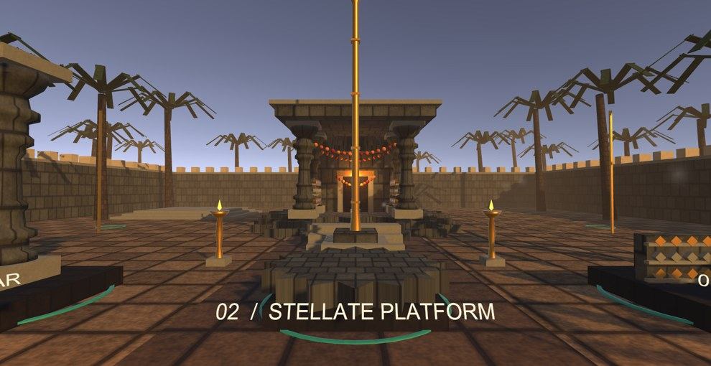
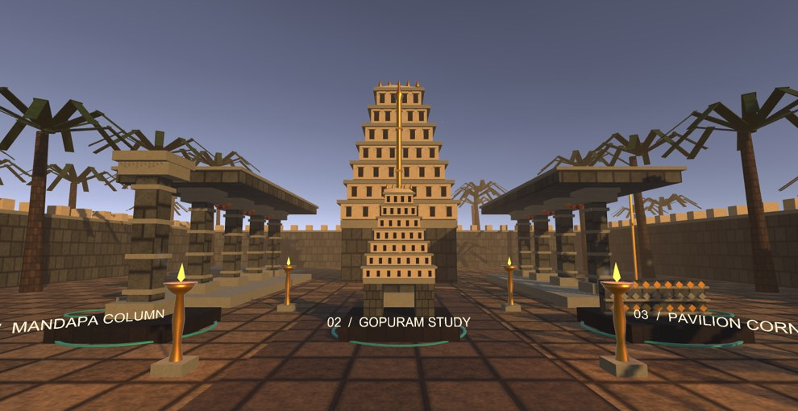
What the user sees
Belur: stellate platform and hall
Gallery hub: pick a temple miniature to enter it
Hampi: gopuram and pillared pavilions
Notes:
These are real captures from the app. The hub holds three miniatures; entering one places you in its courtyard.

Slide 10
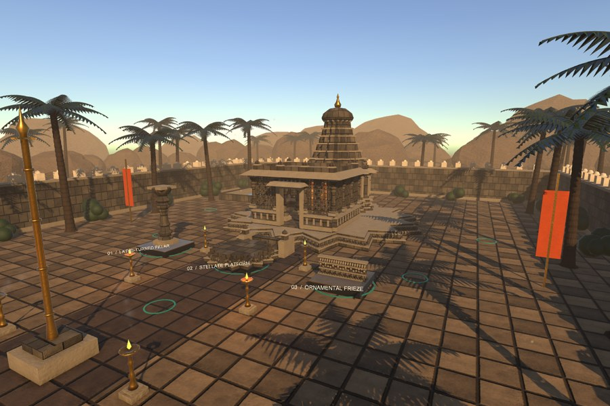
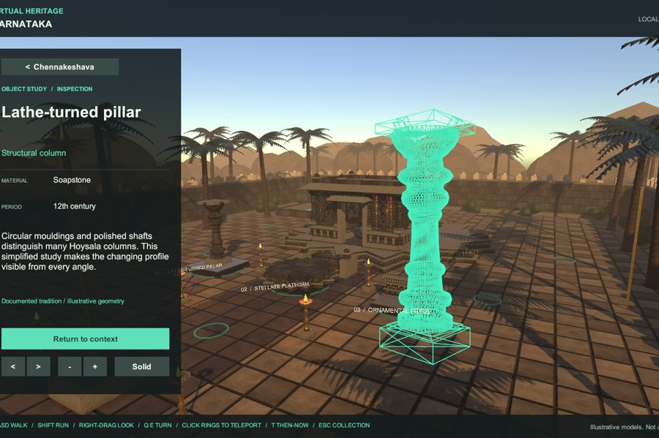
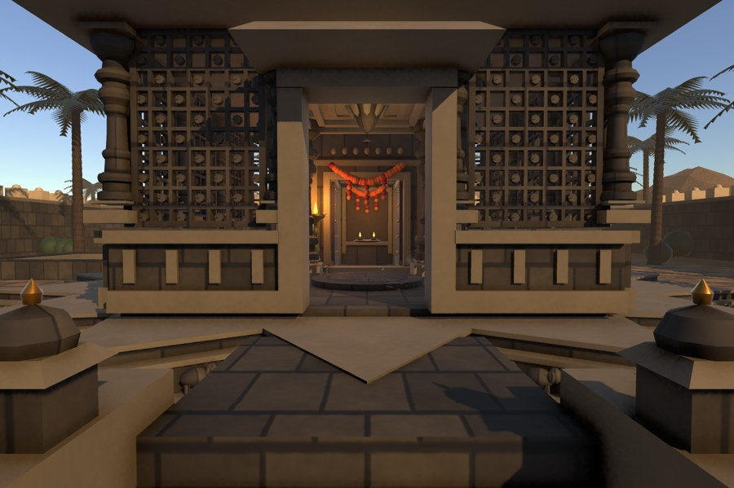
Interactions
Then and Now
Inspect
Walk it for real
Weathered present-day finish versus an illustrative restoration, including towers that no longer survive.
Pull out any element, rotate and scale it, and switch to wireframe to see its mesh.
WASD or thumbstick. You climb steps onto platforms, and walls and pillars stop you.
Notes:
Three interactions. Then/Now (key T), Inspect (key I) with wireframe (key F), and real walking with collision and step-up. In VR: teleport rings or thumbstick, 30 degree snap turn.

Slide 11


Results
98 / 98
≈2.9k
0
≈50 MB
smoke checks passing
lines of runtime C#
external models, textures or audio
first web load, then cached
What the test covers
What it cannot cover
All three temples, nine inspections, timelines, Then/Now, teleports, audio and UI modes.
Headset optics, comfort and frame rate still need a pass on real hardware.
Notes:
Numbers come from Artifacts/smoke-results.json and the repo. Be upfront about the limit: the automated test cannot judge VR comfort or frame rate.

Slide 12




Future scope
Real scans
Standalone VR
Guided group tours
Photogrammetry or Gaussian splatting for measured, accurate geometry
Android build for Quest without a PC
Multiplayer sessions with a teacher leading
Narration
More sites
User study
Multilingual audio guide, Kannada first
Somanathapura, Badami, Pattadakal, Aihole
Measure learning gain and comfort with students
Notes:
Most of these build directly on the current architecture: the catalog is JSON-driven, so adding a site is mostly data plus geometry. Photogrammetry or Gaussian splatting would replace the illustrative meshes.

Slide 13
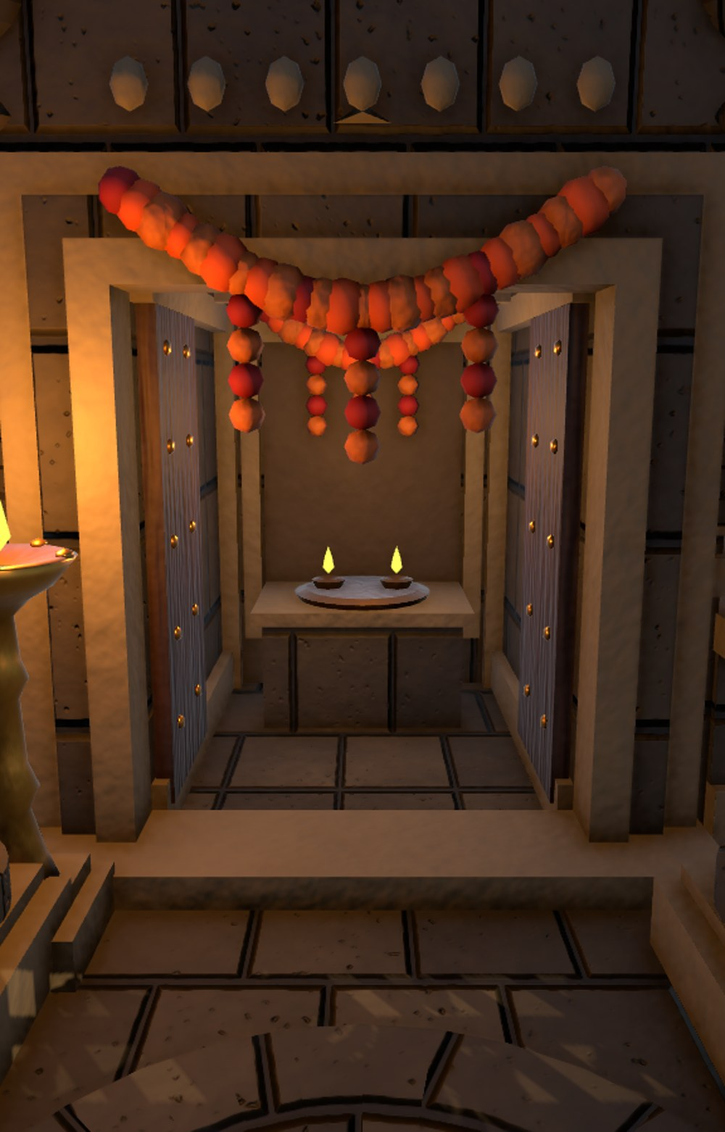
Conclusion
1
One codebase, three platforms
Unity 6 + OpenXR + WebGL 2 reach VR, desktop and browser.
2
Light and self-contained
All geometry, textures and sound are generated by code.
3
Honest about history
Illustrative models, with a confidence label on every claim.
https://virtual-heritage-karnataka-cgvr.vercel.app/
Notes:
Close with the three takeaways and offer the live demo link.

Slide 14
References
[1]
J. L. V. Zambrano, A. K. Alcívar Cedeño, J. C. P. Escobar, and A. F. Suárez Mera, “Immersive virtual reality for the preservation of cultural heritage,” in Proc. 10th Int. Conf. eDemocracy & eGovernment (ICEDEG), 2024, pp. 1–6, doi: 10.1109/ICEDEG61611.2024.10702094.
Relevance: VR gallery for remote heritage access: our motivation.
[2]
L. Nisiotis, C. Nikolaou, N. Markov, and A. Hadjiliasi, “Developing a cyber-physical-social metaverse system for interactive cultural heritage experiences,” in Proc. IEEE 49th Annu. Comput., Softw., Appl. Conf. (COMPSAC), 2025, pp. 654–663, doi: 10.1109/COMPSAC65507.2025.00088.
Relevance: Interactive heritage experiences beyond passive viewing.
[3]
J. Gabel et al., “Exploring written artefacts in virtual reality: Potential and challenges for creating immersive tools and applications,” in Proc. IEEE Conf. Virtual Reality 3D User Interfaces Abstr. Workshops (VRW), 2025, pp. 25–28, doi: 10.1109/VRW66409.2025.00013.
Relevance: Close inspection of artefacts, like our Inspect mode.
[4]
W. Herbrich, P. Zittlau, F. Joeres, and C. Hansen, “Prototype development of a cross-reality digital twin ecosystem: The web, open source and open data,” in Proc. IEEE VRW, 2025, pp. 459–462, doi: 10.1109/VRW66409.2025.00100.
Relevance: Web-based cross-reality delivery, like our WebGL build.
Notes:
All four are IEEE papers from 2024 or 2025; metadata checked against Crossref. Use them to position the project: VR heritage access, interactive experiences, artefact inspection, and web-delivered XR.

