Slide 1
Predicting Consumer Tastes: The Role of Big Data vs. Creativity at Gap Inc.
Kshitij Chauhan (KC), Amy Fischbach and Andrew Abello
10/1/2024

Slide 2

Background and Strategic Challenge at Gap Inc.
Declining sales led CEO Art Peck to replace creative directors with a data-driven approach.
Gap adopted a big data strategy to improve product offerings, shorten production cycles, and compete with fast-fashion brands like Zara.
The challenge was balancing data-driven decisions with creativity to maintain brand identity and improve market responsiveness.

Slide 3
Addressing Gap Inc.'s Strategic Challenges
To determine if replacing creative directors with a data-driven approach was the right decision, we analyzed the outcomes and implications of this shift.
Google Trends
Rating Distribution
Regression Analysis
Sentiment Analysis
Analyze consumer interest in key fashion items to identify trends and optimize Gap's product strategies
Use web scraping to analyze product ratings and reviews for Gap items on Amazon to assess customer sentiment
Sentiment Analysis
Use regression to assess how different factors affect demand/ratings, use for A/B testing to show effectiveness
Insights into each brand's image, revealing areas of positive engagement and highlighting negative sentiment that needs addressing

Slide 4
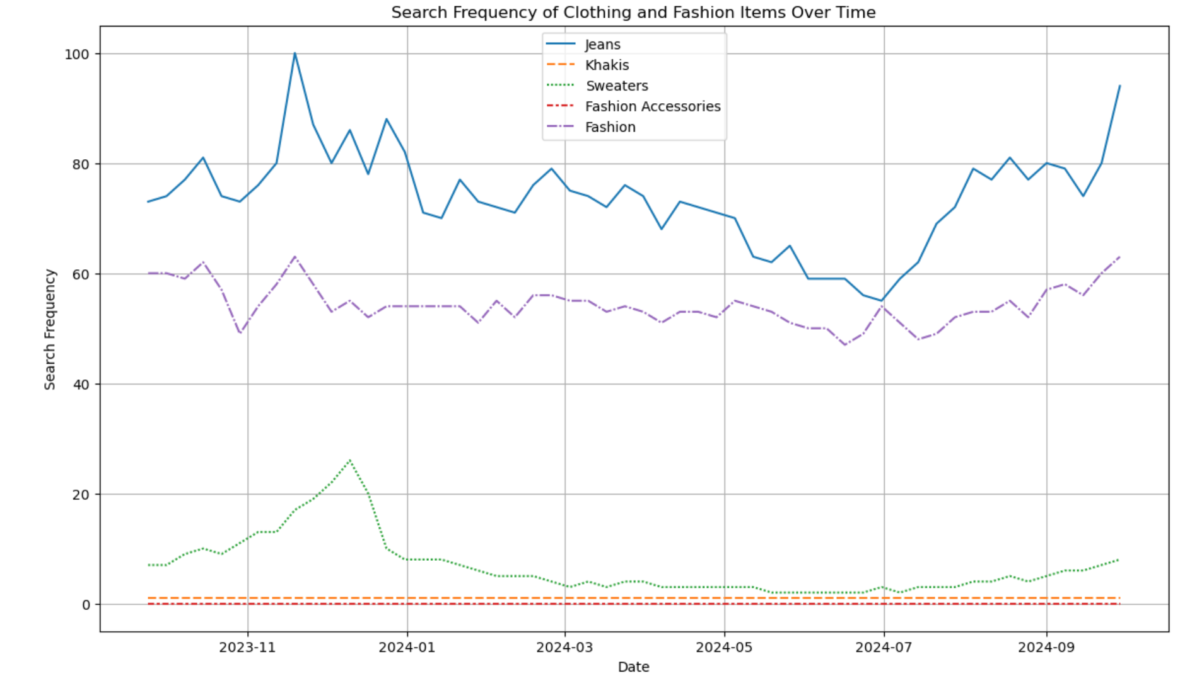
Consumer Interest in Clothing : A Search Frequency Analysis
Relative popularity of different fashion items based on Google Trends data, highlighting both peak and steady periods of consumer interest.

Slide 5
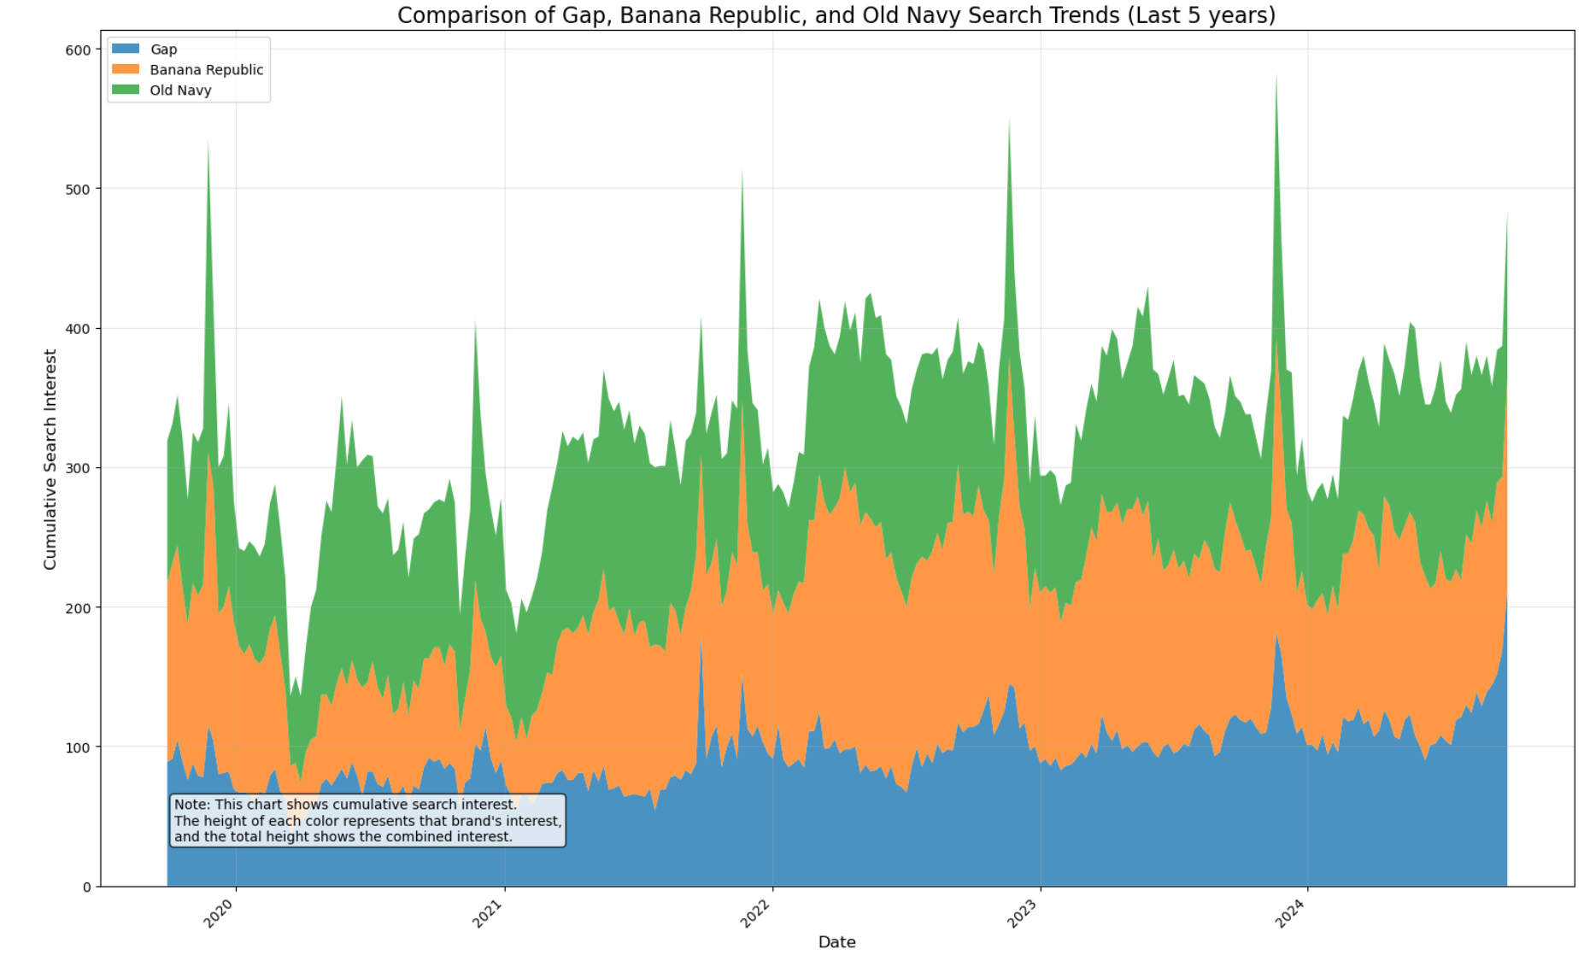
Comparing Search Trends for All 3 Gap Brands
Shows search interest trends for Gap, Banana Republic, and Old Navy from 2020 to 2024, highlighting brand popularity over time.
Stacked area chart represents cumulative search interest for each brand over five years.
Old Navy consistently shows higher interest, with noticeable seasonal spikes.
Old Navy maintains higher engagement, while Gap and Banana Republic show lower, fluctuating interest.

Slide 6
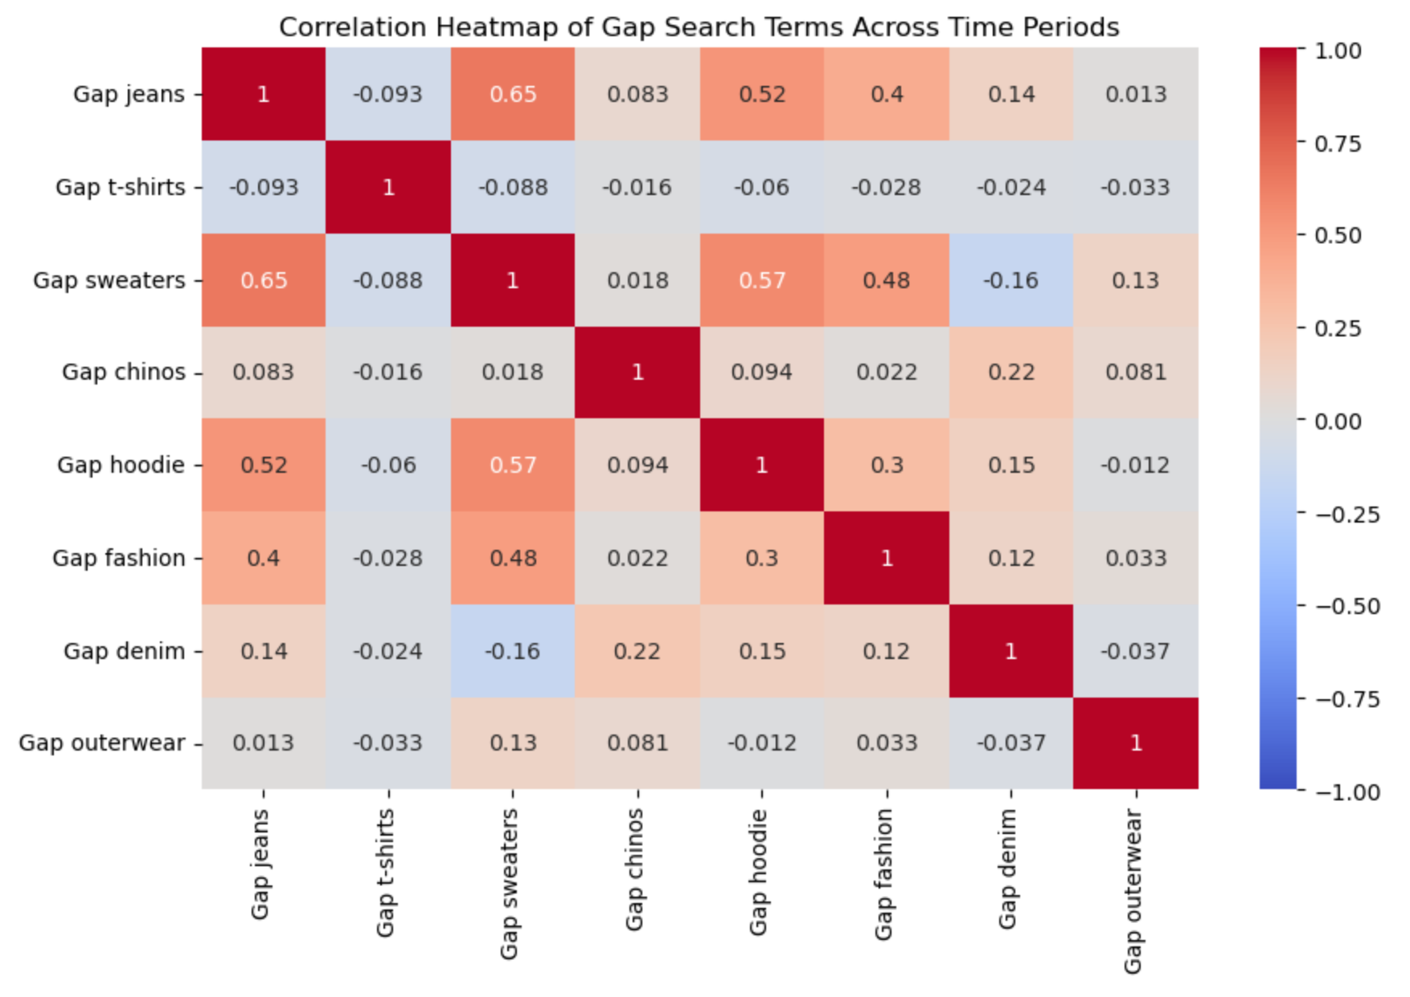
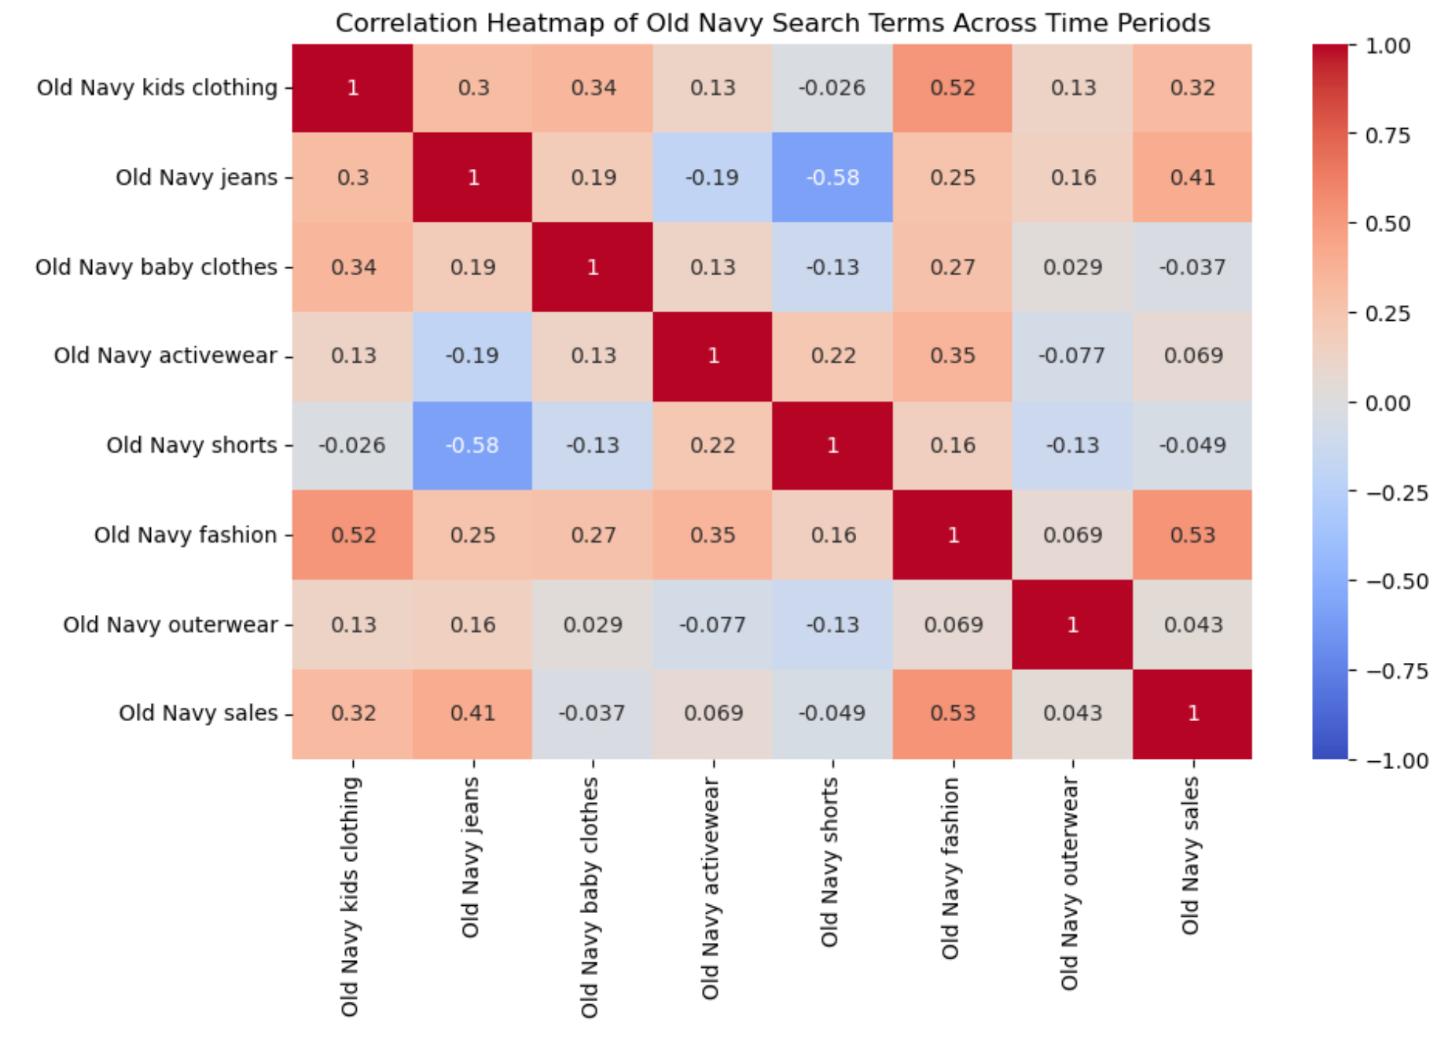
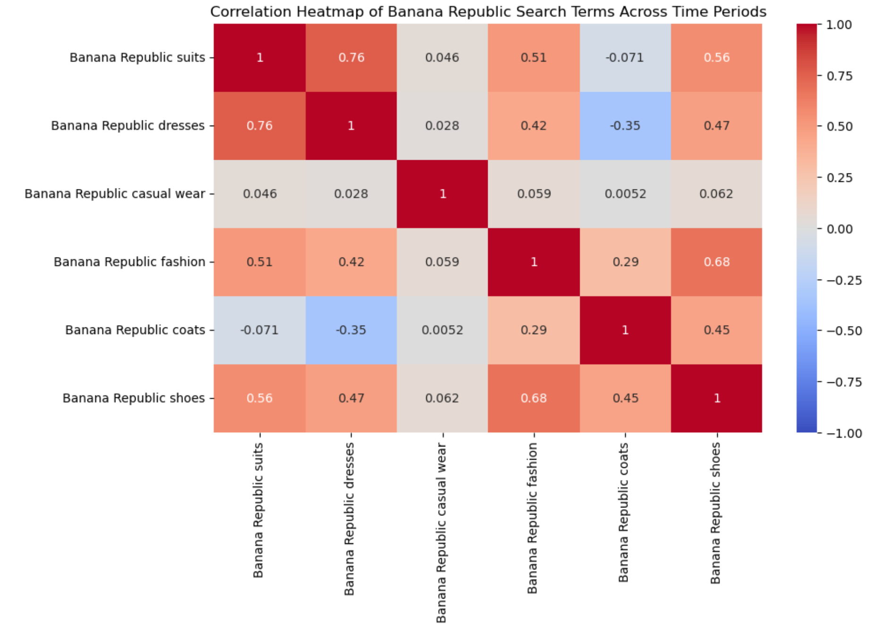
Search Term Correlations Across 3 Brands (5 years)

Slide 7
Heatmap for Gap, Old Navy, Banana Republic (5 years)
GAP
"Gap Jeans" and "Gap Sweaters" (0.65): Indicates potential bundling opportunities
"Gap Hoodies" and "Gap Sweaters" (0.57): Seasonal alignment can inform stock planning
Old Navy
Negative correlation between "Old Navy Shorts" and "Old Navy Jeans" (-0.58)
"Old Navy Fashion" and "Old Navy Sales" (0.53): Emphasizing fashion trends can drive sales
Banana Republic
"Suits" and "Dresses" (0.76): Suggests marketing or bundling for formal events
"Shoes" and "Fashion" (0.68): Provides insights for cross-selling strategies

Slide 8
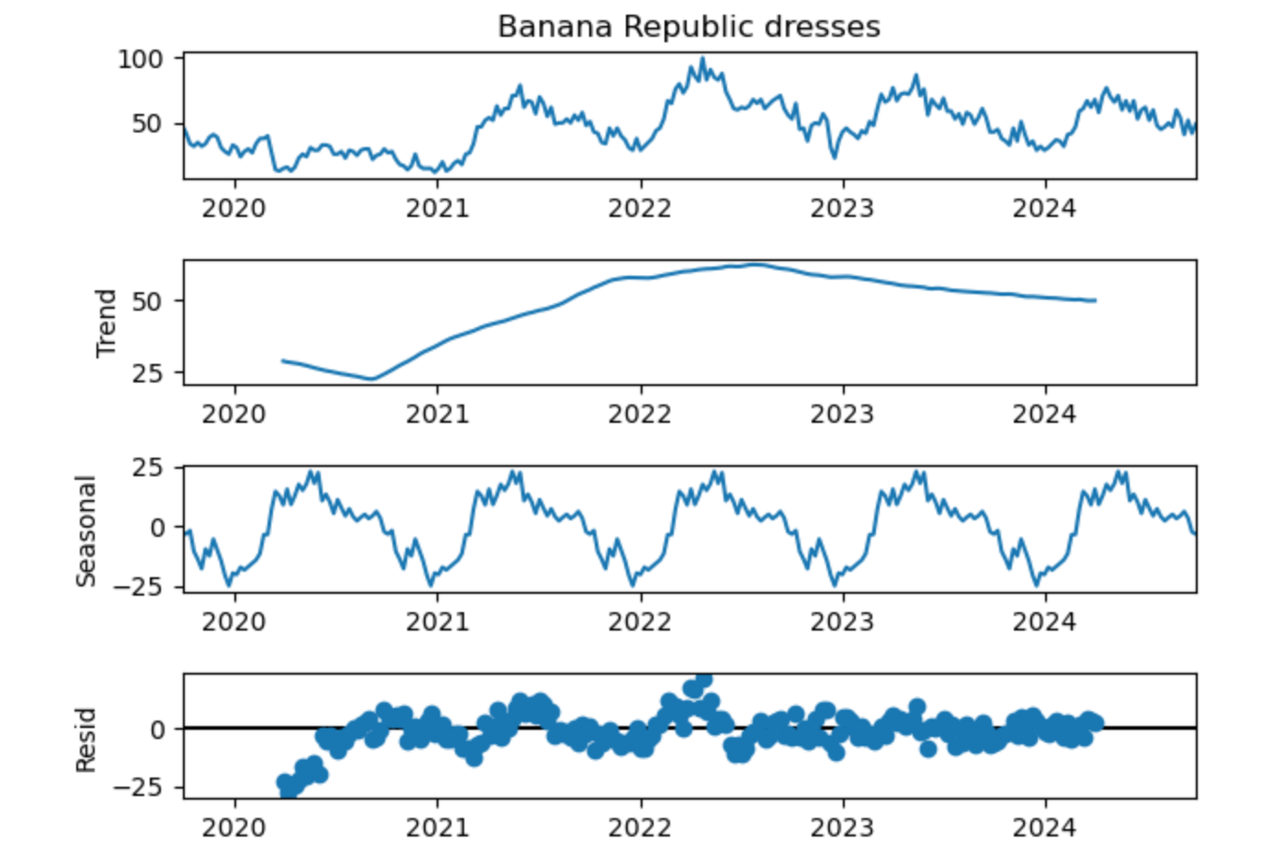
Google Trends Analysis: Banana Republic Dresses
Provides insights into long-term trends, seasonality, and irregular patterns in consumer interest for Banana Republic dresses.

Slide 9
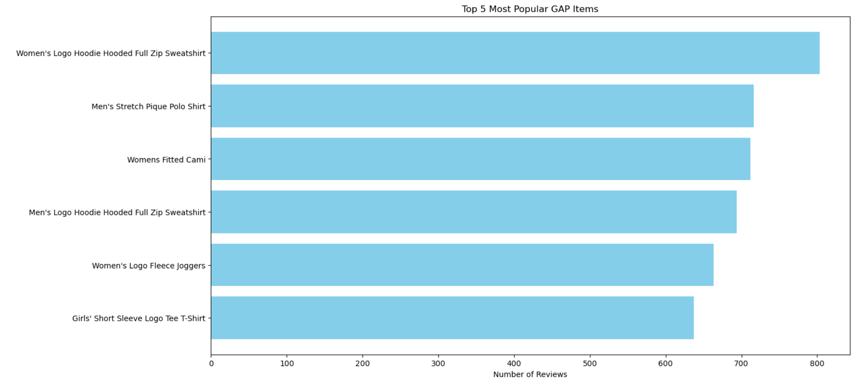
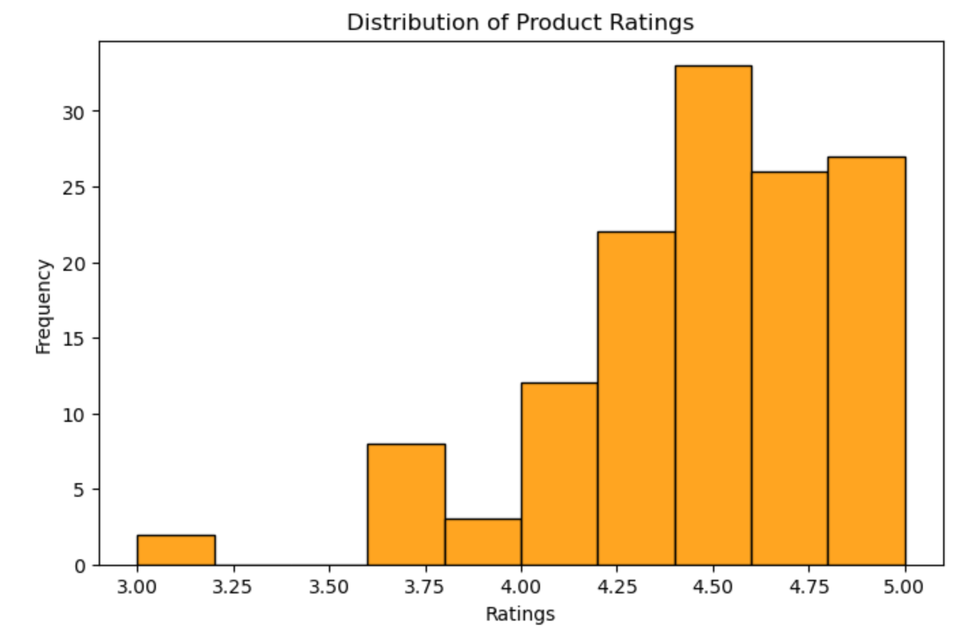
Rating Distribution Analysis: Top 5 Most Popular Items
Top 5 Most Popular Items
Top 5 Gap items by reviews, led by "Boys' Logo Hoodie."
Women's items like "Hoodie" and "Fitted Cami" also popular.
High review count suggests these are customer favorites.
Distribution of Ratings
Most ratings fall between 4.0 and 4.5, showing positive feedback.
No ratings below 3.0, indicating good overall perception.

Slide 10
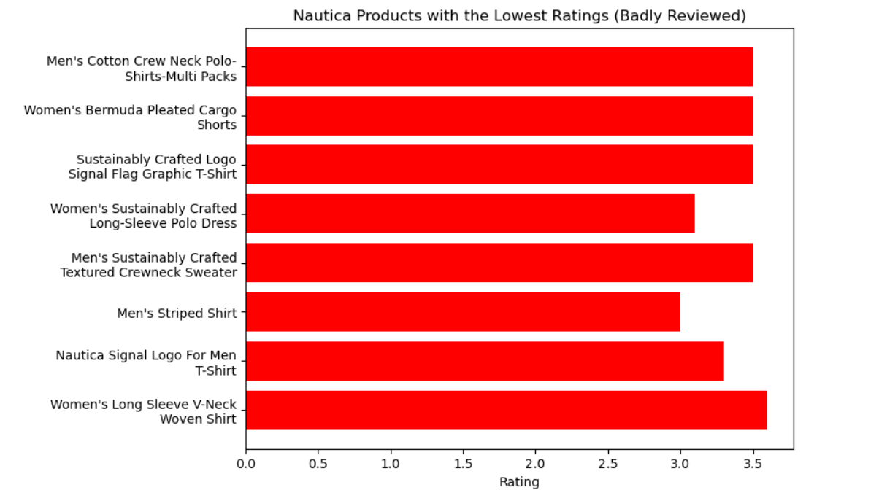
Opportunity Analysis: Nautica's Lowest-Rated Clothing Products
Analysis of Nautica's lowest-rated products on Amazon reveals potential market gaps that GAP can strategically fill

Slide 11
Regression Analysis to Understand Demand and Price/Ratings
Price Impact on Demand (# of Reviews)
Test Price to see effect on Demand
Find Price to be not significant
Pricing doesn’t affect demand as much on Amazon
Test Price to see effect on Ratings
Find Price to be significant
Lower Price helps with higher rating
Pricing Impact on Ratings

Slide 12
Regression Analysis for A/B Testing New Marketing Campaign
Run designed campaign for extended period of time
Set up regression equation:
Demand = B0 + B1*test*price +B2*test*impressions
Run regression analysis again to see if test price and impressions from test group affect demand

Slide 13
Applying Sentiment Analysis
GAP | Old Navy | Banana Republic | Zara | H&M
8 positive articles 24 negative articles | 3 positive articles 9 negative articles | 3 positive articles 7 negative articles | 7 positive articles 26 negative articles | 10 positive articles 28 negative articles
Takeaways
70%-75% negative for Gap brands vs competitors (74%-78%)
Business Action
Increase positive visibility with new influencer collabs, charity partnerships, etc.
Better sentiment overall, however, competitors have more articles

Slide 14
Limitations Across All Analyses
Limitations in Google Trends
Limitations in Sentiment Analysis
Context is limited in why searches may be trending (affect by decisions not made by Gap)
Can be limited to people using alternative browsers other than Google
Azure cannot predict human context for all words
NYT may have articles that are about the brand outside of customer scope
Limitations in Regression
Limitations in A/B Testing
Having too many factors or not enough
Factors being dependent on each other (Multicollinearity)
Factors not significant, need to test new data
Understand if randomization of groups is occurring
Determine time-period properly to get worthwhile sample
Control for other dynamic options in play (holidays, targeting software, news, etc.)

Slide 15
Finding a Strategic Path Forward
Big Data Techniques will work for all 3 Gap Brands
Answers questions regarding targeted marketing, getting ahead of fashion trends, and running future promotions (pricing and campaigns)
Marketing needs a combination of Science and Art
Science: Pulling data from websites to look for trends in sentiment and pricing, along with A/B testing to show effectiveness
Art: Connecting emotionally with the customer through story-telling and campaign design
Big Data is a good new model for Gap
Data cannot lie: seeing trends through fashion wants pushes Gap back to the front
Caution: Needs to keep some creative team to connect emotionally to people where data cannot

Slide 16
Thank You

Slide 17
Appendix

Slide 18
Financial Analysis of Gap Inc.
Examining the Financial Impact of Strategic Changes
Before 2015, Gap relied heavily on creative directors for trendsetting. The net income in 2015 was $1.26 billion.
After replacing creative directors with a big data-driven approach in 2015, revenues and net income showed mixed results.
Revenue: From 2015 to 2018, total revenue hovered around $15.5 billion to $16.5 billion, showing minimal growth.
Net Income: A sharp decline from $1.26 billion in 2015 to $676 million in 2017, with further drops in subsequent years, reaching negative figures in 2021.
 | 2015 FY | 2016 FY | 2017 FY | 2018 FY | 2019 FY | 2020 FY | 2021 FY | 2022 FY
Total Revenue ($000) | 16,435,000 | 15,797,000 | 15,516,000 | 15,855,000 | 16,580,000 | 16,383,000 | 13,800,000 | 16,670,000
Net Income ($000) | 1,262,000 | 920,000 | 676,000 | 848,000 | 1,003,000 | 351,000 | -665,000 | 256,000

Slide 19
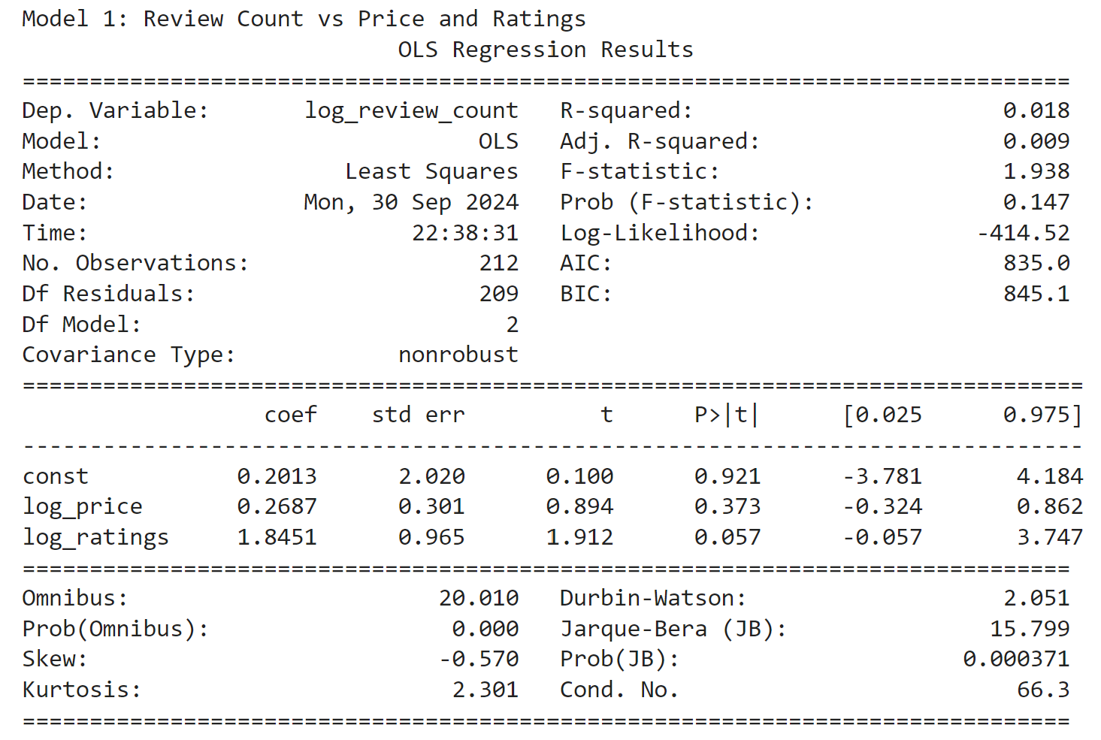
Regression Analysis Output Review vs Price/Ratings

Slide 20
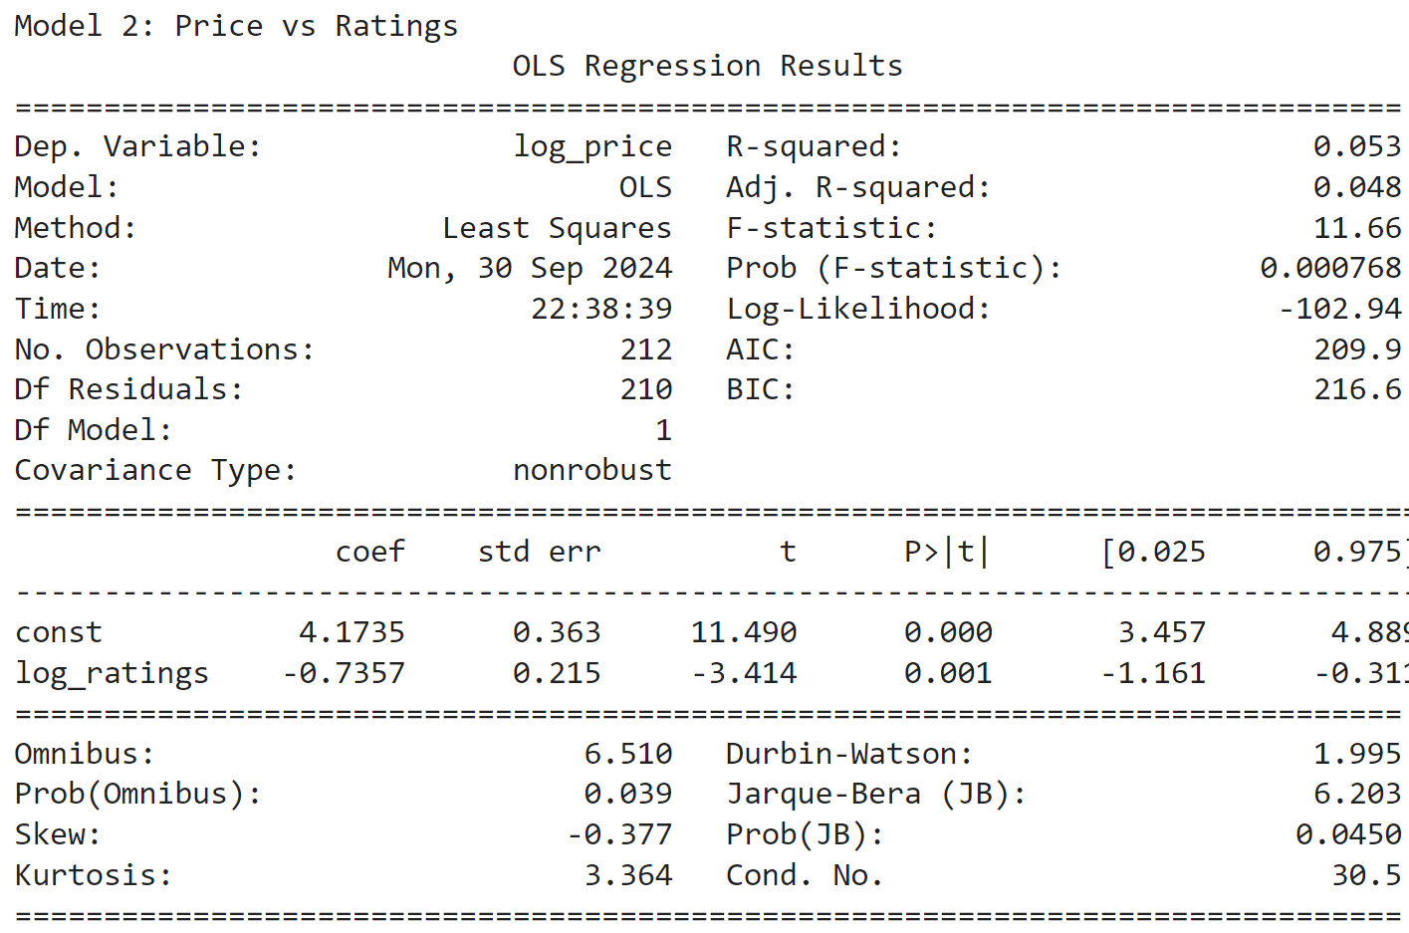
Regression Analysis Output Price vs Ratings

Slide 21
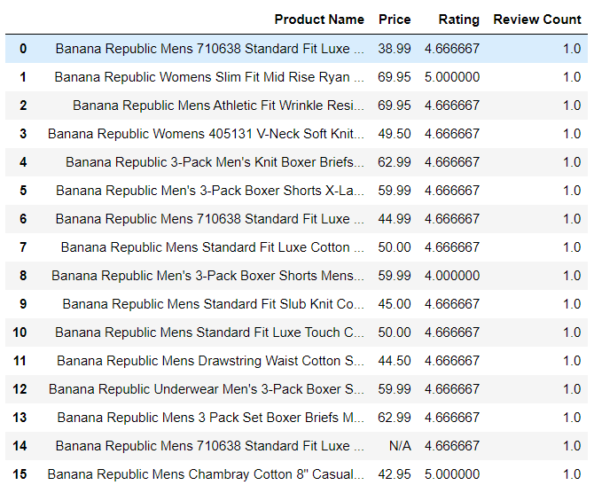
Rating Analysis: Data scraped from Amazon
Collected ratings, prices, and review counts for Banana Republic products from Amazon to analyze trends and consumer preferences.
The table summarizes key data points, offering insights into customer feedback and helping identify market positioning opportunities

Slide 22
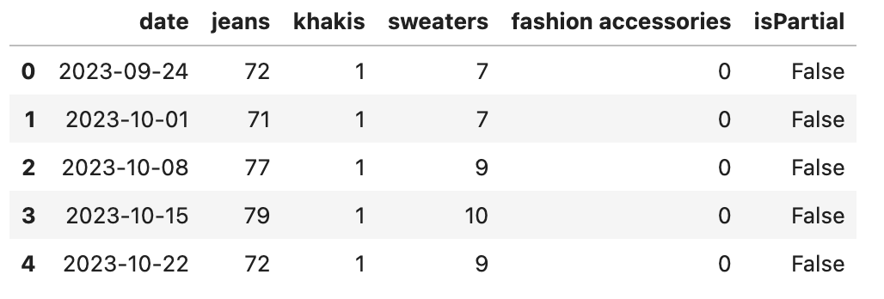
Google Trends Analysis: Consumer Interest in Key Fashion Items
The graph presents weekly Google Trends data for various fashion items, helping to identify shifts in consumer interest over time

