Slide 1

Seshadrirao Gudlavalleru Engineering College
Department of Computer Science and Engineering
Title
Streamlit - powered Data Science : Visualizing Cryptocurrency Markets
Presented By: Team B17
Team Members:
K . Koteswararao (21481A0598)
J. KeerthiLahari (21481A0584) under the Guidance of
G . ThanmaiTeja (21481A0570) Mr . U. Vinod Kumar
K .Venkata Kalyani (21481A05A5) Assistant Professor | M . Tech
K .Ganesh (21481A0599)

Slide 2
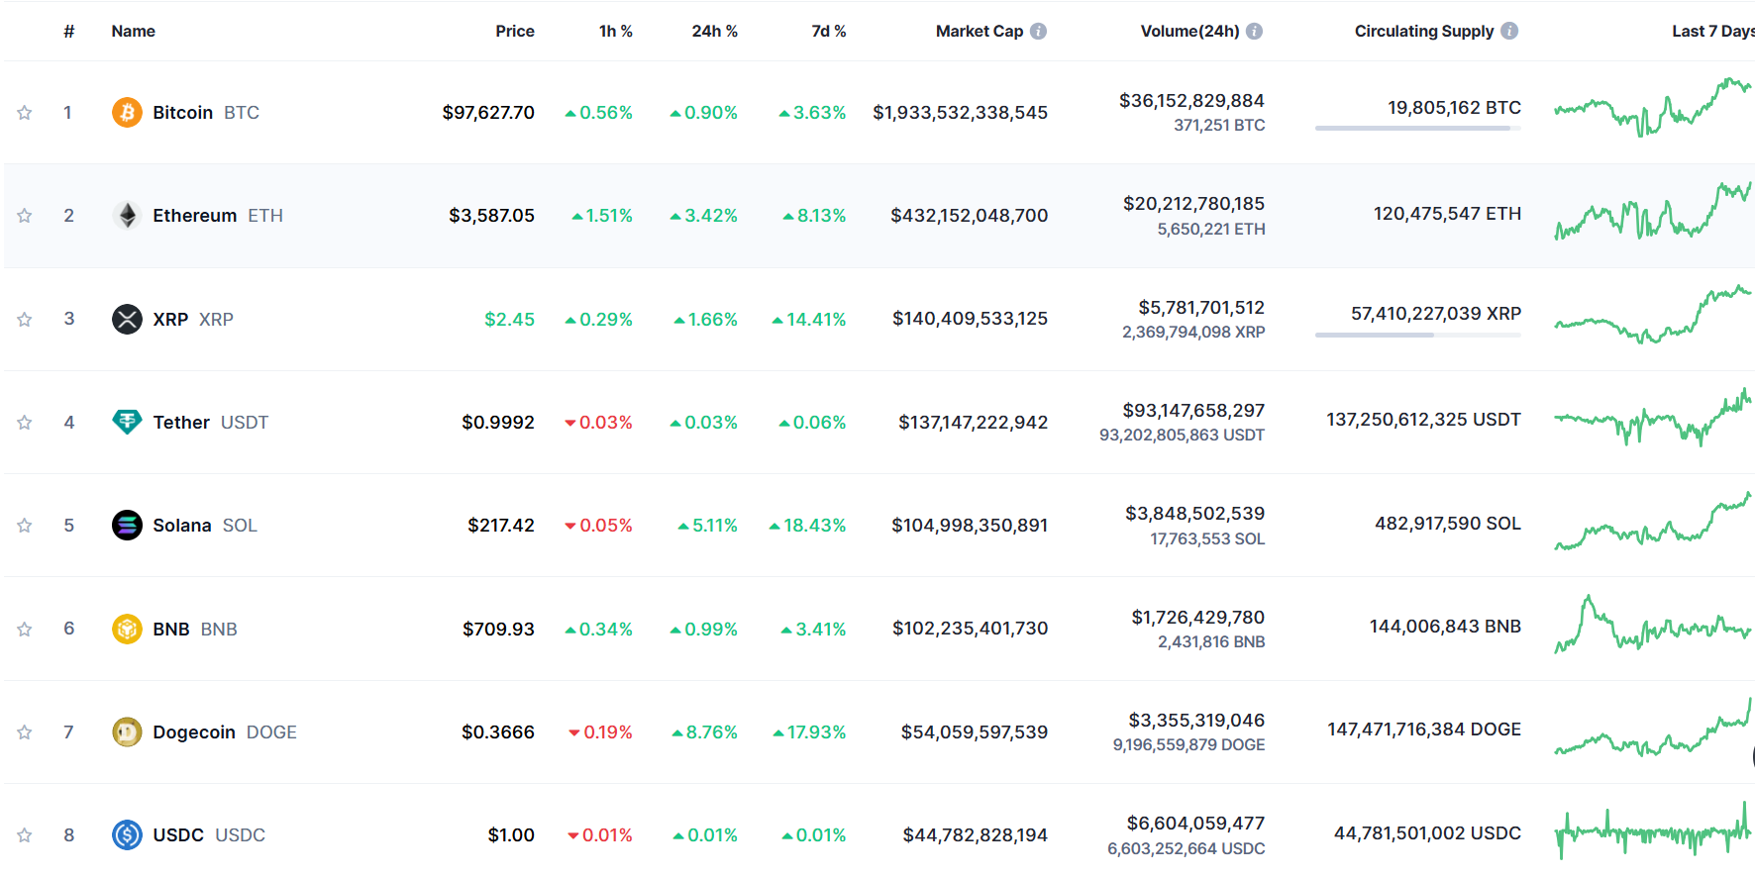
Dataset used :
Link : https://coinmarketcap.com

Slide 3
Technologies and tools used:
Streamlit (Web app framework)
Pandas (Data manipulation)
Google Cloud Shell (Development environment)
BeautifulSoup/Selenium (Web scraping tools)
Data visualisation techniques:
pandas
matplotlib
Seaborn
Base64
Cryptocmd.

Slide 4

Streamlit :
For developing interactive web applications.
Open-source Python library for building custom web apps.
No need for front-end coding (HTML/CSS).
Simplifies sharing of interactive dashboards.
Integrated with Python's data analysis libraries.

Slide 5
Webscraping:
Technique to extract structured data from websites.
Tools: BeautifulSoup (simple parsing), Scrapy (advanced scraping), Selenium (dynamic content).
Application: Extracts CoinMarketCap data for analysis.
Ensures up-to-date and relevant datasets.

Slide 6

Google cloud shell:
Browser-based command-line tool for development.
Pre-configured with tools like Python and Git.
Supports real-time collaboration and scalability.
Allows deployment and testing of Streamlit apps directly in the cloud.

Slide 7
Data visualisation techniques:
Pandas: Powerful library for data manipulation and preparation, offering seamless integration with visualization tools.
Matplotlib: Flexible plotting library that enables the creation of static, interactive, and animated visualizations.

Slide 8
Data visualisation techniques:
Seaborn: Enhances Matplotlib with high-level, aesthetically pleasing statistical graphics.
Base64: Encodes and decodes binary data for embedding images in Streamlit dashboards.
CryptoCMD: Extracts cryptocurrency market data directly for dynamic and automated visualizations.

Slide 9


